Slide 1
Wallet Management App
Project Presentation
Prajjawal Banati
SAP ID 500060722
CSEG2013 OOPs through Java
Dr. Dhirendra Kumar Sharma
Department of Cybernetics
UPES Dehradun

Slide 2
Contents
Project Overview
Requirement description
Methodology
Flow diagram
Tools
Output layout
Future scope

Slide 3
Project Overview
My project is related to Platform Dependent Wallet management app.
Idea behind my Application is to make Money transactions secure and easy.
Pay Module
Add Money Module
Passbook Module

Slide 4
Requirement Description
Login Module
Add Money Module
Pay Money Module
Passbook Module
Timer Window
Password Window

Slide 5
Methodology
Classes Defined in my Project:-
Wallet:- Package
Login:- Java Frame Form
Add account:- Java Frame Form
Pay:- Java Frame Form
Dashboard:- Java Frame Form
Add money:- Java Frame Form
Passbook:- Java Frame Form

Slide 6
Concepts
Concepts which are used in this are:
Java AWT
Encapsulation
Polymorphism

Slide 7
Class Wallet:-
Class:- Wallet
Functions:-
Main(String args[])

Slide 8
Login (Java Frame Form)
Package:- Wallet
Class:- Login
Constructor:- Login()
Functions:-
Main(String args[]):- public void
initComponents():-Private void
jButton1ActionPerformed(ActionEvent):- Private void [Add Account]
jButton2ActionPerformed(ActionEvent):- Private void [Login]
jButton3ActionPerformed(ActionEvent):- Private void [Close]
Other Entities:-
jTextField1:- (Accept the user_id)
jPasswordField1:- (Accept the password)

Slide 9
Add Account (Java Frame Form)
Package:- Wallet
Class:- AddAccount
Constructor:- AddAccount()
Functions:-
Main(String args[]):- public void
initComponents():- private void
jButton1ActionPerformed(ActionEvent):- private void [Register]
jButton2ActionPerformed(ActionEvent):- private void [Close]
Other Entities:-
jTextField1:- (Accept the Name)
jTextField2:- (Accept the Date Of Birth)
jTextField3:- (Accept the User_id)
jPasswordField1:- (Accept the Password)
jPasswordField5:- (Accept the Confirm Password)

Slide 10
Dashboard (Java Frame Form)
Package:- Wallet
Class:- Dashboard
Constructor:- Dashboard()
Functions:-
Main(String args[])
initComponents():-private void
jButton1ActionPerformed(Action Event):- private void [Pay]
jButton2ActionPerformed(Action Event):- private void [Logout]
jButton3ActionPerformed(Action Event):- private void [Add Money]
jButton4ActionPerformed(Action Event):- private void [Passbook]
Other Entities:-
jLabel2Field

Slide 11
Pay (Java Frame Form)
Package:- Wallet
Class:- Pay
Constructor:- Pay()
Functions:-
Main(String args[])
initComponents(): private void
jButton1ActionPerformed(Action Event):- private void
jButton2ActionPerformed(Action Event):- private void
Other Entities:-
jTextfield1(accept the sender user_id)
jTextfield2 (accept the money to be paid)

Slide 12
Add Money(Java Frame Form)
Package:- Wallet
Class:- AddMoney
Constructor:- AddMoney()
Functions:-
Main(String args[])
initComponents():- private void
jButton1ActionPerformed(Action Event):- private void [Close]
jButton2ActionPerformed(Action Event):- private void [Add]
Other Entities:-
jTextField1(accept the money to be added)

Slide 13
Password(Java Frame Form)
Package:- Wallet
Class:- Password
Constructor:-Password()
Functions:-
Main(String args[])
initComponents():-private void
jButton1ActionPerformed(Action Event):- private void [Proceed]
Other Entities
jPasswordField1(accept the password)

Slide 14
Passbook(Java Frame Form)
Package:- Wallet
Class:- Passbook
Constructor:- Passbook()
Functions:-
Main(String args[])
initComponents():- private void
jButton1ActionPerformed(Action Event):- private void [Close]
Other Entities
jTable1(Show the paid transactions)
jTable2 (Show the received transactions)
jTable3 (Show the added money transactions)

Slide 15
Database Definition
Database Name:- Bank
Table 1:- add money
(Name, DOB, User ID, Password, Balance)
Table 2:- details
(Date, Time, User ID, Balance)
Table 3:- transactions
(Date, Time, Sent_To, Amount, Balance, Admin)
Table 4:- transactions2
(Date, Time, Recieved_From, Amount, Balance, Admin)

Slide 16
Tools
Netbeans IDE
XAMMP Server(For SQL Database Connectivity)

Slide 17
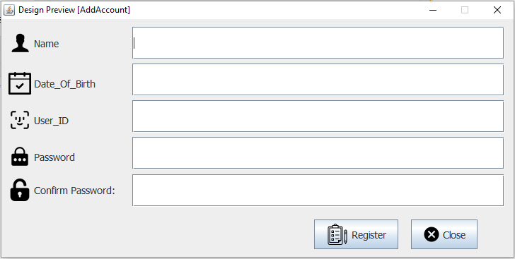
Output Layout
Add Account

Slide 18
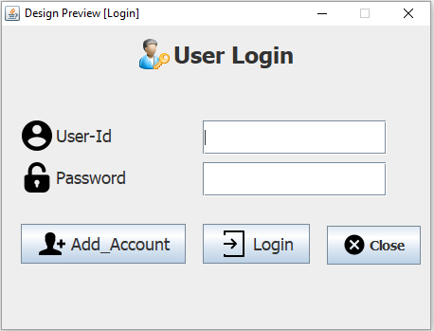
Output Layout
Login Page

Slide 19
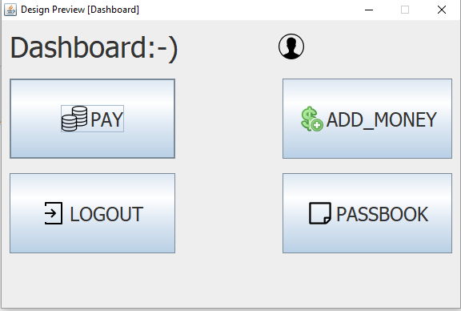
Output Layout
Dashboard

Slide 20
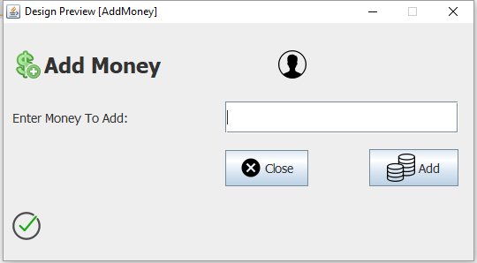
Output Layout
Add Money

Slide 21
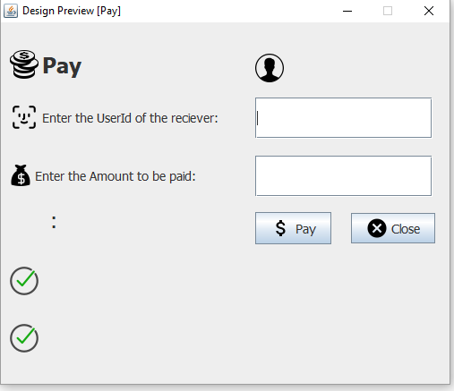
Output Layout
Pay Module

Slide 22
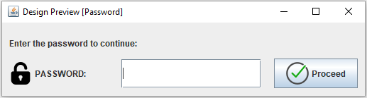
Output Layout
Password

Slide 23
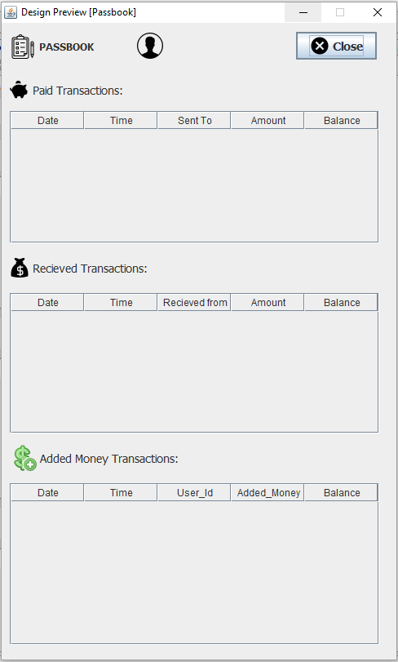
Output Layout
Passbook

Slide 24
Future Scope
In place of using password to carry out the transaction OTP service will be kept in place of that to make it more secure.
If a user is loginned on one device he will not able to access the account on other device until he logs out from the former device.
Random Password Generator.
Payment module will contain a list of previous senders to make fast transactions.
Forgot password Module will be installed.
Recent Transactions carried would be messaged to the user’s mobile number.

