Slide 1
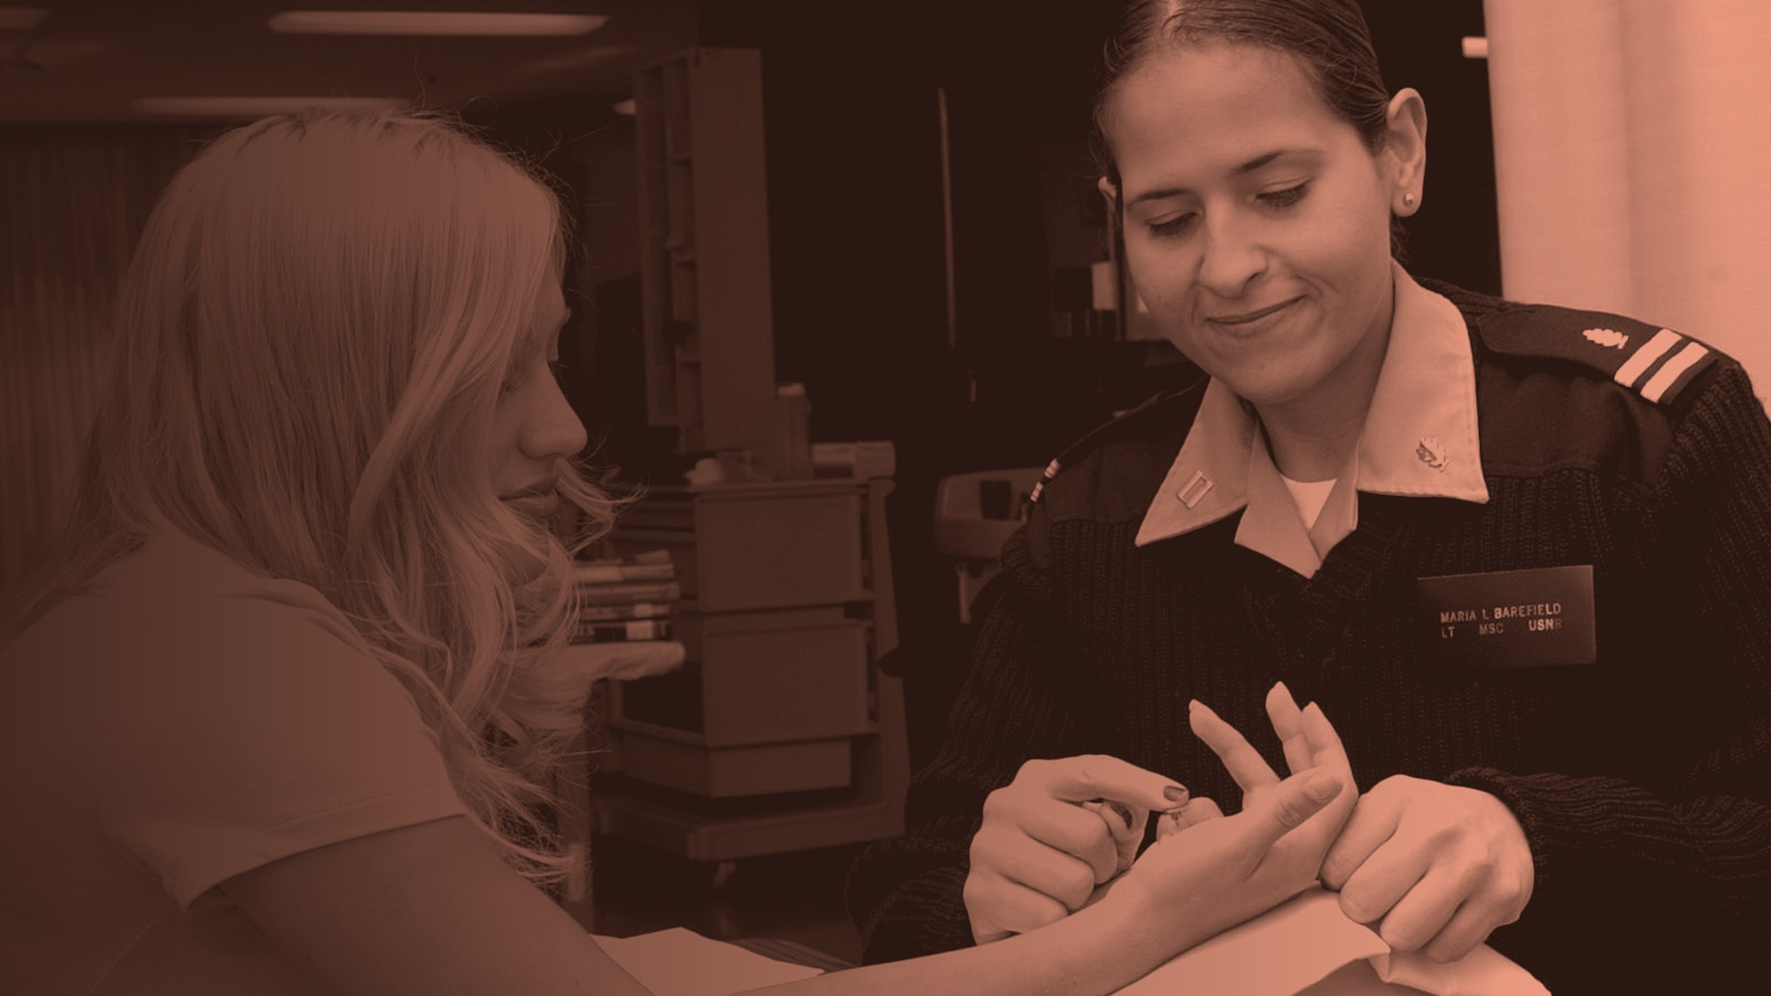
NYU TANDON · MECHANICAL ENGINEERING SENIOR DESIGN · PROJECT 19
A Soft Robotic Assistant for Physical Interaction with Elderly and Rehabilitation Patients
Force you can measure. Bounded when the power is off.
Team ASTRA · Advisor: Prof. Nana Obayashi · 22 September 2026
Notes:
0:00-0:20 | Team ASTRA, Project 19. One sentence up front: we are building the assistive arm that reports, in newtons, how hard it is pushing on a patient.

Slide 2
THE PITCH IN ONE LINE
Rehab is rationed by therapist time — and the machines that could extend it are too rigid to leave near a frail patient.
Our answer is a soft arm a patient can lean on, which measures and reports the force it applies at every moment of contact.
Notes:
0:20-0:50 | The narrative spine. Problem in one clause, answer in one clause. Everything after this is evidence for one of the two.

Slide 3

Who our customer is
BUYER
Clinics and care facilities
Physical therapy clinics and elder-care facilities. Short on therapist hours, not on patients.
END USER
Patients
Elderly and rehabilitation patients who need steadying, guided reach and postural support — hundreds of times, not once.
END USER
Therapists
One therapist covers several patients. A passive gravity-balancing orthosis produced sustained gains on about 4 minutes of therapist attention per hour.
Patients need repetitions. Clinics need them delivered without a therapist inside every one.
ASTRA · Project 19 · Soft Robotic Assistant
3 / 11
Notes:
0:50-1:20 | The 4 min/session figure (T-WREX) is the supervision budget we design to. Say 'supervised use' out loud — it pre-empts the obvious challenge.

Slide 4
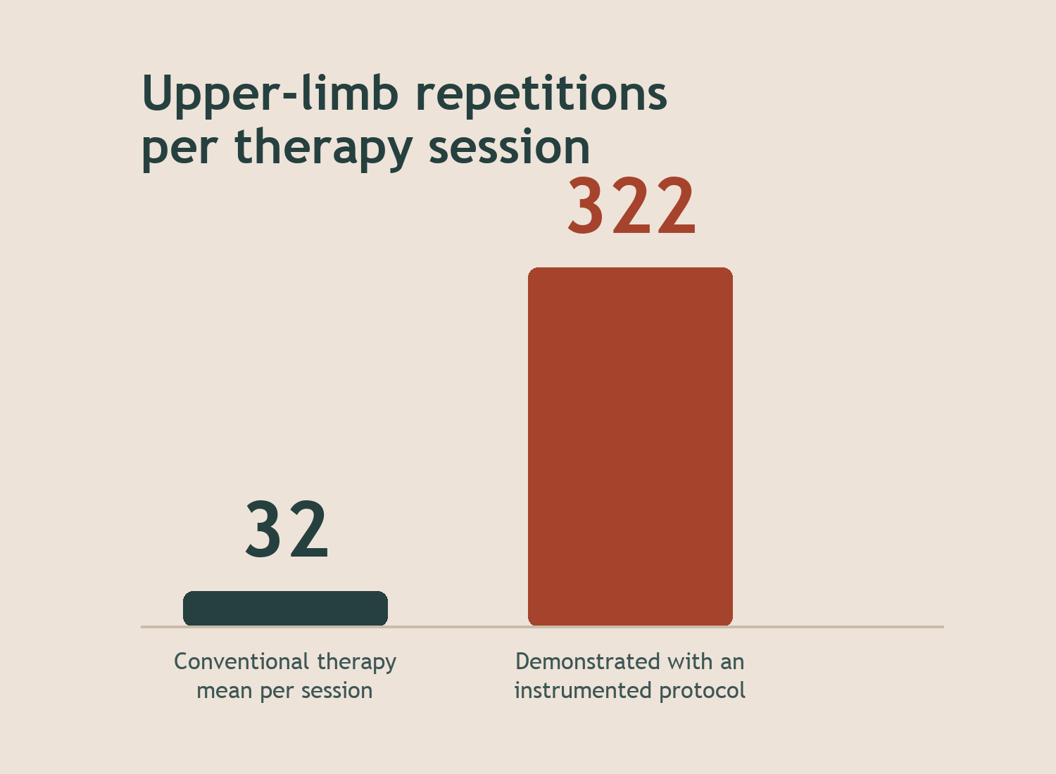
What their problem is
Recovery runs on repetitions, and every repetition costs a therapist's hands.
Conventional therapy delivers a mean of 32 upper-limb repetitions per session (95% CI 20–44). An instrumented protocol has reached 322 in the same hour.
The ceiling on therapy is staff time, not patient willingness — and the machines meant to lift that ceiling are either unsafe to leave against a frail body, or cannot carry load at all.
The patient needs contact that is both load-bearing and safe. Nothing on the market is both.
ASTRA · Project 19 · Soft Robotic Assistant
4 / 11
Notes:
1:20-1:55 | Land 32 vs 322. That gap is the whole commercial case.

Slide 5
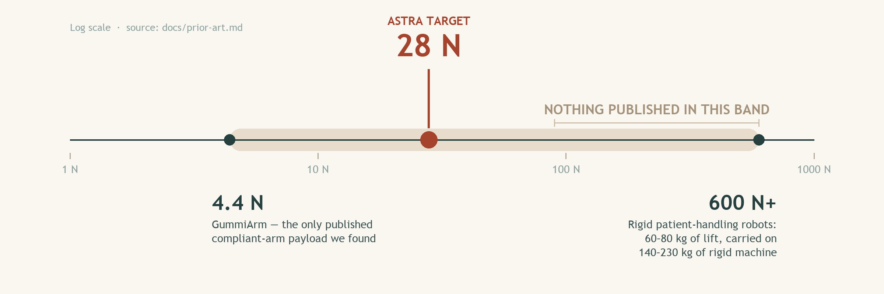
Why nobody has already fixed it
A standards vacuum
The wrong population
ISO 13482 publishes no contact limits, and ISO/TS 15066 states it does not apply to non-industrial robots — and the pain data behind both comes from healthy young volunteers.
Pressure-pain threshold drops significantly over age 62, and reduced protective sensation travels with reduced tissue tolerance. Pain onset is not a valid proxy for injury onset here.
ASTRA · Project 19 · Soft Robotic Assistant
5 / 11
Notes:
1:55-2:35 | The answer to 'why is it a problem' is not 'nobody tried'. It is a physics problem plus a standards vacuum. Point at the gap on the chart.

Slide 6
What exists today, and what it never reports
Compare | Rigid patient-handling (RIBA, RoNA) | Soft freestanding humanoids (HuggieBot, King Louie) | Worn exosuits (Harvard soft shoulder) | ASTRA
Assistive force | Lifts 60–80 kg | None published | 6.6 N·m per limb, measured on patients | 28 N, measured and reported
Load path | Rigid to floor, on a 140–230 kg robot | To floor, unquantified | Onto the patient's own skeleton | Rigid to floor, compliance in the actuation
Status | Discontinued — RIKEN-SRK closed 2015, none deployed in care | 48 human subjects in uncontrolled full-body contact; force never reported | Delivering measured assistance to real patients | Bench instrument, supervised use
The soft freestanding torso is not empty ground. What nobody has built is the instrument.
ASTRA · Project 19 · Soft Robotic Assistant
6 / 11
Notes:
2:35-3:05 | Name HuggieBot before the room does — Prof. Obayashi will know it. Conceding the form factor is what makes our narrower claim credible.

Slide 7

VALUE PROPOSITION
A compliant support arm that delivers a characterised, instrumented contact-force envelope — measured, not asserted.
Unlike rigid assistive robots
A series spring makes interaction force readable from its own deflection, and bounds that force when the actuator is unpowered.
Unlike the soft humanoids already built
The deliverable is the measurement, not the demonstration. We publish the envelope, the method, and the conditions it holds under.
ASTRA · Project 19 · Soft Robotic Assistant
7 / 11
Notes:
3:05-3:30 | If asked 'why is soft safer' — it isn't, on impact. Haddadin (IROS 2010) shows joint elasticity does not reduce peak impact force. Compliance buys measurability and an unpowered bound.

Slide 8
What we will actually build
ARCHITECTURE
RULED OUT ON THE NUMBER
BEHAVIOUR
Rigid spine, soft interface
Not a fully inflatable arm
Stiffens, holds, then releases
Rigid grounded load path, compliance placed in the actuation, designed soft covering at the contact patch.
Series-elastic over variable-stiffness; impedance control, not admittance.
M = PπD³/8 gives about 26 N·m for a Ø150 mm arm at 20 kPa.
A 200 N lean at 0.5 m applies roughly 100 N·m. The inflatable branch fails by a factor of four.
Compliant on approach, stiffer under load, with an explicit braked state for a sustained lean.
Removing power reduces the force it can apply rather than trapping the user.
Material down-select — silicone, TPU, pneumatic bladder, tendon drive — runs against 28 N and ≈10 N·m, not the tens of N·m the brief implies.
ASTRA · Project 19 · Soft Robotic Assistant
8 / 11
Notes:
3:30-4:00 | Lead with the equation for the inflatable branch — it is ruled out on a number, not on taste.

Slide 9
Scope: what we will have by the end of the year
1 · DESIGN
2 · BUILD
3 · TEST
Down-select the actuator
One instrumented arm
Measure the envelope
Against 28 N of assistive force and ≈10 N·m of shoulder gravity compensation.
At that target, actuator families that look disqualified come back into range.
A series-elastic support arm on a base that reacts ≥330 N applied at hand height without tipping.
Force output, deflection-based force estimate, contact pressure, unpowered residual force — plus a human-subject approachability study.
Out of scope, deliberately: sit-to-stand lift (>121 N·m at the hip, which a commercial lower-limb exoskeleton already fails), unsupervised operation, and contact testing with frail participants. This is a bench instrument, not a clinical product.
ASTRA · Project 19 · Soft Robotic Assistant
9 / 11
Notes:
4:00-4:30 | Stating what we are NOT doing is what makes one academic year credible. Sit-to-stand is the first thing a reviewer will ask us to add.

Slide 10
How we will know it worked
Measure | How | Target
Assistive force | Load cell at the contact point, compared against force estimated from spring deflection | 28 N sustained, ±6 N modulation band
Contact safety | Quasi-static clamping test and pendulum impact rig, sampled ≥10 kHz with a 100 Hz filter | Below 50 N/cm² at the sternum (Behrens, n = 112 — not ISO's 120), margin no tighter than 30%
Unpowered bound | Cut power under a held lean; record residual force and whether the arm releases | Bounded, non-clamping, releases
Approachability | Within-subjects, soft covering on vs off, same arm and motion. Perceived Danger as primary measure, RoSAS for approachability, plus stop distance in cm | n = 32–40 healthy adults, preregistered
Healthy adult volunteers at the Robotics Center, supervised. Contact testing with frail participants is full-board IRB and outside this calendar — we start the paperwork with our senior design professor either way.
ASTRA · Project 19 · Soft Robotic Assistant
10 / 11
Notes:
4:30-4:50 | Row 3 is the one to point at: it turns the value proposition into a pass/fail test. Why n = 32-40: between-subjects at d = 0.5 needs 128 (Bartlett 2022); within-subjects needs about a quarter of that.

Slide 11
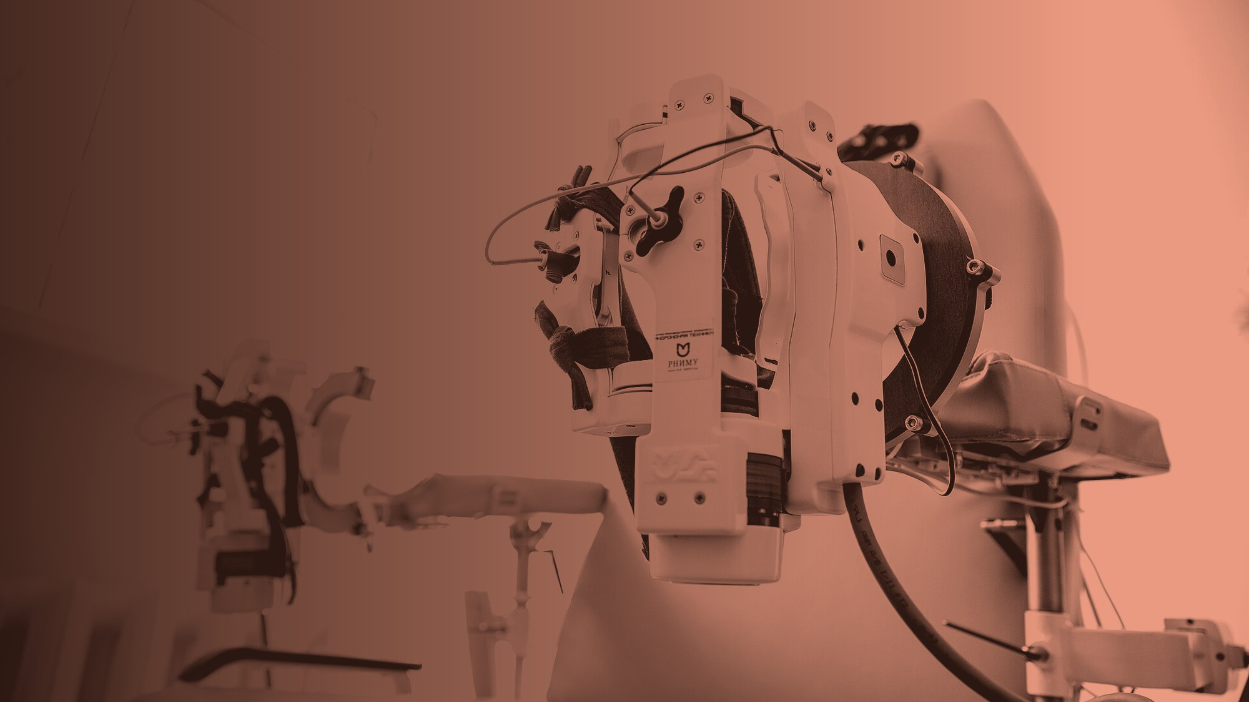
MAIN MESSAGE
Compliance is not what makes it safe. Measurement is.
We will produce the first instrumented contact-force envelope for a soft assistive arm: 28 N, read from spring deflection, bounded when the power is off.
Thank you. Questions?
Photography: U.S. Navy (public domain) · agilemktg1 (PDM) · A. Chernogorodov (CC BY 4.0) · US Army CCDC (CC BY 2.0) · M. M. Ockerbloom (CC BY-SA 4.0). Charts drawn from docs/prior-art.md.
Notes:
4:50-5:00 | Land it and stop. If Q&A goes to 'why not fully soft', the answer is one equation: M = PπD³/8.

