Slide 1
device_connection_task_description.png
Cloud
1 - Create model
2 - Create product
3 - Register device
Data transmission
Device
6 - Log in
5 - Connect to network
4 - Burn credentials

Slide 2

App
EnOS Mobile
Keppel
Storage OS
Device
6 - Log in
5 - Connect to network
4 - Burn credentials
Device
iOS
Android

Slide 3
App
EnOS Mobile
Keppel
Storage OS
EnHyBird
Scaffold
Basics plugin
MQ & Storage
Internal plugin
Single container
User & Access Control
App Portal
Web container
Hybrid init
Hybird lib
tabbar
Performance monitoring
User behavior analysis
cordova
Persistent data
log
Switch language
Share
Menu management
envontext
navibar
router
Kernel
Tab container
Push
Forced upgrade
H5 Bundle
router
Hot update
Switch skin
Finger Print
Mobile OS
iOS
Android

Slide 4
1 - Cloud: Create Model
（Edge, Subdevice）
2 - Cloud: Create Product （Edge, Subdevice）
3 - Cloud: Create Device （Edge, Subdevice）
4 - Device: Burn Device Triple（Edge, Subdevice）
5 – Edge: Connect to Network
Define attributes, measure points, services, and events.
Power on edge to connect
to network. Edge carries device triple and request login.
Obtains ProductKey and ProductSecret
Obtains device triple
Burn device triple into firmware
9 – Data Transmission
8 – Edge: Proxies Subdevice to Log in
7 – Edge: Add Topology
6 – Edge: Log in
Edge, in representative of subdevices, starts to send device telemetries.
Edge uses the device triple of subdevices and represents subdevices to log in
Add subdevices into the topology of the edge gateway
Cloud authenticates device and device logs into cloud. After the first login, edge is activated.
edge_connection_task_description.png
Cloud
1 - Create model
（Edge, subdevice)
2 - Create product
（Edge, subdevice)
3 - Register device
（Edge, subdevice)
Device
4 - Burn Device Triple（Edge, Subdevice）
Data transmission
Edge
8 - Proxies subdevice to log in
6 - Log in
5 - Connect to network
7 - Add topology

Slide 5



App
App
App
App
App
App
API gateway
EnOS cloud
IoT Hub
Cloud Edge
Clusters
Device
registration
service
Edge
Edge
Device
registration
service
2
4
Proprietary
Protocol
with SN
1
Edge
3
Edge
MQTT
Device
3rd Party
System
Device
3rd Party
System
Device
3rd Party
System
device_connection_methods.png
App
App
App
App
…
App
API Gateway
EnOS Cloud
IoT Hub
Cloud Edge
Clusters
Device
registration
service
Device
registration
service
1
2
4
Proprietary
Protocol
with SN
Edge
Edge
MQTT
3
Edge
Edge
3rd Party
System
3rd Party
System
3rd Party
System
Device
Device
Device

Slide 6
inverter_gateway.png
EnOS IoT Hub
Edge
Inverter
Inverter
Inverter
Inverter

Slide 7
turbine_scada_gateway.png
EnOS IoT Hub
Edge
SCADA
SCADA
Turbine
Turbine
Turbine
Turbine

Slide 8
certificate_preparation.png
Prepare
Certificate
0 - Define models, products, and create devices in EnOS console
2 - Generate CSR and Key in local edge device via OpenSSL
3 - Call EnOS API to get certificate via CSR and device key
4 - Save the certificate as a file (.pem for python, .jks for JAVA)
1 - Get EnOS CA root

Slide 9


certificate_service_secure_communication_01.png
Edge
IoT Hub
EnOS CA
1a – Create key pair and csr
Get X.509 certificate
X.509 certificate
1b – Issue certificate
1c – Save certificate

Slide 10
certificate_service_secure_communication_02.png
Edge
IoT Hub
EnOS CA
2a – Provision
OK
2b – Create device
Activate device. Get X.509 certificate
2c – Create key pair and csr
Forward X.509 certificate request
2d – Activate device
X.509 certificate
2e – Issue certificate
X.509 certificate
2f – Bind certificate
2g – Save certificate

Slide 11

certificate_service_secure_communication_03.png
Edge
IoT Hub
EnOS CA
3a – Validate server
3b – validate device
TLS handshake with X.509 certificate
MQTT(data)
3c – Device data
MQTT(data)
3d – Configure or control signal

Slide 12
certificate_service_secure_communication_04.png
Edge
IoT Hub
EnOS CA
4a – Revoke certificate
OK
4b – Revoke certificate and
update crl

Slide 13

secret_communication.png
Device
IoT Hub
Key and secret
a – Create device
Login. productKey, deviceKey,deviceSecret
b – Provision
Success
c – Validate device
MQTT(data)
d – Device data
MQTT(data)
e – Configure or control signal
f – Execute command

Slide 14


connection_scenario_2.2
connection_scenario_1.1
Device
Device registered in the cloud with device triple burned in the firmware
Presents device triple
Device Activated
(Static)
1.1
Device Login
Data Send Telemetries

Slide 15

connection_scenario_2.3
connection_scenario_1.2
Device
Device presents productKey, productSecret
1. IoT Hub returns deviceSecret
2. Presents device triple
1.2
Device registered in the cloud with product credentials burned in the firmware and dynamic activation enabled
Device Activated
(Dynamic)
Device Login
Data Send Telemetries

Slide 16
connection_scenario_2.1
connection_scenario_1.3
Device
Pluggable Acquisition
Chip
Calls REST API for dynamic device registration and obtains device triple
1. IoT Hub returns deviceSecret
2. Presents device triple
1.3
Device not registered in the cloud With product credentials burned in the firmware
Acquisition chip burned with:
SA of the acquisition chip
Device productKey
orgID that the device belongs to
Device Activated
(Dynamic)
Device Login
Data Send Telemetries

Slide 17
connection_scenario_1.1
connection_scenario_2.2
Subdevice
Edge Gateway
2.2
Not registered in the cloud without credential burned in the firmware
Edge burned with SA, edge device productKey, and subdevice productKey
Add Topology
Device Login
Data Send Telemetries
Calls REST API for dynamic sub device registration and obtains device triple
Subdevice logs in to cloud through edge and presents device triple

Slide 18
connection_scenario_1.2
connection_scenario_2.1
Subdevice
Edge Gateway
2.1
Registered in the cloud without credential burned in the firmware
Edge burned with SA, edge device triple and sub-device device triple
Add Topology
Device Login
Data Send Telemetries
Subdevice logs in to cloud through edge and presents device triple

Slide 19
ota_lifecycle_management.png
Re-verifying
Maintaining upgrade strategy
Adding Firmware
Firmware Storage
Verifying Firmware
Batch Upgrade
Upgrade Progress Tracking
Start
Storing firmware and URL
Deleting firmware that failed to be verified
Deleting firmware that failed to be upgraded
Deleting added firmware
Viewing upgrade detail
Deleting Firmware
Yes
Upgrade Complete？
No
End
Users can delete the firmware after a successful upgrade
Users don’t perform any operation after the upgrade completes

Slide 20
asset_tree.png
Tree 1
Tree 2
Node 1
Node 4
Asset 1
Asset 1
Node 2
Node 5
Asset 2
Node 3
Asset 3
(Device)

Slide 21

Device (OTA Client)
OTA Server
EnOS
1. Device reports current firmware version
/sys/${productkey}/${devicekey}/ota/device/inform
2. Add firmware on console and send upgrade request to device
MQTT
3. Send firmware URL to device
/sys/${ProductKey}/${DeviceKey}/ota/device/upgrade
4. Device reports upgrade progress
/sys/${productkey}/${devicekey}/ota/device/progress
5. Console displays upgrade progress
HTTPS
Download
Firmware
6.Download firmware from the URL using HTTP
7. Upgrade complete. Device reports firmware version.
/sys/${productkey}/${devicekey}/ota/device/inform
8. Console displays upgrade success.
cloud_pushed_ota_process.png

Slide 22
Device (OTA Client)
OTA Server
EnOS
1. Device reports current firmware version
2. Records current version
/sys/${productkey}/${devicekey}/ota/device/inform
2a. Add firmware on console. Start batch upgrade upon device request
4. Device sends an upgrade request
3. Maintains the to-be-upgraded device list
/sys/${productkey}/${devicekey}/ota/device/getversion
5. Decide whether or not the device can be upgraded
5a. Returns available new version and URL
/sys/${productkey}/${devicekey}/ota/device/getversion_reply
6. Device downloads firmware
7. Reports upgrade progress
8. Displays upgrade progress
/sys/${productkey}/${devicekey}/ota/device/progress
8a. Downloads firmware by HTTPS according to the URL
9. Device reboots with the new firmware partition.
10. Upgrade complete. Device reports firmware version.
11. Console displays upgrade success
/sys/${productkey}/${devicekey}/ota/device/inform
update_upon_request_ota.png

Slide 23
coap_connection_process.png
Device
EnOS Console
Application
1. Create a model and then a product. Obtain the product key and product secret.
2. Register a device and obtain the device secret.
3. Configure authentication keys on the device, including product key, device key, and device secret. For devices that uses unique-certificate-per-product authentication, configure only the product key and device key.
4. Power on the device and get the device online.
5. The device sends a request to initiate a handshake
6. Handshake confirmed. A secure message channel is established.
7. (Optional) The device sends a request to query its device secret.
8. (Optional) Device secret included in the response is sent to the device by EnOS.
9. The device initiates authentication.
10. The device is authenticated, activated and gets onboard EnOS.
11. EnOS sends a Coap ACK message.

Slide 24
coap_upstream_flow.png
Device
EnOS Console
Application
1. The device reports data.
2. EnOS converts binary data to JSON by using data parsing script.
3. EnOS stores data in valid format.
4. EnOS an ACK message.
5. Applications obtain data by using APIs, such as getMeasurepointByDeviceKey.
6. EnOS sends requested data back in the response.
7. Lifetime timer starts.
8. If device does not exchange any message with EnOS within Lifetime. Device gets offline.

Slide 25
coap_downstream_flow.png
Device
EnOS Console
Application
1. Applications set measure points or invoke services by using APIs, such as setMeasurepoint, invokeService.
2. EnOS converts JSON to binary format by using data parsing script.
3. The device sends a request for commands.
4. EnOS issues the command.
5. The command times out or fails to be sent. EnOS re-sends the command.
6. The device executes the command.
7. The device returns the result in the response.
8. EnOS is acknowledged that the device has executed the command.
9. EnOS logs the result.
10. Application calls an API to query execution status.
The status is returned in the response.

Slide 26
cloud2cloud.png
Device
3rd-party Cloud
Data Forwarding App
EnOS Cloud
0. Register Data Forwarding App to retrieve service account
Master data mapping
Ingest telemetry
Retrieve master data, obtain data forwarding list
Extract data, transform format
Call REST API to report telemetry
New device login
Listen on master data update
Call REST API to create device
Return device creation result

Slide 27

smart_device.png
non_smart_device.png
EnOS cloud
EnOS cloud
IoT Hub
IoT Hub
HTTP/MQTT/CoAP
HTTP/MQTT/CoAP
Smart Device
Gateway-Device
Modem
MCU
Modem
Controller
Sensors
Antenna
Antenna
Actuators
Modbus/RS485/RS232/Zigbee/BLE
Sub-Device
Controller
Sensors
Actuators
Smart Device Connection Model
Non Smart Device Connection Model

Slide 28
device_lifecycle_management.png
Device Lifecycle Management
Determine connection scheme
Model assets
Organize assets hierarchically
Decommission devices
Revoke credentials
Plan / Design
Provision
Service
Maintenance
Decommission
Register and provision devices
Device identity (key/secret, certificate)
Device-end development to send telemetry
Update firmware on-the-air (OTA)
Update security credentials
Enable / Disable device
(online / offline)
Alerts
Dashboard
Data asset management

Slide 29

Device （符合ENOS标准的JSON-formatted data）-> Data Hub
Device (自定义格式) -> 云端解析器解析 -> Data Hub
Formatted data
Device
IoT Hub
Custom format
Device
Data Parser
IoT Hub

Slide 30
Fundamental
Stream Analytics
API
Data Store
Application

Slide 31
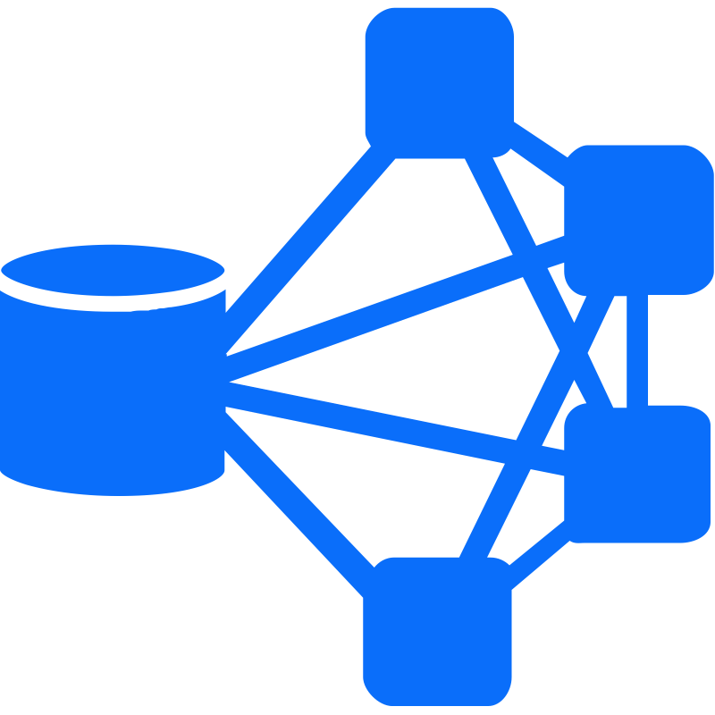
3rd Party
System
MQTT
Data processing
EnOS IoT Hub
Offline Kafka
topic
Offline
streamset
Rule engine
Offline Data Integration
TSDB
3rd Party
System
MQTT
Realtime
streamset
EnOS IoT Hub
Rule engine
Realtime
Kafka topic
EnOS IoT Hub
MQTT
Real time Data Integration
MQTT
Archive

Slide 32




coap_messageflow.png
CoAP/UDP
HTTPS
核心网
DTLS
HTTPS
NB-IoT Network
Core network of a carrier
IoT Cloud
Applications
Device
Device SDK
MCU
SIM Card
NB-IoT Module

Slide 33
EnOS Cloud / 3rd Party System
Resource management
Data Connectivity
MQ & Storage
3rd Data Forwarding
Cloud Connectivity
Data Gapfill
Model
RDB
Edge Computing
Streaming Data Process & Analytics
Script Calculation
Adaptive Intelligence
Alarm/Event Genertator
Template
TSDB
Device Protocol Freamwork
TCP/UDP/HTTP/FTP/RTU…
MQTT/Modbus/OPC…
SDK
Device
Device
Device
Device

