Slide 1
Name – Madhava Reddy – Anantha Lakshmi Institute of Technology and Science
Ineuron internship
DETAILED PROJECT REPORT
FLIGHT TICKET PRICE PREDICTION APPLICATION

Slide 2
Objective:
For purchasing an airplane ticket, the traditional purchase approach is to buy a ticket far in advance of the flight’s departure date to avoid the risk that the price may increase quickly before the date of departure. However, this is not always the case; if airline corporations wish to increase sales, they can lower prices. Airlines employ a variety of factors to decide flight ticket rates, including whether the trip is around the holidays, the quantity of available seats on the plane, and even the month. Some of the variables can be seen, while others are hidden. In this context, customers are attempting to discover the best day to purchase a ticket, while airline firms, on the other hand, are attempting to maximize overall revenue.
The main objective here is -
1. Airline companies have the freedom to change the flight ticket prices at any moment. Travelers can save money if they choose to buy a ticket when its price is the lowest.
2. The problem is how to determine when is the best time to buy flight ticket for the desired destination and period.
3. Airline companies use many different variables to determine the flight ticket prices: indicator whether the travel is during the holidays, the number of free seats in the plane etc. Some of the variables are observed, but some of them are hidden
4. In other word, when given the historical price and the current price of a flight for a specific departure date, algorithms need to determine whether it is suitable

Slide 3
Problem Statement:
Travelling through flights has become an integral part of today’s lifestyle as more and more people are opting for faster travelling options. The flight ticket prices increase or decrease every now and then depending on various factors like timing of the flights, destination, and duration of flights various occasions such as vacations or festive season. Therefore, having some basic idea of the flight fares before planning the trip will surely help many people save money and time.

Slide 4
Data Sharing Agreement
Size of test set: 2671 records
FEATURES: Airline: The name of the airline.
Date_of_Journey: The date of the journey
Source: The source from which the service begins.
Destination: The destination where the service ends.
Route: The route taken by the flight to reach the destination.
Dep_Time: The time when the journey starts from the source.
Arrival_Time: Time of arrival at the destination.
Duration: Total duration of the flight.
Total_Stops: Total stops between the source and destination.
Additional_Info: Additional information about the flight
Price: The price of the ticket.

Slide 5
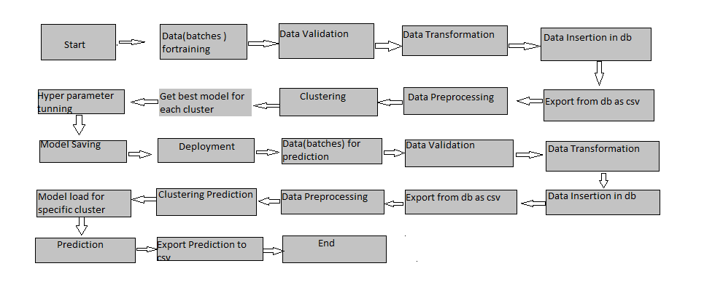
Architecture

Slide 6
Data collection
collected data buy using data scraping tool octoprase and used insta data scraping google extender
websites like make my trip and ixigo were used to collect data
A multitude of consumer travel sites supply fare information for multiple routes, times, and airlines.
Used Kaggle for some data set

Slide 7
Error Handling
We have designed this project in such a way that, at any step if error occur then our application should not terminate rather it should catch that error and display that error with proper explanation as to what went wrong during process flow.

Slide 8
Model Training:
Solution of Flight fare prediction is used to predict the flight fare in advance, so it should be as accurate as possible so that it should give as much as possible accurate price prediction.
That’s why before building this model we followed complete process of Machine Learning . Here are summary of complete process:
1. First we cleaned our dataset properly by removing all null value and duplicate value present in dataset.
2. Then we performed feature extraction, in which I extracted journey date, month and departure and arrival hour , minutes in new separate column.
3. After that I performed feature engineering step in which I created one new feature “Total_Duration”. In this feature what I have done is , I converted total time in minutes.
4. Then I performed feature selection step in which I dropped some feature like(Route, Date_of_journey, Departure_time, arrival_time and Additional_Info).
5. Then I handled categorical variable by performing One-Hot encoding.
6. Then I split the hole data set train-test split. After that I performed scaling on X_train and X_test.

Slide 9
Model Selection –
7. After performing above step I was ready for model training. In this step, I trained my dataset on different Regression Learning algorithm(Linear, Random-Forest, K-NN, DecisionTreeRegression, SVR, Ridge, Lasso and Elastic net). After training the dataset on different algorithms I got highest accuracy of 80% on RandomForrestRegression.
8. After that I applied hyper-parameter tuning on all model which I have described above. Here also I got highest accuracy of 85% on test dataset by same RandomForrestRegression.
9. After that I saved my model in pickle file format for model deployment.

Slide 10
Prediction:
The testing files are shared in the batches and we perform the same Validation operations ,data transformation and data insertion on them.
The accumulated data from db is exported in csv format for prediction
We perform data pre-processing techniques on it.
KMeans model created during training is loaded and clusters for the preprocessed data is predicted
Based on the cluster number respective model is loaded and is used to predict the data for that cluster.
Once the prediction is done for all the clusters. The predictions are saved in csv format and shared.

Slide 11









Tools Used
,

Slide 12
Tools used
PyCharm is used as IDE.
For visualization of the plots, Matplotlib, Seaborn are used.
Azure is used for deployment of the model.
Cassandra is used to retrieve, insert, delete, and update the database. Front end development is done using HTML/CSS, Flask is used for backend development and for API development.
GitHub is used as version control system.

Slide 13
Conclusion
The Flight Fare prediction model will predict the fare of flight in prior so that costumer can get the idea of how much money they are going to spend on traveling.

