Slide 1
The Intellectual Property (IP) Aspect in Cyber Law
Vishram V Kunte
12th Sept 2023

Slide 2
Intellectual Property Rights
The world we live in is driven by innovation. Research and development projects are going global.
Talking of India and its innovations, KPMG Survey (2018) honoured India as the 3rd largest tech innovation leader in the world.
This presents a reality regarding the significance of intellectual property and its contribution in promotion and growth of innovation and research projects around the world.
The Intellectual Property Law has been the fastest growing legal field in recent years.
Pretty obvious that without having the assurance of security regarding one’s innovation, creative works or a brand, it is unlikely that companies or individuals will be willing to give their time, effort and money into such projects.
Hence, strong Intellectual Property Laws and growth in innovation work.

Slide 3
Intellectual Property Rights
IPR Forms:
Patents
Copyrights
Industrial design rights
Trademarks
Plant variety rights
Trade dress
Geographical indications
Trade Secrets
IP is any creation of the intellect or mind, like
Art
Music
Literature
Inventions
Logo / Taglines
Symbols etc
Violation of IPR is called
Infringement in case of patents, copyrights
and trademarks
Misappropriation in case of trade secrets

Slide 4
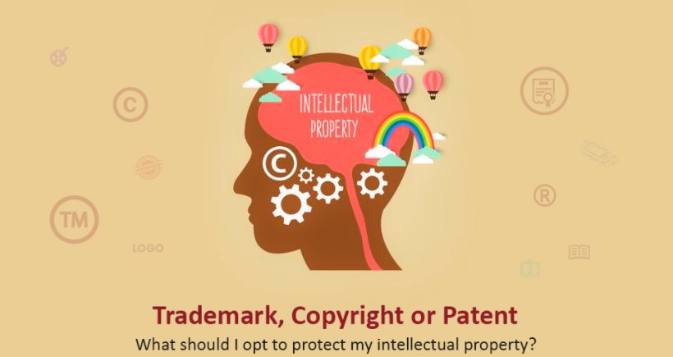
Intellectual Property Rights
The domain of intellectual property is vast. But it’s essential to have a good understanding of the most common rights that are offered through IP protection.
The most commonly applied for are:
TRADEMARK
COPYRIGHT
PATENT

Slide 5
Intellectual Property Rights
What is Intellectual Property ?
Creation of Human Brain
Property is creation of Human intellect or brain
Intangible assets generated out of human creativity or innovation by individual
Refers to the general term for the assignment of property rights on assets
Property = Bundle of Rights (Buy, Sell, Lease, Transfer, Rent etc.)
Industrial property, which includes inventions, trademarks, industrial designs and geographic indications and Copyright which includes literacy and artistic works
IPR is legal protection provided to creators of Intellectual property (IP)

Slide 6
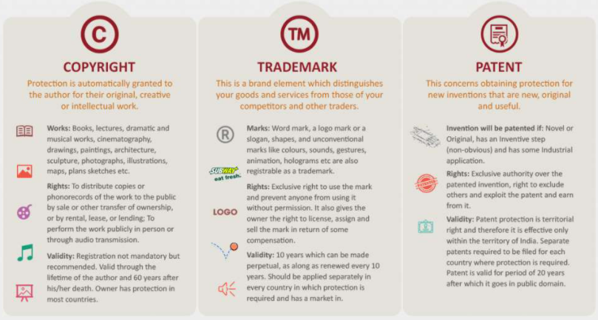
Copyright – Trademark - Patent

Slide 7
What is Copyright ?
A copyright is a collection of rights automatically vested to you once you have created an original work.
Rights include the right to reproduce the work, to prepare derivative works, to distribute copies, to perform the work publicly, and to display the work publicly.
As the copyright owner, you have the authority to keep “right”, to transfer them individually to one or more people, or to transfer them collectively to one or more people. E.g. Print / Distribution etc
Can be accomplished through licensing, assigning, and other forms of transfers. The power of copyright allows you to choose the way your work is made available to the public.

Slide 8
What is Patent
Primary goal of the patent law is to encourage innovation and commercialization of technological advances.
Patent law incentivizes inventors to publicly disclose their inventions in exchange for certain exclusive rights.
A patent protects inventions.
Inventions can include new and useful processes, machines, manufactures, compositions of matter as well as improvements to these.
Certain computer programs may fall within the subject matter protected by both patents and copyrights. E.g. RSA Algorithm for PKI
Patent system compliments copyright protection by providing protection for functional aspects of the software, which are not protected by copyright.
Unlike the copyright registration process, the patent application process is expensive, complex, difficult, and time consuming and generally should not be attempted without the assistance of an experienced patent attorney or agent.

Slide 9

What is Trademark ?
A trademark is a word, phrase, symbol, and/or design that identifies and distinguishes the source of the goods of one party from those of others.
A service mark is a word, phrase, symbol, and/or design that identifies and distinguishes the source of a service rather than goods.
E.g. brand names, slogans, and logos.
“Trademark” is often used in a general sense to refer to both trademarks and service marks.
Similar to copyright, a person does not need to register a trademark or service mark to receive protection rights, but there are certain legal benefits to registering the mark.
Service Marks are often slogans e.g. Plumber Service – “The Leak Fixers”, “Amul – The Taste of India” etc
Rarely there is an overlap between trademark and copyright law but it can happen — for instance, when a graphic illustration is used as a logo the design may be protected both under copyright and trademark.

Slide 10
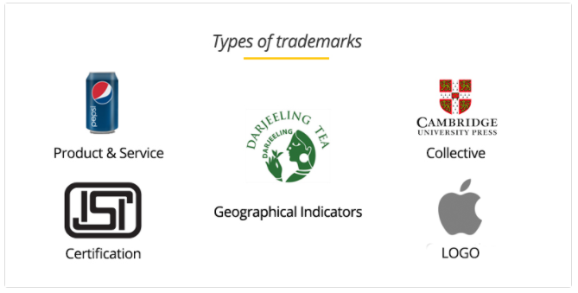
Type of Trademarks in India https://quickcompany.in/articles/types-of-trademark-in-india

Slide 11
World Intellectual Property Organization
World Intellectual Property Organisation (known as WIPO, is a specialised agency of the United Nations) is an international agency that works for the protection of legal rights in artistic and literary works, inventions, trademarks, and other original creations.
The organisation works for the promotion of international agreements on copyright, patents, trademarks, and other original creations.
It also provides technological information and other assistance to developing countries. WIPO has a membership of more than 110 countries.
Situated in Geneva, Switzerland. WIPO administers two treaties that were established in the 1880’s.
One protects copyright. The other protects patents, trademarks, and other original creations.

Slide 12
WIPO Role
WIPO plays a particularly important role in educating intellectual property officials world wide about the importance of establishing and implementing strong intellectual property laws.
The creative community looks to WIPO treaties to establish a basic standard of intellectual property protection world wide. This organisation, and the new WIPO Copyright Treaty in particular, represent a fundamental step in promoting growth and protecting our nation‘s precious technology assets in the new digital era.
Origin of IPR could be traced to the century old first international convention relating to copyright called the 'Berne Convention for the Protection of Literary and Artistic Works of 1886‘.
14 countries that adopted it agreed certain standard rules for the protection of literary and artistic works and also agreed to protect works published in each of the member countries. The Berne Convention was revised several times and many more countries joined over the succeeding years.

Slide 13
World Intellectual Property Organization
Sound recordings are subject to the provisions of 1971 ‘Geneva Convention for the Protection of Producers of Phonograms against Unauthorised Duplication of their Phonograms’.
Over 40 member countries, including the United Kingdom and the United States have adopted this convention.
WIPO organised a conference in December 1996, inviting around 160 member countries, the agenda being modification of the existing norms and creation of new norms on Intellectual property Rights, so as to cope with the creation, adoption, transmission and distribution of proprietary works in the digital medium.
Three draft treaties, prepared by WIPO were discussed in detail namely:
Copyright of Electronic Records
Protection of Performers and Producers of Phonograms
New form of Sui-generis (of one‘s own origin) Protection of Databases

Slide 14
IP and Copyrights
Under the new 'Copyright Treaty‘, computer software and computer programs in any mode or form of expression are protected as literary works.
Under the ‘Performances and Phonograms Treaty', a new right called the 'Right of Transmission' (which is specific for electronic records) has been added to the existing rights of reproduction, public performance and communication.
Clause takes care of the digital on-line delivery of proprietary works. This provision will pave way for legalisation of the functioning of on-line digital department stores, digital bookstores, and digital record and video shops.
Concept of online copyrights has taken birth.
Broadcasting now covers transmission by satellite and transmission of encrypted signals.
By virtue of the phonograms treaty, performers and makers of phonograms are granted right of reproduction, both direct and indirect in any manner or form, and an exclusive right of making available to the public of their performances stored in phonograms by interactive, on—demand, on- line delivery methods.

Slide 15
Electronic Copyrights Management System
With the advancement of digital computing, storage technology and widespread use of the Internet, Digital Libraries have become the state of the art libraries.
CD-ROMs are replacing journals and books. Library users want information on-line. The successful growth and use of digital library will depend on the resolution of IPR issues in general and copyright issues in particular.
In certain circumstances and under certain conditions it is not an infringement of copyright for public libraries or archives to distribute a copy of a work for reference and education.
Browsing of books/printed material in book stores and libraries has been a legitimate intellectual interface with the author. This has been an important component of learning.
Due to the fact that the digital media enables fast and unauthorised copies being taken, such an exemption is likely to be misused.
With digital reference material being available through electronic media, suitable legislation may be required to ensure that the right to online browsing is retained.

Slide 16
Electronic Copyrights Management System
The purpose of an ECMS is to aid enforcing the copyrights owned by the author, publisher etc., and to keep track upon the actions performed by an end user so that the appropriate royalties can be provided to the copyright owner.
Design and development of an ideal Electronic Copyright Management System should address the following basic issues namely-
Technical expression of copyrights - i.e., Making known to the end user that the copyrights are owned by the author etc., by utilising technological innovations.
Automatic access control, licensing, collection of revenue by way of royalty, enforcing various rights, and monitoring various activities with a view to prevent infringement.

Slide 17
Electronic Copyrights Management System
An ideal ECMS should evolve a mechanism for declaring the copyrights through explicit statements in machine readable formats.
Copyright statements should embedded to the information objects. Machine readable copyright declarations/statements are instrumental in developing suitable systems for automatic access control, licensing, royalty revenue collection etc.
Based on the above criteria, the components of a good ECMS could be:-
a digital copyright registration and recording system
a digital library system with affiliated repositories of copyrighted works and
a transaction monitoring system to check the illegal use of works.
Technologies are being developed for protecting electronic or machine readable copyright works.
Explicit Copyright Control, Content Registration, Author Registration, Digital Watermarking etc, are some of the methods being tried upon to implement ECMS.

Slide 18
Indian Copyrights Act on Soft Propriety Works
Section 63B which was introduced in the Copyright Act 1957, treats knowing use of infringing copy of computer programs to be an offence.
Any person who knowingly makes use on a computer of an infringing copy of a computer program shall be punishable with imprisonment for a term which shall not be less than seven days but which may; extend to three years and with fine, which shall not be less than fifty thousand rupees but which may extend to two lakh rupees:
Provided that where the computer program has not been used for gain or in the course of trade or business, the court may, for adequate and special reasons to be mentioned in the judgement, not impose any sentence of imprisonment and may impose a fine which may extend to fifty thousand rupees.

Slide 19
Indian Copyrights Act on Soft Propriety Works
Section 64 provides the Power to police to seize infringing copies-
Any police off‌icer, not below the rank of a sub-inspector, may, if he is satisfied that an offence under section 63 in respect of the infringement of copyright in any work has been, is being, or is likely to be, committed, seize without warrant, all copies of the work, and all plates used for the purpose of making infringing copies of the work, wherever found, and all copies and plates so seized shall, as soon as practicable, be produced before a Magistrate.
Any person having an interest in any copies of a work, or plates seized under sub-section (1) may, within fifteen days of such seizure, make an application to the magistrate for such copies (or plates) being restores to him and the magistrate, after hearing the applicant and the complainant and making such further inquiry as may be necessary, shall make such order on the application; as he may deem.
Apart from these penal provisions, there are no special provisions with regard to soft copyrights, in the Indian Copyright Law at present.

Slide 20



