Slide 1
Electronic Commerce
(e – Commerce)
Vishram V Kunte
6th Sept 2023

Slide 2
E-Commerce
Change in our Society and Economy
Sophistication and the advancement in IT
Growth of IT industry and Integration IT in our Day-to-Day activities
Increasing use of ICT (Info and Communication Tech.)
In Global economy most businesses have gone ‘online’, indicating change in the manner of conducting business
Define Electronic commerce (e-Comm) to be any of the transaction that is completed using a computer facilitated network.
Understand how e-Comm operate but also the security issues and concerns involved in the ‘e-Comm’
Online in the ‘Virtual World’ or on the Web – Cannot be free from the ‘Risks
Cybercriminals lurk around for lucrative gains by stealing our valuable sensitive personal information

Slide 3
E-Commerce
E-comm is used to describe the use of Internet by Businesses and consumers to exchange information, buy and sell goods / services
E-comm is meant to offer solutions to a variety of market related problems:
Commerce with geographic separations
Complex interactions between Businesses that are labor and information intensive
Supply chain that have an excess inventory because of an inability to foresee and plan for the right products
Digital Marketplaces enable web-based trading hubs that bring together sellers and buyers
Great advantage of Digital Marketplaces is their ‘Flexibility’
In Digital World nothing is Safe

Slide 4
Commerce / Trade in Digital World
Modern World computers and allied electronic devices widely communicate / interact with other devices through range of networks
Speed of business has increased phenomenally, expectations of ‘delivery’ of products / services drastically changes
Quite common for ‘consumers’ to identify sellers, evaluate products, compare prices
Business Org re-engineer / innovate their processes – to streamline procurement processes, reach to new customers, maintain customer ‘loyalty’, manage internal operations
Electronic revolution in our economy

Slide 5
Electronic Commerce ?
E-Comm involves buying and selling of products or services over electronic medium
Selling portals we buy books, household items, ‘apps’ that we install on our mobile phones
Although sequence of business transactions are like one that is used for the conventional commerce
Most important characteristics is almost lack of ‘face-to-face’ relationship between merchant and the customer

Slide 6
Drivers of e-Comm
Global Mergers and Acquisitions
Mobile computing and ubiquitous customer connectivity
Changing Economic Models
Continued Growth of Global economy
Changes in Paradigm and Power of the Supply Chain
Competitive IT environment

Slide 7
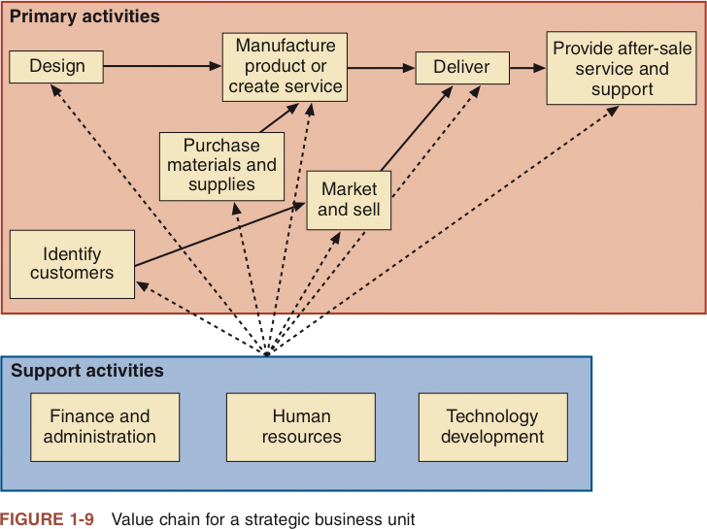

Slide 8
Electronic Business Models (Slight Difference Between Two)
Brokerage Model – Facilitate e-comm by bringing together ‘buyers’ and ‘sellers’. Also facilitate sale / purchase transaction
Advertising Model – Via emails, Advertising messages in the form of banner ads.
Infomediary Model – Assist buyer and sellers to provide data about products and their products
Merchant Model – e.g. Wholesalers and retailers of goods and services
Direct Model – Allow manufacturers to reach buyer directly and compress distribution channel, reduce cost in their ‘Supply-Chain’

Slide 9
Electronic Business Models (Slight Difference Between Two)
Affiliate Model – Provide opportunities for purchasing where people are surfing. Percentage of revenue is shared.
Community Model – Revenue share can be based on Services or voluntary contributions
Subscription Model – Users are charged periodic fee.
Utility Model – on-demand metered model or pay as you go successfully used by ‘Cloud Service Providers.

Slide 10
Internet Domains (e-Business)
B2C – Business to Consumer
Greater order convenience
Lower Cost
Easier information and price gathering
B2B – Business to Business
Higher Volume of Business than B2C
Lower cost via B2B auctions
Buying alliance
Greater access to Information

Slide 11
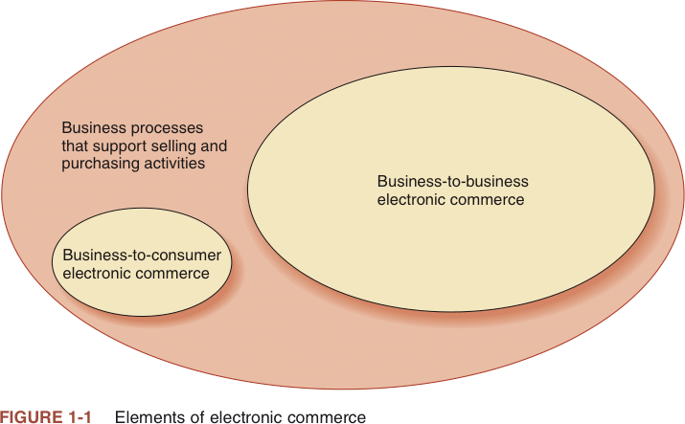

Slide 12
Internet Domains (e-Business)
C2C – Consumer to Consumer
Transactions via online trading e.g. eBay
Consumer create / share online product information
C2B – Consumer to Business
Facilitate communication between customer and businesses

Slide 13
EDI (Electronic Data Interchange)
Building block of e-Commerce
EDI is a standardized method for exchanging business documents with your trading partners—quickly, accurately, and reliably
Component of e-Comm
For supply chain businesses of any size, implementing EDI is essential for sustained competitiveness and growth
EDI reduces costs and improves operational performance across your business.
EDI accelerates data flow, enhances accuracy and streamlines administration
EDI makes it easier to manage inventory and reduce associated costs

Slide 14
EDI (Electronic Data Interchange)
“Electronic Data Interchange is the electronic transfer from one computer to another computer of processable data using agreed standard to structure the data". EDI is direct computer to computer transfer of business information between two businesses
Helps to establish a direct connection between trading partners
EDI focus is on trade interchange
Standard is required to ensure that companies speak same language
It is desirable to move from proprietary codes to standards

Slide 15
EDI (Electronic Data Interchange) Security
Data exchanged in electronic form between business and their customers / business partners
Speed and reliability of information exchange, wealth and prosperity of e-Business relies on ‘Safe and Secure’ exchange of data and information
Electronic information growing in volume
Three Major risk to EDI messages :
Loss of Integrity
Loss of Confidentiality
Non-Availability

Slide 16
EDI (Electronic Data Interchange) Security
Loss of Integrity
Alternation, Modification or destruction of Data
Critical in case of electronic payment services
Sensitive Information – Medical records / Personnel Records
Critical Processes / Commercial Designs
Loss of Confidentiality
Sensitive Information (Medical Records / Personnel Records)
Specific recipes in fast food industries
Non-Availability
Criticality for ‘just-in-time’ and 24 hrs trading, Critical processing sequence in Pharma manufacturing

Slide 17
Advantages of Electronic Commerce
Increased Sales
Reaching market segments at locations that are geo dispersed
Create virtual communities
Decreased Cost
Handling Sales inquiries
Providing price quotes
Determining product availability

Slide 18
Disadvantages of Electronic Commerce
Perishable grocery products are much harder to sell online
It is difficult to:
Calculate return on investment
Integrate existing databases and transaction-processing software into software that enables e-commerce
Cultural and legal obstacles also exist

Slide 19
Language Issues
To do business effectively in other cultures a business must adapt to those cultures
Researchers have found that customers are more likely to buy products and services from Web sites in their own language
Localization
Translation that considers multiple elements of the local environment

Slide 20
Culture Issues
An important element of business trust is anticipating how the other party to a transaction will act in specific circumstances
Culture:
Combination of language and customs
Varies across national boundaries
Varies across regions within nations

Slide 21
Electronic Commerce
Electronic commerce (e-commerce)
Businesses trading with other businesses and internal processes
Electronic business (e-business)
Term used interchangeably with e-commerce
The transformation of key business processes through the use of Internet technologies

Slide 22
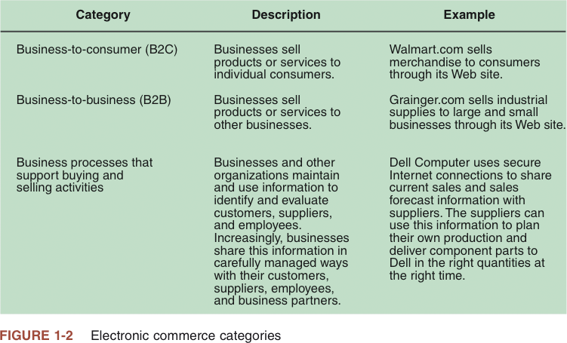

Slide 23
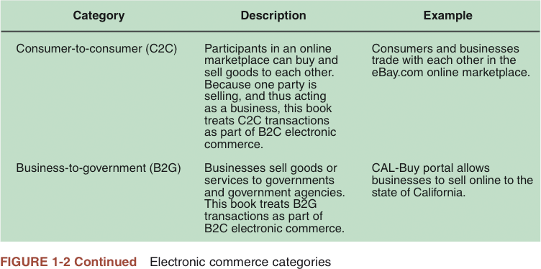

Slide 24
The Development and Growth of Electronic Commerce
Electronic funds transfers (EFTs)
Also called wire transfers
Electronic transmissions of account exchange information over private communications networks
Electronic data interchange (EDI)
Transmitting computer-readable data in a standard format to another business

Slide 25
The Development and Growth of Electronic Commerce (continued)
Trading partners
Businesses that engage in EDI with each other
Value-added network (VAN)
Independent firm that offers connection and transaction-forwarding services to buyers and sellers engaged in EDI

Slide 26
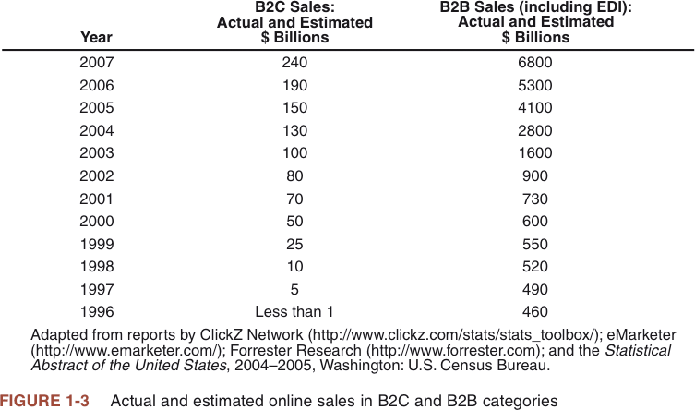

Slide 27
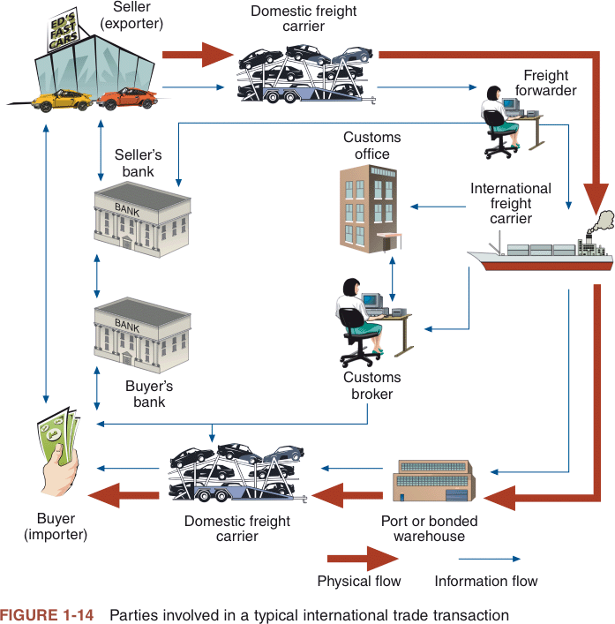

Slide 28
e-Commerce changing Paradigm

Slide 29
Delivery to Become Fast, Faster, Fastest
In recent times, consumers have become more conscious of the time it takes to receive their deliverables
Lack of patience that they possess, and e-commerce businessmen are sure to feel the pressure of making ‘instant’ deliveries.
Though the time taken to instant delivery is subject to numerous variables, such as time of order placement, location of warehouse, location of consumers, stock in inventory, and last-mile delivery, businessmen will leverage the prowess of technology and upgrade their last-mile delivery software to achieve delivery as fast as they can.

Slide 30
Mobile Shopping to Take Over Website Shopping
Consumers seek is convenience. A marked shift in the way consumers choose to exhibit their shopping behaviors.
Last decade saw the growing prominence of an e-commerce website, mobile apps hold the realm of the future shopping behaviors of consumers.
Mobile apps are being simpler and simpler by the day, which is attracting a large pool of audience to interact with them and create huge sales prospects for businessmen.
Websites have the limitation that is being gradually bridged by mobile apps with their utmost convenience.
So, if you are looking at a website to begin your digital journey and achieve e-commerce success, you need to leap higher towards the mobile app to get the desired business outcomes.

Slide 31
Shopping at the Voice Command
Call it Alexa, Ok Google, or Siri, the advent of voice command technology is gradually making inroads towards the ecommerce landscape to highlight the convenience feature for consumers.
The last year saw a rise in the use of voice command for shopping; however, the year 2020 will see a significant adoption of voice command technology, which will make it necessary for businessmen to incorporate this technology in their e-commerce mobile apps.
This is just a small scenario to the growing popularity of voice command. In the future, with the increasing adoption rate of voice assistant devices, forget mobiles, these voice assistants will be the real rulers, who will determine the sales of your ecommerce business.

Slide 32
Social Commerce will be the Go-to-way
As data is the real asset of the e-commerce website, the data extracted from the social media usage of individuals will continue to play a significant role. Currently, Instagram is gaining traction as a key e-commerce mobile app. The contribution of Facebook to e-commerce sales can also not be neglected.
Besides e-commerce, social media also serves as an influencer to the purchasing behaviour, or rather an impulsive purchasing behaviour of consumers. In the future, social commerce or evolution of social media as a key e-commerce platform will remain integral for businessmen.
Connecting with friends and suggesting great stuff to buy and try will be the key feature that businessmen should look at incorporating in the e-commerce app they develop.

Slide 33
Cryptocurrency on the Horizon
From cash on delivery, to net banking, credit cards, debit cards, and wallets, the way that consumers make payments for their purchases has truly become easy or as they say, it has become one tap checkout system.
Currently, a large number of individuals rely on e-wallet and PayPal accounts to make payments, which shows a shift from paper-based cash payment model to digital payment model. In 2020, the trend of using e-wallet will gain a significant momentum; however, some e-commerce giants will also make a shift towards embracing the future of payment models – cryptocurrency.
Though cryptocurrency wouldn’t be a profound trend as of yet in 2020 it will surely make a prominent mark and make its presence felt as an emerging payment model.

Slide 34
Artificial Intelligence and Augmented Reality to Take Customer Experience to Another Level
At the end of the day, e-commerce platforms are developed to take the customer experience to a new level. If there is one thing that distinguishes physical stores from online commerce portals, it is the touch and feel that customers can experience.
However, e-commerce mobile apps have been falling short of this experience, which has been gaining ground to brick and mortar stores. In the year 2020, e-commerce mobile apps will experience a transformation with a touch of artificial intelligence and augmented reality.
Customers will be able to upload their pictures to the e-commerce mobile app and get a glimpse of how the clothing or makeup or accessories would look on their body. Such an experience is sure to increase customers’ interest in e-commerce mobile apps.’

Slide 35
Personalization will Become the New Standardized Strategy
While the e-commerce websites and mobile apps of the last five years would offer nothing more than a shopping experience to customers a stir has been observed in the e-commerce arena, wherein the e-commerce businessmen are getting to know their customers better.
So, instead of consumers coming to the mobile app or website with their requirements, The smart businessmen are making deals and offers, on the basis of information extracted from the consumers in the form of the demographics such as their age, sex, location, weight, height, choices, search results, past purchases, et cetera.
The personalization of e-commerce, in turn, serves as a crucial marketing strategy for businessmen, who are looking at pushing their sales and getting better at customer retention. The personalization offers twofer benefits for e-commerce portal in terms of increasing sales and driving the attention of consumers with the help of push notifications to ensure better sales prospects in the future.

Slide 36
Subscription-based E-commerce is the New Addition
Ever wondered, what makes e-commerce mobile apps so different from the conventional brick and mortar stores? It is the attraction of deals and discounts that these online channels have to offer.
The reduced cost of operation, which significantly lowers the overhead cost of running a business, gives an edge to an e-commerce businessman to make a profit even without squeezing some of the operational cost. On the other hand, the brick and mortar stores already suffer from high overhead cost which ranges from land, power, workers etc.
While deals and discounts will remain the routine feature of e-commerce mobile apps, the year 2020 will also witness a spurt in the subscription-based shopping for consumers who buy the same products frequently. The trend will have a high prominence on the sales of baby food items, pharmaceuticals, et cetera.

Slide 37

Trends that are Going to be Influential for E-Commerce in 2020

Slide 38
e-Commerce Security

Slide 39
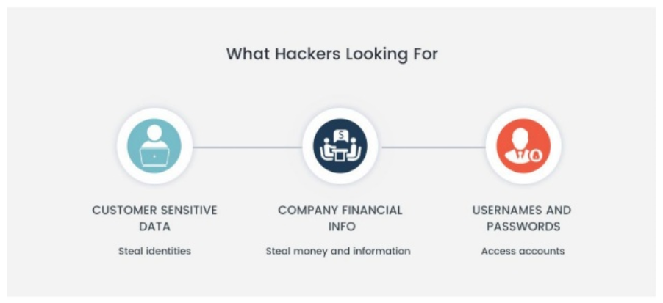

Slide 40
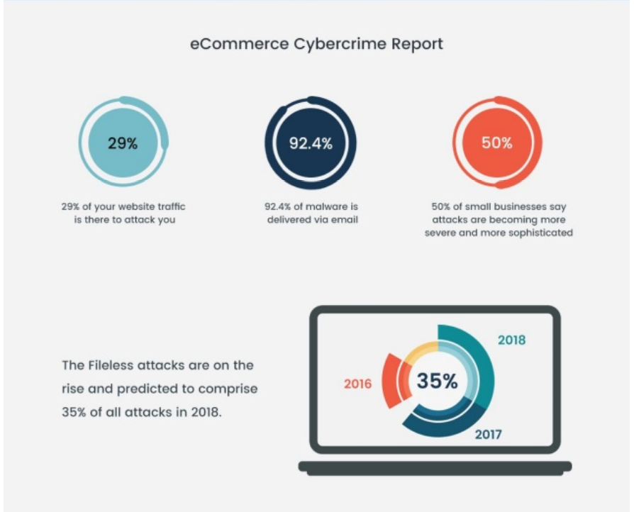

Slide 41
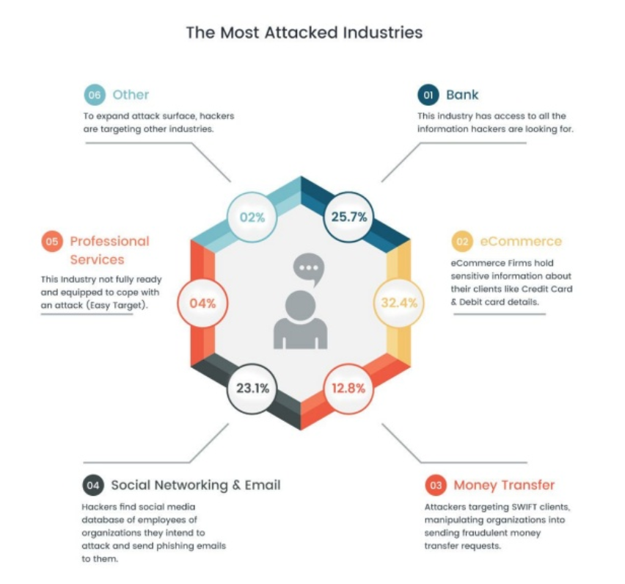

Slide 42



