Slide 1
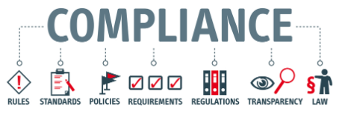
Information Security Standard Compliances SoX, GBLA, HIPAA, ISO, FISMA, NERC, PCI
Vishram V Kunte
5th Oct 2023

Slide 2
SoX – Sarbanes Oxley

Slide 3
Sarbanes-Oxley Act
SoX Act of 2002, is U.S. Law meant to protect investors from fraudulent accounting activities by Corporations.
Covers issues such as auditor independence, corporate governance, internal control assessment and enhanced financial disclosure
Prolonged corporate scandals e.g. Enron and WorldCom, Act was enacted to restore investors confidence in the financial markets and close loopholes that allowed public companies to defraud investors
Enron scandal accounting and corporate fraud as its shareholders lost $74 billion in the four years leading up to its bankruptcy, and its employees lost billions in pension benefits
Corporations must save all business records, including electronic records and electronic messages, for “not less than five years.” Consequences for noncompliance include fines or imprisonment, or both

Slide 4
Sarbanes-Oxley Act
SoX Act of 2002, ensures that corporate executives are held responsible for establishing, evaluating and monitoring the effectiveness of ‘Internal Controls’ over their financial reporting
SOX has provisions that include both criminal and civil penalties for any violations
Sec. 302: CEO and CFO to certify that the financial reports are true and accurate. Adequate controls exists over financial reporting.
Sec. 404: External auditors certify that these controls are adequate
Sec. 409: Prompt reporting of any changes in financial conditions
Sec. 802: mandate to retain accounting documents and work papers for a minimum of seven years
Network security is a fundamental component of SOX compliance

Slide 5
Sarbanes-Oxley Act
(PCAOB) Public Companies Accounting Oversight Board was created as a result of SOX to define auditing standards
Management is not only responsible for financial information but also for the way that information is generated, accessed, collected, stored processed and transmitted
Any publicly traded company in United States is subject to SOX
SOX compliance can be achieved by adopting a controls framework such as
ISO 27001 or
Process Framework such as COBIT (Control Objective for Information and Related Technology)

Slide 6
GLBA: Gramm-Leach-Bliley

Slide 7
GLBA Act (History)
Due to the remarkable losses incurred as a result of 1929's Black Tuesday and Thursday, the Glass-Steagall Act (1933) was originally created to protect bank depositors from additional exposure to risk, associated with stock market volatility.
As a result, for many years, commercial banks were not legally allowed to act as brokers. Since many regulations have been instituted since the 1930s to protect bank depositors, GLBA was created to allow these financial industry participants to offer more services.
Commercial bank Citicorp’s merger with the insurance firm Travelers Group, led to the formation of the conglomerate Citigroup, which offered not only commercial banking and insurance services, but also lines of business related to securities.
Citicorp’s merger was a violation of the then-existing Glass–Steagall Act, as well as the Bank Holding Company Act of 1956.

Slide 8
GLBA Act
Gramm–Leach–Bliley Act (GLBA), also known as the Financial Services Modernization Act of 1999
Mandates that all financial institutions establish appropriate ‘Security Standard’
Protect customer data from internal and external threats and unauthorized access occurring through online systems and networks
Ensure that companies maintain ‘Data Integrity’ and ‘Privacy Standards’ for employees and customers PT
Not just a ‘Best Practices’, but legal requirements
Title V of GLBA talks about ‘Privacy’

Slide 9
HIPAA – Health Insurance Portability Accountability Act
Protection of Electronic Personal Health Information
Technical Safeguards
Physical Safeguards
Administrative Safeguards

Slide 10
What is HIPAA
HIPAA is the acronym for the Health Insurance Portability and Accountability Act that was passed by Congress in 1996
HIPAA does the following:
Provides the ability to transfer and continue health insurance coverage for millions of American workers and their families when they change or lose their jobs
Reduces health care fraud and abuse
Mandates industry-wide standards for health care information on electronic billing and other processes; and
Requires the protection and confidential handling of protected health information

Slide 11
Why HIPAA??
Genetic advancements
as more is known about our genetic predisposition to diseases, HIPAA will ensure that, for example, an individual is not denied insurance because the company knows that she may eventually develop MS
Marketing
as information is more easily captured concerning, for example, the prescriptions we purchase, HIPAA is designed to prevent marketing of unsolicited products or services based on harvested marketing data.
Technology
as information is quickly and sometimes loosely moved around networks, HIPAA standards will hold violators accountable for accidental or intentional ‘interception’ of protected health information (PHI).

Slide 12
What Objectives do the Privacy Regulations Accomplish for Patients?
Give patients more control over their health information
Set boundaries on the use and disclosure of health records
Establish appropriate safeguards for all people who participate in or are associated with the provision of healthcare to ensure that they honor patients’ rights to privacy of their PHI
Hold violators accountable through civil and criminal penalties
Strike a balance when public responsibility requires disclosure of some forms of data--for example, to protect public health

Slide 13
HIPAA Act (Penalties)
HIPAA Enforcement Rule Violation Levels (minimum fine per incident shown)
The entity was unaware and would have remained unaware based on reasonable measures | $100 to $50,000
“Reasonable cause” – in which the violation was caused by an element that would prompt action in an ordinary person | $1000 to $50,000
“Willful neglect” – in which the violation was caused by intentional avoidance but rectified within 30 days | $10,000 to $50,000
Willful neglect but not mitigated within 30 days | $50,000

Slide 14
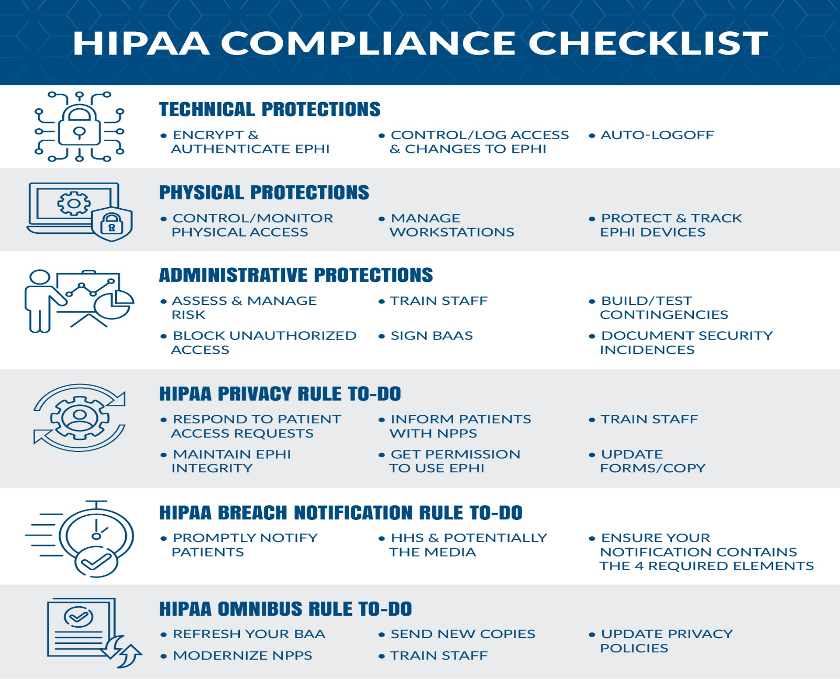
HIPAA
EPHI – Electronically Protected Health Information
BAA - Business Associate Agreement
NPPS – Notice of Privacy Practices

Slide 15
ISO 27001 – Information Security Management System
What is ISO 27001/ISO 27002
ISO Standard:
ISO 27001 is the management framework for implementing information security within an organization
ISO 27002 are the detailed controls from an implementation perspective

Slide 16
Why Information Security?
More and More Dependence on Information Systems
Need for a long term and failure proof system for Securing every form of Information Asset
Theft of Information can cause disasterous results for companies
Companies in India have projects which force them to protect sensitive client information
Projects are awarded to companies who have a sound system to protect Information
International Laws like HIPPA and Data Protection law have set the benchmark for protecting information being stolen or tampered.

Slide 17
Information types
Information can be:
created
stored
destroyed
Used
Transmitted
Information format
Paper
Databases
Disk(ette)s
CD-ROMs
Tapes
(Design) drawings
Films
Conversations
…
Character of information
Financial
Strategic
Operational
Person dependent
…

Slide 18
What Can Be Done With Information?
Created
Stored
Destroyed?
Processed
Transmitted
Used - (for proper and improper purposes)
Lost!
Corrupted!

Slide 19

Business requirements for information security
management:
Commercial requirements
Legal requirements
What is information security?
Basic components
Managing information boundaries
Sharing information with partners
Holistic approach

Slide 20
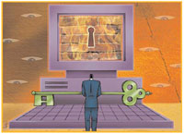
Commercial Requirements:
Client / Customer / Stakeholder - requirement of contract / condition for Invitation to Tender. Marketing - seen as giving a competitive edge in marketing of product / service. Demonstration to Trading Partner of commitment to information security. Internal management tool - for control and confidence.

Slide 21

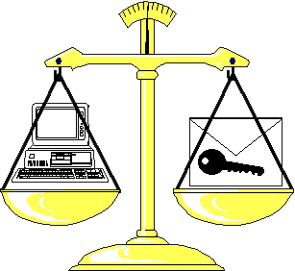
Legal Requirements:
Companies Trading Regulation
Copyright, Designs and Patents Regulation
Data Protection Requirements
Computer Misuse
Regulation of Investigatory Powers

Slide 22
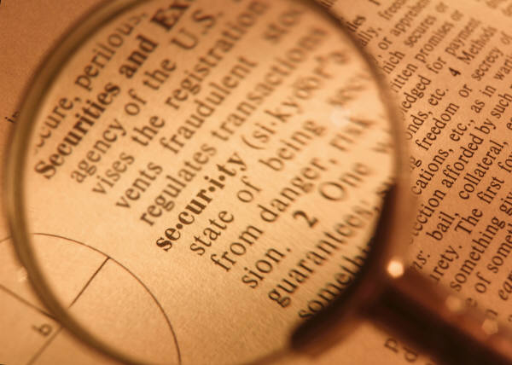
What is information Security?
“Information Security protects information from a wide range of threats in order to ensure business continuity, minimise business damage and maximise return on investment and business opportunities.”

Slide 23
Basic components
Confidentiality
Ensuring that information is accessible only to those authorised to have access
Integrity
Safeguarding the accuracy and completeness of information and processing methods
Availability
Ensuring that authorised users have access to information and associated assets when required

Slide 24
Integrity
Confidentiality
Availability
In some organisations, integrity and / or availability
may be more important than confidentiality.

Slide 25
Context for Info Security Management
The Public
Internal
Mgmt.
customers
Integrity
Confidentiality
Employees
Risk
Litigation
Availability
Stakeholders
Internal Audit

Slide 26
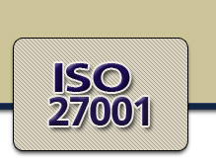
What is ISO 27001?
It’s a International Standard for Information Security Management
It consists of various Specification for information Security Management
Code of Practice for Information Security Management
Basis for contractual relationship
Basis for third party certification
Can be Certified by Certification Bodies
Applicable to all industry Sectors
Emphasis on prevention

Slide 27
History and Development of ISMS standard (BS7799 – ISO 17799 - ISO27001)
ISO 17799:2005 and
ISO 27001:2005 released
2005
New BS 7799-2
Passed and accepted
Sep 2002
2001
New BS 7799-2 (drafted)
December 2000
ISO/IEC 17799:2000
Swedish standard SS 62 77 99 Part 1 & 2
1999
New issue of BS 7799 Part 1 & 2
1998
BS 7799 Part 2
1995
BS 7799 Part 1

Slide 28
ISO 27001:2005 Structure
Five Mandatory requirements of the standard
Section 4 – General and Documentation requirement
- General requirements
- Establishing and maintaining an ISMS
- Documentation Requirements
“The Organization shall develop, implement, maintain and continually improve a documented ISMS within the context of the organizations overall business activities and risk. For the purposes of this standard the process used is based on PDCA model…”

Slide 29
Plan Do Check Act Cycle (PDCA)
Interested parties
Plan
Interested parties
Establish the ISMS
Implement and operate the ISMS
Maintain and improve the ISMS
Do
Act
Monitor and review the ISMS
Information security requirements and expectations
Managed information security
Check

Slide 30
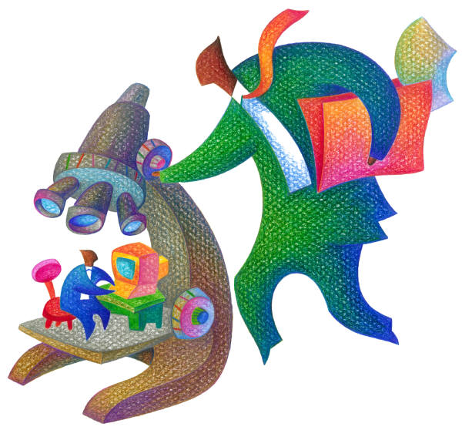
ISO 27001:2005 Structure
Section 5 - Management Responsibility
Management Commitment
Resource Management
Section 6 – Internal ISMS Audits
Section 7 - Management Review of the ISMS
Review Input
Review Output
Section 8 - ISMS Improvement
Continual Improvement
Corrective Action
Preventive Action

Slide 31
Important Areas of Concern
ISO27001
Security policy (5)
Organization of information security (6)
Asset management(7)
Human resources security (8)
Physical and environmental security (9)
Communications and operations management (10)
Access control (11)
Information systems acquisition, development and maintenance (12)
Information security incident management (13)
Business continuity (14) management
Compliance (15)

Slide 32
ISO17799:2005 Framework
Incident
Management
Security Policy
Compliance
Security Organisation
Business Continuity Management
Information Security Management System
Asset Classification & Control
System Development
Personnel Security/ HR Security
Access Control
Physical and Environmental
Communications & Operations

Slide 33
2. Organization of information security
Objective:
Internal Organization
External Parties
Covers:
Management commitment to information security
Information security coordination
Allocation of information security responsibilities
Authorization process for information processing facilities
Confidentiality agreements
Contact with authorities
Contact with special interest groups
Independent review of information security
Identification of risks related to external parties
Addressing security when dealing with customers
Addressing Security in third party agreements

Slide 34
2. Organization of information security - Example
Management Security Forum
Chaired by
CEO / COO
eSecurity Group
Specialised services (e.g. Penetration testing)
Information Security Group
Chief Information Security Officer
QMG
Audits and reviews
Integration security processes in BMS
Location Security Managers
Security Incident handling
MIS and dash boards
Security Coordination
Specialised staff:
Risk Assessment
BCP/DRP
Application Security
Security audits and reviews
Security Training & Awareness
TIM
IT Operations
Network Security
Monitoring

Slide 35
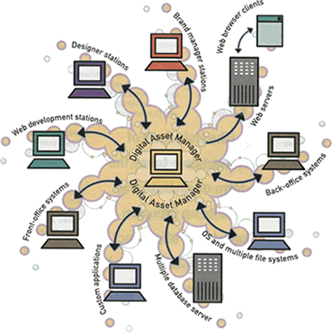
3. Asset Management
Objective:
Responsibility for assets
Information classification
Covers:
Inventory of assets
Ownership of assets
Acceptable use of assets
Classification guidelines
Information labelling and handling

Slide 36
Information Asset – (Sample)
Inventory of Information Assets are categorized & classified as below
Sr | Asset Category | Classification
1 | Paper Assets | Client Confidential
2 | Electronic Data | Company Confidential
3 | Hardware | Commercial in Confidence
4 | Software | Restricted
5 | People | Critical & Non Critical
Valuation of Information Assets – Scale
- Very High, High ,Medium ,Low , Negligible
Other Attributes of Inventory
- Asset Group, Asset Classification, Value, Storage Area, Storage location ,
- Asset Owner, Asset Retention, Remarks

Slide 37

4. Human Resource Security
Objective:
Prior to employment
During employment
Termination or change of employment
Covers:
Roles and responsibilities
Screening
Terms and conditions of employment
Management responsibilities
Information security awareness, education and training
Disciplinary process
Termination responsibilities
Return of assets
Removal of access rights

Slide 38
5. Physical and Environmental Security
Objective:
Secure Areas
Equipment Security
Covers:
Physical Security Perimeter
Physical entry Controls
Securing Offices, rooms and facilities
Protecting against external and environmental threats
Working in Secure Areas
Public access delivery and loading areas
Cabling Security
Equipment Maintenance
Securing of equipment off-premises
Secure disposal or re-use of equipment
Removal of property

Slide 39
6. Communications & Operations Management
Objective:
Operational Procedures and responsibilities
Third party service delivery management
System planning and acceptance
Protection against malicious and mobile code
Backup
Network Security Management
Media handling
Exchange of Information
Electronic Commerce Services
Monitoring
Covers:
Documented Operating procedures
Change management
Segregation of duties

Slide 40

6. Communications & Operations Management (contd..)
Separation of development, test and operational facilities
Service delivery
Monitoring and review of third party services
Managing changes to third party services
Capacity Management
System acceptance
Controls against malicious code
Controls against mobile code
Information backup
Network Controls
Security of network services
Management of removable media
Disposal of Media
Information handling procedures
Security of system documentation
Information exchange policies and procedures
Exchange agreements

Slide 41
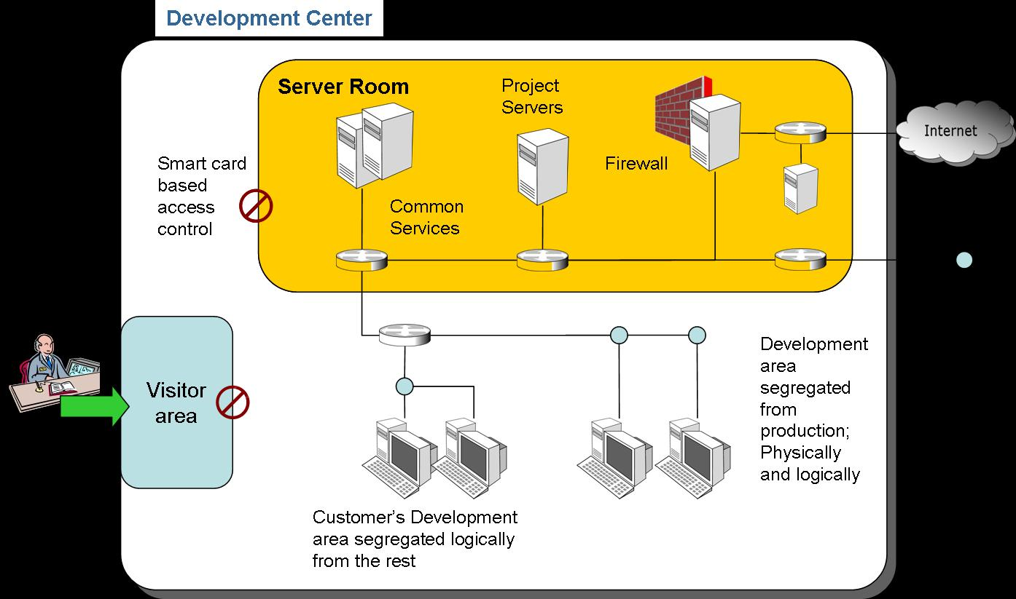
6. Communications & Operations Management (contd..)
Exchange agreements
Electronic Messaging
Business information systems
Electronic Commerce
On-Line Transactions
Publicly available information
Audit logging
Monitoring system use
Protection of log information
Administrator and operator logs
Fault logging
Clock synchronisation

Slide 42


7. Access Controls
Objective:
Business Requirement for Access Control
User Access Management
User Responsibilities
Network Access Control
Operating system access control
Application and Information Access Control
Mobile Computing and teleworking
Covers:
Access Control Policy
User Registration
Privilege Management
User Password Management
Review of user access rights
Password use

Slide 43
7. Access Controls (contd..)
Unattended user equipment
Clear desk and clear screen policy
Policy on use of network services
User authentication for external connections
Equipment identification in networks
Remote diagnostic and configuration port protection
Segregation in networks
Network connection control
Network routing control
Secure log-on procedures
User identification and authentication
Password management system
Use of system utilities
Session time-out
Limitation of connection time
Information access restriction
Sensitive system isolation
Mobile computing and communications
Teleworking

Slide 44
8. Information systems acquisition, development and maintenance
Objective:
Security requirements of information systems
Correct processing in applications
Cryptographic controls
Security of system files
Security in development and support processes
Technical Vulnerability Management
Covers:
Security requirements analysis and specification
Input data validation
Control of internal processing
Message integrity
Output data validation
Policy on use of cryptographic controls
Key management
Control of operational software
Protection of system test data

Slide 45
8. Information systems acquisition, development and maintenance (contd)
Access Control to program source code
Change control procedures
Technical review of applications after operating system changes
Restriction on changes to software packages
Information leakage
Outsourced software development
Control of technical vulnerabilities

Slide 46
9. Information Security Incident Management
Objective:
Reporting information security events and weaknesses
Management of information security incidents and improvements
Covers:
Reporting information security events
Reporting security weaknesses
Responsibilities and procedures
Learning from information security incidents
Collection of evidence

Slide 47
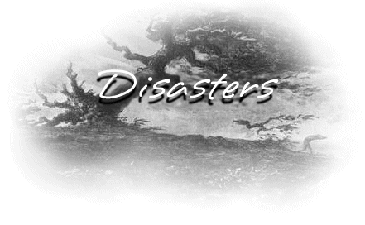
10. Business Continuity Management
Objective:
Information security aspects of business continuity management
Covers:
Including information security in the business continuity management process
Business continuity and risk assessment
Developing and implementing continuity plans including information security
Business continuity planning framework
Testing, maintaining and re-assessing business continuity plans

Slide 48
11. Compliance
Objective
Compliance with legal requirements
Compliance with security policies and standards, and technical compliance
Information Systems audit considerations
Covers:
Identification of applicable legislation
Intellectual property rights (IPR)
Protection of organizational records
Data protection and privacy of personal information
Prevention of misuse of information processing facilities
Regulation of cryptographic controls
Compliance with security policies and standards
Technical compliance checking
Information systems audit controls
Protection of information system audit tools

Slide 49
Compliance Management
Security
Policies
Company policies
Regulatory concerns
Contractual requirements
Distribution and awareness
Enforcement
Deterrence
Technology means
Clause 49
SOX
DPA
MSA
STRADA

Slide 50
FISMA – Federal Information Security Management Act

Slide 51
FISMA
Aftermath of 9 / 11 (2001) tragedy in USA, Congress passed and President signed, the e-Governance Act
Act recognized the importance of InfoSec to US economic and national security interests
Act requires federal agencies to develop, document and implement organization wide InfoSec programs to protect the CIA of information and systems that support the operations and assets of the organization

Slide 52
What is FISMA
Federal Information Security Management Act (FISMA) of 2002
Requires federal agencies to implement a mandatory set of processes, security controls and information security governance
FISMA objectives:
Align security protections with risk and impact
Establish accountability and performance measures
Empower executives to make informed risk decisions
NIST Special Publication
(SP) 800-53Technical guide to deploy appropriate controls
NIST risk management is at the core of FISMA

Slide 53
NERC – North American Electric Reliability Corporation

Slide 54
What is NERC
Federal Energy Regulatory Commission (FERC)
› The Federal Energy Regulatory Commission (FERC) is the United States federal agency with jurisdiction over interstate electricity sales, wholesale electric rates, hydroelectric licensing, natural gas pricing, and oil pipeline rates.
North American Electric Reliability Corporation (NERC):
› The North American Electric Reliability Corporation (NERC) is a not-for-profit international regulatory authority whose mission is to ensure the reliability of the bulk power system in North America.
Critical Infrastructure Protection Standards
› Standards for cyber security protection

Slide 55

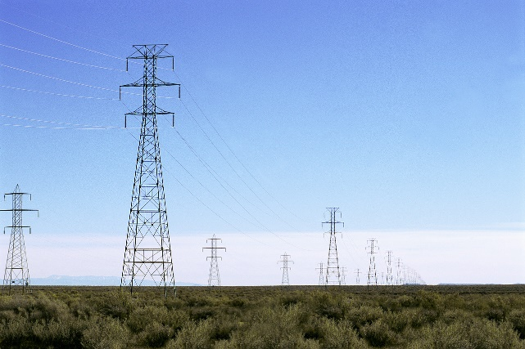
Purpose of NERC - CIP Cyber Security Standards (Critical Infra Protection)
Ensure that all entities responsible for the reliability of the Bulk Electric Systems in North America identify and protect Critical Cyber Assets that control or could impact the reliability of the Bulk Electric Systems.
Applicability
Generation Owner
Generation Operator
Transmission Owner
Transmission Operator
Load Serving Entity

Slide 56
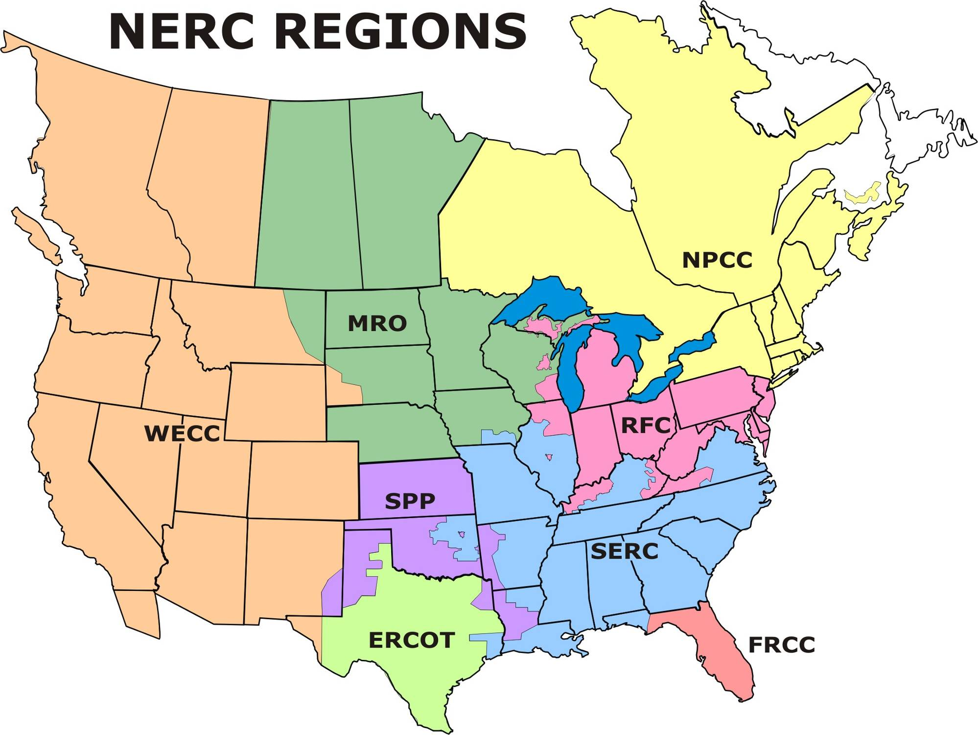
North American Electric Systems Overview
NERC is made up of eight regions that oversee the reliability and operation of the Bulk Electric System.
>All Electric Generation and Transmission agencies report to one of these regions.
SDG&E reports to the WECC, Western Area reporting agency,
>All regions must comply with NERC CIP 002-009 Standards.
Notes:
Larry
NERC’s map of Regions.
Slide builds with key points to address on right.

Slide 57
PCI – DSS (Payment Card Industry Data Security Standard)

Slide 58
Payment Card Industry Security Standard
Cyber crime is growing in diversity and sophistication
Integrated POS Systems are increasingly targeted
In most cases, magnetic stripe data is stolen from log files as opposed to traditional databases
Sensitive data is often unknowingly stored leading to risk
Hackers are targeting centralized servers with Internet connectivity, not just an e-commerce issue
SQL Injection is most common attack method

Slide 59



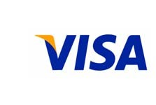








The PCI Security Standards Council Members

Slide 60
What is PCI DSS
Payment Card Industry Data Security Standard:
Guidelines for securely processing, storing, or transmitting
payment card account data
Established by leading payment card issuers
Maintained by the PCI Security Standards Council (PCI SSC)

Slide 61


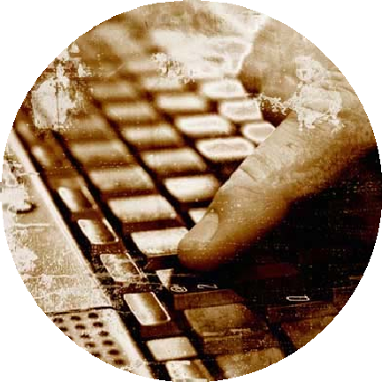
Top 5 Reasons for Account Data Compromise
Based on MasterCard Forensics Examinations of Hacked Entities
#1
Ineffective Patch Management
#2
#3
No Security Scanning
Weak Network Level Security
#4
#5
SQL
Injection
Lack of Real Time Security Monitoring
13 November 2007

Slide 62
PCI Compliance Levels
Category | Criteria | Requirements | Compliance Date
Level 1 | Merchants >6 MM annual transactions (all channels) All TPPs All DSEs storing data for Level 1, 2, 3 All compromised merchants, TPPs and DSEs | Annual Onsite Audit ¹ Quarterly Network Scan | 30 June '05 ²
Level 2 | All merchants > 1 million total MasterCard transactions < 6 million total MasterCard transactions annually All merchants meeting the Level 2 criteria of a competing payment brand | Annual Self-Assessment Quarterly Network Scan | 31 December 2008
Level 3 | All merchants with annual MasterCard e-commerce transactions > 20,000 but less than one million total transactions All merchants meeting the Level 3 criteria of a competing payment brand | Annual Self-Assessment Quarterly Network Scan | 30 June '05
Level 4 | All other merchants | Annual Self-Assessment Quarterly Network Scan | Consult Acquirer
TPPs and DSEs must use a certified third party to perform the onsite audit
TPPs and DSEs were previously required to completed quarterly scans and self-assessments by 30 June 2004

Slide 63
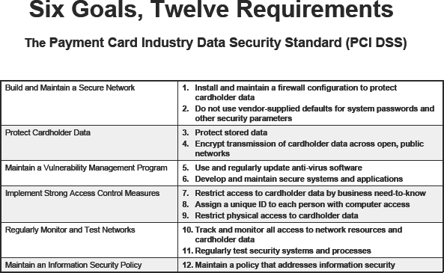

Slide 64
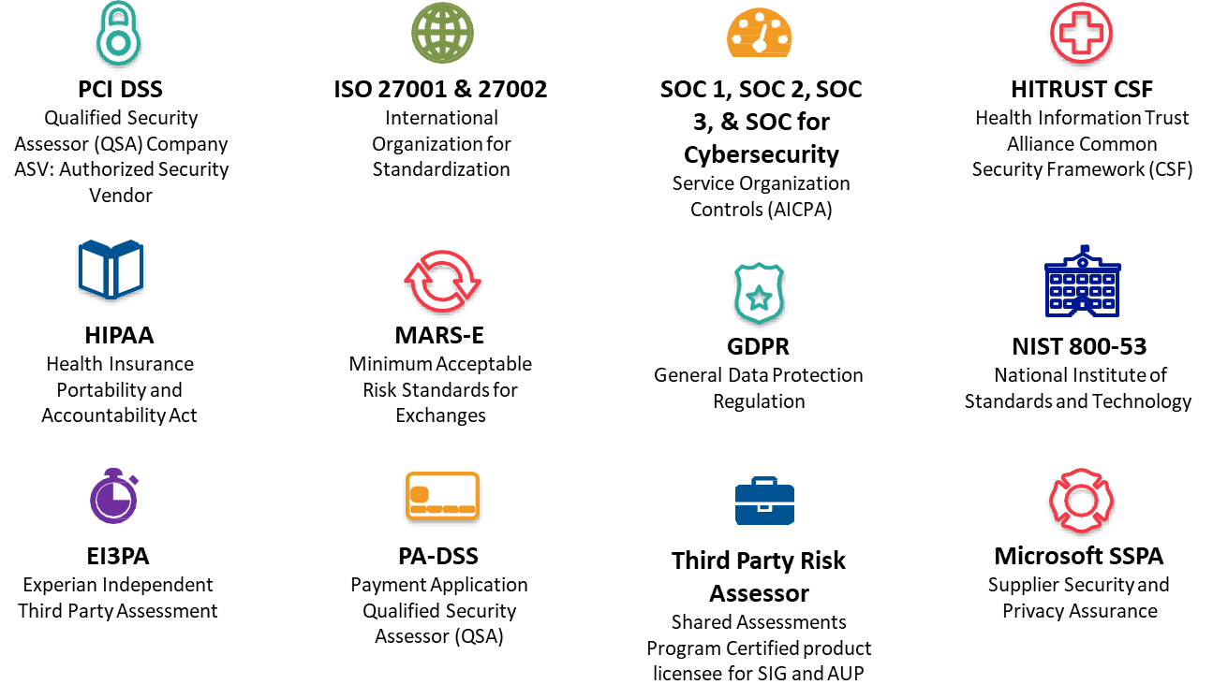
Compliance Domains…

Slide 65



