Slide 1
Straight or Skew? A new puzzle
Zhi (Richie) Li , NetID: zhil7

Slide 2
Outline
Introduction
Demo and Play
Methods
Algorithm Analysis
Performance Measurement
Game Balance
Summary and Future Works

Slide 3
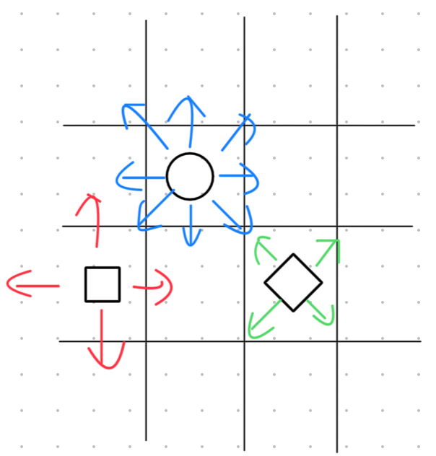
Introduction
This is a game that I might have invented myself. I was inspired by the Play Station controller, which contains different shapes of buttons, and also by lots of square grid puzzles.
Players play on an NXN grid with numbers on the sides, just as we did in "Undead", but now players place squares, diamonds, and circles in the cells. A square can be seen straight, a diamond can be seen diagonally, and a circle can be seen in either direction, as shown in the following picture.

Slide 4
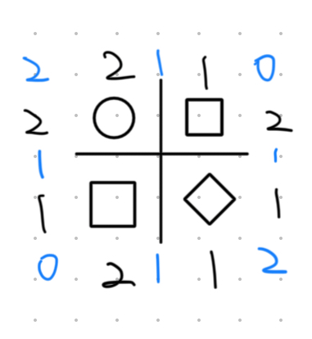
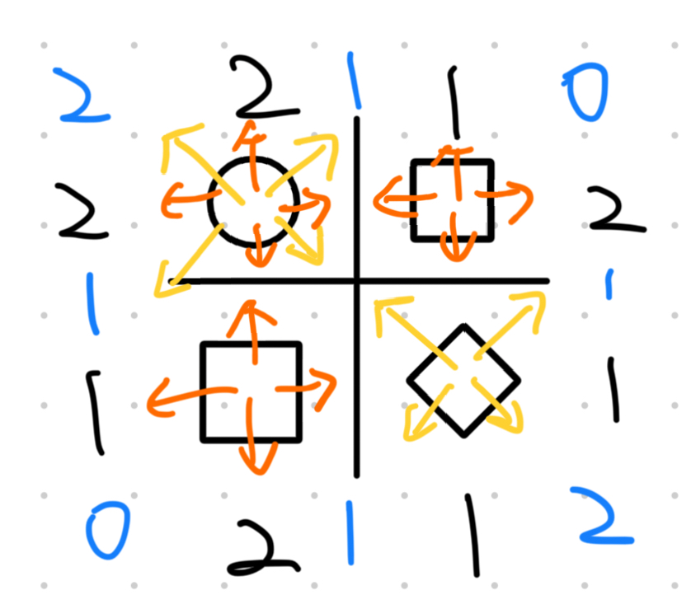
Introduction
Note that instead of 4n views (n=length of the grid), we have 8n views because we now have the skewed direction that ends differently than the straight ones. As shown in the third picture, the orange arrows point to black numbers, and the yellow arrows point to blue numbers.

Slide 5
Demo and Play
Let me show the game on my iPad
You will also be playing one later!

Slide 6
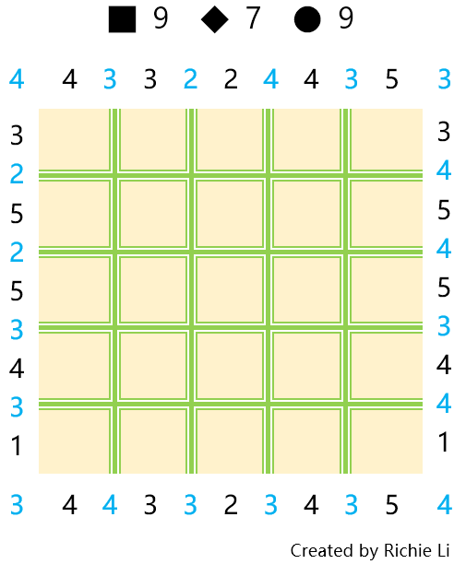
Methods – Data Structures
Counter: dictionary
Clues: lists in each direction
Straight (2)
Oblique (4)
Grid: 2D object list
Cell: row, col, shape

Slide 7
Methods – Algorithms
What do we need to calculate when solving or generating the puzzle?
General
Is the board full?
Place a shape into the grid
Is the puzzle valid?
Modifying the clues

Slide 8
Methods – Algorithms
Solving:
Finding Solutions
What cell should we choose to place which shape, brute force*
Backtracking
If we did not successfully place a shape, go back and retry the last move, recursively
Generating:
Randomly pick shapes to form a unvalidated puzzle
Solve it to see if we should regenerate

Slide 9
Algorithm Analysis
def is_valid(self, Cell) -> bool:
Checks if a placement is valid
Modifies the shape of a cell (as if we were putting a shape into the grid)
Add 1 to edge clues that are affected
Square, Diamond: 4 edges
Circle: 8 edges
Time complexity: O(4n) or O(8n) ~ O(n); n = size of the grid

Slide 10
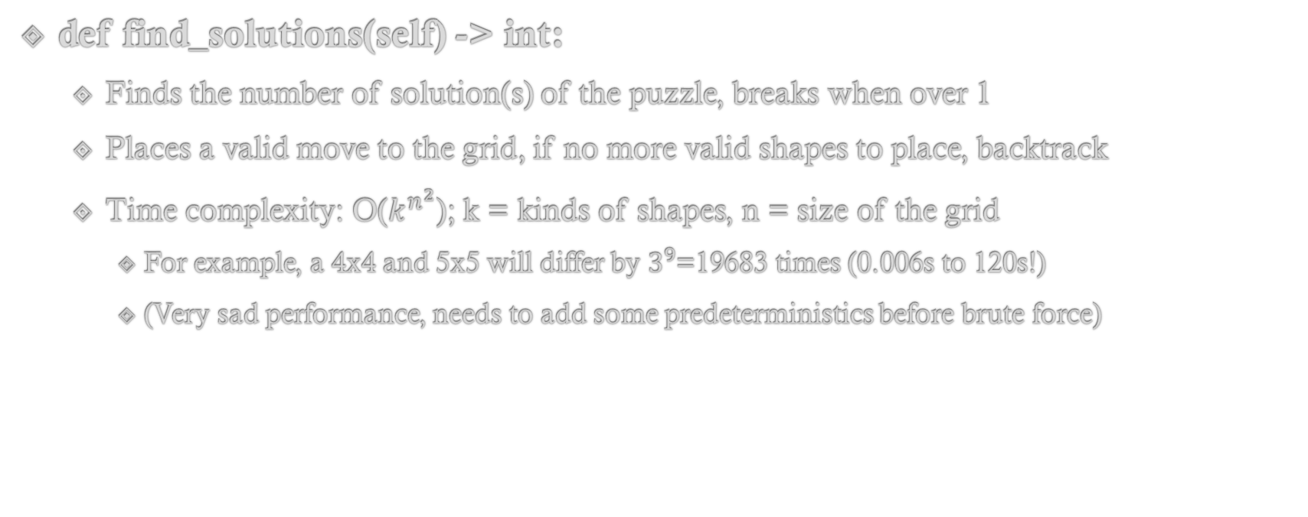
Algorithm Analysis
def find_solutions(self) -> int:
Finds the number of solution(s) of the puzzle, breaks when over 1
Places a valid move to the grid, if no more valid shapes to place, backtrack
Time complexity: O($k^{n^{2}}$); k = kinds of shapes, n = size of the grid
For example, a 4x4 and 5x5 will differ by $3^{9}$=19683 times (0.006s to 120s!)
(Very sad performance, needs to add some predeterministics before brute force)

Slide 11
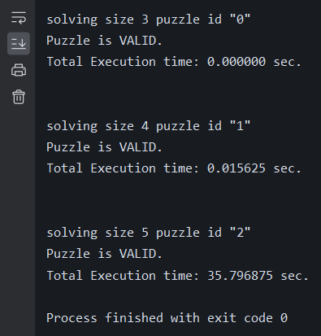
Performance Measurement
Comparing the solving speed of 3x3, 4x4, 5x5
3x3 and 4x4 are solved immediately, while
5x5 took half a minute!!
Whose taking up the time?

Slide 12
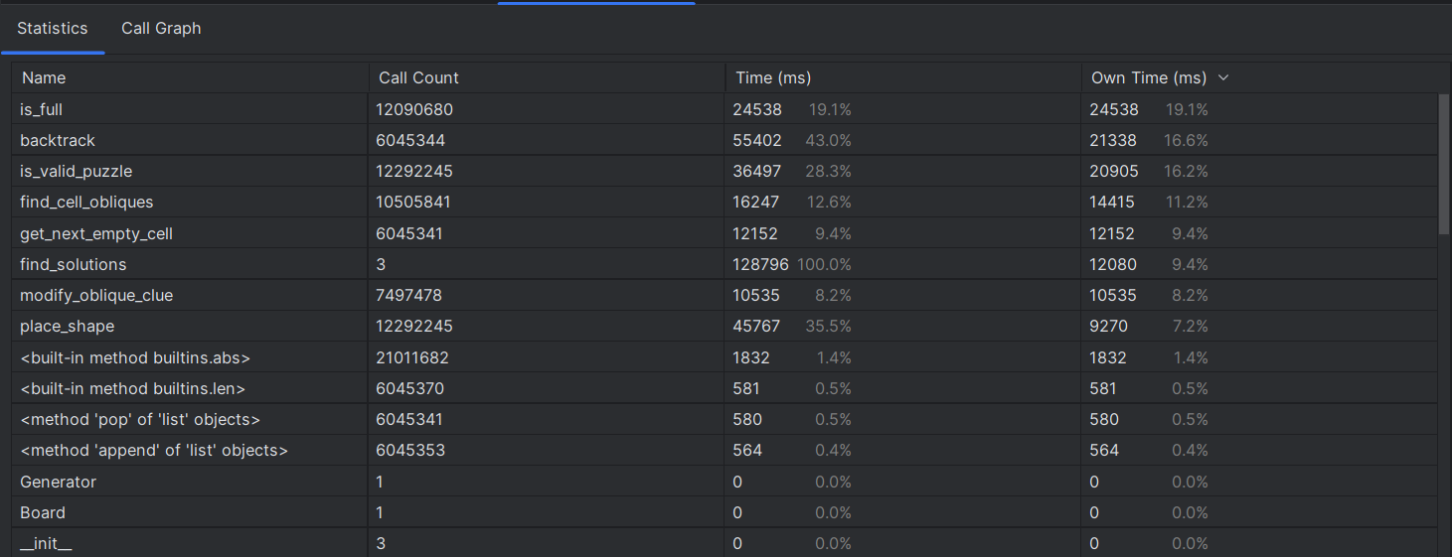
Performance Measurement
12m
6m
12m
10m
6m
7m
12m

Slide 13
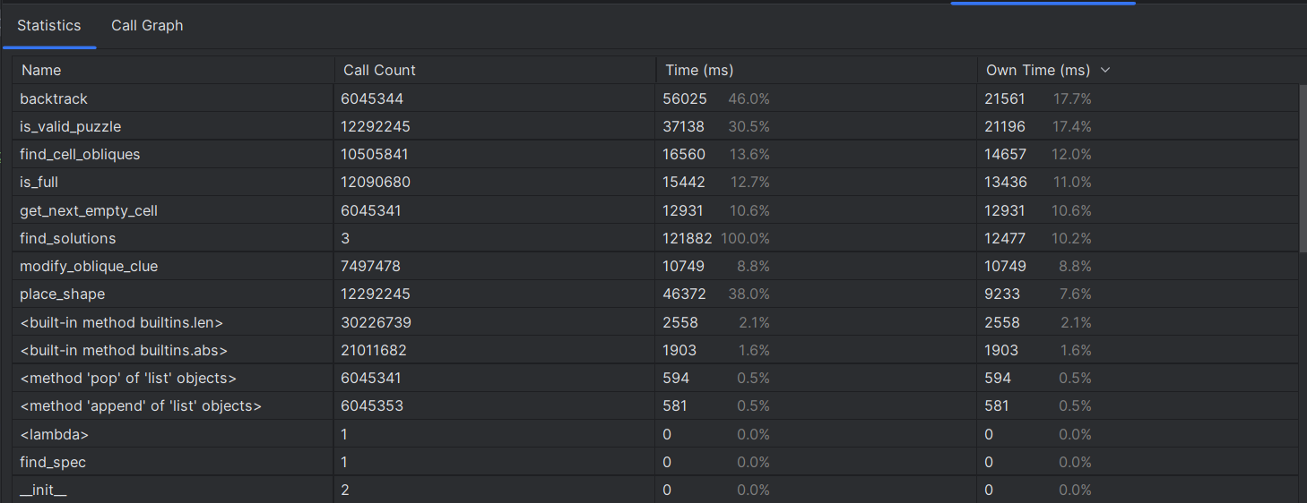
Performance Measurement
After optimizing the is_full function..
24.538s →13.436s (11.102s faster) in a total runtime of 120s

Slide 14
Summary and Future Works
Coming up with an original puzzle wasn't that hard, but it was difficult to design a balanced one
The need of classifying which is easy and which is hard (Future Work)
The diagonal lines might not be intuitive as it seems
As we did in undead, the generation time of a bigger puzzle rises a lot when increasing size
So I stored the created puzzle for later use
Come up with a better solver other than brute force solving
Maybe creating a GUI to make it easier to let users access the game
For example, they can click to insert shapes or click "GIVE ME A CLUE, IT'S TOO HARD"

Slide 15
References
Undead from Simon Tatham's Portable Puzzle Collection
www.chiark.greenend.org.uk/~sgtatham/puzzles/js/undead.html
Previous Assignments
Documents of Python modules

Slide 16
Thank you for your attention

