Slide 1
[Document Title]
NOTICE
The information contained in this document is not to be used for any purpose other than the purposes for which this document is furnished by GENPACT, nor is this document (in whole or in part) to be reproduced or furnished to third parties or made public without the prior express written permission of GENPACT.
Version Control
Version No. | Date | Type of Changes | Owner/ Author | Date of Review/Expiry

Slide 2
Ghost Hunting – Inconsistent Data Issue

Slide 3
API Analysis

Slide 4
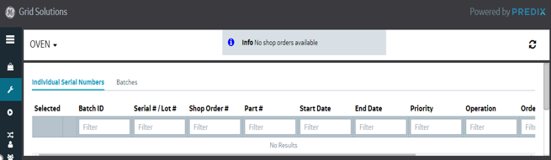
Application Name: MES
Issue Statement: On selecting any Plant from Operator Workflow tab some times users get data populated and some time its shows unavailability with information “No Shop orders available”.
User Cases:
Selecting any plant from Operation Workflow, sometimes User get data populated
While another time, when user select the same plant, the data is loaded over the page and showed the information as respective data.

Slide 5
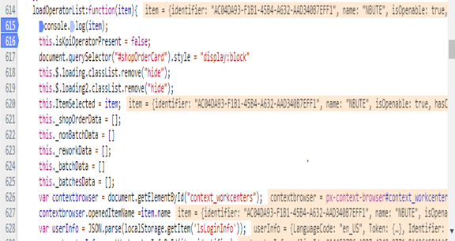
Our Analyses:-Flow of Application:
We found that “On selecting any plant an event handler (Event: Click) is called “
Note: Line #: 513 in operatorsworkflow view.html.html
This future calls the displayOperatorListData function which internally call’s loadOperatorList function which takes item as parameter which is the plant that we selected as an object.
********************************************************************
itemOpenHandler: function(item) {
_this.goBack = false;
localStorage.removeItem("isNonBatched");
_this.displayOperatorListData(item);
_this.$.context_workcenters.querySelector("px-context-browser-typeahead").clearSearchTerm();
}
*********************************************************************
Here item is parameter which user select as plant as an object
Item: {identifier: "650033A7-9E88-440A-B9A5-A484F583030E", name: "OVEN", isOpenable: true, hasChildren: false, selectedAsset: true, …
}
loadOperatorList: function (item) {
console.log(item);
this.isKpiOperatorPresent = false;
document.querySelector("#shopOrderCard").style = "display:block"
this.$.loading.classList.remove("hide");
this.$.loading2.classList.remove("hide");
this.clockActionEnabled = true
this.ItemSelected = item;
this._shopOrderData = [];
this._nonBatchData = []
this._reworkData = [];
this._batchData = []
this._batchesData = [];
this.opListResponseComplete = false

Slide 6
This function is responsible for API calls that are triggered on selecting the plant.
********************************************************
else {
var ironAjax = document.getElementById("requestShopOders");
var params = {
"name": "/Workcenter/Operator",
"namespace": "/ShopOrders",
"paramnames": "workcenter,operator,language",
"paramvalues": item.identifier + "," + userInfo.Identifier + ",en_US"
}
ironAjax.params = params;
ironAjax.headers = this.getHeaders();
ironAjax.generateRequest();
localStorage.setItem("workcenterParamValues", JSON.stringify(params));
localStorage.removeItem("BatchParamValues");
if (item.details.isBatchingEnabled) {
var ironAjaxBatches = document.getElementById("retrive_BatchesTab");
var paramsBatches = {
"name": "/Operations/Batch/All",
"namespace": "/ShopOrders",
"paramnames": "workcenter,user",
"paramvalues": item.identifier + "," + userInfo.Identifier }
ironAjaxBatches.params = paramsBatches;
ironAjaxBatches.headers = this.getHeaders();
ironAjaxBatches.generateRequest();
localStorage.setItem("BatchParamValues", JSON.stringify(paramsBatches));
} }
************************************************************

Slide 7
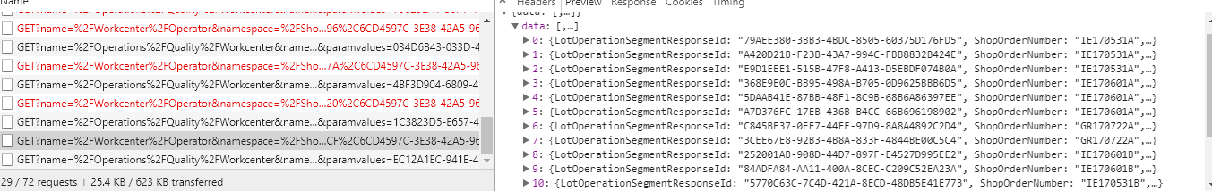
API Details
There are two API calls that are happening:
https://vdcglq05530.ics.cloud.ge.com:8443/ProxyService/GET?name=/Workcenter/Operator&namespace=/ShopOrders&paramnames=workcenter,operator,language&paramvalues=AC04DA93-F1B1-45B4-A632-AAD340B7EFF1,41A7A10E-1201-40B1-93CA-4525E7BE58E9,en_US
Here the first param value is item.identifier and other is userinfo.identifier , this return the list of lotoperation data
while the second API calls the workcenter details.
https://vdcglq05530.ics.cloud.ge.com:8443/ProxyService/GET?name=/Operations/Quality/Workcenter&namespace=/ShopOrders&paramnames=workcenter&paramvalues=AC04DA93-F1B1-45B4-A632-AAD340B7EFF1
We found that for these Ajax call the Polymer component used (Iron-Ajax) has a success and failure function which depending on the response of the API are triggered.

Slide 8
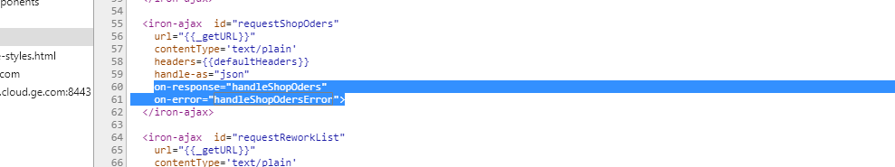
On Success we call handleShopOders function while on error we call handleShopOdersError function. HandleShopOrders function iterates the response and create the table
_{For example the response is}

Slide 9
This is iterated here to create the response table with detail and icons.
Where as on error condition we show a generic error message irrespective of error type.
handleShopOders: function (e) {
// var usersResponse = data.detail.__data__.response;
var data = e.detail.response.data;
this._shopOrderData = [];
this._nonBatchData = []
this._batchData = []
for (var i = 0; i < data.length; i++) {
var node = data[i];
node.id = i;
node.isSelected = false
node.iconElement = this.getIconTextItem(false, this._getIcon(node.Icon));
node.selectSerialElement = this.getSerialInputCheckboxItem(false, node.id, "serialElement")
node.BatchIdElement = this.getIconSerialTextItem(false, ((node.BatchId == null) ? this._labels.notbatchedLabel : node.BatchId), node.BatchId);
node.SerialLotNumberElement = this._getLink(false, i, node.LotOperationSegmentResponseId, node.SerialLotNumber);
node.SerialLotNumberElementNonBatch = node.SerialLotNumber
node.ShopOrderNumberElement = node.ShopOrderNumber
node.PartNumberElement = node.PartNumber
node.startDateElement = node.StartDate
node.endDateElement = node.EndDate
node.CompletedQuantity = new Number(node.CompletedQuantity);
node.Priority = new Number(node.Priority);
node.LotQuantity = new Number(node.LotQuantity);
node.OrderQty = new Number(node.OrderQty);
handleShopOdersError: function(e){
var _this = this;
// var usersResponse = data.detail.__data__.response;
this._shopOrderData = [];
this._nonBatchData = []
this._batchData = []
this.$.loading.classList.add("hide");
this.message = this._labels.handleShopOdersError;
this.$.alert_message.classList.remove("hide");
setTimeout(function() {
_this.$.alert_message.classList.add("hide");
},5000);
return;
},

Slide 10
Function Name: setClockOn
Function Name: validateBatched
setClockOn(){
this.$.offButton.classList.remove("clockActive");
this.$.offButton.classList.add("clockInactive");
this.$.onButton.classList.remove("clockInactive");
this.$.onButton.classList.add("clockActive");
this.$.comments_btn.disabled = false;
this.$.comments_btn.classList.remove("btn-disabled");
if(this.isPickingStation)
this.validatePickingMissing();
else{
this.$.completeAllButton.disabled=false;
this.$.completeAllButton.classList.remove("btn-disabled");
}
this.$.ncrButton.classList.remove("btn-disabled");
this.$.ncrButton.disabled=false;
var recordButton = document.querySelector("#recordButton");
if(recordButton!=null){
//recordButton.classList.remove("btn-disabled");
recordButton.disabled=false;
var recordBtn = document.querySelector("#recordBtn");
recordBtn.classList.remove("btn-disabled");
recordBtn.disabled=false;
}}
**************************************************************************** So after every 3000 ms after the API are called our setClockOn/setClockOff function gets called which changes the DOM specific to ON/Off button.
If at particular scenario the response from API is slow the function(setClockOn) to update the class over the button hangs. This might be the reason of the problem.
validateIsBatched:function(){
if(this.orderDetail.batchId != "not-batched"){
this.async(function(){
document.getElementById("ncrButton").disabled = true;
document.getElementById("ncrButton").classList.add("btn-disabled");
this.disableOrderDetailButtons();
this.validateNcrIcon();
})
return true;
} else{
var _this = this;
this.async(function(){
var recordBtn = document.getElementById("recordBtn");
if(recordBtn != null){
recordBtn.disabled = false;
recordBtn.classList.remove("btn-disabled")
}
document.getElementById("offButton").disabled = false;
document.getElementById("offButton").classList.remove("btn-disabled")
document.getElementById("onButton").disabled = false;
document.getElementById("onButton").classList.remove("btn-disabled")
document.getElementById("pauseButton").disabled = false;
document.getElementById("pauseButton").classList.remove("btn-disabled")
document.getElementById("comments_btn").disabled = false;
document.getElementById("comments_btn").classList.remove("btn-disabled");
document.getElementById("ncrButton").disabled = false;
document.getElementById("ncrButton").classList.remove("btn-disabled");
_this.isClockOn();
_this.validateNcrIcon();
})
*************************************************************************** This function again is calling isClockOn function.

Slide 11
Recommendation
UI END :
Setting a Flag which is set to true once setClockOn function is executed once so to put a check if the flag is false then only execute the function .This will be helping to render the ON/OFF clock button class once.
Remove the setClockOn function from the setInterval loop so the function would not be called after every 3000ms.
API END:
Instead of calling all 3 API after every 3000 ms we can create a micro service which will return a check if there is any change in LotOperation data this service will return a flag true or false if there is a change in data we will receive true from service then only we can call the 3 API.
For debugging at API level:
We are planning to set logs at API layer at start and end point of micro service, So that on the basis of it, we can check how much time API is taking to fetch data from DB and then sending it to UI layer.

Slide 12
Database Analysis for splocal_clockOnOperations Procedure Execution

Slide 13
Execution Pattern for 16-May-2018

Slide 14
Execution Pattern for 04-Jun-2018

Slide 15
Execution Pattern for 05-Jun-2018

Slide 16
Execution Pattern for 06-Jun-2018

Slide 17
Action Plan
Analyze the API code to put for debug level message to identify the exact layer of issue.
Analyze the database server logs shared by DBA team to identify the reason for high execution time of procedure in few scenarios
Identify if there is high memory usage or any maintenance job getting executed in database at times when issue is faced.
Analyze the procedure code to understand if any queries is having issue which impacts it execution in few scenarios.
Get higher level of logging enables at database server for root cause analysis
Complete the API setup in meeting scheduled with Kevin for 08-Jun-2018.
Roadblocks:
UI and API local setup is in progress for further analysis.
Logs received from DBA Team to be converted to readable format.
Production database server access for doing monitoring of memory and other activities going on in server.
Feasibility of enabling Profiler execution on Production database.

Slide 18
Issue Activity Log :
# | Activity Description | Date & Time Stamp
1 | Mail with basic details of issue reported | 02-Jun-2018 12:56 AM IST
2 | Team started analyzing the logs and tried to related with issue details mentioned | 04-Jun-2018 2 PM to 8 PM IST
3 | Meeting with Roberto to undertand exact issue faced and steps to be followed to try simulating the issue | 04-Jun-2018 8:00 PM IST
4 | Received the QA Environment details to try out steps and simulation of issue from Roberto | 04-Jun-2018 9:00 PM IST
5 | Team re-started analyzing the logs and tried simulation of issue in QA Env | 04-Jun-2018 10:00 PM IST
6. | No Relevant information found in API Logs post analyzing the logs | 05-Jun-2018 04:00 PM IST
7 | Tried simulating the issue but the issue couldn’t be replicated in QA Environment. | 05-Jun-2018 07:00 PM IST
8 | Observed the high frequency calls of API and multiple calls to On Clock Function | 05-Jun-2018 09:00 PM IST
9 | Shared the API level analysis and few other observations/queries with Roberto & Avi | 06-Jun-2018 12:06 AM IST
10 | Received response from Roberto about queries that there is not defined time & pattern of this issue occurrence | 06-Jun-2018 12:08 AM IST
11 | Avi responded on our observation about API that the frequent API call is for data retrieval on a fixed time interval basis and to analyze further if the high frequency could be cause of issue in Clock on & Off | 06-Jun-2018 08:00 AM IST
12 | Analyze the database logs for 16-May and observed high execution time for procedure called during Clock on Operation in some cases | 06-Jun-2018 04:00 PM IST
13 | Meeting with Jesus to check the database connection and analyze the database procedure further | 06-Jun-2018 07:00 PM IST
14 | Windows Authentication configured on database server didn’t work as Team is using Genpact Credentials to login | 06-Jun-2018 07:30 PM IST
15 | Jesus requested for SQL server authentication for Sriram, Pradeep , Neeraj & Abhishek to Roberto | 06-Jun-2018 07:52 PM IST

Slide 19
Issue Activity Log :
# | Activity Description | Date & Time Stamp
16 | Received document from Jesus with steps to raise ticket with DBA team for any request | 06-Jun-2018 07:21 PM IST
17 | Vinod observed one serial during debugging for which ON button was not happening/taking long time and share the same analysis with Roberto & Avi in follow up meeting | 06-Jun-2018 08:30 PM IST
18 | During meeting it was found that the issue for this serial number was due to status change of that particular serial number | 06-Jun-2018 08:45 PM IST
19 | Analysis related to database procedure taking time in few cases was shared for 1 days logs | 06-Jun-2018 08:50 PM IST
20 | Decided to analyze the database logs for few more days to find out some pattern and analyze further the API and prepare the document for same | 06-Jun-2018 09:00 PM IST
21 | Avi shared the contact person for doing the local setup by our team Required for further analysis & Simulation of issue | 06-Jun-2018 10:38 PM IST
22 | Received the database & API logs for 04-Jun, 05-Jun & 06-Jun | 06-Jun-2018 10:00 PM IST
23 | Analysis of database logs for execution time of procedure called at CLOCK ON operation | 06-Jun-2018 10:15 PM IST
24 | Requested the GitHub Repo Access for doing the code setup | 07-Jun-2018 12:20 AM IST
23 | Completed the analysis of database logs manually | 07-Jun-2018 07:00 PM IST
24 | Created the document with analysis of API level issue observed along with recommendation | 07-Jun-2018 07:00PM IST
25 | Meeting with Roberto & Avi for further discussion about analysis/observations | 07-Jun-2018 08:30 PM IST
26 | Analysis of database high execution at same time (~ 1 PM ) on 05-Jun & 06-Jun and document prepared for API analysis shared | 07-Jun-2018 08:45 PM IST
27 | Requested database server logs for analyzing the issue of high execution time of procedure on 05-Jun & 06-Jun | 07-Jun-2018 09:30 PM IST
28 | Jesus share the steps to requested database server access to extract application logs and created SQL Server authentication credentials for database access | 07-Jun-2018 09:30 PM IST
29 | DBA team shared the logs but not in readable format , so requested them to share the readable format | 07-Jun-2018 11:00 PM IST
30 | Meeting with Leo for doing UI code setup | 07-Jun-2018 10:00 PM IST

Slide 20
Database Changes
(Implemented, Under Process, To be Discussed)

Slide 21
Proposed & Implemented
Changed Server memory from 16 GB to 64 GB and allocated 32 GB to Clearwater SQL Instance from 6 GB, which is an addition of 26 GB for SQL Server.
Changed SOADB file/s auto growth to 512 MB for both data and log files in contrast to 1 MB and 10% growth for database and log files.
Changed the Index and stats maintenance jobs to run for every 8 hours, which was earlier configured to run every 4 hours. Current schedule as follows:- Runs every 8 Hours starting 11 AM.
Move the instance (VDCGWP03012.logon.ds.ge.com\ENSQLOLTPO06) belonging to energy connections to separate server.
Once the third instance is moved out need to re-evaluate the file locations to separate tempdb files and User Database files, furthermore the user databases data files and log files should also be moved to separate drives
Note: This can be implemented without the movement of the third instance however this requires adding drives to server.
2. Need to trace few events to see if we have any issues during the clock on operation. This can be done if the issue doesn’t resolve after implementing the aforementioned changes.
Implementation Pending - In Under Discussion
Pending Proposal-(TBD)

Slide 22
Thankyou

