Slide 1


Safety
5041 CyBear Robotics
1/16/2025

Slide 2

Rules
When working with tools and the robot
Wear all proper PPE
Tie back long hair
Roll back long sleeves
Take off any hanging jewelry/wristwatches/rings that can get caught in moving machinery
General
No horse play, especially around moving machinery or a powered robot
Keep walkways uncluttered and keep tools/robot/etc out of the way of doors
Know where the First-Aid Kit is at all times
Keep food and beverages away from work areas, the robot, and tools

Slide 3

Working With the Robot
You must do ALL above rules as well
Wear all proper PPE
No horse play
Do not work on the robot when it is connected to a charged battery
Stay out of the way of moving parts, i.e, swinging arm, extending arm, turning wheels, spinning parts
Keep body parts away from moving parts, i.e, fingers or hands away from gears and wheels
When lifting the robot, have assistance from at least one other member, and always know (and let everyone else know) where the robot is being moved. Make sure parts are secured, and the power is off.

Slide 4
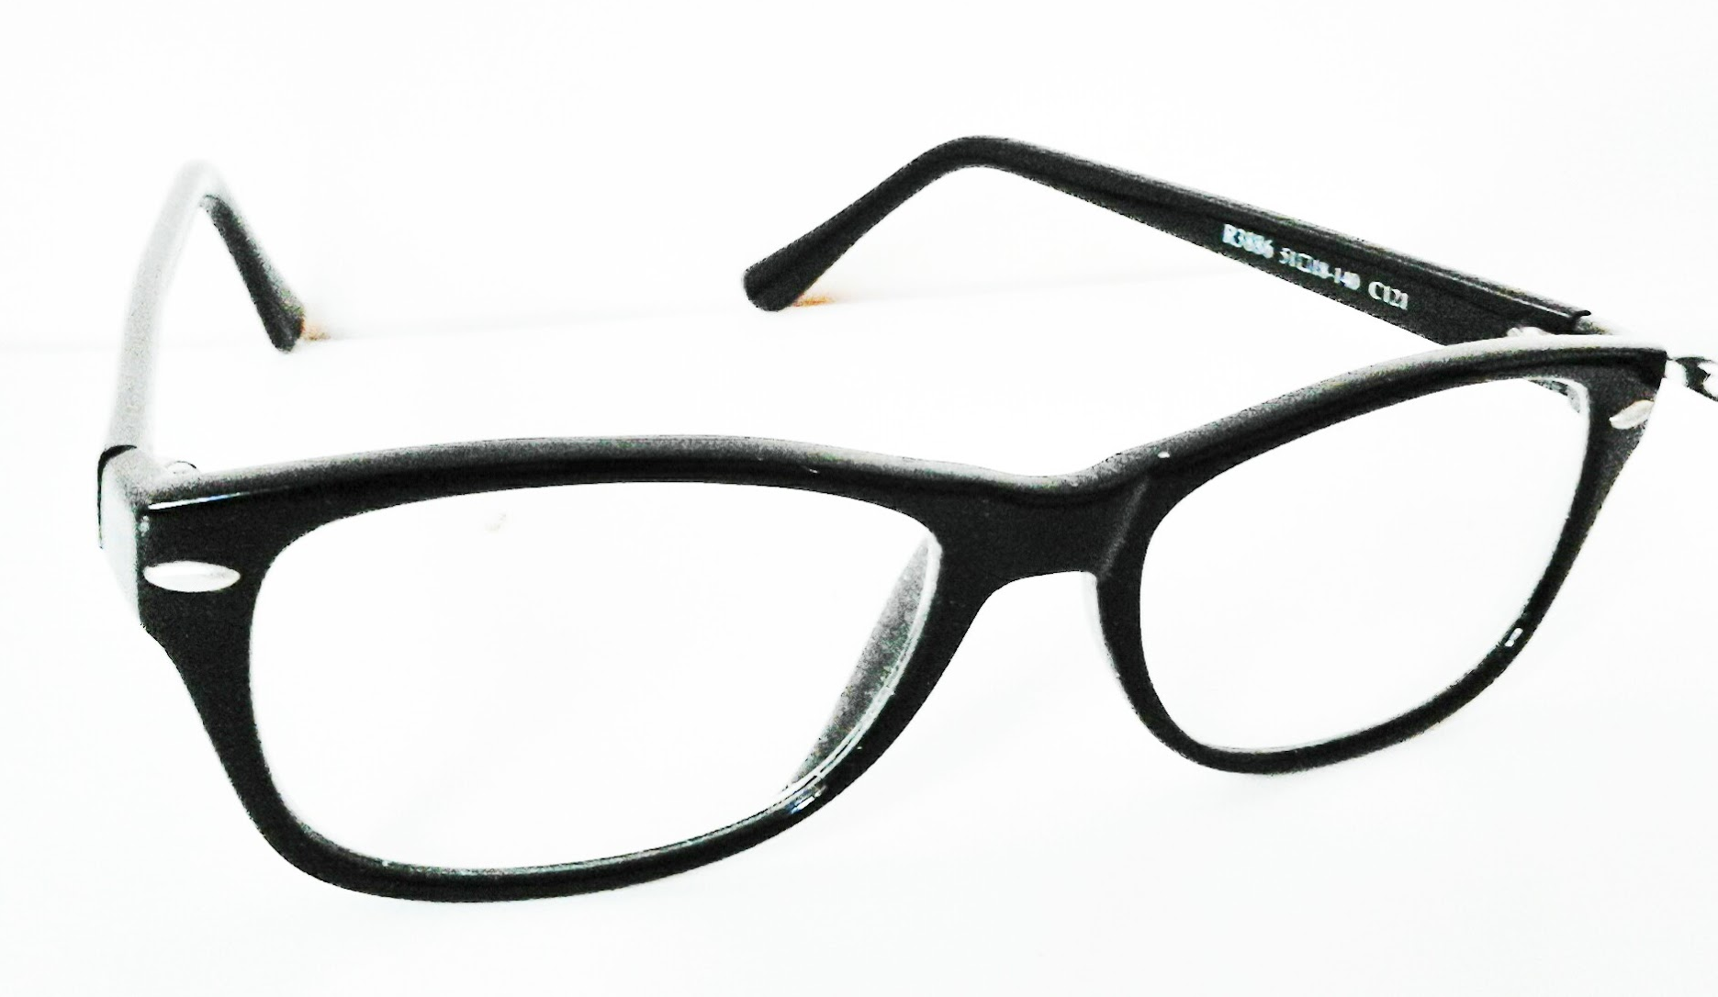
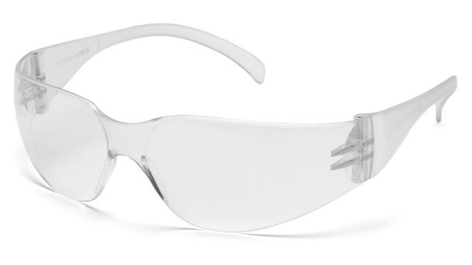
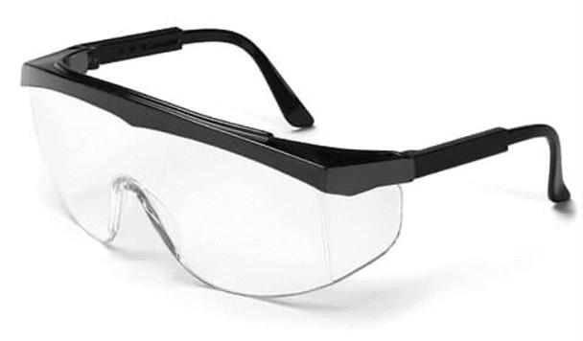
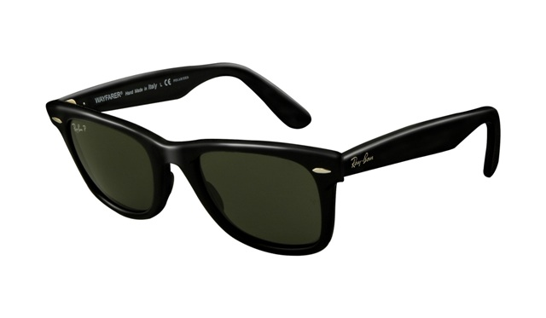


PPE: Safety Glasses
Safety Glasses are ALWAYS required when in the vicinity of or when using ANY and ALL power tools or a powered robot (Even if not enabled!)
At events, safety glasses are worn at ALL times when in the pits and on the field. Drive Team and Media must wear safety glasses
Safety glasses must be approved. No regular prescription/reading glasses or sunglasses!

Slide 5
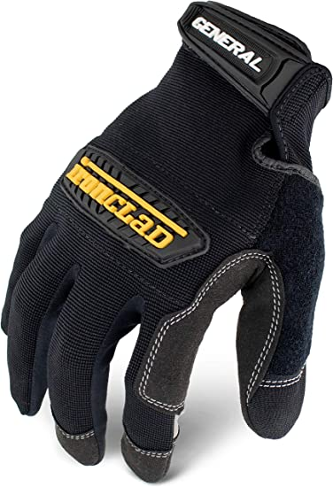
PPE: Gloves
Wear gloves if you are dealing with hot materials, i.e, grinded/cut/welded metal
Wear when welding
Wear when using Heat Gun

Slide 6
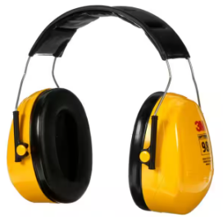
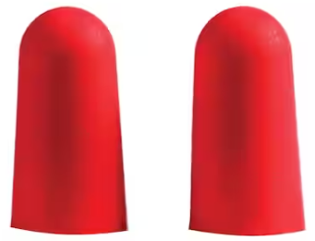
PPE: Ear Protection
Required for loud machinery, i.e, Miter Saw, Bench Grinder, Table Saw, etc
Recommended for louder hand held power tools, i.e, Angle Grinder, Jigsaw, Air Compressor,

Slide 7
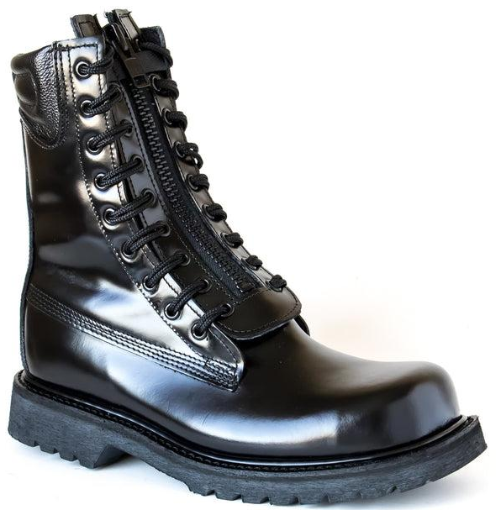
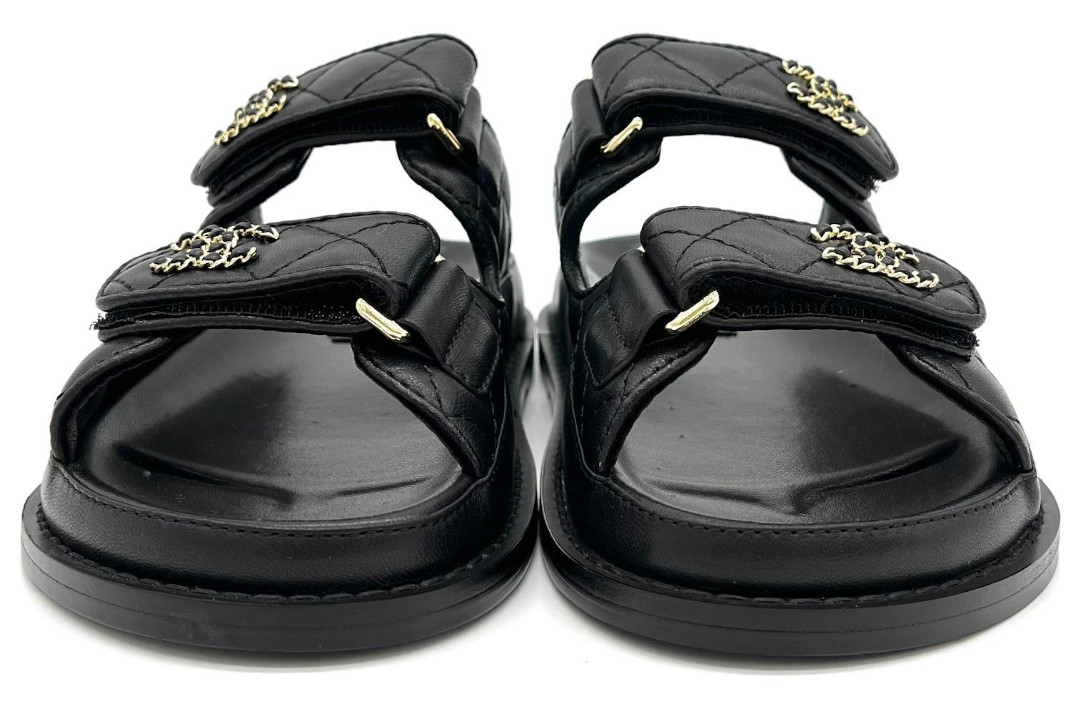
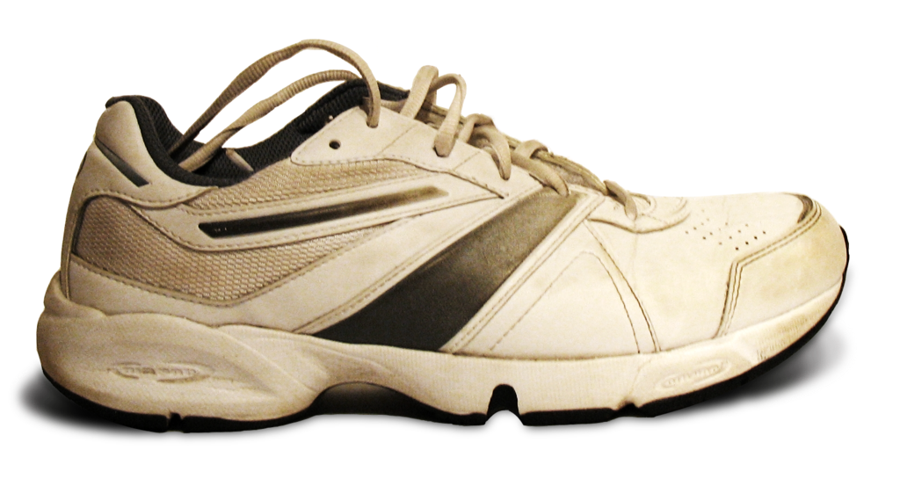
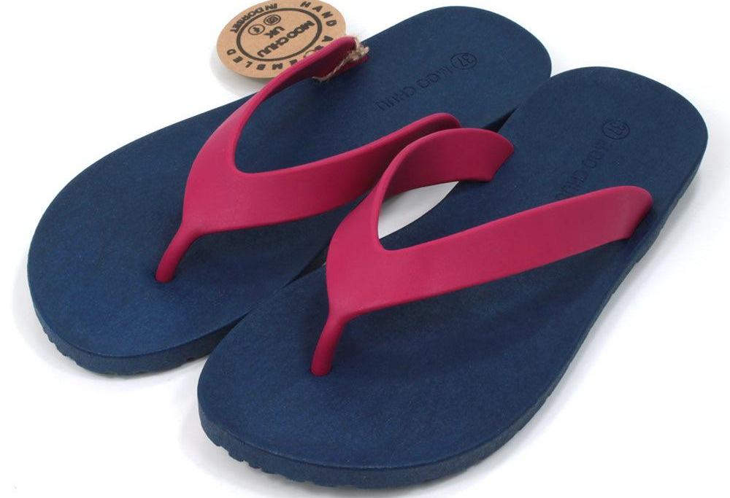
PPE: Foot Protection
Boots, Steel Toes, and closed toed sneakers required at all times
Flip Flops, Hey Dudes, Sandals, etc, are not proper foot protection

Slide 8
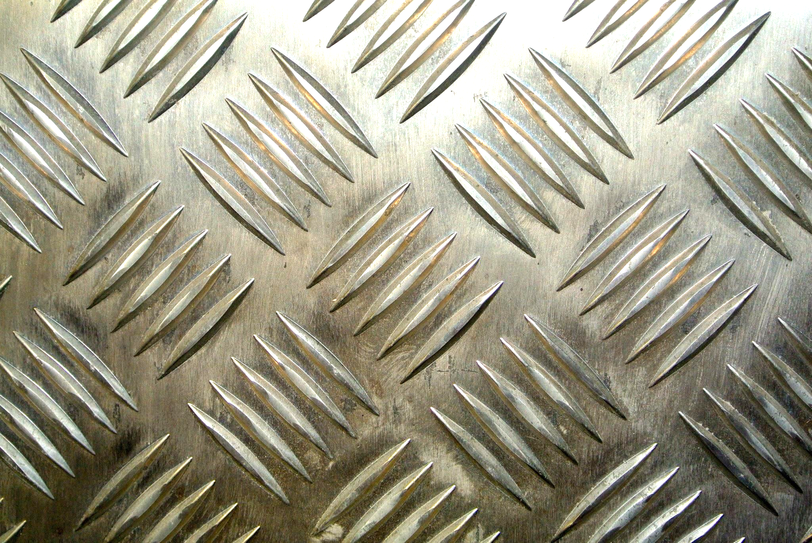
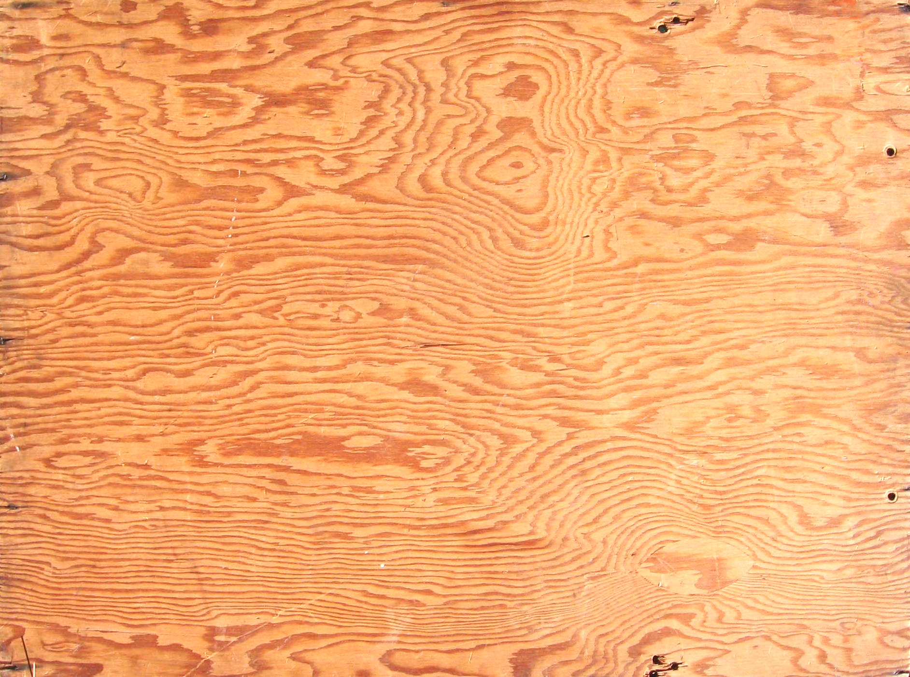
Building Materials
Be sure that all materials are free of hazards, i.e, splinters, sharp edges, cracks, etc
When carrying materials, never take more than you can lift. Take multiple trips and ask for help

