Slide 1


Tool Safety
5041 CyBear Robotics
1/16/2025

Slide 2

General Rules
A mentor must be present when using power tools
Wear proper PPE
Roll up long sleeves
Tie back long hair (to the shoulders or more)
Remove hanging/dangling jewelry
Make sure all safeguards are in place
Clean up your work area when you are finished
If you encounter a problem, notify a mentor or your Safety Captain

Slide 3
Hand Tools
Use the correct tool for the job
Don’t use a wrench as a hammer, or a screwdriver/exacto knife as a chisel
Do not use broken or damaged tools
Splintered wood handle
Loose handle
Damaged cords on wired power tools
Cracked battery on power tools
Cracked Rotating Blade
Direct sharp points at the floor when carrying tools
Do not throw or toss tools
Do not hold materials in your hand when using tools

Slide 4
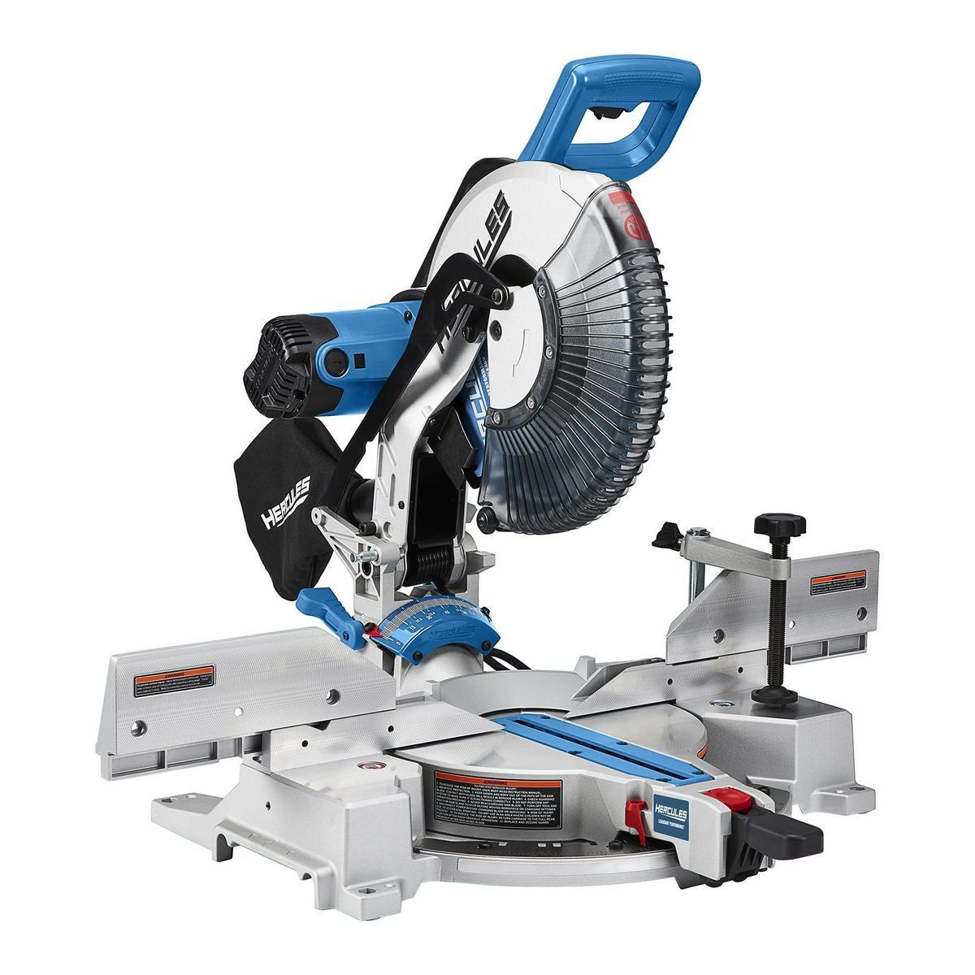
Miter Saw
Safety Glasses and Ear Protection required while in use
Ensure all safeguards are in place before use
Keep hands away from the blade
After completing a cut, let the blade come to a complete stop before retrieving materials
Unplug after usage
Clean your work area after usage

Slide 5

Bench Grinder
Safety Glasses and Ear Protection required while in use
Ensure all safeguards are in place before use
Keep hands away from spinning wheels
After completing a grind, let the wheels come to a complete stop before leaving the machine
Only grind metal

Slide 6
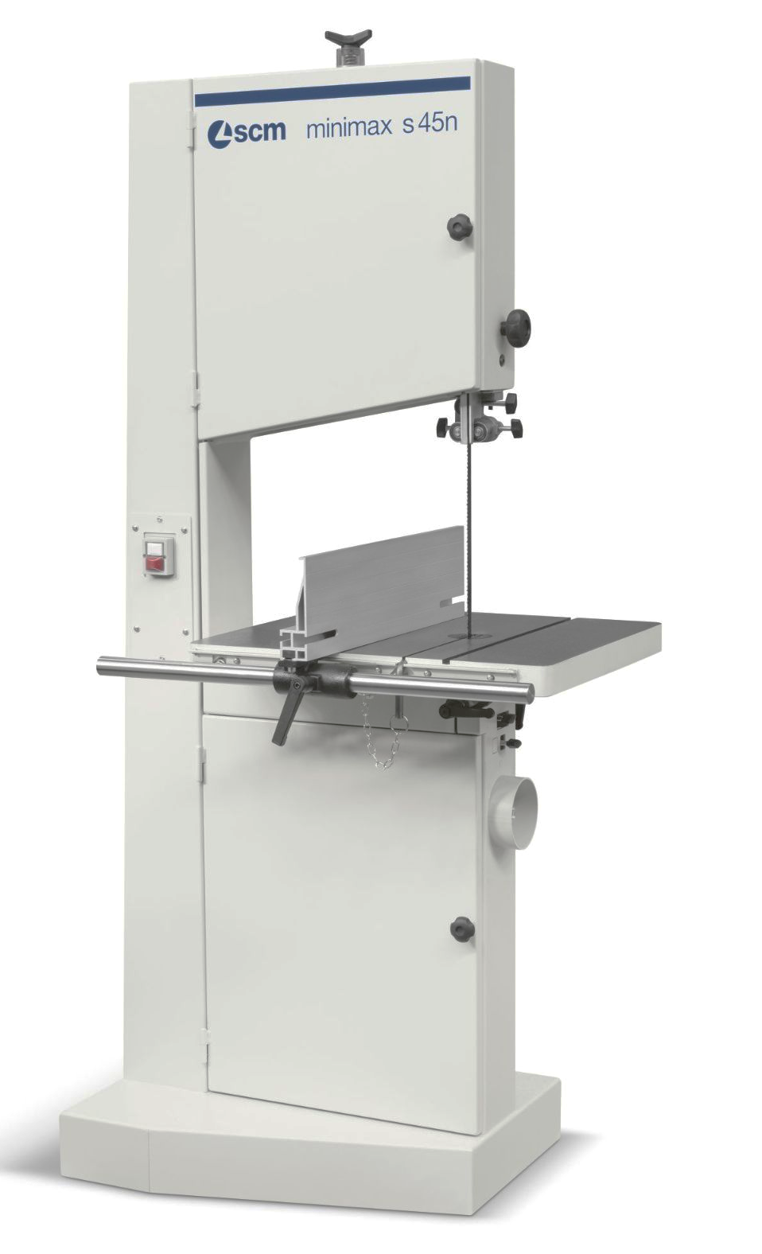
Band Saw
Safety Glasses required while in use
Ensure all safeguards are in place before use
Keep hands away from the blade
The teeth of the blade should be facing down towards the table of the machine, and should be free of any bends and warps
After completing a cut, let the blade come to a complete stop before retrieving materials

Slide 7
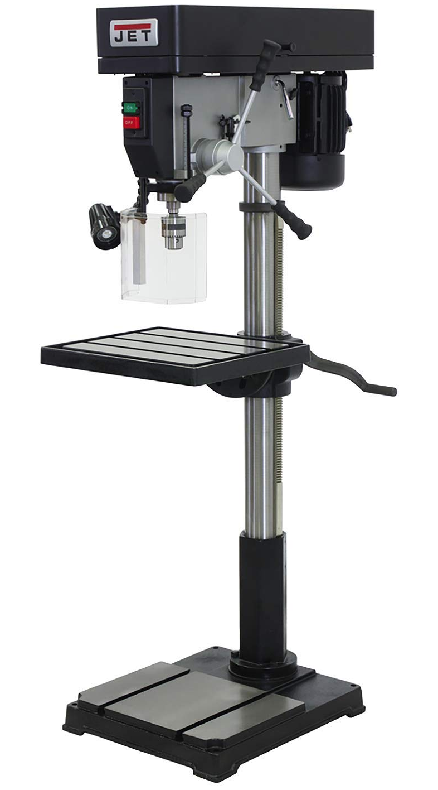
Drill Press
Safety Glasses required while in use
Ensure all safeguards are in place before use
Keep hands away from the bit
After completing a cut, let the bit come to a complete stop before retrieving materials
Unplug after usage

Slide 8
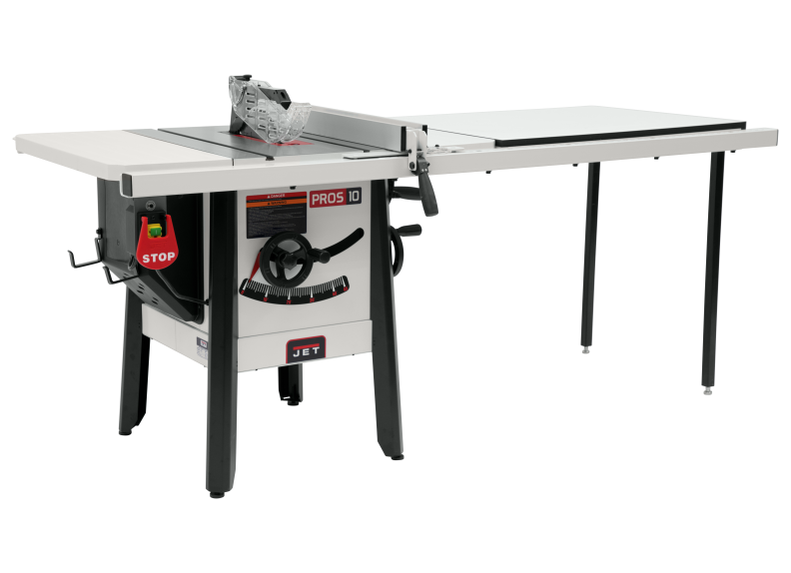
Saw Table
Safety Glasses and ear required while in use
Ensure all safeguards are in place before use
Always have assistance from a mentor
Keep hands away from the blade. Safe distance is around 6 inches away from the blade
After completing a cut, let the blade come to a complete stop before retrieving materials

Slide 9




Handheld Power Tools
Safety Glasses required while in use
Do not wear gloves if there is rotating machinery
Keep hands away from the blade/bit
Ear protection is required if you are grinding metal
Ear protection recommended for louder tools

