Slide 1
GLOBAL TEMPERATURE
TREND ANALYSIS
Linear algebra from raw climate data to a 2100 projection
1880 → 2100
Vandermonde matrices
QR orthogonalization
Least squares
Eigenvalue structure
UE25MA242A | Mathematical Foundation for AI & Data Science
Mini Project – Problem 8
Preetham S. • 1st Year B.Tech CSE • PES University

Slide 2
The question and the workflow
One dataset, several linear-algebra viewpoints
Project question
1
Data
NASA GISTEMP v4
Can a transparent mathematical pipeline turn annual global temperature anomalies into a defensible long-range trend projection?
2
Represent
Vandermonde / design matrix
3
Solve
RREF, Gaussian, LU, QR
The result is a mathematical projection—not a physical climate model.
4
Explain
Projection + eigendecomposition
5
Forecast
2050 and 2100 anomalies
2

Slide 3
Data: a real-world vector
Live NASA download with an embedded offline fallback
Source: NASA GISTEMP v4 global annual mean
The script downloads the current CSV.
If the network is unavailable, the embedded copy keeps the analysis reproducible.
Time is scaled as t = (year − 1950) / 50 to improve numerical conditioning.
146
annual values
1880–2025
Anomaly relative to the 1951–1980 baseline
Observed range
−0.49°C to +1.29°C
Why scale time?
Using raw years would make powers in a degree-7 Vandermonde matrix unnecessarily large. Scaling keeps the same model meaning while making the computation safer.
3

Slide 4
From data to equations
Interpolation uses a Vandermonde matrix; regression uses an overdetermined design matrix
Exact interpolation
Approximate regression
V c = y
A x ≈ y
8 nodes: every 10 years from 1880 to 1950
Vᵢ = [1, tᵢ, tᵢ², …, tᵢ⁷]
Solve with RREF, Gaussian elimination, and LU.
146 observations, 3 features for the selected degree-2 model
The data vector is not exactly in Col(A), so project it onto that subspace.
Check: max |RREF − NumPy| = 1.26 × 10⁻⁸
Overdetermined system → least squares
4

Slide 5
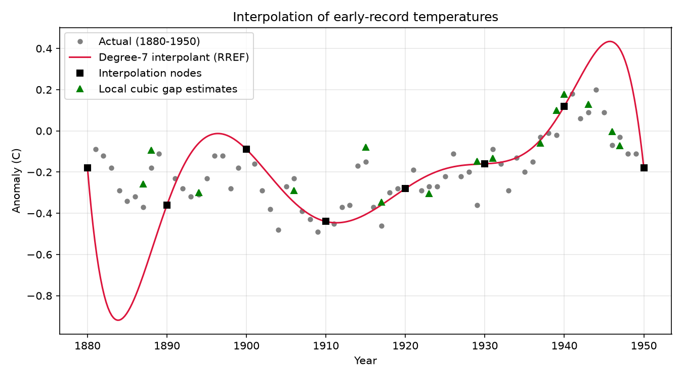
Exact interpolation: useful, but sensitive
The generated plot compares the degree-7 interpolant with actual early-record values
What it demonstrates
The interpolant passes through the 8 chosen nodes.
63 other early years are treated as missing and estimated.
Degree-7 missing-year RMSE: 0.252°C.
Local cubic gap filling improves RMSE to 0.088°C.
High-degree exact fits can oscillate between nodes.
5

Slide 6
Subspaces, QR, and projection
The least-squares estimate is the closest point to y inside the polynomial trend subspace
Orthogonalization
Orthogonal projection
A = Q R
P = Q Qᵀ ŷ = P y r = y − ŷ
Modified Gram–Schmidt builds an orthonormal basis Q.
||QᵀQ − I|| = 2.90 × 10⁻¹⁵
||A − QR|| is approximately zero.
The selected model has rank 3 and nullity 0.
P is symmetric and idempotent: P² = P.
The residual is perpendicular to Col(A).
||Aᵀr|| = 3.43 × 10⁻¹⁵
This is the geometric meaning of least squares.
6

Slide 7
Model selection: choose degree by extrapolation error
Train on 1880–2000; test on unseen years 2001 onward
Degree
Train RMSE (°C)
Test RMSE (°C)
Decision
1
0.1378
0.4927
2
0.1175
0.2226
SELECTED
3
0.1174
0.2640
4
0.1099
0.4316
5
0.1098
0.6019
The lowest test error—not the lowest training error—determines the degree.
This guards against choosing a flexible polynomial that memorizes the past but extrapolates poorly.
7

Slide 8
Least-squares fit: numerical checks
Three solution routes agree, and the fit explains most of the observed variance
0.1205°C
0.9098
2.64
3.33 × 10⁻¹⁶
fit RMSE
R²
condition number of A
diagonalization vs QR
The implementation validates the same coefficient vector through:
Normal equations → QR / back-substitution → NumPy least_squares
Residual orthogonality and the Pythagorean identity provide independent geometric checks.
8

Slide 9
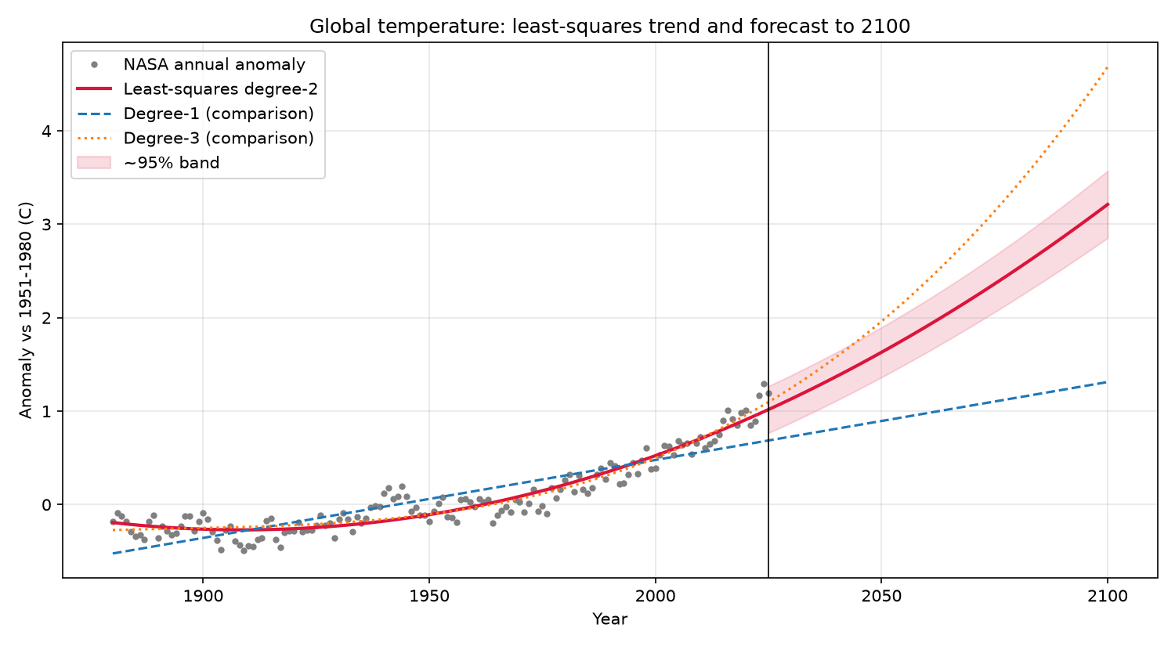
The forecast plot
Degree-2 least squares is the selected extrapolation model; comparison curves show model sensitivity
How to read it
Grey dots: annual NASA anomalies.
Crimson: selected degree-2 trend.
Dashed / dotted lines: degree-1 and degree-3 sensitivity checks.
Shaded region: approximate 95% prediction band.
The band widens farther into the future.
9

Slide 10
Forecast values: mathematical projections
Anomaly relative to the 1951–1980 baseline
Year
Prediction
Approx. 95% band
2030
+1.13°C
[+0.88, +1.38]°C
2050
+1.63°C
[+1.36, +1.90]°C
2075
+2.36°C
[+2.06, +2.66]°C
2100
+3.21°C
[+2.85, +3.57]°C
The model projects continued warming, but uncertainty and model-form sensitivity increase with horizon.
10

Slide 11
Eigenvalues: the structure of AᵀA
Diagonalization provides a third way to understand the least-squares system
AᵀA = Qₑ Λ Qₑᵀ
Why this matters
AᵀA is symmetric, so its eigenvalues are real and its eigenvectors are orthogonal.
Λ turns the coupled system into independent eigen-directions.
x = Qₑ Λ⁻¹ Qₑᵀ Aᵀy reproduces the QR solution.
Reconstruction error: 2.32 × 10⁻¹³.
Eigenvalues (descending)
246.1765 102.8811 35.2531
Energy share: 64.1% • 26.8% • 9.2%
Power iteration matches the dominant eigenvalue.
11

Slide 12
Conclusion and responsible interpretation
What the project demonstrates—and what it does not claim
Key takeaways
Limitations
Linear algebra converts climate observations into matrices, subspaces, projections, and eigen-directions.
Exact interpolation can fill gaps, but least squares is better suited to noisy, overdetermined observations.
Independent algorithms and residual identities verify the numerical work.
The selected degree-2 model projects +1.63°C in 2050 and +3.21°C in 2100.
A polynomial extrapolation assumes the past trend shape continues.
It does not model emissions, feedbacks, volcanic forcing, or ENSO variability.
The prediction bands quantify statistical extrapolation uncertainty, not full physical-climate uncertainty.
Use these values as a transparent mathematical exercise, not as a policy-grade climate forecast.
Thank you
12

