Slide 1
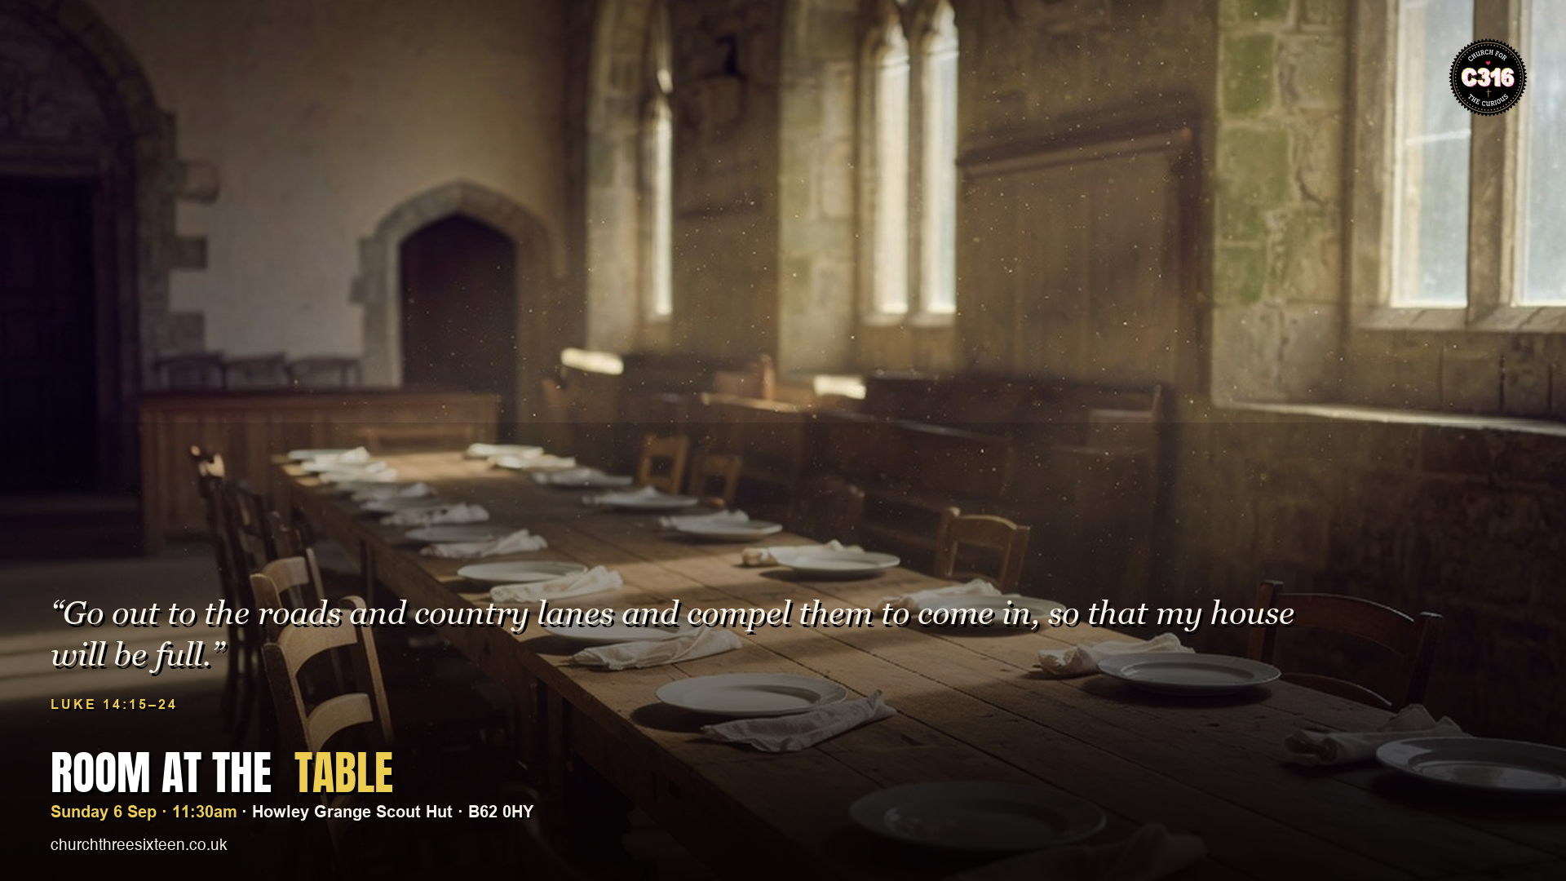

Slide 2
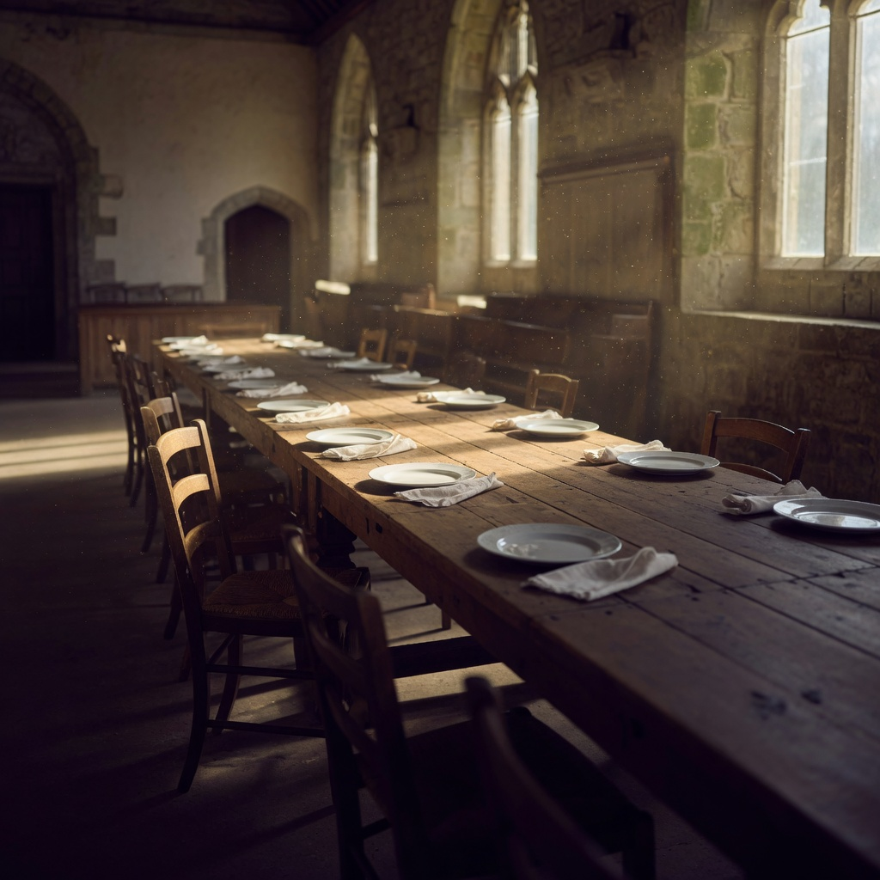
MAIN OBJECTIVE
Show that Jesus’ table still has room for the people who assume they are not invited — and that C316 exists to make that room visible in Halesowen.
SUNDAY 6 SEP · LUKE 14:15–24 · C316

Slide 3
POINT 1
The table is bigger than the guest list
The first invitees make excuses. Jesus is not thrown. The host keeps sending invitations. God’s welcome is not limited to the people who look ready.
SUNDAY 6 SEP · LUKE 14:15–24 · C316

Slide 4
POINT 2
The people on the edge are not plan B
The poor, the crippled, the blind and the lame are the ones the servant is told to bring. The gospel is not a leftover. It is aimed at the ones who never expected a seat.
SUNDAY 6 SEP · LUKE 14:15–24 · C316

Slide 5
POINT 3
There is still room
The house is not full yet. ‘Compel them to come in’ is not force — it is urgent, personal, going-out love. C316 does not wait for people to find the door.
SUNDAY 6 SEP · LUKE 14:15–24 · C316

Slide 6
APPLICATION
This week, invite one person who would not assume they belong at church to sit with you on Sunday. Don’t just hope they come — go with them.
Jesus still makes space for the ones who feel left out.
SUNDAY 6 SEP · LUKE 14:15–24 · C316

