Slide 1
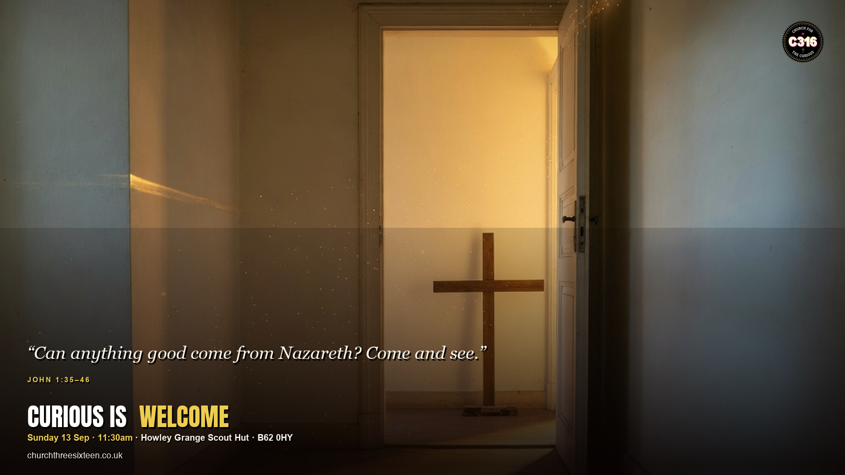

Slide 2
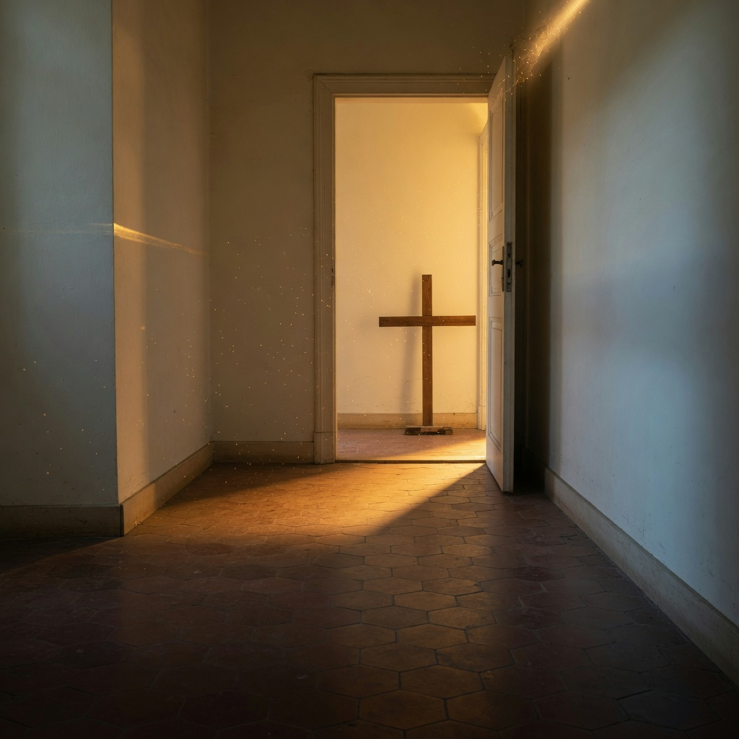
MAIN OBJECTIVE
Give permission to take a first step toward Jesus without having all the answers — curiosity is how faith often begins.
SUNDAY 13 SEP · JOHN 1:35–46 · C316

Slide 3
POINT 1
The first disciples were seekers, not experts
Andrew and the other disciple follow a question more than a lecture. Jesus turns and asks, ‘What do you want?’ He starts with desire, not a test.
SUNDAY 13 SEP · JOHN 1:35–46 · C316

Slide 4
POINT 2
The invitation is Come and see
Philip does not win an argument with Nathanael. He offers an encounter. C316 is a church for the curious — you do not need certainty to walk through the door.
SUNDAY 13 SEP · JOHN 1:35–46 · C316

Slide 5
POINT 3
Curiosity is not a threat to faith
Nathanael’s scepticism (‘Can anything good come from Nazareth?’) is welcomed, not shamed. Honest questions are a doorway, not a problem to manage.
SUNDAY 13 SEP · JOHN 1:35–46 · C316

Slide 6
APPLICATION
Bring your real questions this Sunday. And send one curious friend a simple text: ‘Come and see. I’ll sit with you.’
You don’t need all the answers to take a first step.
SUNDAY 13 SEP · JOHN 1:35–46 · C316

