Slide 1
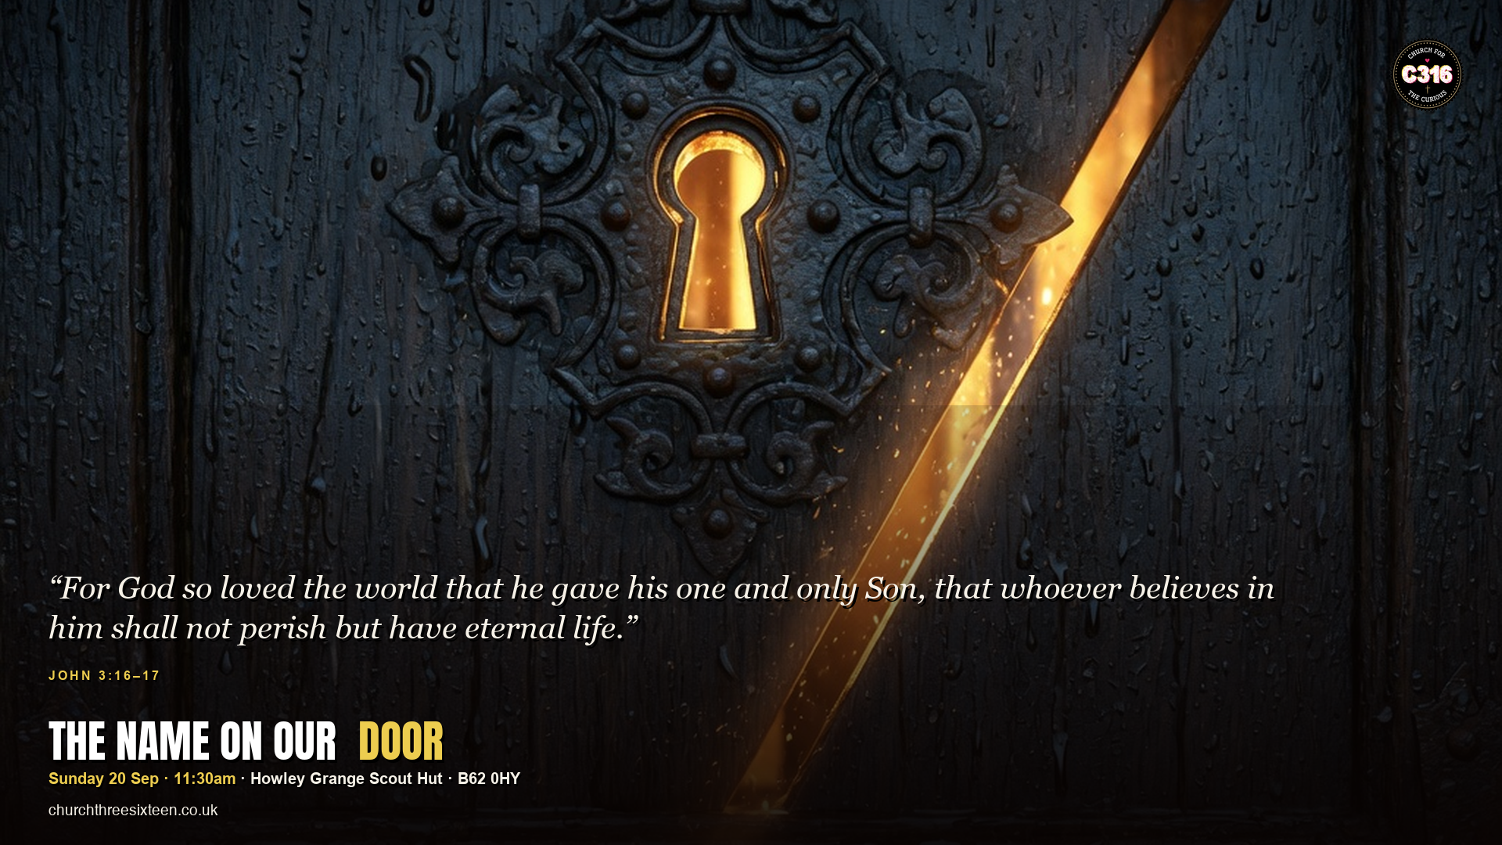

Slide 2

MAIN OBJECTIVE
Make John 3:16 the identity on the door of C316 — God loves this street, this postcode, these people, and sent Jesus to rescue, not to shame.
SUNDAY 20 SEP · JOHN 3:16–17 · C316

Slide 3
POINT 1
Loved — the gospel starts with God, not with us
Before we cleaned anything up, God loved. ‘The world’ includes Halesowen. The name on our door is not a brand first — it is a love story.
SUNDAY 20 SEP · JOHN 3:16–17 · C316

Slide 4
POINT 2
Given — love that never costs is not this love
God gave his Son. John 3:16 is not a slogan; it is a gift with a cross in the middle. We exist because of that giving.
SUNDAY 20 SEP · JOHN 3:16–17 · C316

Slide 5
POINT 3
Not condemned — Jesus came to save
Verse 17 stops the church from becoming a courtroom. The curious, the doubters, the followers are met with rescue, not a raised eyebrow.
SUNDAY 20 SEP · JOHN 3:16–17 · C316

Slide 6
APPLICATION
Learn John 3:16 by heart this week. Say it over one person in B62 0HY by name — and invite them to the house that verse built.
For God so loved the world — including Halesowen.
SUNDAY 20 SEP · JOHN 3:16–17 · C316

