Slide 1
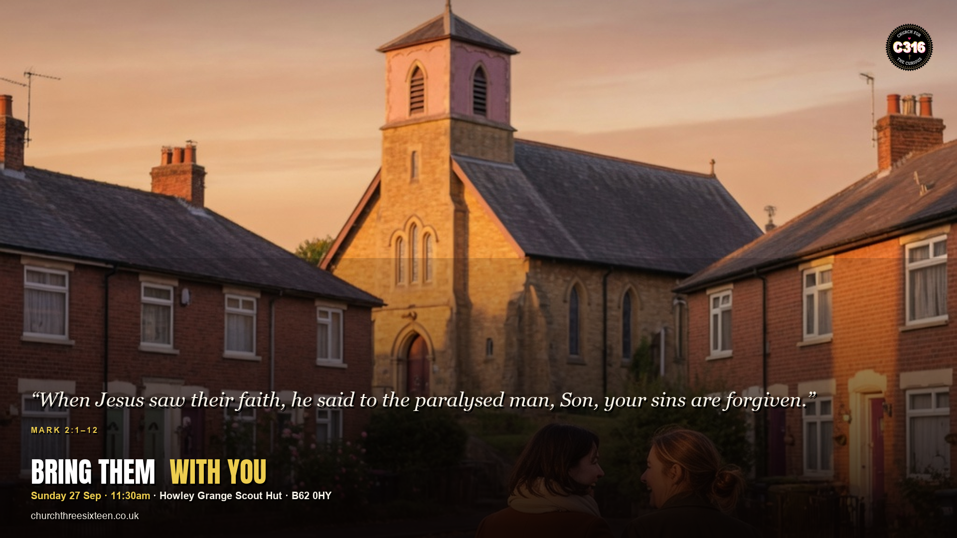

Slide 2
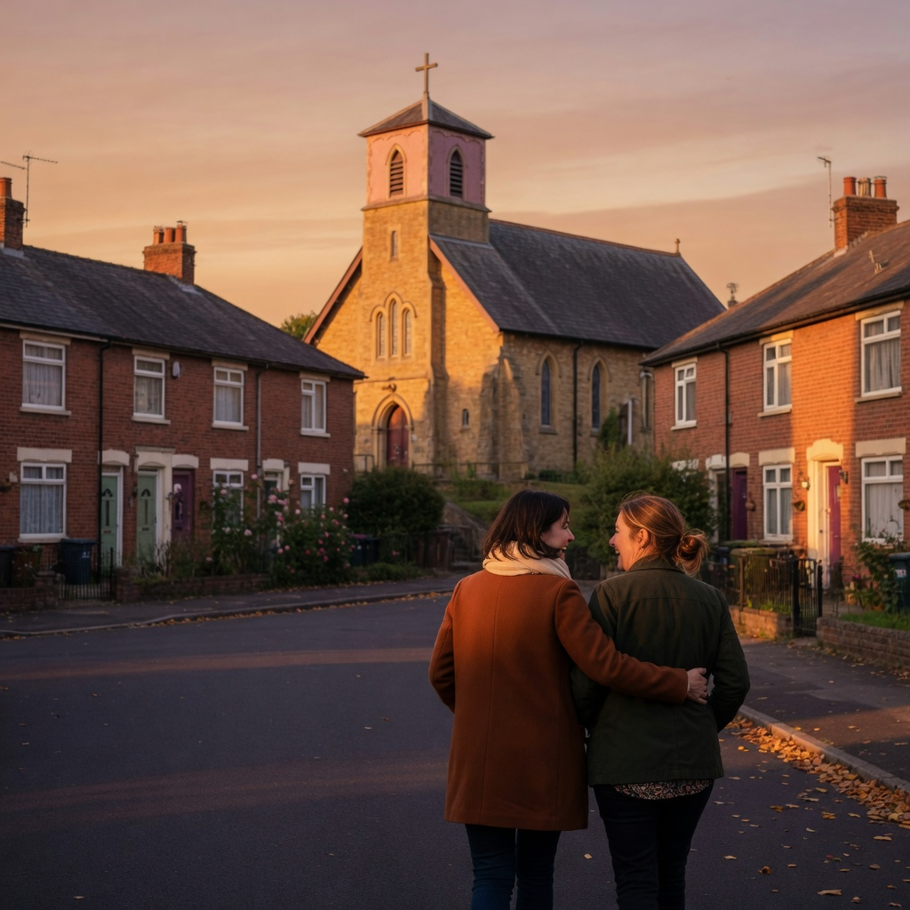
MAIN OBJECTIVE
Show that faith is rarely a solo project — we carry people to Jesus, and Jesus sees the faith of friends.
SUNDAY 27 SEP · MARK 2:1–12 · C316

Slide 3
POINT 1
Four friends did what he could not do alone
The man on the mat needed carriers. Some people will meet Jesus because someone else refused to come to church empty-handed.
SUNDAY 27 SEP · MARK 2:1–12 · C316

Slide 4
POINT 2
Jesus sees their faith
Mark says ‘their’ faith. A church can believe for someone who is still on the way. Community is part of how healing starts.
SUNDAY 27 SEP · MARK 2:1–12 · C316

Slide 5
POINT 3
The roof comes off when love won’t wait
They could not get through the door, so they made a hole. Creative, inconvenient love is normal in the kingdom.
SUNDAY 27 SEP · MARK 2:1–12 · C316

Slide 6
APPLICATION
Name one person. Ask them this week. Offer to pick them up. Faith often starts when friends carry someone to Jesus.
Faith often starts when friends carry someone to Jesus.
SUNDAY 27 SEP · MARK 2:1–12 · C316

