Slide 1


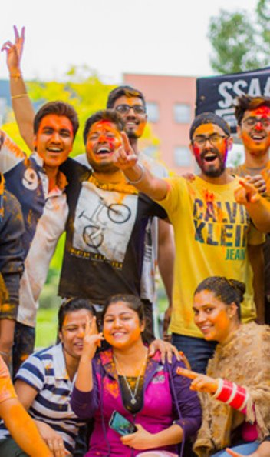
Forgot your
Charger?
Upcoming events?
Helping hand?
Need a
Have you ever…

Slide 2
Give Monash Students
the means to help themselves.

Slide 3
ShareMon
Sharing everything within Campuses
Team TwoMenDown

Slide 4


Awesome Features.
Share Services
Volunteering
Event Annoucements

Slide 5
But, what about Facebook?

Slide 6
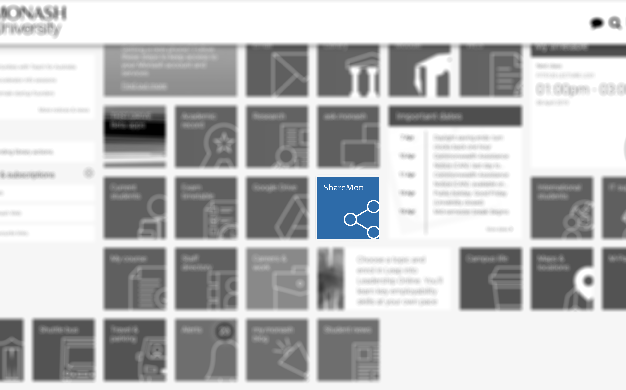
Integrated
Within the Monash environment

Slide 7
No one gets left behind.

Slide 8
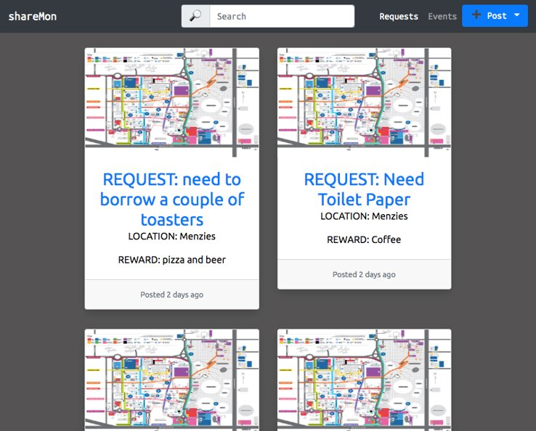
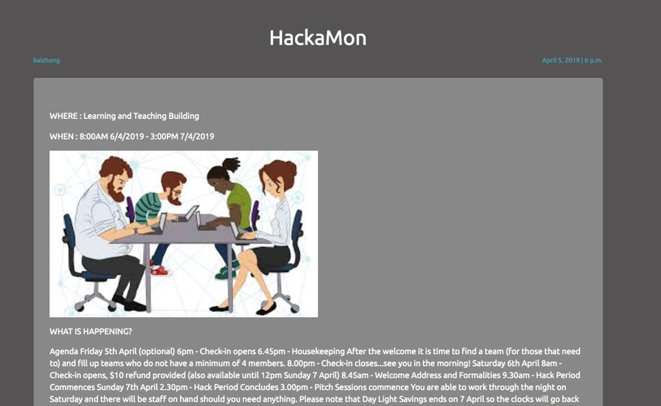
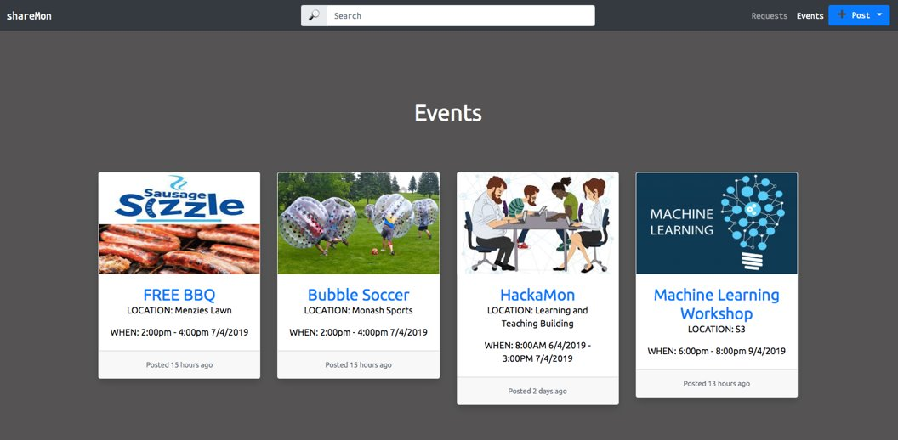

Slide 9
Crowdsourcing.

Slide 10
Why?

Slide 11
“Delivering an annual core operating margin of 5 per cent.”

Slide 12
70,000+ Students

Slide 13
Thank you.

