Slide 1
UDF Project
Simple Calculator App
C. Rohan – 247R1A6616
G. Tanishq – 247R1A6623
GVSS Jaswanth – 247R1A6624
Shaik Junaid Kareem -247R1A6658

Slide 2
Project Overview
What is the Simple Calculator App?
A mobile application built with Flutter that performs basic arithmetic calculations. Users enter numbers via interactive buttons, select mathematical operators (addition, subtraction, multiplication, division), and view real-time results. It demonstrates fundamental principles of mobile app development including UI design, user interaction, data management, and state updates.
Learning Objectives & Purpose
• Understand Dart programming fundamentals (variables, functions, operators, control flow)
• Learn Flutter UI development and widget composition
• Master button interaction and event handling
• Implement state management using setState()
• Practice Flutter UI layout using Rows and Columns
• Gain hands-on mobile application development experience
Technology Stack
Flutter: Google's cross-platform UI framework providing pre-built widgets, responsive layouts, and hot-reload for rapid development. Allows single codebase deployment to iOS and Android.
Dart: Modern programming language designed for Flutter, featuring strong typing, null safety, and excellent support for object-oriented and functional programming paradigms.
Notes:
1.7.2013
2
‹#›

Slide 3
Project Objectives & Goals
✓ Build Functional Calculator
Create a fully working calculator with polished UI, responsive buttons, and accurate calculations
✓ Master Dart Programming
Learn variables, data types, operators, functions and conditionals in Dart
✓ Implement User Interaction
Handle button presses, capture user input, and trigger appropriate calculations
✓ Handle Arithmetic Operations
Implement +, −, ×, ÷ with an error message for division by zero
✓ Practice UI Layout
Use Flutter's layout widgets: Scaffold, Column, Row, Container, Expanded
✓ State Management
Use setState() to trigger UI rebuilds when application data changes

Slide 4
Core Technologies & Dart Concepts
🎨 Flutter Framework
Provides reusable UI widgets, manages layouts, handles user events, enables cross-platform compilation
⚙️ Dart Language
Statically typed, supports variables, functions, classes, conditional logic, object-oriented programming
🔘 Button Widgets
ElevatedButton captures user taps, executes callback functions, updates application state
🔄 State Management
setState() notifies Flutter framework of data changes, triggers widget rebuild with new values
Core Dart Concepts Used:
Variables (store display text & numbers) • Data Types (double, String, bool) • Operators (arithmetic: +, −, *, /) • Functions (process button taps) • Conditionals (if/else for operations) • setState() (update display)

Slide 5
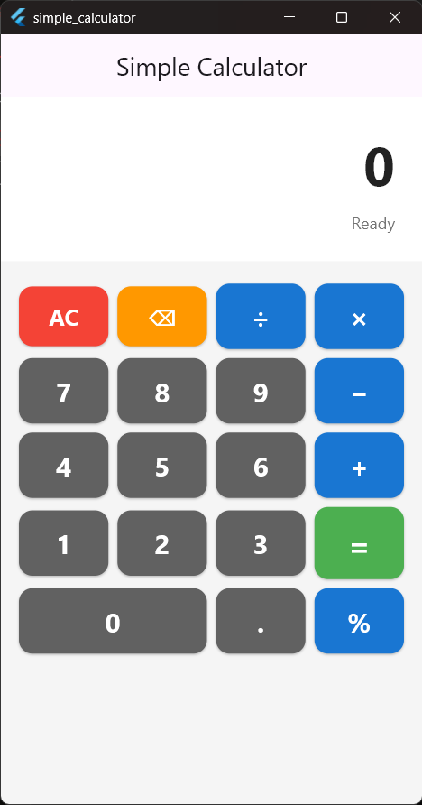
Calculator UI Design
Interface Components
• Display Area
Large text widget showing entered numbers and results, with a status line (Ready / Operation) below
• Number Buttons
Buttons 0-9: rows 7-8-9, 4-5-6, 1-2-3, plus a double-width 0 button
• Operator Buttons
Four buttons: + (plus), − (minus), × (multiply), ÷ (divide)
• Utility Buttons
AC (clear), ⌫ (backspace), = (equals), . (decimal point), % (percent)
• Color Scheme
Grey number keys, blue operators, red AC, orange ⌫, green =
• Layout
Rows of Expanded buttons share the screen width equally

Slide 6
Widget Hierarchy & Architecture
Widget Tree Structure
Widget Descriptions
• Scaffold
Scaffold (AppBar + body)
↓
Column (vertical layout)
├── Container (display area)
│ └── Text (display/status)
│
└── Expanded → Column
├── Row (AC, ⌫, ÷, ×)
├── Row (7, 8, 9, −)
├── Row (4, 5, 6, +)
├── Row (1, 2, 3, =)
└── Row (0, ., %)
Provides app structure, handles app bar and body
• Column
Arranges children vertically (display above buttons)
• Row
Arranges buttons horizontally in each row
• Text
Displays numbers and calculation results
• ElevatedButton
Interactive button widget that responds to taps
• Container
Provides padding, margins and background colours
• Expanded
Makes each button share the row width equally

Slide 7
Calculation Workflow & Logic Flow
Step 1
User presses a number button (0-9)
Button's onPressed() callback is triggered
Step 2
Digit is appended to the display text
onNumberPressed() updates the display via setState()
Step 3
User presses an operator button (+, −, ×, ÷)
firstNumber and operation are saved; next digit replaces display
Step 4
User enters second number (0-9)
Digits appear on the display
Step 5
User presses equals button (=)
secondNumber is read from display; if/else picks the operator
Step 6
Calculation is performed
Appropriate arithmetic operation executes
Step 7
Error handling checks division by zero
If dividing by 0, display shows "Error: Div by 0"
Step 8
Result is displayed
setState() triggers UI rebuild with final answer

Slide 8
Dart Programming Logic
Example: onEqualsPressed() – operator check (excerpt)
if (operation == '+') {
result = firstNumber + secondNumber;
} else if (operation == '−') {
result = firstNumber - secondNumber;
} else if (operation == '×') {
result = firstNumber * secondNumber;
} else if (operation == '÷') {
if (secondNumber == 0) {
display = 'Error: Div by 0';
return;
}
result = firstNumber / secondNumber;
}
display = result.toString();
Key Logic Concepts Demonstrated:
• Variables: display, firstNumber, secondNumber, operation store calculator state
• Functions: Each button press calls a function to handle the input
• Conditional Logic: if/else statements check which operator was selected
• Arithmetic Operators: +, −, *, / perform actual calculations
• Type Conversion: toString() converts number result to text for display
• setState(): Notifies Flutter to rebuild UI with new display value

Slide 9
Features & Learning Outcomes
✓ Implemented Features
✓ Learning Outcomes
• Simple, intuitive calculator interface
• Real-time display updates as users type
• Four arithmetic operations (+, −, ×, ÷)
• Clear (AC) button to reset calculator
• Decimal point support for precise calculations
• Equals button to compute results
• Division by zero error handling
• Backspace (⌫) and percent (%) buttons
• Dart syntax and language fundamentals
• Flutter widget system and composition
• Event handling and user interaction
• State management with setState()
• UI layout using Rows and Columns
• Reusable button helper (buildButton)
• Conditional logic implementation
• Mobile app development experience

Slide 10
Conclusion & Key Takeaways
Project Summary
The Simple Calculator App successfully demonstrates how Flutter and Dart work together to create interactive mobile applications. Through building this project, we implemented fundamental programming concepts including variables for data storage, operators for calculations, conditionals for decision-making, and state management for dynamic user interfaces. This calculator proves that well-designed applications require careful consideration of UI layout, proper error handling, and understanding of how modern frameworks manage reactive updates.
Key Takeaways & Future Implications
➜ Cross-Platform Development
Flutter enables single codebase deployment to iOS, Android, web, and desktop platforms
➜ Modern Language Design
Dart provides strong typing, null safety, excellent support for OOP and functional programming
➜ Reactive Architecture
State management through setState() is central to building responsive, interactive applications
➜ UI/UX Importance
Careful design following familiar patterns dramatically improves user experience and usability

