Slide 1

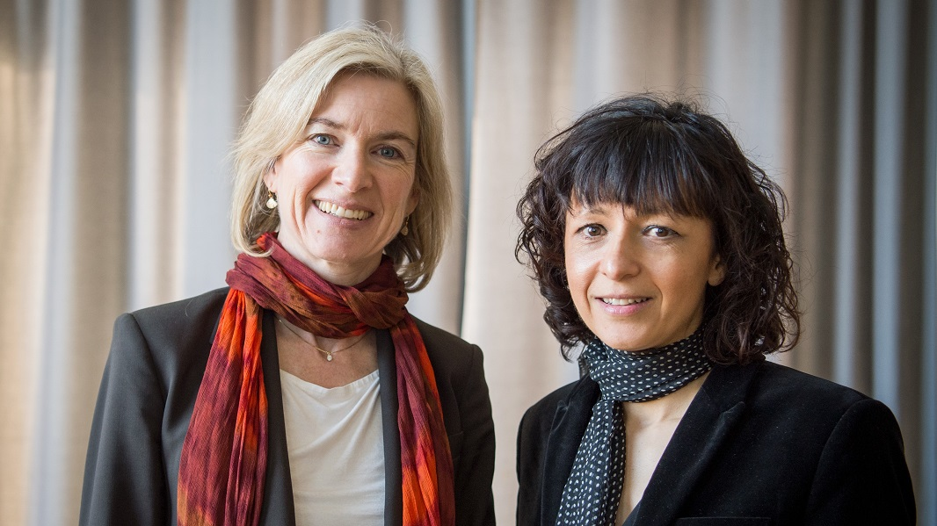
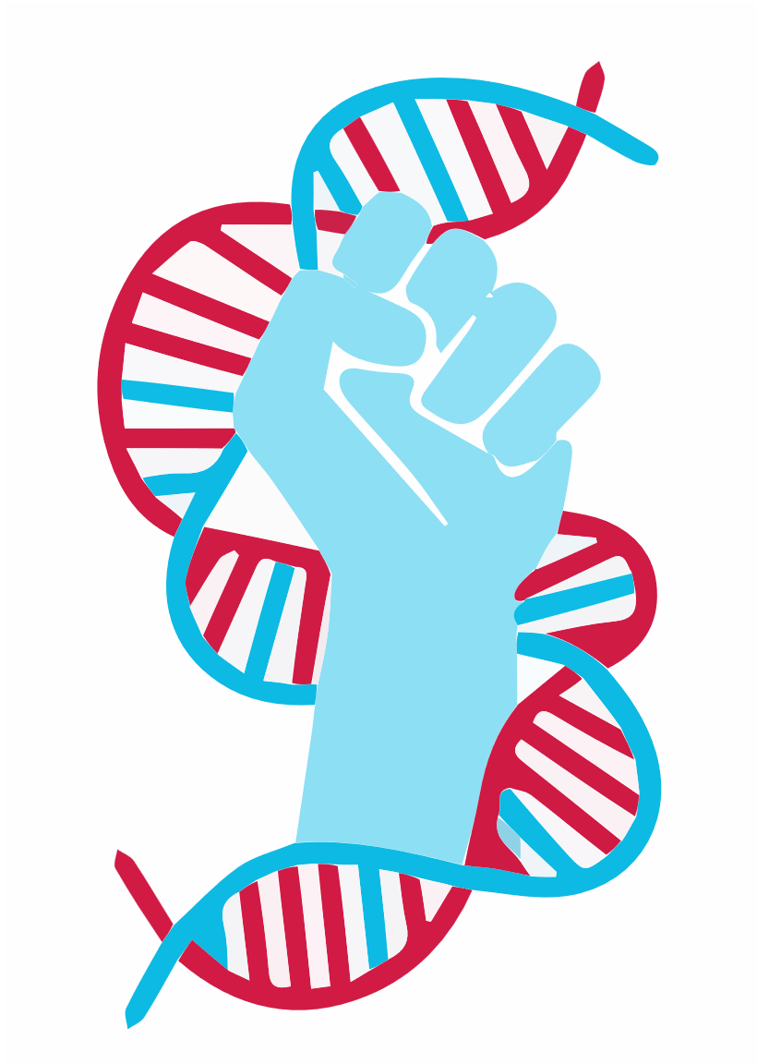

CRISPR applications in
cancer treatment
Emmanuelle Charpentier and Jennifer Doudna
What is CRISPR?
Clustered regularly interspaced short palindromic repeats
Over the years, many scientists have thought about the possibility of altering the human genome to stop or treat deadly diseases, such as cancer. In 2012, Jinek et al. identified two significant discoveries which have led to further advancements within the field of bio-genetics. The first innovation is the decoding of the human genome, which has given scientists the chance to further understand how human genetics works and provides an understanding of DNA sequencing. The second innovation involves the use of the DNA editing technology CRISPR.
Reference:
Jinek, M., Chylinski, K., Fonfara, I., Hauer, M., Doudna, J. A., & Charpentier, E. (2012). A Programmable Dual-RNA-Guided DNA Endonuclease in Adaptive Bacterial Immunity. Science, 337(6096), 816–821. https://doi.org/10.1126/science.1225829
https://www.nature.com/articles/d41586-020-02765-9
https://www.minipr.com/introduction-fluorescence-lab/
https://commons.wikimedia.org/wiki/File:Octicons-mark-github.svg
Group Name: 5101
https://github.com/5101name/5101name.github.io

Slide 2
Advantages
Disadvantages
The advancements of cancer treatment and research.
The reduction of research cost.
The creation of more effective cancer medications
Long initial time investment.
The inefficiency of CRISPR’s.
The unintended side-effects
CRISPR Impact on society
Crispr gives those who suffer from diseases that are incurable or do not have many therapeutic alternatives new hope. Crispr has the ability to modify the human genome and tailor medicine so that it is utilized only when necessary for a particular person's body. This would lead to fewer adverse drug reactions, quicker patient recovery, and a faster pace of new drug development. As novel medicines and disease control might be implemented thanks to Crispr, it would be possible to treat or perhaps completely eradicate several human diseases and tumors. Cancers, hereditary muscle mutations including Duchenne muscular dystrophy, leukemia and HIV are the main subjects of several current crispr studies. Only individuals who have tried every other form of treatment should be given the option of this technique, which is still extremely new. The use of cas9 to remove duplicated genes or replace the gene to make it functional again can help some monogenic diseases (Hsu et al., 2014).
Reference:
Hsu, Patrick D., Lander, Eric S., & Zhang, F. (2014). Development and Applications of CRISPR-Cas9 for Genome Engineering. Cell, 157(6), 1262–1278. https://doi.org/10.1016/j.cell.2014.05.010

Slide 3
Conclusion
In conclusion, our daily lives are impacted by technology. Since technology permeates every aspect of our lives, we frequently take it for granted and don't realize how much it affects us until we are without a phone, a vehicle, access to water, or electricity. Technology advancements have significantly raised our standard of living. CRISPR technology can be applied in a variety of fields due to its accuracy. CRISPR has shown to be quite helpful in the medical field. It has not yet received approval to be used in clinical trials on humans. However, it is highly likely that in the future, adult humans will be the subjects of approved clinical studies and treatments. The potential for technology toward enhances cancer treatments it tremendous. CRISPR works on all cell types and therefore provides countless opportunities. It is also being tested for usage in fields connected to microbiology. I consider all of these CRISPR applications to be good uses of the technology since they all aim to make the world a better place.
Team update
Research
Presentation
Proposal
Meeting minutes
Team contract
Website

