Slide 1

CouchDB
Avinash Agumamidi
Madhu Reddy
Vishnu C Mandalapu
Azharuddin H Mohammad

Slide 2
Talking about these..!!
CouchDB is.. ??
NoSQL Database – types
SQL vs CouchDB
Why CouchDB.?
CouchDB Features
JSON
Command line utility - CURL
Futon
HTTP API
Views
Map/ Reduce Functions..

Slide 3
CouchDB Is..
An open-source document oriented database
Created By : Damien Katz
Year : 2005
Language : Erlang
License : Apache Software Foundation(2008)

Slide 4

CouchDB Is..
NoSQL Database
.....Uses Map/Reduce queries written in javascript

Slide 5
NoSQL Databases
Schema-Free
Distributed
Open Source
Horizontally Scalable
Easy Replication Support

Slide 6
Types of NoSQL Databases
Key - value stores:
each data value consists of an indexed key and a value for that key
Examples − BerkeleyDB, Cassandra, DynamoDB, Riak.
Column stores:
Examples − BigTable, HBase and HyperTable
Document stores:
Examples − CouchDB and MongoDB
Object stores:
Examples − Neo4J, db4o

Slide 7
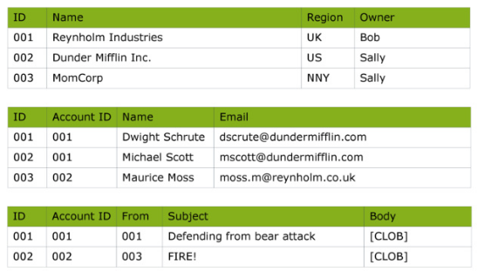
Relational Storage

Slide 8

Document-Oriented Database
Data is stored in documents
......and not in relations like an RDBMS

Slide 9
SQL v/s CouchDB
SQL | CouchDB
Relational | Non-Relational
Tables | Documents
Rows and Columns | Document Fields
SQL Query Engine | Map/Reduce Functions

Slide 10
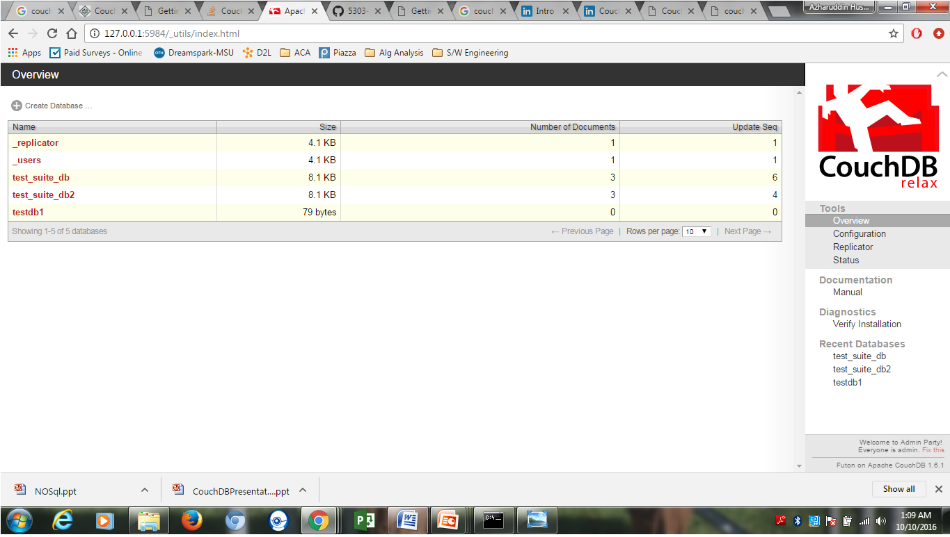
Why CouchDB..?
HTTP based REST API
No need to worry about structure of the data
Easy-to-use Replication

Slide 11
CouchDB Features..!!
Data Representation - Using JSON
Interaction - Futon / CouchDB API
Querying - Map / Reduce
Design Documents - Application code(Language : Javascript)
Documents can have attachments

Slide 12
JSON..
Stands for Javascript Object Notation
Derived from Javascript scripting language
Used for representing simple data structures and associative arrays

Slide 13
JSON..
Example: {
"firstName": "John",
"lastName": "Smith",
"age": 25,
"phoneNumber": [
{
"type": "home",
"number": "212 555-1234"
},
{
"type": "fax", "number": "646 555-4567"
} ]
}

Slide 14
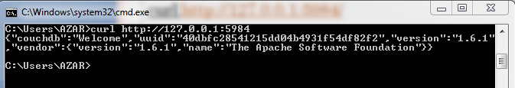
(Command line utility) CURL- server API
To access the homepage of CouchDB
curl http://127.0.0.1:5984/

Slide 15
CURL – Database API
Command to get a list of Databases :
curl -X GET http://127.0.0.1:5984/_all_dbs
Command to create a Database :
curl -X PUT http://127.0.0.1:5984/DB_name
Curl's -v option :
curl -vX PUT http://127.0.0.1:5984/DB_name
Command to destroy a Database :
curl -X DELETE http://127.0.0.1:5984/DB_name

Slide 16
CURL – Document API
Command to create a document :
curl -X PUT http://127.0.0.1:5984/albums/
6ert2gh45ji6h6tywe324743rtbhgtrg \ -d
'{"title":"abc","artist":"xyz"}'
Command to get a UUID :
curl -X GET http://127.0.0.1:5984/_uuids
Command to retrieve a Document :
curl -X GET http://127.0.0.1:5984/albums/
6ert2gh45ji6h6tywe324743rtbhgtrg

Slide 17
CURL – Document API
Command for attachments :
curl -vX PUT http://127.0.0.1:5984/albums/
6ert2gh45ji6h6tywe324743rtbhgtrg/ \
artwork.jpg?rev=2-2739352689 --data-binary
@artwork.jpg -H "Content-Type: image/jpg“
To view the image in the browser, URL is :
http://127.0.0.1:5984/albums/6ert2gh45ji6h6
tywe324743rtbhgtrg/artwork.jpg

Slide 18
CURL – Replicate API
Command to replicate a Database :
curl -vX POST http://127.0.0.1:5984/
_replicate \ -d '{"source":"albums","target":
"albums_replica"}'

Slide 19
FUTON
Built-in admin interface
Access to all CouchDB features
Create and Destroy databases
Create, View and Edit Documents
Compose and run Map / Reduce Views
Replicate a Database

Slide 20
FUTON Interface Demo

Slide 21
(HTTP API) HTTP Request Methods
Method | Description
PUT | Creates new objects, databases, documents, views and design documents.
GET | GET requests are used to request data from the database
POST | Post request is used to upload data. Used to set values, upload documents, set document values, and can also start certain administration commands.
DELETE | DELETE requests to delete databases and documents.
COPY | Using COPY method, you can copy documents and objects

Slide 22
HTTP Status codes
Status Code | Description
200 − OK | This status will be issued when a request completed successfully.
201 − Created | This status will be issued when a document is created.
202 − Accepted | This status will be issued when a request is accepted
404 − Not Found | This status will be issued when the server is unable to find the requested content.
405 − Resource Not Allowed | This status is issued when the HTTP request type used is invalid.
415 − Bad Content Type | Requested content type is not supported by the server
500 − Internal Server Error | This status is issued whenever the data sent in the request is invalid

Slide 23
CouchDB View
Using Map/Reduce Functions..!!
- Demo

Slide 24
Thank You !!

