Slide 1

PHONEBOOK APPLICATION

Slide 2
Project is done by:
Deepthi J
R Sai Sudheshna
Shaik Rasheeda begum
Jangala Vijaya
Kosana Varalakshmi

Slide 3
Index:
Introduction
Software Details
Technical requirements
Modules
Advantages and Disadvantages

Slide 4
Introduction:
Phonebook is a project which is designed to store the contact details i.e., name, number of a person.
This is achieved by using functions, pointers, linked lists and file handling.
Adding new records ,listing them, modifying them, searching for saved contacts and deleting the records are the basic functions carried in this application.

Slide 5



Software details:
This application is coded and made using the following compilers:
Ubuntu
Putty for Linux

Slide 6
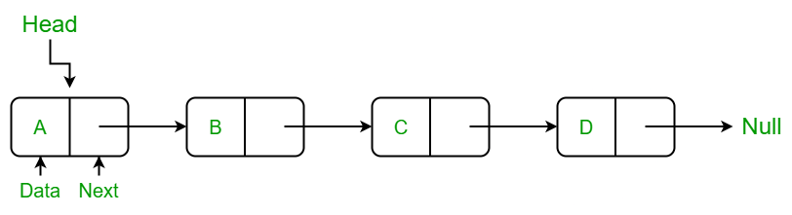
Technical Requirements:
We used linked lists, pointers and functions while working on this.
We used concepts of file handling and dynamic memory Allocation.
Linked list:
A linked list is a set of dynamically allocated nodes, arranged in such a way that each node contains one value and one pointer. The pointer always points to the next member of the list. If the pointer is NULL, then it is the last node in the list.

Slide 7
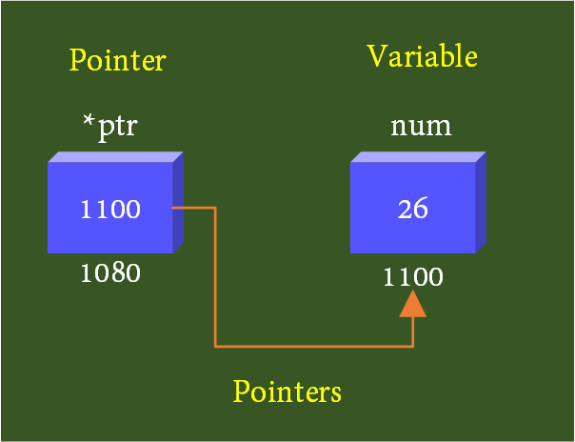
pointers:
A pointer is a variable that stores the memory address of another variable as its value and is created with the * operator.
Ex:*ptr;
Functions:
A function is a group of statements that together perform a task. Every C program has at least one function, which is main(), and program execution starts from main.

Slide 8
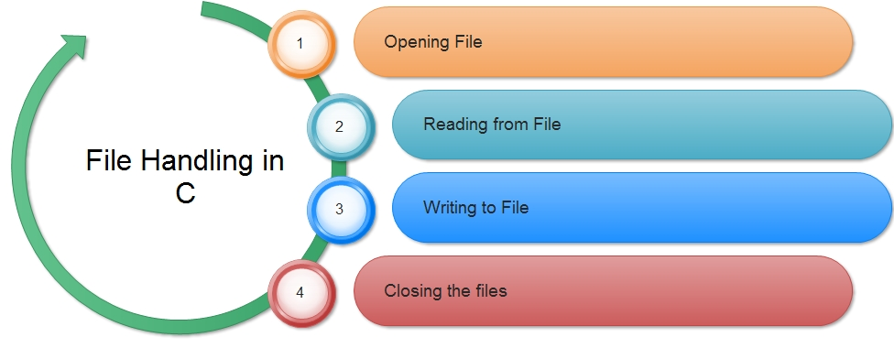
File handling:
File handling refers to the method of storing data in the C program in the form of an output or input that might have been generated while running a C program in a data file.
It enables us to create, update, read, and delete the files stored on the local file system through our C program.
fopen, fclose, fscanf or fgets, fprintf or fputs are some operations.

Slide 9
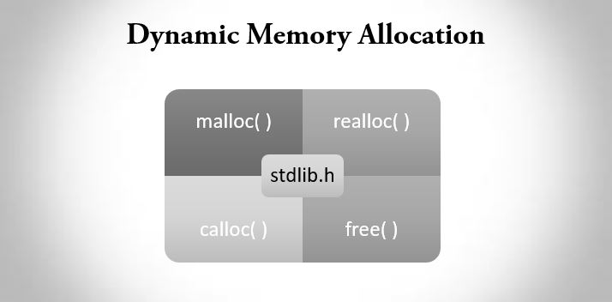
Dynamic Data Allocation:
The concept of dynamic memory allocation in c language enables the programmer to allocate memory at runtime.
Dynamic memory allocation in c language is possible by 4 functions of stdlib.h header file.
malloc()
calloc()
realloc()
free()

Slide 10
Malloc():
The malloc() function allocates single block of requested memory.
It doesn't initialize memory at execution time, so it has garbage value initially.
It returns NULL if memory is not sufficient.
The syntax of malloc() function is given below:
ptr = (cast-type*)malloc(byte-size)

Slide 11
Multi files and make file:
A large C program should be divided into multiple files. This makes each file short enough to conveniently edit, print, etc.
It also allows some of the code, e.g. utility functions such as linked list handlers or array allocation code, to be shared with other programs.
A makefile is a special file, containing shell commands, that you create and name makefile (or Makefile depending upon the system). While in the directory containing this makefile, you will type make and the commands in the makefile will be executed.

Slide 12

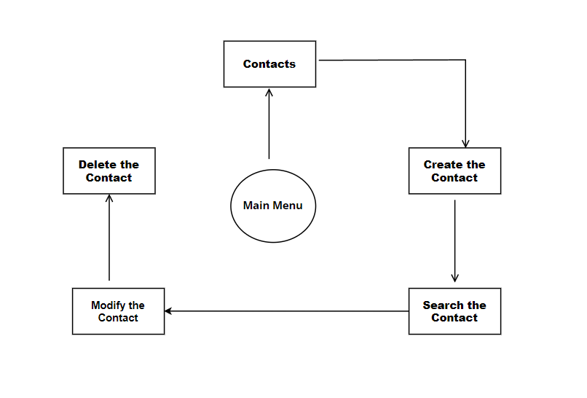
DFD level-0

Slide 13
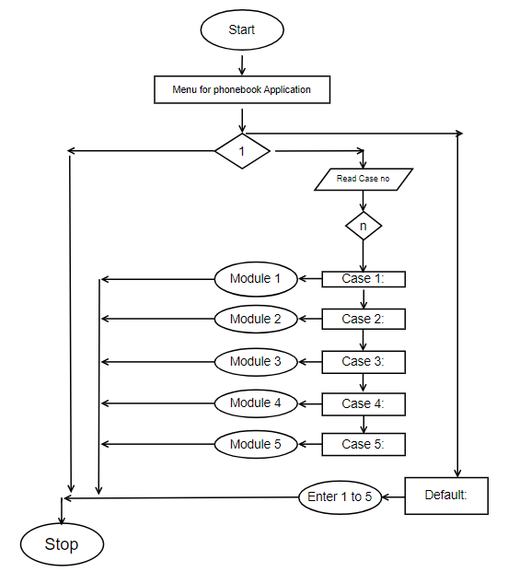
DFD LEVEL-1

Slide 14
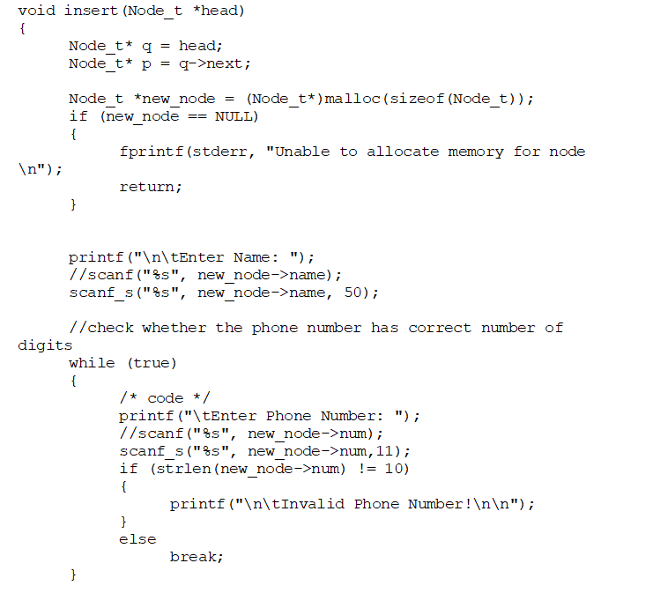
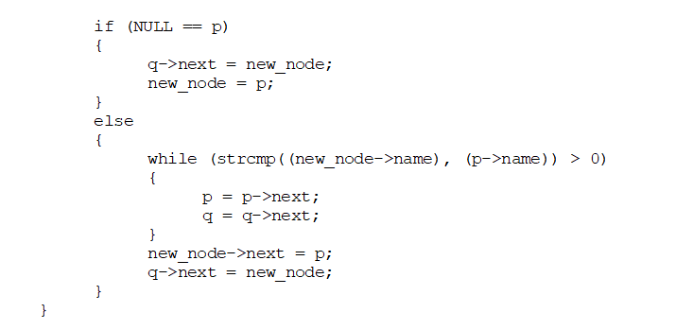
Modules
Insert():
The following is the code snippet for insert function. It allows user to insert the details i.e., name , number of the contact.

Slide 15
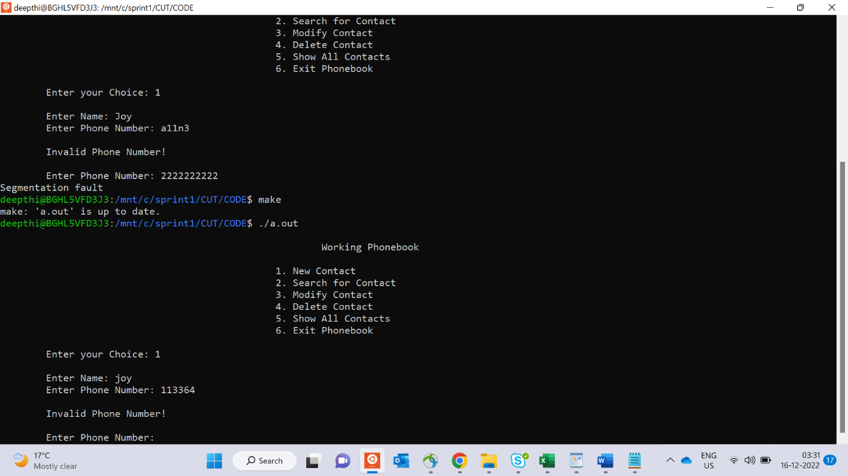

Slide 16
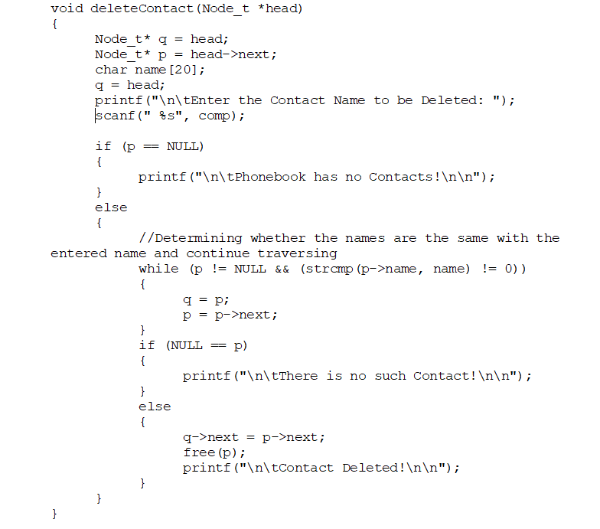
delete():
The following is the code snippet for delete function. It allows user to delete a particular contact.

Slide 17
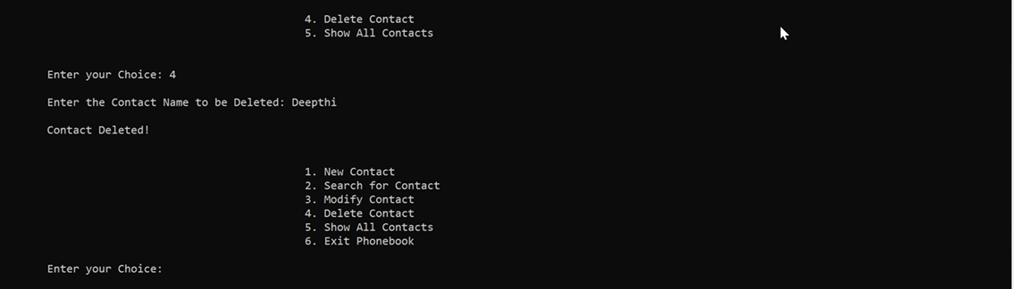

Slide 18
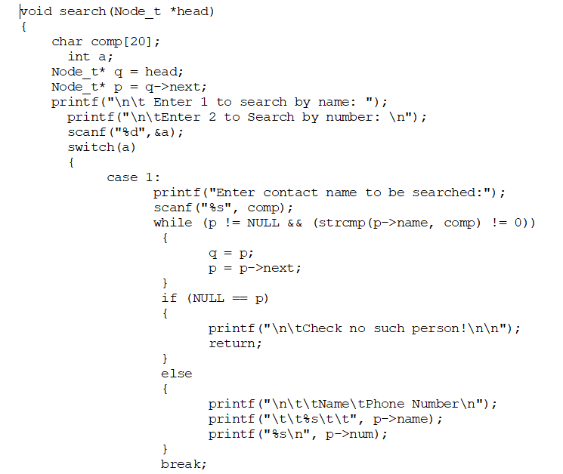
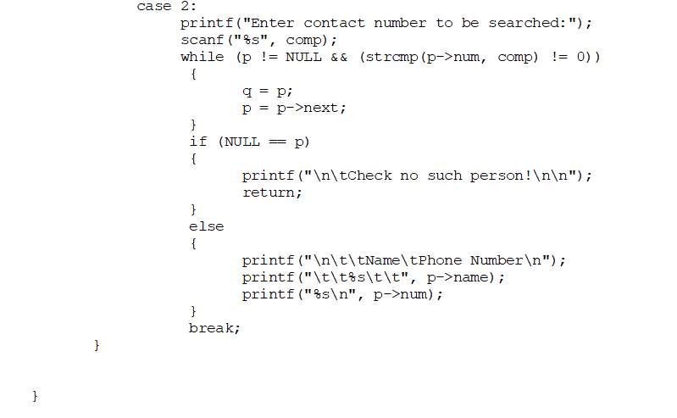
Search():
The following is the code snippet for search function. It allows user to search a particular contact using name or number.

Slide 19
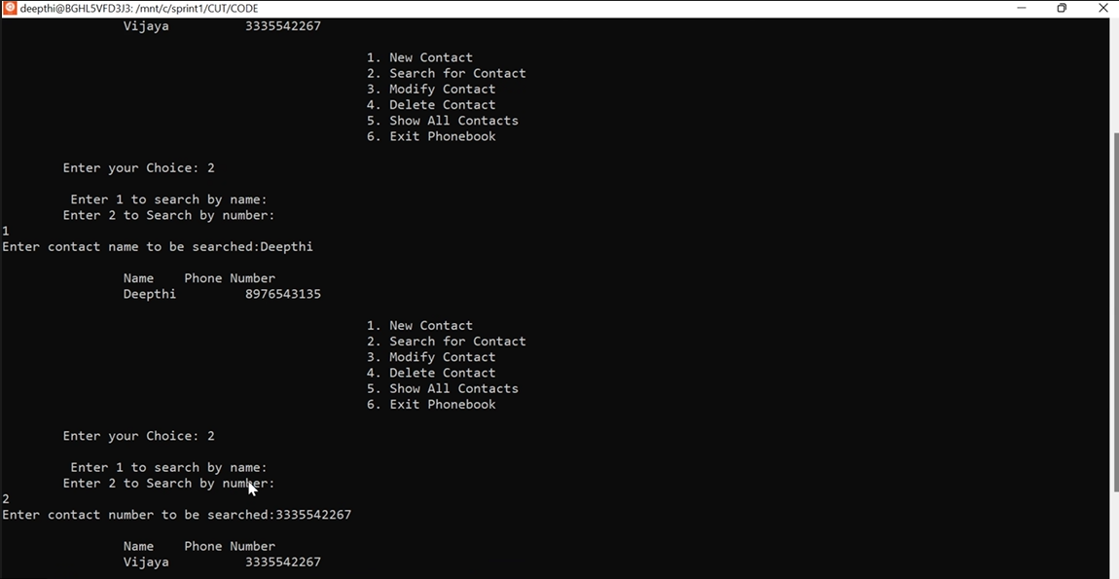

Slide 20
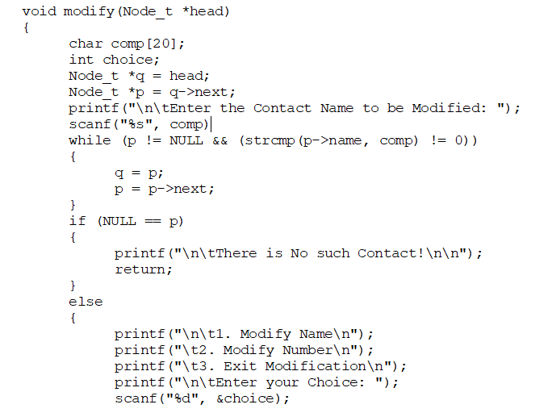
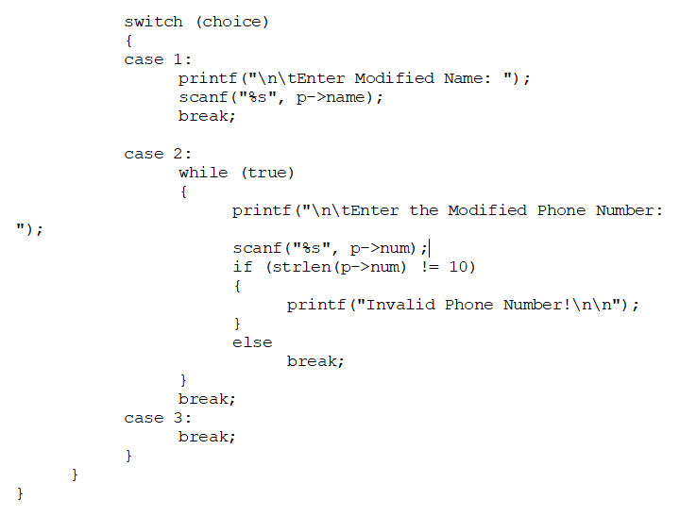
Modify():
The following is the code snippet for edit function. It allows user to perform modification on data of a particular contact i.e., modifying the name, number or email of the contact.

Slide 21
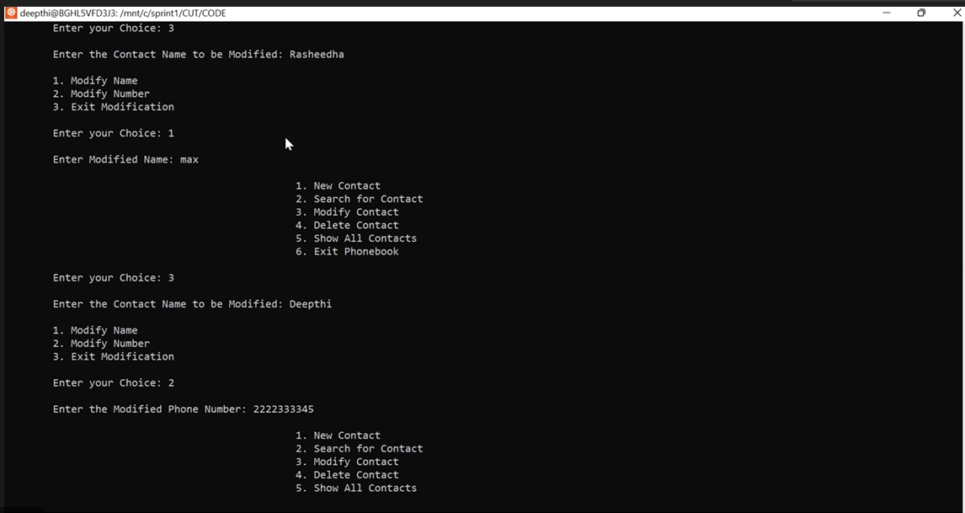

Slide 22
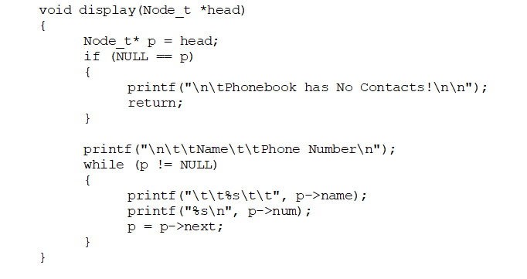
Display():
The following is the code snippet for display function. It allows user to see the entire information i.e., name, number and email of all contacts.

Slide 23
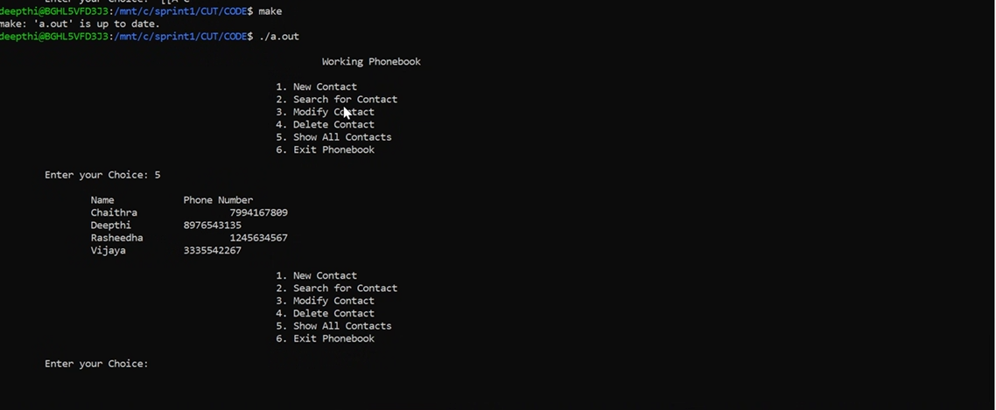

Slide 24
Advantages and Disadvantages:
It becomes easy for the user to store information about his/her contact.
Easy for user to search particular contact using name or number and can update the data anytime.
Sometimes it becomes difficult to store contacts with 2 or more contact numbers.

Slide 25
THANK YOU

