Slide 1
ZigBee™ Concepts
How to Use the ZigBee Standard to Build Robust Mesh Networks
Notes:
ZigBee is the networking technology of choice for monitoring and control in a wide variety of applications and devices in homes, buildings and industries. ZigBee standards and application profiles let you easily and cost effectively add intelligent new features that improve efficiency, reliability, convenience, safety and security of your products.
Don’t miss a great opportunity to understand ZigBee mesh networking and how you can incorporate the technology into products for smart energy (e.g., smart meters, programmable thermostats, in-home displays), home automation systems (e.g., lighting devices, HVAC, security, access controls) and many other applications.
This webinar from Silicon Labs will help you get a strong foundation in ZigBee concepts including architecture, clusters, device types, routing, network security etc. as well as an introduction to the Silicon Labs’ market leading Ember ZigBee Platform for speedy development of ZigBee Complaint products.
Finally, with regard to giveaways, here are some ideas:
(LUCKY ATTENDEES) Give non Silicon Labs products like iPod Touch…or,
(INCENTIVE TO BUY KITS) Discount coupon - 25%? - to any attendee that buys a Dev’ Kit within 6 months? Or,
(INCENTIVE FOR SERIOUS ATTENDEES) – FREE Schematic Review of Design within 12 months ($880 on price list), or
FREE Layout Review of Design within 12 months ($1045 on price list)

Slide 2

What is ZigBee?
The wireless mesh networking standard for monitoring and control
Low-power (mains or battery)
Simple (self-configuring)
Reliable and robust (self-healing)
Flexible (mesh topology)
Secure (built-in cryptography)
Low-cost
Market Name | Wi-Fi™ | Bluetooth™ | ZigBee™ | Sub-GHz Proprietary
Underlying Standard | 802.11 | 802.15.1 | 802.15.4 | Proprietary / 802.15.4g
Application Focus | Web, Email, Video | Cable Replacement | Monitoring & Control | Monitoring & Control
Battery Life (days) | 0.5‒5 | 1‒7 | 100 ‒1,000+ | 1000+
Network Size | 32 | 7 | 100s to 1000s | 10s to 100s
Bandwidth (K bits/s) | 11,000+ | 720 | 20‒250 | 0.5‒1000
Range (meters) | 12‒30+ | 1‒10+ | 1‒100+ | 1‒7000+
Network Architecture | Star | Star | Mesh | P2P / Star
Optimized For | Speed | Low Cost, Convenience | Reliability, Low Power, Low Cost, Scalability | Long Range, Low Power, Low Cost
Notes:
This slide highlights the differences between different wireless networking protocols. It can be used to guide the customer to the right solution for their application.
Wi-Fi®
Most widely adopted solution for high bandwidth data communications (11 Mbs and up). Typically used as a replacement for an Ethernet cable. Capable of supporting high bandwidth applications such as web, e-mail and video. Large installed based in both enterprise and home environments. Very high power consumption. Star network does not scale beyond 32 nodes, so multiple Wi-Fi hotspots are needed to serve a large number of nodes. Not currently supported by Silicon Labs products.
Bluetooth®
Most widely adopted solution for low bandwidth point-to-point communications. Typically used as a replacement for a low bandwidth cable such as USB or audio. Capable of supporting applications such as headset/speakers and low bandwidth data transfer. Large installed based in mobile phones. Power consumption can be low. Star network does not scale beyond 7 devices. New release (Bluetooth low energy (BTLE)) is gaining acceptance in Body Area Networks with the mobile phone as the hub. Not currently supported by Silicon Labs products.
ZigBee®
Standard solution for low power wireless sensor networks. Typically used for monitoring and control applications. Standard includes both communications and applications protocols. Standardized applications include Smart Energy and Home Automation (see next slide for more details). Hybrid-Mesh network can scale to 1000s of nodes. Optimized for extremely long battery life (up to 10 years). Currently only available at 2.4 GHz. ZigBee products are the focus of the rest of this presentation.
Sub-GHz/Proprietary
There are a number of other low power wireless networking standards such as KNX, Wireless M-Bus, etc and proprietary wireless networking protocols that operate in the sub-GHz range. These solutions are typically either a wireless replacement for an existing wired standard (KNX/wireless M-Bus) or focus on particular applications (e.g. proprietary Automatic Meter Reading protocols). Silicon Labs has a range of sub-GHz transceivers and wireless MCU products that can address this market. Please contact either Thomas Barber (thomas.barber@silabs.com) or Greg Fyke (greg.fyke@silabs.com) for more information on the sub-GHz products.

Slide 3
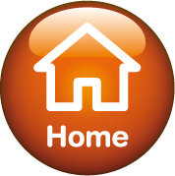


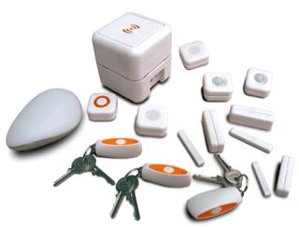
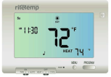
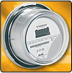
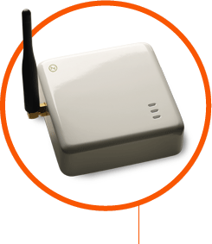
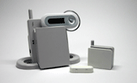




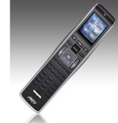
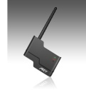
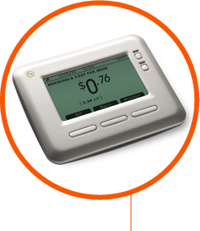

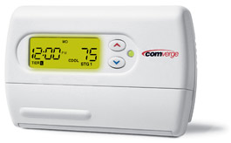
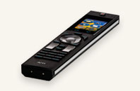





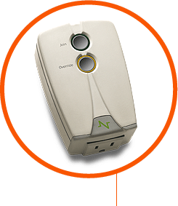
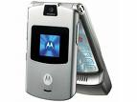

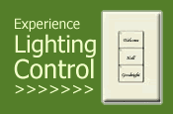
ZigBee Applications
Urgent demand for smart energy + compatibility with mainstream home automation systems enables customer choice
Utility AMI Network
Energy Services Portal (Electric Meter or Gateway)
Programmable Communicating Thermostat (PCT)
ZigBee HAN
In-Home Display
Load Control Device
3
HVAC System
Mobile Phone
Notes:
The purpose of this slide is to reinforce the fact that ZigBee is a standard for both applications and wireless networking.
The ZigBee standard supports a number of applications profiles including Smart Energy, Home Automation, Light Link, Building Automation, Remote Control, Health Care, Retail Services, Telecom Services and Input Device. Only the Smart Energy and Home Automation profiles are commonly used today. The Light Link profile has been endorsed by Osram and Philips, a top light control supplier, but is not widely deployed today.
The Ember ZigBee software provides complete reference application code for the Smart Energy, Home Automation and Light Link Profiles.
The graphic illustrates some of the devices supported by the Smart Energy (left side) and Home Automation (right side) Profiles
Smart Energy—smart meters, in-home display, programmable communicating thermostats (PCT), load control devices and smart appliances (not shown)
Home Automation—lighting devices (lights, switches, dimmers), closure devices (window shades), HVAC (thermostat, temperature sensor, pressure sensor, humidity sensor, pumps), security devices (display and sensors), access control (door/window locks) and remote controls
Not all of the customers shown are Silicon Labs customers .

Slide 4
ZigBee Systems Architecture
HCL
Custom OEM…
Application Profiles
(defined by ZigBee and OEMs)
HCL
Custom OEM…
App Profile
Custom OEM…
Home Automation (HA)
Building Automation (CBA) Smart Energy (SE)
+ more ...
ZDO
ZDO
ZDO
SSP
App Support (APS)
Stack Feature Sets (defined by ZigBee Alliance)
SSP
App Support (APS)
SSP
App Support (APS)
ZigBee 2007 Specification: - ZigBee
- ZigBee PRO
NWK
NWK
NWK
Radios (defined by IEEE 802.15.4)
Medium Access (MAC)
IEEE 802.15.4
Ratified Spring 2003
Physical Radio (PHY)

Slide 5
ZigBee Stack Architecture
{
Initiate and join network
Manage network
Determine device relationships
Send and receive messages
Application
Network organization
Route Discovery
Device Discovery
Message relay
Security
ZigBee Pro
Feature
Set
ZigBee
802.15.4
Medium Access
Physical RF

Slide 6
ZigBee Concepts: Application Profile
Determines application-level features, protocol
Examples: Home Automation (HA), Smart Energy (SE)
Defines device types with different capabilities (clusters)
16-bit “device ID” enumerates device type within the profile
Inherits network-level features from stack feature set
Majority of public profiles use ZigBee Pro as dominant stack feature set; non-Pro devices only allowed as end devices.
Most profiles interoperable with each other, except SE (due to security)
Identified by 16-bit application profile IDs
Profile IDs allocated, maintained by ZigBee Alliance
can request private profile IDs for custom applications

Slide 7
ZigBee Concepts: Clusters
A “cluster” is a set of message types related to a certain device function (e.g: Metering, Ballast Control)
Enumerated by 16-bit Cluster ID
ZigBee Cluster Library (ZCL)
Defines clusters for use in public profiles
Same cluster (and ID) can be used in multiple profiles
Allows for manufacturer-specific extensions (per cluster, attribute or command)
Groups clusters into “functional domains”, e.g. Lighting, HVAC
Defines “attributes” and “commands” for a given cluster
Uses “client” and “server” model of communication
Client sends messages to server; server maintains attributes
Standard command/messaging format to ensure interoperability, abstract command handling
Spec available for public download at zigbee.org website

Slide 8
ZigBee Concepts: Clusters
ZigBee Cluster Library
Application Profiles
Others…
Closures
Commercial Building Auto.
Safety & Security
Lighting
Others…
HVAC
AMI
Measurement & Sensing
General
Home Automation

Slide 9
Home Automation (HA) Profile
Defined by ZigBee Alliance’s ZHA group
Interface between devices in the home or small building
Often used in hospitality scenarios as well
Becoming key part of the emerging security / monitoring / automation (SMA) market
ZigBee Residential Security (NWK layer encryption)
ZigBee Pro required for routers and coordinators
ZigBee 2006/2007 feature sets supported for end devices
Small to large networks, generally with central gateways
Interoperability, ease of installation/setup are key concerns
Clusters used:
General (Basic, On/Off, Groups, Scenes, …)
Measurement/Sensing (Light, Temp, Pressure)
Lighting (Color Control)
HVAC (Thermostats, fans, pumps)
Closures (Shade controls)
Security/Safety (Alarms, zones, …)

Slide 10
Home Automation (HA) Profile – Device Types
General
Range Extender, On/Off Switch & Output, Level Control Switch & Output, Mains Outlet, Remote Control, Config Tool, Simple Sensor
Lighting
Light, Switch, Dimmer, Occupancy & Light Sensor
Closures
Shade & Controller
HVAC
Heater/Cooler, Thermostat, Temp / Pressure / Flow Sensor, Pump & Controller
Intruder Alarm Systems (IAS)
Warning Device, Controller/Indicator, Zone

Slide 11
Smart Energy (SE) Profile
Defined by ZigBee Alliance’s ZSE group
Interface between AMI and HANs
Security is a key concern
Standard Security + extra features
NWK layer encryption among all nodes in network
APS layer encryption among pairs of devices
Trust Center facilitates key installation
Key Establishment Cluster to negotiate unique keys via ECC
Anonymous messaging for AMI→HAN comms (pricing, events, etc. → Avoids need for dedicated bridge device
Typically ZigBee Pro, but ZigBee 2007 may be used for end devices
Utilizes fragmentation for larger messages
Uses channels that don’t overlap with WiFi
Clusters Used:
Key Establishment
Price
Demand Response / Load Control (DRLC)
Simple Metering
Message (for updating displays)
Over-the-Air [OTA] Bootloading (new in SE1.1)
Tunneling (complex metering) (not yet completed)
Pre-payment (not yet completed)

Slide 12
Smart Energy (SE) Profile – Device Types
Energy Service Portal (ESP) – gateway between utility and home; acts as ZC & TC
Metering Device (gas, water, electric, …)
In-Premise Display (IPD)
Programmable Communicating Thermostat (PCT)
Load Control Device (e.g. remote disconnect)
Smart Appliance
Prepayment Terminal
Range Extender

Slide 13
New Areas of ZigBee Development
Commercial Building Automation (ZBA group)
Large building control for lighting, HVAC, industrial systems
Supports BACNet tunnelling for legacy devices
Personal, Home and Hospital Care (ZHC group)
Improved monitoring and data collection
Telecom applications (ZTA group)
Number of applications for information delivery, location-based services, gaming
SMA [Security, Monitoring, Automation] (ZHA group)
Primarily implemented using HA profile
Offered by cable/telecom providers through set-top box

Slide 14
New Areas of ZigBee Development (cont.)
IPv6-based ZigBee stack for SE2.0 (ZIP, ZSE groups)
More easily facilitates ZigBee to IP/Ethernet bridging
New SE profile based on IEEE standards (ROLL, RPL, EXI, HTTP, …)
Better low power end device support (LPED, ZGP groups)
Battery-less end devices for ultra-low power applications
“Green Power” standard for energy harvesting devices
Retail Services (ZRS group)
Inventory management, UPC tracking, pricing, etc.
Standardization of Philips’ “SmartLight” protocol as ZigBee Light Link (ZLL group)
Colored, dimmable, LED-based lighting

Slide 15
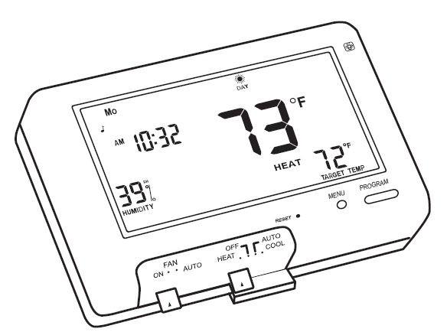
ZigBee Concepts: Endpoints
An endpoint is a service point within a ZigBee node–up to 255 endpoints/node
Endpoints 0 and 240-255 are reserved for special functions; endpoints 1-239 are available for user applications
Endpoint 0: ZigBee Device Object [ZDO]; used for network config/admin
Endpoint 255: Broadcast endpoint
Each endpoint implements a single device type from a single application profile
Different endpoints on a single node may represent devices from different application profiles
Endpoint numbers for devices/profiles not standardized across devices
Example endpoint implementation:
Endpoint # – Profile Name: Device Type
0 – ZigBee Device Profile (ZDP): ZDO
1 – HA: Thermostat
2 – HA: On/Off Output
3 – SE: In-Premise Display
4 – MSP: proprietary vendor extensions

Slide 16
ZigBee Concepts: Node Types
ZigBee Type | Notes
ZigBee Coordinator (ZC) | Special router that forms the network; only 1 per PAN
ZigBee Router (ZR) | No duty cycling available
ZigBee End Device (ZED) | Does not participate in routing; may be sleepy; requires ZC/ZR “parent” for network participation
ZC
ZR
ZED

Slide 17
ZigBee Concepts: PAN ID
16-bit identifier shared by all nodes in PAN
Used in MAC header to filter out traffic not pertaining to own network
ZC picks value upon forming network
Should be random to ensure uniqueness → Stack detects conflicts and updates network automatically

Slide 18
ZigBee Concepts: Extended PAN ID
64-bit extended PAN ID (EPID) known to all nodes in PAN; unique per PAN
Chosen by ZC at network formation time
Only sent OTA in response to Active Scan
Intended to enhance selection of eligible networks during scan/join activity, enable recognition of network after PAN ID change (due to previous conflict)

Slide 19
ZigBee Concepts: Addresses
EUI-64
Network Address
64-bit globally unique address (IEEE “MAC address”) assigned to each device at manufacturing; never changes | 16-bit network unique address (“node ID”) assigned to each device when it joins the network; may change over time
Notes:
-Should emphasize that EUI64 is set at mfg time and doesn’t change, whereas the short address can vary depending on the network environment.
-May be helpful to draw analogy between Ethernet MAC address → EUI64 and IP address → short address.

Slide 20
Creating a Network
ZC starts the network by choosing a channel and unique two-byte PAN-ID and Extended PAN ID.
ZR or ZED joins the ZC.
ZR or ZED joins the ZR. (ZR becomes the ZED’s “parent”.)
Network grows outward from ZC.
Notes:
Venkat says to add a legend here, but I think it’s clear enough, so I deleted his bright orange letters across the middle of the page.

Slide 21
Joining a Network
New ZR or ZED scans channels to discover all local (1-hop) ZR or ZC nodes
PAN ID/EPID, Stack feature set, Joining Allowed sent back to scanning node.
Application chooses a network to join; stack selects best join candidate and submits a join request
If accepted, the new device receives a confirmation that includes the network address. (Authentication then occurs as needed.)

Slide 22
ZigBee Concepts: Standard Security
Backwards compatibility with non-Pro ZigBee devices
Network Key (known to all devices in PAN)
Provides encryption (128-bit, 32-bit) of NWK layer and above
Security level = 5 (Only level supported by ZigBee)
All nodes share the same encryption key
Key can be pre-loaded or passed at join time
Key sequence # can be used to switch between keys
Trust Center (TC)
One device (typically ZC) serves this role for entire network; other devices can validate locally
Validates join requests for secure networks
Can authenticate nodes access based on security key

Slide 23
ZigBee Concepts: Security
Link key (known only to source and destination):
Link key may be pre-installed during manufacturing, passed during joining
Can use global (fixed) or unique (device-specific) link keys for each device pair.
Used to encrypt NWK key delivery between TC and joining node
Can also use these for APS encryption of certain application messages between any 2 nodes
TC can act as trusted 3rd party for creating a link key
Used in SE profile for passing sensitive customer data
Additional security constructs (CBKE, ECC, etc.) can be layered on top of this

Slide 24
Network Authentication Process
New device (“joiner”) associates to PAN through some “joinee” device already on PAN.
Joinee sends Update Device command to TC (encrypted with joinee/TC link key) with joiner’s identity.
If accepted, TC sends Tunnel Data command to joinee, encrypted with joinee/TC key
Payload contains NWK key for joiner, encrypted with joiner/TC link key
Joinee relays secure data to joiner as Transport Key command, encrypted with joiner/TC key
Joiner decrypts with its TC link key to get NWK key

Slide 25
ZigBee Concepts: Messages
Unicast messages
Direct transmission
Explicitly specify 16-bit destination network address (node ID) & endpoint
Indirect transmission
Application specifies only a table index; binding table or address table entry is used to determine destination parameters
Broadcast messages
Sent to “all” devices in the network
Can limit radius of propagation
Can limit reception by class of devices (all devices; non-sleepy only; routers only)
Multicast messages
Sent to a group of one or more nodes
Multicast table held locally to track group participation (via 16-bit group IDs); multicast binding for group also signifies membership
Can limit propagation radius by hops per group members versus non-members

Slide 26
ZigBee Concepts: Messages
Application populates APS frame for each transmission:
application profile ID
cluster ID
source & destination endpoint
APS options
APS options:
Include source and/or destination EUI-64 in frame
Encrypt message with APS layer link key
Use retries based on APS (end-to-end) ACK
Perform address or route discovery as needed (or by force)
Use fragmentation (spread payload across multiple deliveries)
- group ID (for multicasts)
sequence number

Slide 27
ZigBee: Routing and End Devices
ZED requires parent to participate in PAN
Parent is always first hop for ZED’s outgoing message, last hop for incoming
ZED Broadcasts get unicasted first hop
Indirect Transmission Timeout: Determines how long parents hold incoming messages for their children
If broadcast mask includes sleepy ZEDs, they must poll within timeout to get it → not reliable
APS ACK is sent (if required) by ZED, not parent, after pickup

Slide 28
ZigBee: Routing and Large Networks
0x2049 | 0x2154 | 5
0xA021 | 0x2154 | 2
0x422F | 0x1254 | 3
0x5E2D | 0x2154 | 9
0x1437 | 0xD312 | 3
0x379C | 0xD312 | 3
Routing table overflows!
Gateway
Large networks pose special challenges in ZigBee due to limited memory of embedded devices
Many nodes talking to one “concentrator” would require many broadcasts (route discoveries to common destination) inbound and will quickly overflow routing tables outbound, assuming traditional route discovery.
ZigBee provides aggregation mechanism [“many-to-one route request”] to build route to aggregator node from everyone with a single broadcast
Source routing (sender specifies route path) can be used at concentrator for outbound routes
Notes:
Routing tables in Zigbee are limited (usually something like 16 entries), and an entry is used for every route that a node is active in.
When a lot of nodes talk to one- like with a gateway or data aggregator, routing tables overflow (click)
Additionally, each node uses a broadcast to find the aggregator, wasting network bandwidth
(click) Ember provides an aggregation mechanism that allows a single broadcast to set up routes from each node in the network back to the aggregator (click)
Each time a node sends something using this route, a special temporary reverse route is created allowing the aggregator to send an ACK or other data without more expensive route discoveries that overflow the routing tables
Large networks are also often dense (ie- one node can hear many) - which causes another table to overflow (neighbor). This can have the effect of partitioning the network, since a node can only route through nodes in his neighbor table. Ember has a mechanism that minimizes the chance of partitioning, while ensuring the most efficient traffic flow through the network

Slide 29
ZigBee: Routing and Large Networks
Low RAM concentrator
buffers only most recent source route(s)
nodes send Route Record before every transmission to concentrator
OK if concentrator only talks to destinations in reply
High RAM concentrator
buffers many source routes
Route Record only sent initially (until first source-routed packet arrives from concentrator)
Great if resources permit

Slide 30
ZigBee: Manufacturer’s Extensions
ZCL allows for extensions that are manufacturer specific even in a fully ZigBee compliant and interoperable application.
Implemented in such a way that they can be easily ignored by devices that do not support these manufacturer extensions.
Standard ZCL Header in app. payload
Contains optional Manufacturer Code field
‘Private’ Cluster IDs can be used

Slide 31
ZigBee Concepts: ZDO
ZigBee Device Object (ZDO): Stack service on Endpoint 0 to facilitate discovery / administrative info from node
Requests/responses are standard in ZigBee NWK spec
Two general types of discovery in ZigBee:
Device discovery: find a 16-bit network address from an IEEE 64-bit address, or the reverse.
Service discovery: query a device or the entire network
Active Endpoints Request, Simple Descriptor Request
Devices and endpoints matching specified Profile ID and/or Clusters (Match Descriptor Request)
See ZigBee Device Profile section in ZigBee NWK Spec. for more
Applications can learn about the network around them:
Query device properties (tables, descriptors, configuration, etc.)
Set properties of remote devices (e.g: ask node(s) to permit joining, leave the network, bind/unbind to a destination)

Slide 32
ZigBee Concepts: Addresses
EUI-64
Network Address
Endpoint
Cluster ID
64-bit globally unique address (IEEE “MAC address”) assigned to each device at manufacturing; never changes | 16-bit network unique address (“node ID”) assigned to each device when it joins the network; may change over time | 8-bit logical address within a device (similar to TCP port); each device or service implementation occupies an endpoint | 16-bit field used as an application-specific message type
Notes:
-Should emphasize that EUI64 is set at mfg time and doesn’t change, whereas the short address can vary depending on the network environment.
-May be helpful to draw analogy between Ethernet MAC address → EUI64 and IP address → short address.

Slide 33
ZigBee Concepts: Binding Table
Bindings define persistent device relationships by matching a local endpoint to a remote endpoint & EUI-64
Not required for ZigBee communication, but useful for frequently used, persistent communication paths
Table stored locally at each device; non-volatile
Binding type can be unicast, multicast or many-to-one
“Cluster ID” is associated with each entry; represents the area of functionality (cluster) that the binding is used for (e.g. On/Off cluster)
Remote node ID cache is also maintained (in RAM) to help resolve node ID → EUI64 mappings for Binding Table destinations
External provisioning tool can remotely create/delete entries via ZDO bind/unbind requests.
Source | Destination
8-bit source endpoint | 64-bit MAC address or 16-bit group address 8-bit destination endpoint
maps to

Slide 34
Ember ZigBee Platform

Slide 35
Ember ZigBee Platform
Complete, ready for certification “template applications”
Customer Applications
Development Tools
The most robust, reliable, and comprehensive ZigBee PRO software solution
EmberZNet PRO
Software
Most integrated and complete development environment
EM351 or EM357
Industry leading performance, code density and power consumption
Notes:
35
This slide highlights the total value Silicon Labs delivers for ZigBee.
The hardware is just a piece of the overall solution. The value of the Silicon Labs Ember ZigBee platform includes:
The best networking software (EmberZNet PRO)
Complete reference applications the customer can use to quickly bring new products to market.
Unique development tools that enable customers to quickly build and debug complex networks.
The next few slides will go into detail on each of these topics.

Slide 36
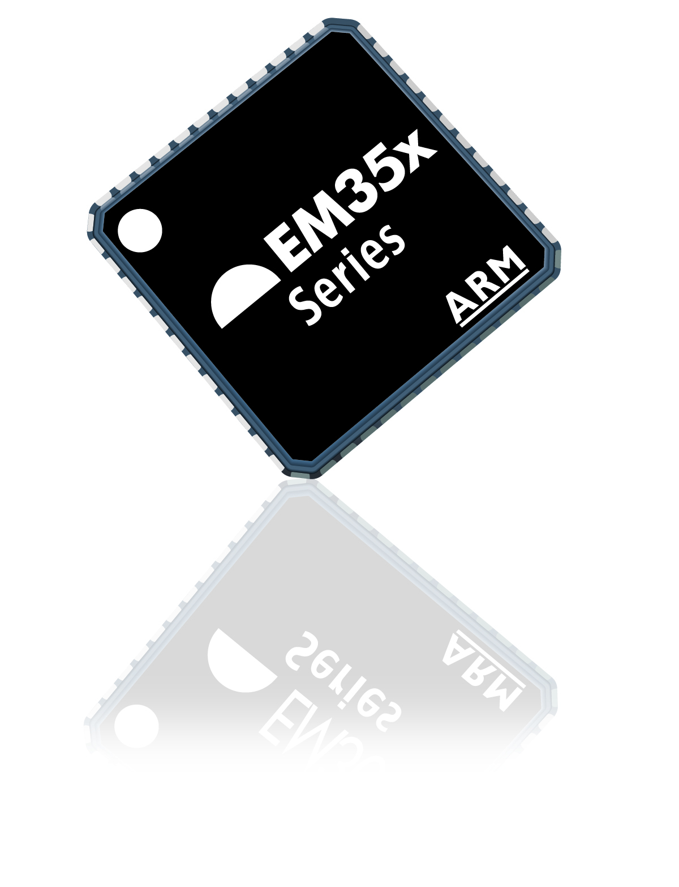
EM35x Series ZigBee System-on-Chip
Third generation ZigBee mesh networking semiconductor systems
Industry’s first ARM Cortex-M3 based ZigBee SoCs
Industry leading performance, code density and power consumption
EM351―integrates an ARM Cortex-M3 processor, IEEE 802.15.4 RF transceiver, 128 kB flash and 12 kB RAM and EmberZNet PRO network protocol stack supporting the ZigBee PRO Feature Set
EM357―optimized for applications that require more memory, it has 192 kB flash and incorporates all the other characteristics and features of the EM351
Notes:
This slide highlights the main features of the EM351/EM357 products including:
ARM Cortex-M3 which can be used to run both the ZigBee software and customer applications
Most of our competitors (TI (8051), Atmel (AVR)) are 8-bit solutions
Freescale recently announced a 32-bit Cortex-M4 solution
Integrated 2.4 GHz RF transceiver supporting IEEE 802.15.4
ZigBee is based on the 2003 release of IEEE 802.15.4
We do not currently support non-ZigBee protocols based on IEEE 802.15.4 on the EM351/357 (only ZigBee is supported today)
Either 192 kB (EM357) or 128 kB (EM351) of FLASH and 12 kB of RAM
Amount of FLASH required depends on the applications support required
The slides should be used to reinforce the idea that the value of the Silicon Labs ZigBee solution goes beyond the hardware. The software and tools are a big part of the product differentiation.
EM35x Key Product Strengths
Hardware
World Class RF performance → longer range/more reliable networks
Industry leading CPU performance → enables single-chip systems
Ultra-low standby current → up to 10 years of battery life
Software
Best-in-class ZigBee stack and application layer → reliable/scalable network
ZigBee Alliance certifiable reference application code → faster time to market
Tools
Unique packet trace capability enables full network analysis → fast debug
Simple graphical Ember AppBuilder interface → ZigBee certifiable applications
Technology leadership
Chair several ZigBee Alliance committees → driving next generation features
Leading the development of ZigBee IP → only open standard for 6LoWPAN

Slide 37
Silicon Architectures
Other System Functions
Host MCU
ZigBee System-
on-
Chip
App’n
APP
APP
…
ZDO
SSP
APS
ZigBee Network Co-Processor
Stack
NWK
MEDIUM ACCESS (MAC)
Radio
PHYSICAL RADIO (PHY)
Network Co-Processor (NCP)
ZigBee stack runs on EM35x, application runs on host processor
“Gateway” class devices—smart meters, in-home display, thermostats, router
System-on-Chip (SoC)
ZigBee stack and application run on EM35x
“End” devices—sensors, lamp/appliance modules
Notes:
37
The EM351/57 products can be used either as a Network Co-Processor (NCP) or as a full System-on-Chip (SoC).
If the application includes a large SoC (TI OMAP, Broadcom Cable Modem SoC, etc), the customer may prefer to run all of the applications code on the large SoC. The EM35x solution can be configured so only the MAC/PHY and networking stack run on the EM35x. The Ember AppBuilder tool provides source code that can be integrated into the larger SoC. The interface between the EM35x and the large SoC would be the EmberZNet Serial Port (EZSP) which is based on an SPI protocol.
If the application is relatively simple, the customer can run the full application on the EM35x. In this mode the EM35x acts as the system SoC.

Slide 38
EmberZNet PRO Software
Complete ZigBee PRO Feature Set Stack (Most Deployed ZigBee Stack!)
True mesh routing
Stochastic Addressing
Fragmentation
Standard Security
Frequency Agility
PAN ID Conflict Resolution
Many-to-one routing
Ember ZNET PRO
Enhanced Features
Asymmetric links
Intelligent table management
Single stack for end point, router & coordinator
Certifiable Reference Applications
Certified HA, SE & LL Profile applications
Full ZigBee Cluster Library (ZCL) implementations
Flexible APIs
Ember AppBuilder Tool
Customer Applications
Development Tools
Reference Apps
Flexible Utilities
Full-featured bootloader options
Robust Mfg test libraries
Powerful debug options
Utilities
Ember ZNet PRO Stack
EM351/EM357
Notes:
This slide highlights the main feature of the EmberZNet PRO protocol stack software. The EmberZNet PRO stack is the most robust, scalable and mature ZigBee PRO stack available. The first seven features listed on the left side are all standard ZigBee features. The last three features are unique to the EmberZNet PRO stack from Silicon Labs.
The asymmetric link feature ensures the link is good in both directions before connected two nodes. This is critical in networks with devices from multiple vendors whose transmit output power and receive sensitivity are different.
Intelligent table management enables denser networks by forcing the routers to chose neighbors that cannot communicate directly. This enables messages to get out of dense networks (like a building utility center with hundreds of electric meters) with fewer hops which improves the bandwidth and latency of dense networks.
Unlike other ZigBee solutions, the EmberZNet PRO stack can be configured as an end point, router or coordinator at run time. The allows for more flexibility in both the device and network design.
ZigBee PRO stack (EmberZNet PRO)
These are all standard features of the ZigBee PRO stack.
True mesh routing—routes chosen my link quality. Network self-heal if a route breaks.
Stochastic addressing—enables the network to scale to thousands of nodes
Fragmentation—enables support of messages longer than the maximum payload for a given burst
Standard security—128-bit security is standard for ZigBee
Frequency agility—allows an entire network to switch frequency if there is a new source of interference
PAN ID conflict resolution—enables selection of a new PAN ID if there is a conflict with another network
Many-to-one routing—reduces network traffic by enabling a single broadcast message to multiple end-points.
Certifiable Reference Applications
Solutions for Home Automation (HA), Smart Energy (SE) and Light Link (LL) profiles available.
ZCL = Zigbee Cluster Library → basic functions that are used to build ZigBee applications profiles
ZCL can be used to develop ZigBee standard profiles that are not currently supported by Silicon Labs or to develop custom applications profiles
Ember AppBuilder tool is a simple graphical interface that enables quickly building ZigBee compliant applications (see later slide for more details).
Flexible Utilities
Full-featured bootloader—enables local or over the air (OTA) reprogramming of the stack and applications code
Robust manufacturing test library—allows the same software image to be used for manufacturing test and normal operation
Powerful debug options—enables full visibility into network for debug and testing (see “Development Tools” slide for more details)

Slide 39
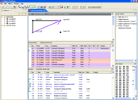
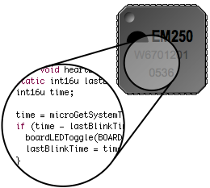
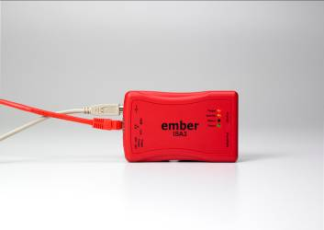
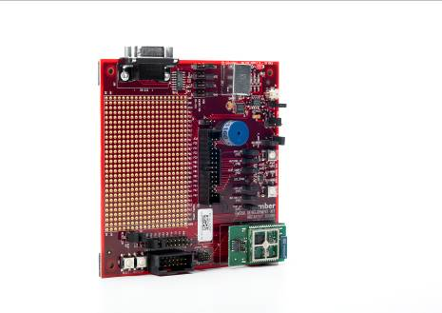
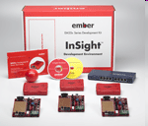
Development Tools
Desktop Network Analyzer
Debug Adapter
Packet Trace Port
Desktop Network Analyzer provides a macroscopic view of the entire network from single console
Debug Adapter provides a high-speed back-channel link between Desktop Network Analyzer and node
Packet Trace Port reaches deep inside the silicon to trace packets and to monitor and control the application.
Development Kits
Pre-packaged Desktop Network Analyzer, debug adapter and development boards for verifying initial hardware and software designs
Notes:
This slides highlights the benefits of the development tools that are provided with the Ember ZigBee solution. The key message is that the tools enable a unique programming and network debugging environment. The customer has full visibility into the network to enable development and debugging of complex networks. The Ethernet backchannel allows networks to be debugged remotely across a standard local area network (LAN). Results in a higher quality more reliable product and faster time to market.
Packet Trace Port—hardware based packet monitoring records each packet transmitted or received and makes it available through a simple two wire serial port
Debug Adapter—provides a bridge between the Packet Trace Port and the Desktop Network Analyzer using a standard Ethernet connection. Can be powered by PoE to reduce wiring required.
Desktop Network Analyzer—GUI that allows the user to view the activity of any node in the network and trace the activity through the applications and network layers down to the packets transferred over the network. Enables fast debugging of network activity.
Development Kits—contain all of the hardware/software required for a customer to develop a simple 2-3 node network.
- Hardware: Radio control modules (3), breakout board (3), debug adapter (3), variety pack of EM35x modules, 8-Port switch with POE, all cables necessary to connect the equipment
- Software: Desktop Network Analyzer, Ember AppBuilder, IAR Embedded Workbench (either 30-day trial or 1-year license)
EM35x NCP Add-on Kit—contains additional hardware to use the EM35x as a Network Co-Processor (NCP)
- Hardware: EM35x NCP breakout board, EM35x module, STM32 host module, battery pack

Slide 40
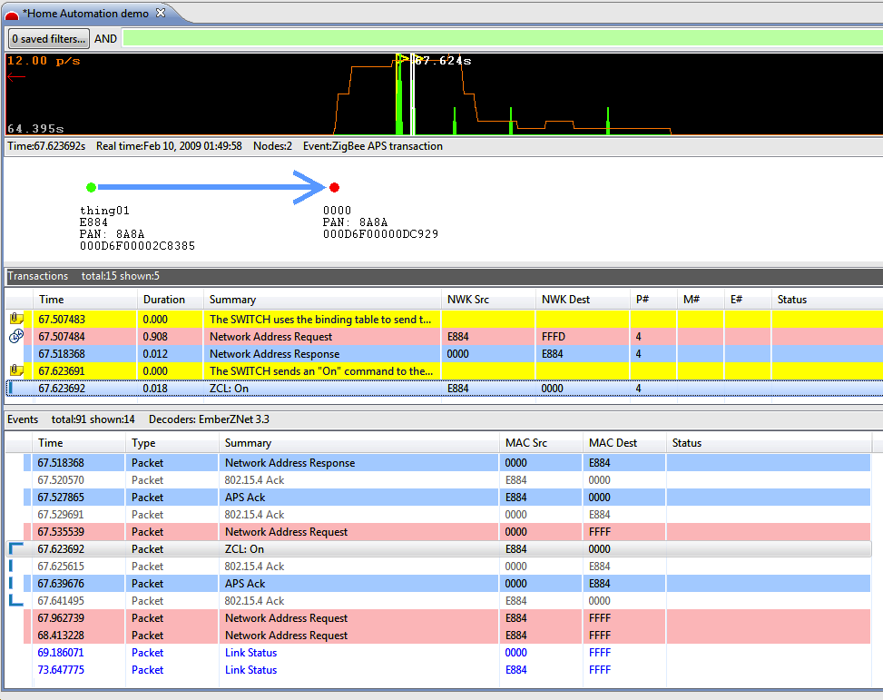
Desktop Network Analyzer
True network-level development platform:
Network-wide view of all packet activity
Decodes all standard ZigBee ZCL commands/activity
Correlates network traffic into higher-level events
Leverages Ethernet out-of-band “backchannel” to provide true activity
Custom decoding and filtering options
Online Video Demos:
http://www.silabs.com/products/wireless/zigbee/Pages/zigbee-training-videos.aspx
Notes:
This slide highlights the features of the Desktop Network Analyzer. The Desktop Network Analyzer enables fast network debugging by providing multiple views of the network activity allowing users to quickly spot time periods of interest, view the transactions both graphically and in text and look at the packets transferred during each transaction.
Filtering can be applied to each level of the activity to allow users to quickly identify nodes, transactions, packets and other parameters of interest.
The top section of the screen (mostly black) shows the overall network activity. This can be used to quickly identify time periods of interest (heavy activity, light activity, etc)
The second section (with the arrow) graphically illustrates the type of transaction being highlighted (in this case a unicast from “thing01” to “0000”)
- This section can be customized to show details about the location and or relationship between the nodes
The third section is a transaction level view of the activity for the given time period. The transaction view interprets the ZigBee cluster activity and displays the activity in more descriptive terms.
The Fourth section is a packet level view of the activity. This shows all of the packet level transfers for the given transaction.

Slide 41
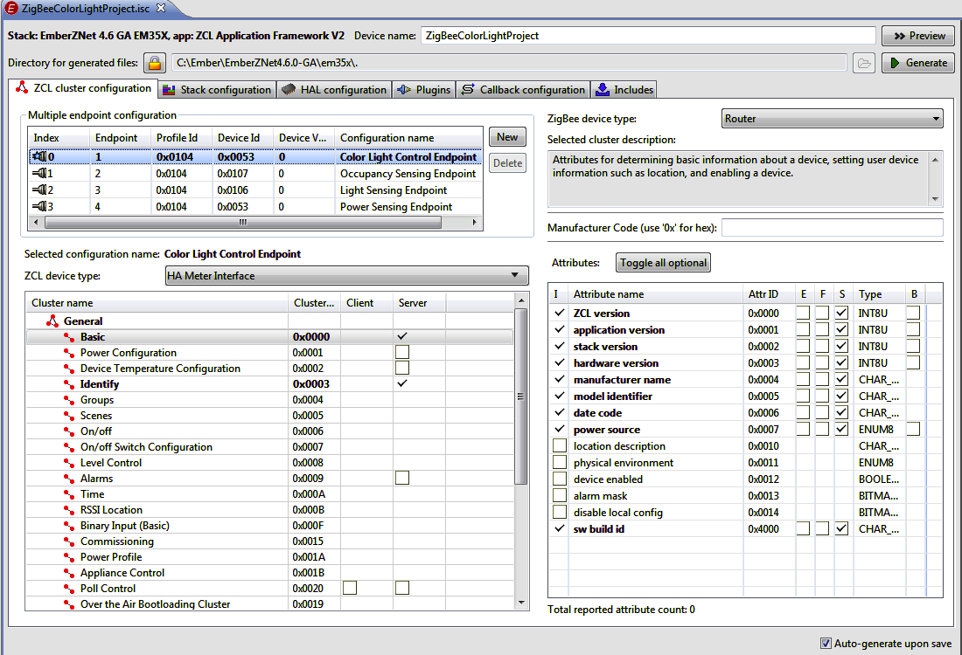
Ember AppBuilder
Generates complete, ready for certification “template application”
Enables “ZigBee Certified Products” based on standard application profiles
Simple graphical interface to select device and network parameters
Device type, commands and behaviors
Automatically includes the ZigBee Cluster Library (ZCL) attributes and reporting
Network forming and joining behaviors
Security modes and operation
Easy vendor customizations
Simply add vendor-specific code to complete the application
ZigBee Cluster Library
Application Profiles
Others…
Closures
Commercial Building Auto.
Safety & Security
Lighting
Others…
Measurement & Sensing
HVAC
Home Automation
AMI
General
Notes:
This slide highlights the benefits of the Ember AppBuilder tool.
The Ember AppBuilder tool provides a graphical interface allowing customers to quickly configure one of the existing applications profiles (Smart Energy, Home Automation or Light Link) or build new applications profiles using the ZigBee Cluster Library (ZCL). The Ember AppBuilder enables fast/easy development of products ready for ZigBee Certified Product testing.
The Ember AppBuilder tool also provide a graphical interface for configuration of the network and each device in the network.
The output from the Ember AppBuilder tool is source code the can be compiled to run either on the EM351/57 or another host processor. Customers can easily add their own device specific code into the Ember AppBuilder output to create complete applications.

Slide 42
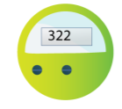














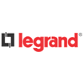




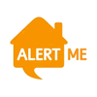
















Most Widely Accepted ZigBee Solution
Smart Energy
+ most other leading AMI vendors
Home Automation & Monitoring
Commercial Building Automation
+ many other tier 1 HVAC & Lighting vendors
Other Applications
Notes:
The Ember ZigBee solution is the most widely accepted ZigBee solution in the market. Major players in each of our key markets have chosen to use our solution.
Smart Energy
- Smart Meters—Landis+Gyr, Itron, Elster
- Home Automation Networks (HAN)—Trillian, Tendril
- Smart Appliances—GE
Home Automation—iControl, Control4, AlertMe, LG, Legrand
Commercial Building Automation—Scheneider Electric, Siemens
Other Applications
- Modules—Digi, CEL, Telegesis

Slide 43
Resources

Slide 44
Support Resources
Ember Developer Portal: www.silabs.com/zigbee-support
FAQ area:
Questions, solutions and tutorials from experienced Ember FAEs
Documentation, Reference Designs
Software Releases
Current versions of Ember software and tools for download → updates about new versions
Access restricted to registered Ember customers, partners, distributors →
Contact portal-logins@silabs.com to request a login
Support Ticketing
Online case tracking/creation
Access to Ember’s global team of experienced Field Application & Support Engineers
Other engineers from your team can view case history

Slide 45
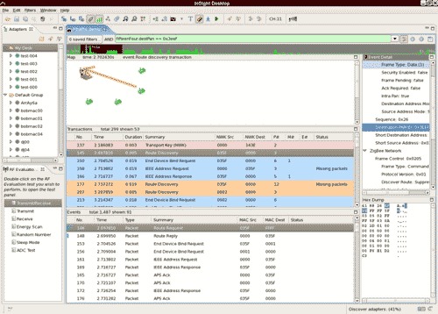
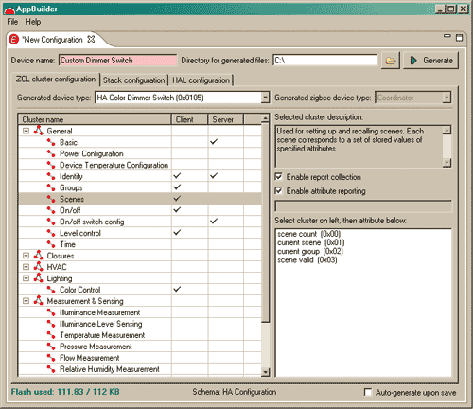
Software Development Tools: Overview
Eclipse-based tools provide:
Real-time and pre-loaded network logging
ZigBee packet decoding, including ZCL frames and Ember proprietary message types
Can decode custom command frames described by AppBuilder XML files
TCP/IP-based programming and debugging of network via debug adapter
Connectivity graph, link quality indication
EWARM for ARM Cortex-M3
Standard IAR toolchain
Licensing available through IAR Systems
ANSI C Compiler, Assembler, Linker
Familiar IDE structure (workspaces contain projects, which contain build-specific configurations)
Source-level debug support
Debugging via SerialWire or JTAG
Desktop Network Analyzer
Ember AppBuilder
Notes:
Can capture from 2 kinds of sources:
Dedicated Sniffer: Special “Sniffer” application loaded on a node. Sniffer isn’t part of the network, just listens to it.
Non-sniffer nodes: Can capture while running any application. Radio captures any packets that the stack is handling for routing, delivery, etc. Device is part of the network, so traffic is only captured when radio is awake. Also can capture API/Debug traces if using Debug stack library or EZSP/ASH traces if node is an NCP.
All data (regardless of PAN ID) is captured unless PAN filter is specified in ISD “Capture with Options” dialog

Slide 46
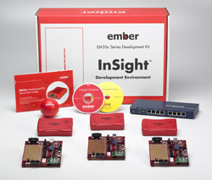
Hardware Overview: Development Kit
Breakout Boards, Radio Modules
Rapid prototyping and development
Debug Adapter for EM35x (ISA3)
Enables on-chip and network-level debugging
Power-over-Ethernet support
Embedded Software
EmberZNet libraries (binary)
Supporting peripheral drivers (source)
Sample application source code
PC-Based Software
Desktop Network Analyzer – development and deployment stage debugging
IAR EWARM-256 (30-day trial or permanent) - compiler environment, source-level debug
Notes:
Available Hardware:
ISA3 (for use with any EM300 series device)
Breakout board for EM35x
Provides access to peripherals, prototyping
RCM (Radio Communications Module)
Kit uses CotS module: ETRX3 by Telegesis
Many variants available; contact Telegesis for pricing, availability
Other modules available through third parties
Additional kit supplement available for network coprocessor [NCP] development
P/N: EM35X-NCP-ADD-ON
Available separately through Ember distributors
Includes STM32F103RET host MCU
Supports SPI and UART to STM32 or to off-board connection

Slide 47
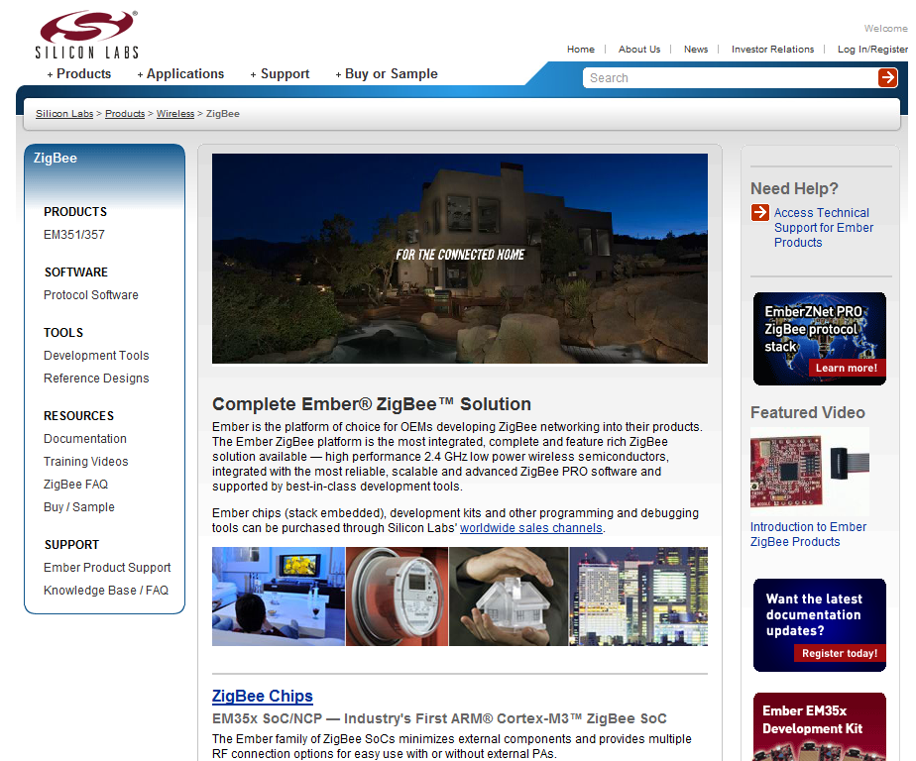
Website Support: www.silabs.com/zigbee
Product portfolio
Dev tools
Training Videos
Full product documentation!
Technical Support & FAQs
Notes:
All product pages have the following information available on the Silicon Labs website: Product portfolio, technical support, documentation and development tools links, and application pages relevant to the product family.

Slide 48
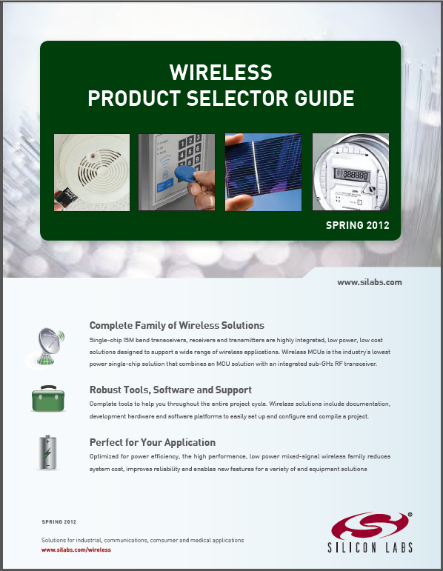
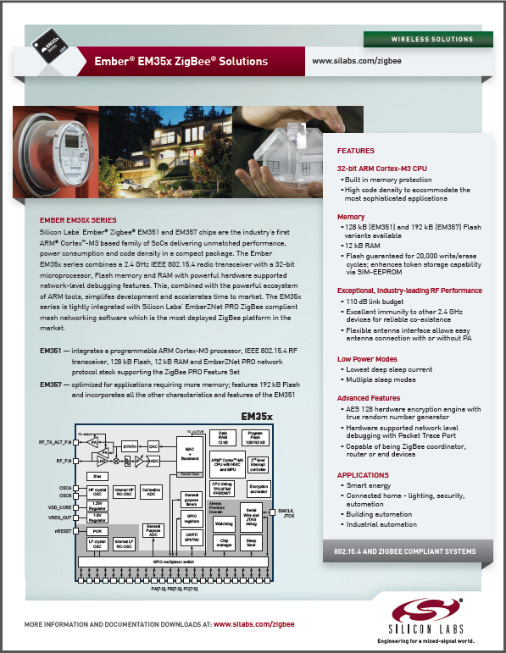
Get Started Today!
Download Documentaion
Wireless Product Selector Guide
Ember Product Solutions Guides
Data Sheets, etc.
www.silabs.com/zigbee
Development tools from Edom: Available Now
www.edom.tw
Orderable part numbers:
Ember Development Kits: EM35X-DEV or EM35X-DEV-IAR
Debug Adapter: ISA3

Slide 49
Special Offer for Attendees
Order by February 28, 2013, and receive a 25% discount off the regular price of $2,500 for an EM35x Development Kit.
Use offer code:
ZBWEGS12

Slide 50
Thank you!
www.silabs.com/zigbee

Slide 51
Glossary & Abbreviations

Slide 52
ZigBee terms & abbreviations – IEEE 802.15.4
FFD = Full-Function Device
Implements all MAC functions; able to serve as a coordinator
RFD = Reduced Function Device
Implements subset of MAC functionality; no coordinator ability
MIC = Message Integrity Code
PAN = Personal Area Network
A single unique ZigBee / IEEE 802.15.4 network
DSSS = Direct Sequenced Spread Spectrum
CCA = Clear Channel Assessment

Slide 53
ZigBee terms & abbreviations – ZigBee Stack components
APS = Application Support layer
Handles end-to-end (multi-hop) comms
NWK = Network (Networking layer)
Handles routing, addressing, joining/forming
MAC = Medium Access Control (layer)
Handles point-to-point comms
PHY = Physical layer
Handles transmission of bits over airwaves
SSP = Security Services Provider
Security engine interfacing with other layers
ZDO = ZigBee Device Object
Software entity built into the stack for handling administrative queries/responses

Slide 54
ZigBee terms & abbreviations – ZigBee node types
ZC = ZigBee Coordinator
Principal controller of the PAN; 1 per network; an FFD
ZR = ZigBee Router
Relays messages; doesn’t duty cycle; an FFD
ZED = ZigBee End Device
Doesn’t relay messages; an RFD; depends on an FFD (parent) for routing inbound/outbound
TC = Trust Center
Handles authentication for devices entering the network
NM = Network Manager
Device responsible for handling frequency agility and PAN ID conflict resolution

Slide 55
ZigBee terms & abbreviations – Key ZigBee terms
Association: process of gaining membership into PAN
Authentication: process of gaining authorization to communicate securely among other devices in PAN
Binding: creating logical/functional links between devices (at application level), such as switch to light or client to server
Cluster: a message type in the application, usually pertaining to some command or attribute; signified by Cluster ID
Commissioning: creating/modifying network-level device relationships (ZC/ZR/ZED) in PAN through association
Endpoint: logical software component on a ZigBee device (like a “port” in Ethernet terms) for handling device functionality at application layer; not to be confused with “end device”
PAN ID: PAN Identifier, used to delineate networks
EPID = Extended PAN ID; used for further disambiguation of PANs
Provisioning – process of matching up devices in network to other devices with compatible services, usually via binding

Slide 56
ZigBee terms & abbreviations – Smart Energy
(Z)SE = (ZigBee) Smart Energy Profile
HA = ZigBee Home Automation Profile
ESP = Energy Service Portal
HAN = Home Area Network
Local Communications
NAN = Neighborhood Area Network
“Last Mile” Communications
SKKE = Symmetric-Key Key Establishment
CBKE = Certificate-Based Key Exchange
ECC = Elliptical Curve Cryptography
MIC = Message Integrity Code

