Slide 1

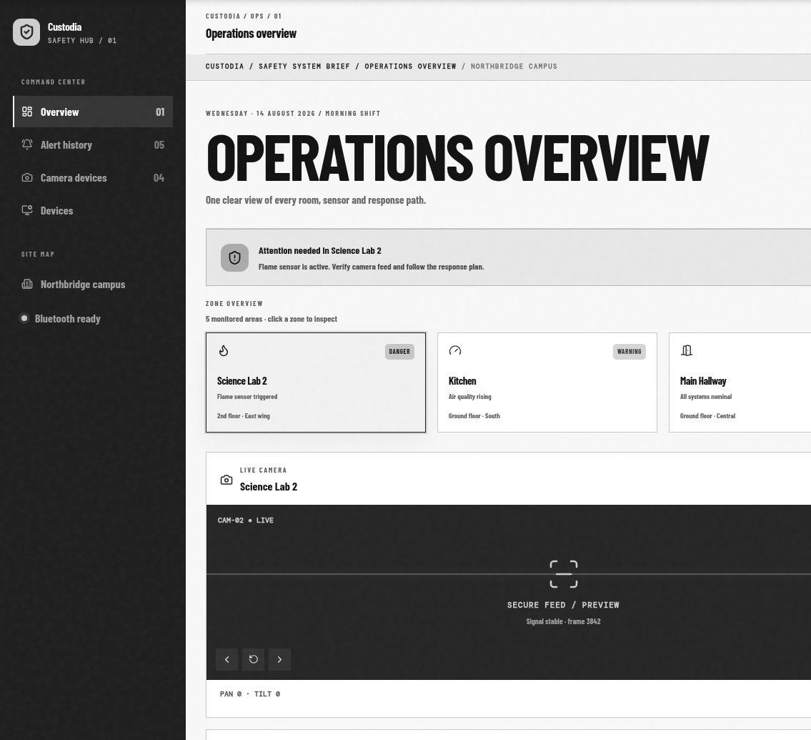

CUSTODIA
SAFETY HUB |01
PROJECT CALL |2026
PRESENTATION / OVERVIEW
Custodia
Real-time hazard detection
meets instant situational
awareness
MONITORING
TELEMETRY
RESPONSE
multi-zone
real-time
guided
OPERATING THESIS
Turn passive alarms into a live safety
picture that guides action.
OPERATING THESIS
CUSTODIA | PROJECT CALL
PRESENTATION | OPERATIONS BRIEF

Slide 2
CUSTODIA
SAFETY HUB | 01
01 | OVERVIEW
OBJECTIVES
THE PROBLEM
Continuous awareness, not just
Standard alarms are
an alarm.
passive.
They alert but do not guide
01
02
occupants to safe exits or give
Continuous multi-zone
Real-time telemetry
responders live data: gas levels,
monitoring
via MQTT / HTTP
exact location, and visual
confirmation.
03
04
That increases evacuation time and risk.
Smart dashboard with
Automated threshold-based
live gauges / video
alerting
UN SDG 8
UN SDG 11
Workplace Safety
Sustainable Cities &
Communities
CUSTODIA |PROJECT CALL
PRESENTATION \OPERATIONS BRIEF

Slide 3
CUSTODIA
SAFETY HUB |01
02 | BUSINESS LOGIC
ALERT PIPELINE
One reading becomes one coordinated response.
01 / SENSE
02 / DECIDE
03 / ACT
LOCALLY
04 / PUSH
05 / COORDINATE
Sensor reads
Compare
Alert payload
Notify
value
→
threshold
→
Buzzer / LED /
→
MQTT / REST to
→
responders
gas, flame,
warning or
relay
backend
log, update,
temp, humidity
critical state
node reacts
notify
immediately
DECISION RULES
STATE MODEL
WARNING
CRITICAL
AUTOMATION
Normal
Gas ppm rising or
Flame detected or
Relay-based power
Warning
temp / humidity out
gas crosses
cutoff on critical
of range
critical threshold
gas / flame
Critical
CUSTODIA |PROJECT CALL
PRESENTATION |OPERATIONS BRIEF

Slide 4
CUSTODIA
SAFETY HUB | 01
03 | APPLICATION
APPLICATION OF THE IDEA
The same safety picture,
wherever the zone is.
A low-cost node becomes
useful when it joins a shared
operational view.
SCHOOLS
RESIDENTIAL BUILDINGS
INDUSTRIAL WORKPLACES /
WAREHOUSES
Protect shared spaces.
See risk by room.
Coordinate the response.
Detect gas, flame, or unsafe
Give facility teams a
conditions across classrooms,
multi-building status grid instead of a
Combine concentration, exact
labs, and common areas.
single alarm tone.
location, and visual confirmation
for faster, safer decisions.
FACILITY MANAGER VIEW
FIRST RESPONDER VIEW
Multi-building status grid
Video + concentration + exact location
Spot which building, zone, or room has an issue before
walking the floor.
Turn an abstract alert into a scene responders can act
on.
CUSTODIA |PROJECT CALL
PRESENTATION |OPERATIONS BRIEF

Slide 5
CUSTODIA
SAFETY HUB | 01
04 |SYSTEM DESIGN
HARDWARE & COMMUNICATION
A practical prototype with a clear path to
deployment.
HARDWARE TIER
COMMUNICATION TIER
Prototype tier → Wi-Fi tier
MICROCONTROLLER
Arduino UNO prototype → ESP32 deployment
Sensor nodes push JSON telemetry over
MQTT / REST API, or serial / Bluetooth
SENSORS
in the prototype build.
MQ-2 / MQ-135 gas sensor + flame sensor
ACTUATORS
ZONE NODE
PAYLOAD
SENSE
→
JSON / MQTT
Buzzer, status LEDs, relay module
zone_id +
reading +
timestamp
PROTOTYPE LINK
HC-05 Bluetooth for local / short-range telemetry
ZONE NODE → COMMUNICATION → SHARED OPERATIONAL VIEW
CUSTODIA |PROJECT CALL
PRESENTATION |OPERATIONS BRIEF

Slide 6
CUSTODIA
SAFETY HUB | 01
04 |SYSTEM DESIGN
DATABASE LAYER, DESIGN MODEL & UI
Firebase / Node.js stores
The dashboard is a live model of the facility.
live state, historical
logs, and alert events.
COLLECTIONS / TABLES
Responsive dashboard
LIVE STATE
zones
building, room, status
MULTI-BUILDING STATUS GRID
ZONE TELEMETRY
sensor_readings
North
Lab 2
Bay 4 / Gas
42 ppm
Normal
Warning
timestamped readings
ESP32-CAM online / last-seen 08:42
alerts
Bay 4
South
Critical
Normal
Historical log feed
severity, zone, resolved status
08:42 / critical alert pushed
devices
node ID, mapping, last-seen
ONE SHARED PICTURE, EVERY ROOM AND RESPONSE PATH.
CUSTODIA |PROJECT CALL
PRESENTATION | OPERATIONS BRIEF

Slide 7
CUSTODIA
SAFETY HUB |01
04 | SYSTEM DESIGN
SYSTEM ARCHITECTURE & PROTOTYPE WIRING
From sensor node to situational awareness.
SENSOR NODE
COMMUNICATION LAYER
DATABASE
DASHBOARD / UI
→
MQTT / REST /
live state + logs +
gauges + video +
gas + flame + actuation
→
Bluetooth
alerts
response
CIRCUIT / WIRING VIEW
DESIGN PRINCIPLE
MQ-2 / MQ-135
The node can fail locally without hiding the
Arduino
→
→
Relay
story.
UNO
Flame sensor
cutoff
Buzzer, LED, and relay respond at the edge.
HC-05 Bluetooth
The backend keeps the facility team informed
and the event traceable.
CUSTODIA | PROJECT CALL
PRESENTATION |OPERATIONS BRIEF

Slide 8
CUSTODIA
SAFETY HUB | 01
05 | IMPACT
IMPACT & FUTURE SCOPE
Reduced evacuation
OPERATIONAL PROMISE
response times.
From sensing risk to guiding
Custodia moves safety from a passive
people out of it.
alert to an informed decision loop.
NOW
FUTURE
Live multi-zone
AI-assisted
CUSTODIA / SAFETY INTELLIGENCE
visibility
response
Faster decisions. Guided exits. Safer
response.
Detect, locate,
AI-based smoke /
and notify from
human detection
one shared
with automated
picture.
exit-path
guidance.
CUSTODIA | PROJECT CALL
PRESENTATION | OPERATIONS BRIEF

