Slide 1
6.10 Unsupervised Learning
Kamilah Ebrahim
The University of Toronto
6.10 Unsupervised Learning

Slide 2
Introduction
For supervised learning we usually have a set of features 𝑋₁, … , 𝑋_{𝑝} and a response 𝑌
measured on 𝑛 observations. The goal is to predict 𝑌 using 𝑋₁, … , 𝑋_{𝑝}.
For unsupervised learning we have a set of features 𝑋 , … , 𝑋 and measured on 𝑛
1 𝑝
observations with no response variable. The goal is to gain information about the features
𝑋₁, … , 𝑋_{𝑝}.
All the methods we have looked at so far in this module are for supervised learning. This section will cover a number of unsupervised learning methods such as:
Principal component analysis Clustering methods
6.10 Unsupervised Learning

Slide 3
Principal Component Analysis
Suppose that we want to visualize 𝑛 observations each containing 𝑝 features.
Scatter plots of the 𝑛 observations with different combinations of 2 features.
For large 𝑝 this is unreasonable.
We need to find a low-dimensional representation of the data that captures as much information as possible.
Principal Component Analysis (PCA) finds the small number of dimensions that the observations vary along the most.
6.10 Unsupervised Learning

Slide 4
The First Principal Component
Each dimension (or principal component) found by PCA is a linear combination of the 𝑝
features.
The first principal component: 𝑍₁ = 𝜙₁₁𝑋₁ + 𝜙₂₁𝑋₂ + ⋯ + 𝜙_{𝑝1}𝑋_{𝑝}
𝜙₁₁, … , 𝜙_{𝑝1} are the loadings of the first principal component. The loadings are normalized ⇒ ∑^{𝑝}_{𝑗=1} 𝜙_{𝑗}²₁ = 1
The loadings are chosen to maximize the variance of 𝑍₁. Each feature 𝑋_{𝑗} has mean zero.
More formally, the first principal loading vector 𝜙 = (𝜙 , 𝜙 , … , 𝜙 ) solves the following
1 11 21
𝑝1
problem:
⎧
𝑛
𝑝
2
⎫
𝑝
{ 1
}
2
maximize
∑ (∑ 𝜙 𝑥 ) subject to ∑ 𝜙 = 1
𝜙 ,…,𝜙
⎨
𝑛
𝑗1 𝑖𝑗
⎬}⎭
𝑗1
11 𝑝1
{
⎩
𝑖=1 𝑗=1 𝑗=1
6.10 Unsupervised Learning

Slide 5
The First Principal Component
To reiterate, the first principal component is
𝑍₁ = 𝜙₁₁𝑋₁ + 𝜙₂₁𝑋₂ + ⋯ + 𝜙_{𝑝1}𝑋_{𝑝}
Each 𝑋_{𝑗} is the vector of 𝑛 observations for the 𝑗-th feature.
Thus, 𝑍₁ is a vector with entries
^{𝑧}𝑖1 ^{= 𝜙}11^{𝑥}𝑖1 ^{+ 𝜙}21^{𝑥}𝑖2 ^{+ ⋯ + 𝜙}𝑝1^{𝑥}𝑖𝑝.
𝑧₁₁, … , 𝑧_{𝑛1} are called the scores of the first principal component.
6.10 Unsupervised Learning

Slide 6
The First Principal Component
Here are a few useful interpretations of the first principal component:
1
The loading vector 𝜙 = (𝜙 , 𝜙 , … , 𝜙 ) defines the direction in the feature space
1 11 21 𝑝1
along which the data varies the most.
2
The first principal component is the line in 𝑝-dimensional space that is closest to the 𝑛
observations.
6.10 Unsupervised Learning

Slide 7
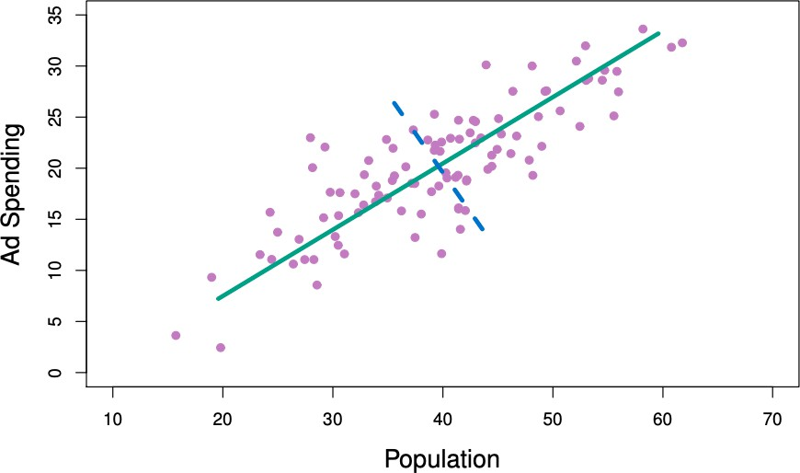
The First Principal Component
A data set with two features (Population and Ad Spending) is plotted below. The green curve is the first principal component.
1
The first principal component is in the widest or most variable direction of the data.
It is also the line in the
2-dimensional space that is closest to the observations.
2
6.10 Unsupervised Learning

Slide 8
The Second Principal Component
Once we have found the first principal component 𝑍 , the second principal component 𝑍 can
1 2
be found.
𝑍₂ is the linear combination of the features that again maximizes variance but is also
uncorrelated with 𝑍₁.
The scores 𝑧₁₂, 𝑧₂₂, … , 𝑧_{𝑛2} are of the form
^{𝑧}𝑖2 ^{= 𝜙}12^{𝑥}𝑖1 ^{+ 𝜙}22^{𝑥}𝑖2 ^{+ ⋯ + 𝜙}𝑝2^{𝑥}𝑖𝑝
𝑍_{the2} is uncorrelated with 𝑍₁ means that the direction 𝜙₁ is orthogonal (perperdicular) to direction 𝜙₁.
6.10 Unsupervised Learning

Slide 9
The Second Principal Component
A data set with two features (Population and Ad Spending) is plotted below. The green curve is the first principal component and the dashed blue curve is the second.
The direction of the second principle component is perpendicular to the direction of the first principle component.
Since there are only two dimensions there is only one choice for 𝜙₂.
If there were 𝑝 > 2 features, there would be multiple directions to choose between.
6.10 Unsupervised Learning

Slide 10
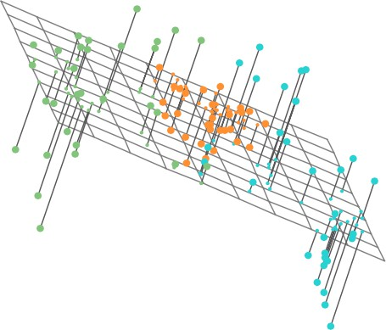
The Second Principal Component
The three dimensional data set with the first and second principal components defining the plane.
The plane is as close to the data points as possible.
It also follows the directions along which the data varies the most.
The colour in this plot it not important.
6.10 Unsupervised Learning

Slide 11
Principal Component Analysis
We can continue to create the principal components by taking the linear combination of the features that maximizes variance while remaining uncorrelated with the previous components.
To make low-dimensional visualisations we can plot the scores for two principal components at a time.
Plot 𝑍₁ against 𝑍₂, 𝑍₁ against 𝑍₃, 𝑍₂ against 𝑍₃, and so on.
On the same plot we can plot the loading vectors on a different axis for each feature. A plot with both the scores and loading vectors is called a biplot.
6.10 Unsupervised Learning

Slide 12
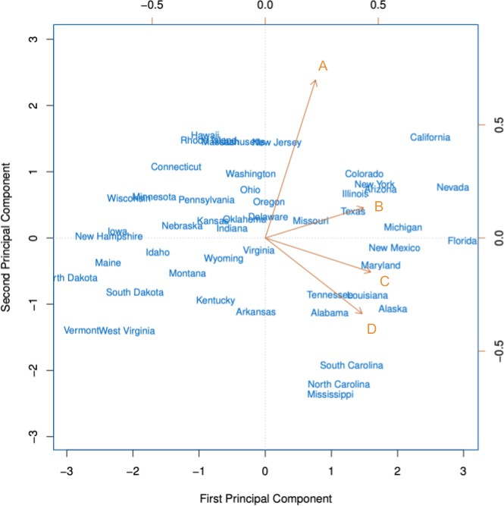
A biplot for the first two principal components of a data set of 50 states with features {A, B, C, D}.
The state names are the scores for the first two principal components.
The orange letters are the loadings for each of the features (top and right axis)
The loading for feature B is approximately
0.54 on the first component
(𝜙 = 0.54)
𝐵1
0.17 on the first component (𝜙_{𝐵2} = 0.17)
6.10 Unsupervised Learning

Slide 13
The Proportion of Variance Explained
The plot we saw is a two-dimensional representation of a four-dimensional data set.
How much information have we lost?
How much of the variance in the data is not captured by the first few principal components?
⇒ We want to know the proportion of variance explained (PVE) by each principal comp
6.10 Unsupervised Learning

Slide 14
he Proportion of Variance Explained
Assuming that the features have been centered to have mean zero…
The total variance in a data set is:
𝑝 𝑝
1
𝑛
∑ Var (𝑋 ) = ∑ ∑ 𝑥
2
𝑗
𝑛
𝑖𝑗
𝑗=1 𝑗=1 𝑖=1
The variance explained by the 𝑚th principal component is:
𝑛 𝑛
𝑝
2
1
1
2
∑ 𝑧 = ∑ (∑ 𝜙 𝑥 )
𝑛
𝑖𝑚
𝑛
𝑗𝑚 𝑖𝑗
𝑖=1 𝑖=1 𝑗=1
The PVE of the 𝑚th principal component is: _{𝑛}
𝑝
2
_{∑𝑝}^{∑𝑛}_{𝑖=1 𝑛}^{𝑧}𝑖²𝑚 ₂ ₌ ∑𝑖=1 ⁽_{𝑝}∑𝑗=1_{𝑛}^{𝜙𝑗𝑚𝑥𝑖𝑗)}
𝑗=1 ∑𝑖=1 ^{𝑥}𝑖𝑗 ∑𝑗=1 ∑𝑖=1 ^{𝑥2}𝑖𝑗
6.10 Unsupervised Learning

Slide 15
The Proportion of Variance Explained
The cumulative PVE of the first 𝑀 principal components is the sum of the first 𝑀 PVEs. There can be at most min(𝑛 − 1, 𝑝) principal components.
The sum of the PVEs for all the principal components sums to one. In the US state plot shown previously:
The first principal component accounts for 60% of the variance in the data. The second principal component accounts for 25% of the variance in the data. Together they account for 87% of the variance in the data.
6.10 Unsupervised Learning

Slide 16
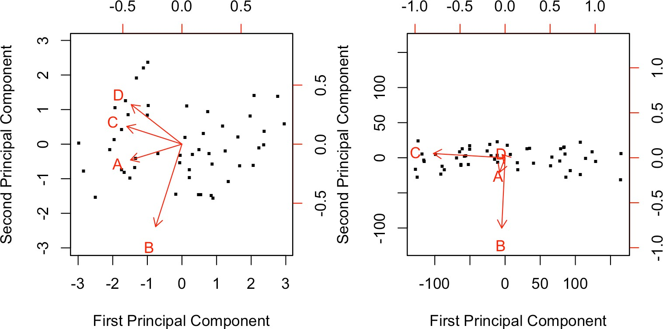
Scaling the Features
We scale each feature to have mean zero and standard deviation one before performing PCA.
Left: PCA biplot with variables scaled.
Right: Same data set but the variables have not been scaled.
is mostly C.
1
_{The} 𝜙₂ is mostly B.
right plot does not show patterns as well.
6.10 Unsupervised Learning

Slide 17
Uniqueness of the Principal Components
Each principal component loading vector is unique up to a sign flip.
The loading vector specifies a direction in the 𝑝-dimensional space.
Changing the sign of every element in the loading vector does not change the direction.
The score vectors are unique up to a sign flip.
𝑍₁ has the same variance as 𝑍₂.
6.10 Unsupervised Learning

Slide 18
How Many Principal Components to Use
For a 𝑛 × 𝑝 data matrix X there are min(𝑛 − 1, 𝑝) distinct principal components.
Use the smallest number of principal components needed for a good understanding of the data.
This will depend on the question and the data.
Look at the first few principal components for patterns in the data.
If there are none then the subsequent principal components will likely not help. If there are then look at the next principal components.
Alternatively, use a scree plot to decide.
Plot of the proportion of variance explained versus the number of principal components Find the point where the the PVE is minimal for subsequent principal components.
Both methods are subjective which is why PCA is mostly used for exploratory data analysis.
6.10 Unsupervised Learning

Slide 19
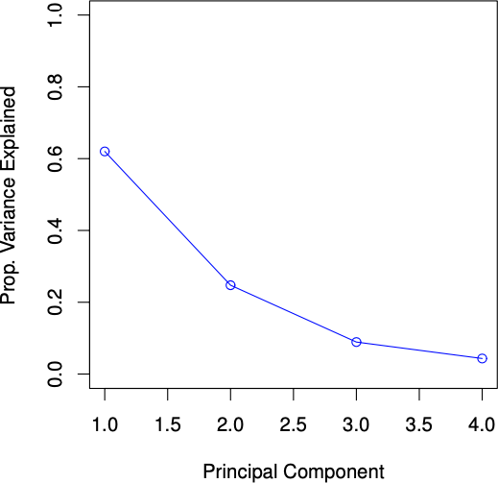
Scree Plot
Most of the variance is explained by the first two principal components.
The PVE levels off after this.
The third principal component accounts for less than 10% of the variance in the data.
2 principal components are probably suﬀicient to get a good understanding of this data set.
6.10 Unsupervised Learning

Slide 20
Exercises: Principal Components Analysis
Open the Unsupervised Learning Exercises R Markdown or Jupyter Notebook file.
Go over the “Principal Components Analysis” section together as a class.
6.10 Unsupervised Learning

Slide 21
Missing Values and Matrix Completion
The statistical learning methods we have learned in this course cannot handle missing predictor values. What can we do?
Remove rows that contain missing values.
If 𝑥_{𝑖𝑗} is missing, replace it with the mean of the 𝑗th predictor.
Perform matrix completion which uses principal components to impute the missing values.
The first two methods are convenient but they do not exploit the correlation between the variables.
6.10 Unsupervised Learning

Slide 22
Matrix Completion
Matrix completion can only be used when the reason for missing data is random.
Random: a patient’s weight is missing from the data set because the scale battery died. Not random: a patient’s weight is missing because they are too heavy for the scale.
Matrix completion works by simultaneously estimating the missing values and solving the principal components iteratively. We will not cover the algorithm but if you are interested see section 12.3 of ISLR2.
6.10 Unsupervised Learning

Slide 23
Exercises: Matrix Completion
Open the Unsupervised Learning Exercises R Markdown or Jupyter Notebook file.
Go over the “Matrix Completion” section together as a class.
6.10 Unsupervised Learning

Slide 24
Clustering Methods
Both PCA and clustering are unsupervised learning methods that attempt to simplify the data via summaries.
Clustering methods aim to find subgroups (clusters) in a data set.
Observations within a cluster are similar to each other and observations from different clusters are quite different.
The definitions of similar and different depend on the problem at hand. There are many clustering methods but we will cover the two best-known:
𝐾-means clustering Hierarchical clustering
6.10 Unsupervised Learning

Slide 25
𝐾-Means Clustering
𝐾-means clustering seeks to partition a data set into 𝐾 distinct, non-overlapping clusters.
1
Specify the desired number of clusters 𝐾.
2
Use the 𝐾-means algorithm to assign each observation to a cluster.
We need some notation:
𝐶 , … , 𝐶 are the sets containing the indices of the observations in each cluster. (Ex: if
1 𝐾
the 𝑖th observation is in the 𝑘th cluster then 𝑖 ∈ 𝐶 )
𝑘
Every observation belongs to a cluster.
No observation belongs to more than one cluster.
Want to choose clusters that minimize the within-cluster variation 𝑊 (𝐶_{𝑘}) for all clusters 𝐶_{𝑘}.
→ Minimize the amount by which observations within a cluster differ.
6.10 Unsupervised Learning

Slide 26
Within-Cluster Variation
Within-Cluster variation for the 𝑘th cluster is the sum of the pairwise squared Euclidean distances between each observation in the 𝑘th cluster, divided by the number of observations in the cluster (|𝐶_{𝑘}|). That is,
1
𝑝
𝑊 (𝐶 ) =
∑ ∑ (𝑥 − 𝑥 )
2
𝑘
′
|𝐶 |
𝑖𝑗 𝑖 𝑗
^{𝑘} 𝑖,𝑖′∈𝐶_{𝑘} 𝑗=1
The Euclidean distance is a way to measure distance in 𝑝-dimensional space. Suppose we have x = (𝑥₁, … , 𝑥_{𝑝}) and y = (𝑦₁, … , 𝑦_{𝑝}), then the Euclidean distance is
𝑑(x, y) = √(𝑥₁ − 𝑦₁)² + ⋯ + (𝑥_{𝑝} − 𝑦_{𝑝})²
Note that we use the squared Euclidean distance in 𝑊 (𝐶_{𝑘}) so we remove the square-root.
6.10 Unsupervised Learning

Slide 27
Within-Cluster Variation
To minimize within-cluster variation in all the 𝐾 clusters we need to solve
minimize ⎧{∑^{𝐾 1} ∑ ∑^{𝑝} (𝑥_{𝑖𝑗} − 𝑥_{𝑖}′_{𝑗})^{2⎫}}
⎬}⎭
^{𝐶1,…,𝐶𝐾 ⎨{}⎩𝑘=1 ^{|𝐶𝑘|} 𝑖,𝑖′∈𝐶_{𝑘} 𝑗=1
We use the 𝐾-means clustering algorithm!
6.10 Unsupervised Learning

Slide 28
K-Means Clustering Algorithm
K-Means Clustering Algorithm
1
Randomly assign each observation a number between 1 and 𝐾. These are the initial
cluster assignments.
2
Repeat steps below until cluster assignments are static.
For each cluster compute the cluster centroid. The 𝑘th cluster centroid is the 𝑝 dimensional vector of the feature means for the observations in the 𝑘th cluster. Assign each observation to the cluster with the closest centroid.
The results obtained depend on the initial random cluster assignment in step 1 of the algorithm.
6.10 Unsupervised Learning

Slide 29
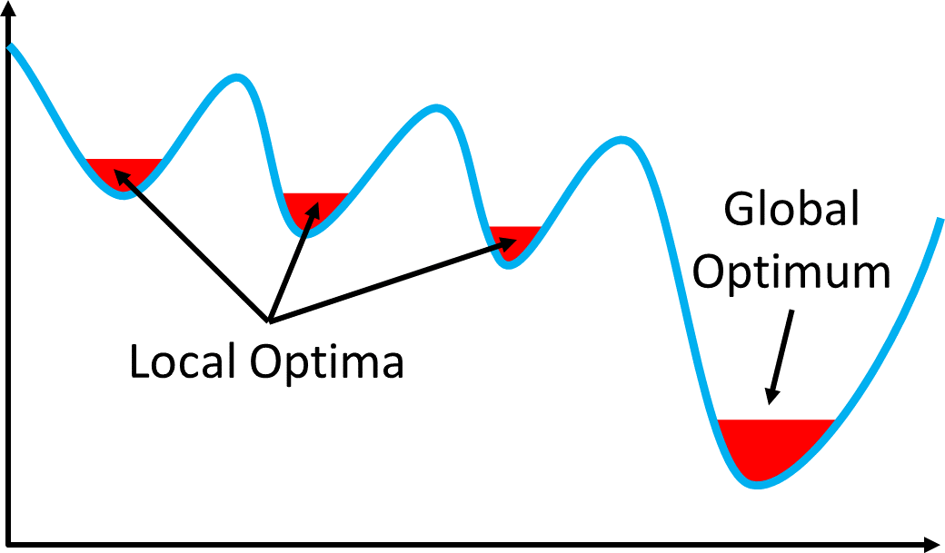
Means Clustering Algorithm
The 𝐾-means algorithm finds a local optimum which does not guarantee it is the global optimum.
To find the global optima:
1
Run the algorithm multiple times
with random initial cluster assignments.
Choose the clustering that minimizes the within-cluster variation (1).
2
6.10 Unsupervised Learning

Slide 30
Exercises: K-Means Clustering
Open the Unsupervised Learning Exercises R Markdown or Jupyter Notebook file.
Go over the “K-Means Clustering” section together as a class.
6.10 Unsupervised Learning

Slide 31
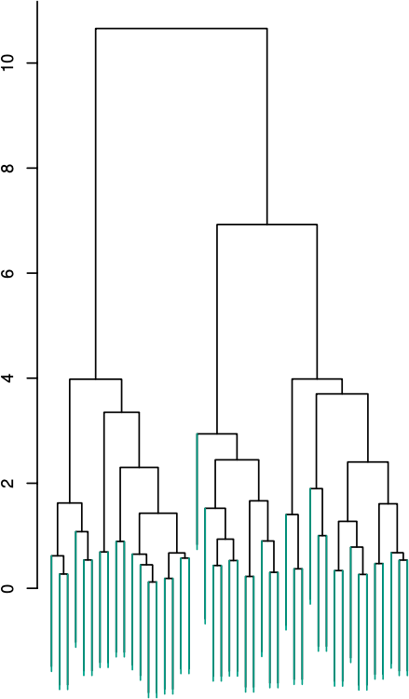
Dendrogram
Hierarchical clustering results in a dendrogram which is a tree-based representation of the observations.
Each leaf (green stick) is an observation. As we move up the dendrogram, observations that are similar fuse into branches.
Then branches fuse into other branches which indicates that the groups of observations are similar.
The height at which two observations fuse indicates how different the two observations are.
6.10 Unsupervised Learning

Slide 32
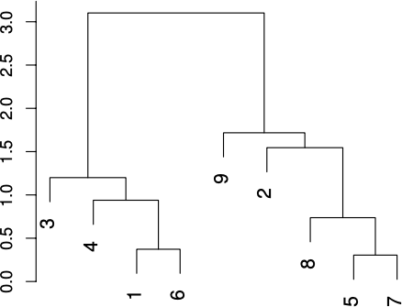
Dendrogram
Observations 1 and 6 are quite similar since they fuse at the bottom of the dendrogram.
Observations 9 and 2 are quite dissimilar since they fuse near the top.
Observation 9 is equally similar to observations 2, 8, 5, and 7.
Thus, the horizontal axis tells us nothing about similarity.
6.10 Unsupervised Learning

Slide 33
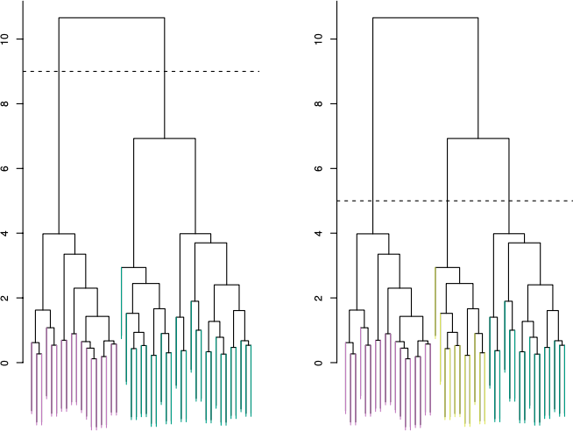
Clustering with a Dendrogram
To create clusters we make a horizontal cut across the dendrogram. The distinct sets of observations beneath the cut are the clusters.
Left: Cutting at a height of 9 results in two clusters.
Right: Cutting at a height of 5 results in three clusters.
We can obtain any number of clusters from a single dendrogram.
Usually the height of the cut is selected by eye based on the desired number of clusters.
6.10 Unsupervised Learning

Slide 34
Dissimilarity Measures
In order to create a dendrogram, we need to define measures of dissimilarity between: A pair of observations.
A pair of groups of observations.
The choice of dissimilarity measures have a strong influence on the shape of the dendrogram. The type of data and the question at hand should be considered.
6.10 Unsupervised Learning

Slide 35
Dissimilarity Between Observations
The most common choice for dissimilarity between observations is Euclidean distance.
Observations that are close to each other are similar.
But in some cases, correlation-based distance might be preferred. Observations with features that are highly correlated are similar.
This focuses on the shapes of the observation profiles rather than their magnitudes.
6.10 Unsupervised Learning

Slide 36
Linkage
Linkage refers to the dissimilarity between two groups of observations. The four most common types of linkage are:
Complete Single Average Centroid
6.10 Unsupervised Learning

Slide 37
Complete Linkage
Complete linkage measures maximal intercluster dissimilarity.
1
2
Compute all pairwise dissimilarities between the observations in cluster A and cluster B. Record the largest of these dissimilarities.
6.10 Unsupervised Learning

Slide 38
Single Linkage
Single linkage measures minimal intercluster dissimilarity.
Compute all pairwise dissimilarities between the observations in cluster A and cluster B. Record the smallest of these dissimilarities.
1
2
This type of linkage can result in trailing clusters in which a single observation is fused at a time. (i.e. leaves fuse to branches more often than branches fuse to branches)
6.10 Unsupervised Learning

Slide 39
Average Linkage
Average linkage measures mean intercluster dissimilarity.
1
2
Compute all pairwise dissimilarities between the observations in cluster A and cluster B. Record the average of these dissimilarities.
6.10 Unsupervised Learning

Slide 40
Complete Linkage
Centroid linkage measures intercluster centroid dissimilarity.
1
Compute the dissimilarity of the centroid for cluster A (a vector of the feature means)
and the centroid for cluster B.
Centroid linkage can result in inversion whereby two clusters are fused at a height below either of the individual clusters.
6.10 Unsupervised Learning

Slide 41
Hierarchical Clustering Algorithm
Hierarchical Clustering Algorithm
1
2
3
Treat each of the 𝑛 observations are its own cluster.
Compute the pairwise dissimilarity between each observation.
For 𝑖 = 𝑛, 𝑛 − 1, … , 2:
Identify the pair of clusters that are the least dissimilar among the 𝑖 clusters.
Fuse these two clusters in the dendrogram at the height that indicates their dissimilarity. Compute the new pairwise inter-cluster dissimilarities among the 𝑖 − 1 remaining clusters.
6.10 Unsupervised Learning

Slide 42
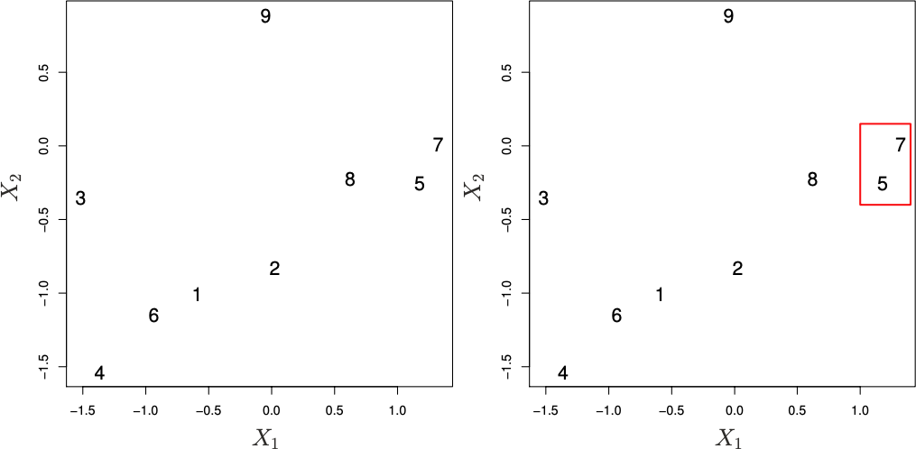
Hierarchial Clustering Algorithim
The first iteration of the algorithm on a data set of 9 observations with two features. Euclidean distance and complete linkage are used.
Left: there are 9 clusters each containing one observation.
Right: identify {7} and
{5} as the most similar clusters and fuse them.
6.10 Unsupervised Learning

Slide 43
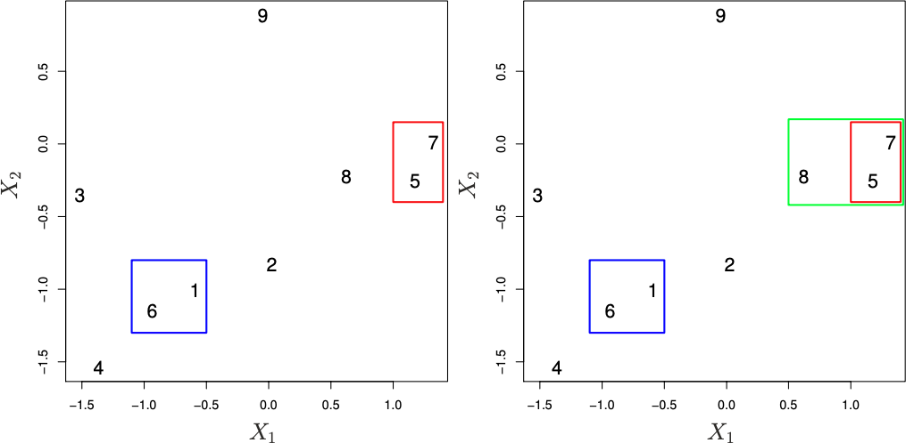
Hierarchial Clustering Algorithim
The next 2 iterations of step 3 of the algorithm.
Left: there are 9 clusters each containing one observation.
Right: identify {7} and
{5} as the most similar clusters and fuse them.
6.10 Unsupervised Learning

Slide 44
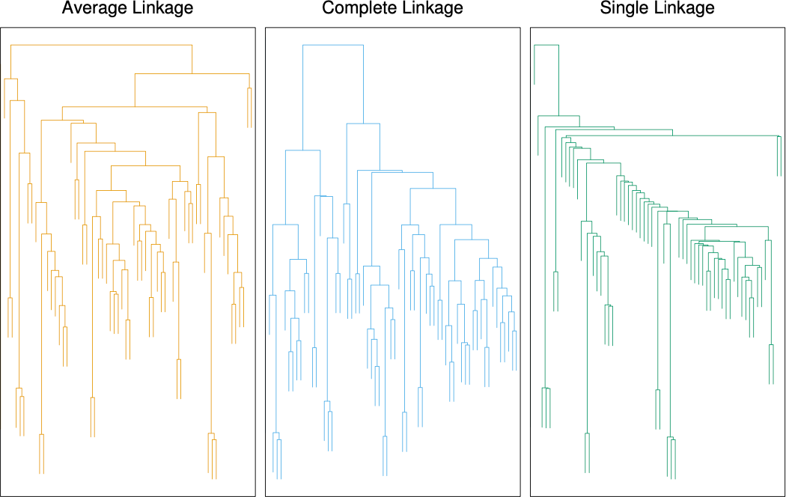
Linkage
The choice of the linkage type will have an effect on the dendrogram produced by the hierarchical clustering algorithm.
6.10 Unsupervised Learning

Slide 45
Exercises: Hierarchical Clustering
Open the Unsupervised Learning Exercises R Markdown or Jupyter Notebook file.
Go over the “Hierarchical Clustering” section together as a class.
6.10 Unsupervised Learning

Slide 46
References
Chapter 12 of the ISLR2 and ISLP books:
James, Gareth, et al. “Unsupervised Learning.” An Introduction to Statistical Learning: with Applications in R, 2nd ed., Springer, 2021.
James, Gareth, et al. “Unsupervised Learning.” An Introduction to Statistical Learning: with Applications in Python, Springer, 2023.
Local optima photo:
By Christoph Roser at AllAboutLean.com under the free CC-BY-SA 4.0 license.
6.10 Unsupervised Learning

