Slide 1
ASSIGNMENT 1
ANSWER KEY AND COMMON ERRORS

Slide 2
Question 1
Out of 17

Slide 3
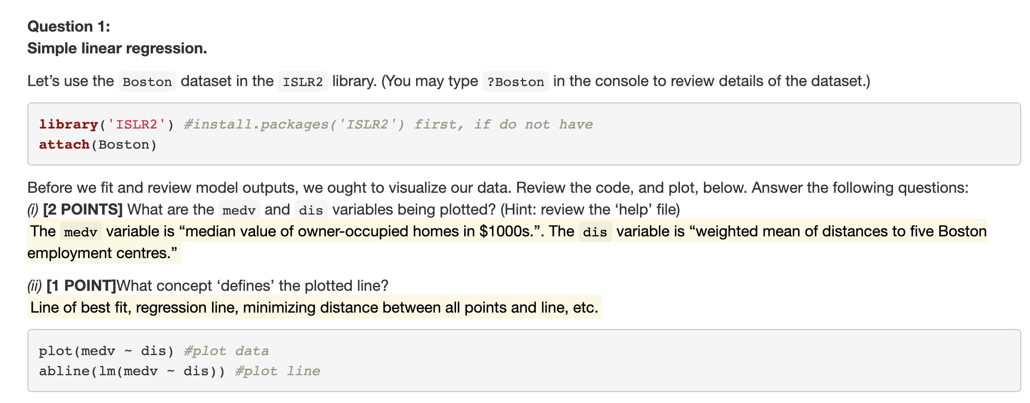
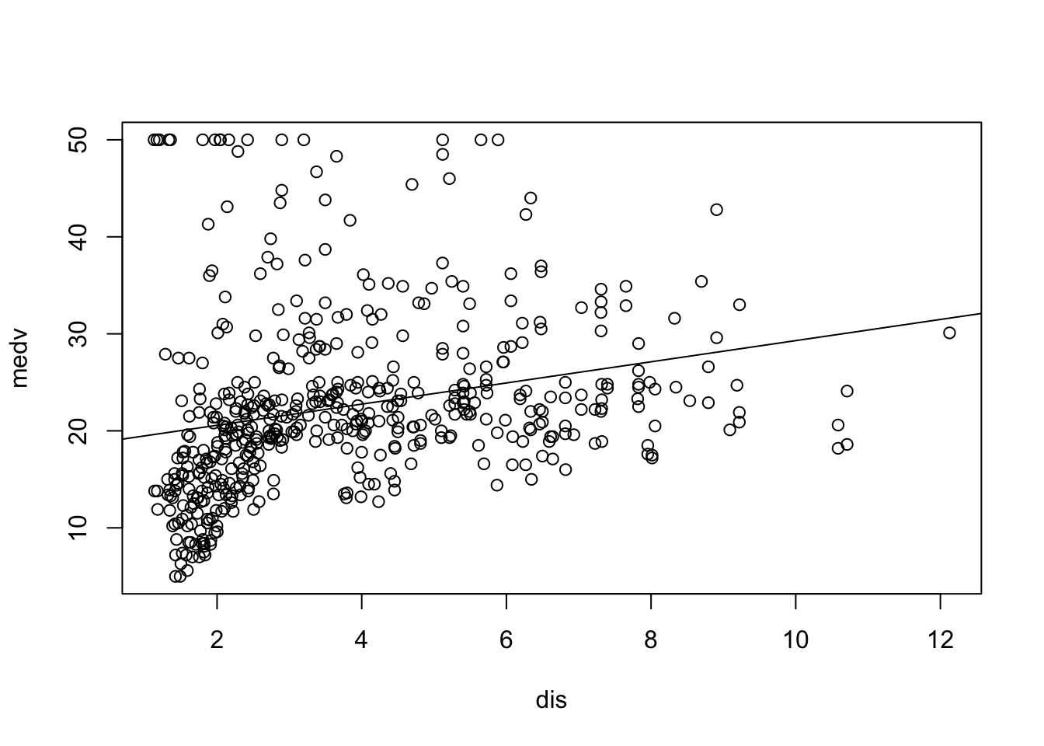

Slide 4
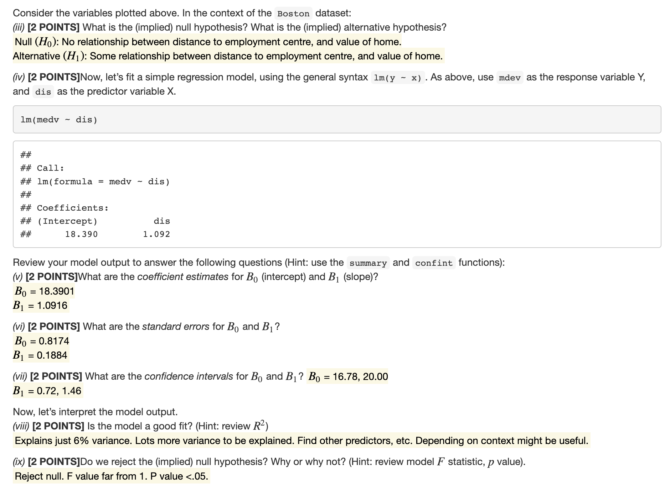
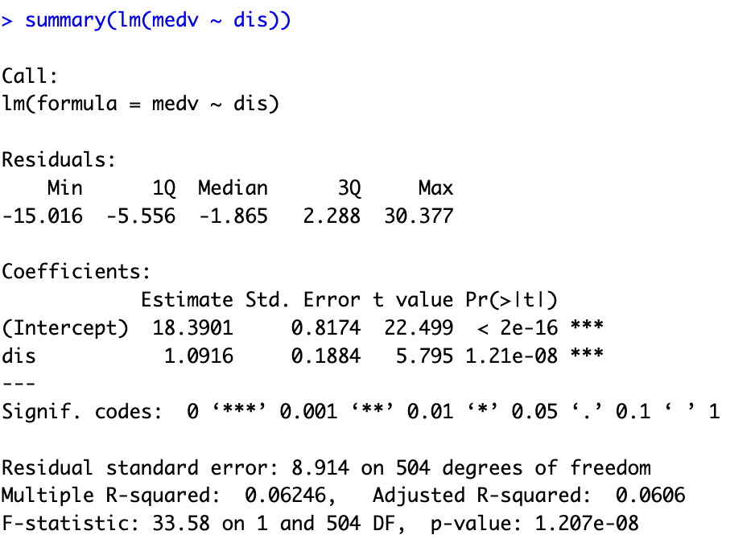
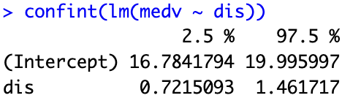

Slide 5
Question 2
Out of 10

Slide 6
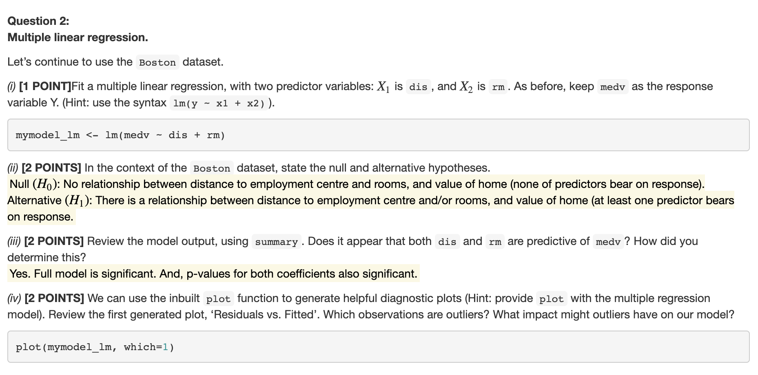
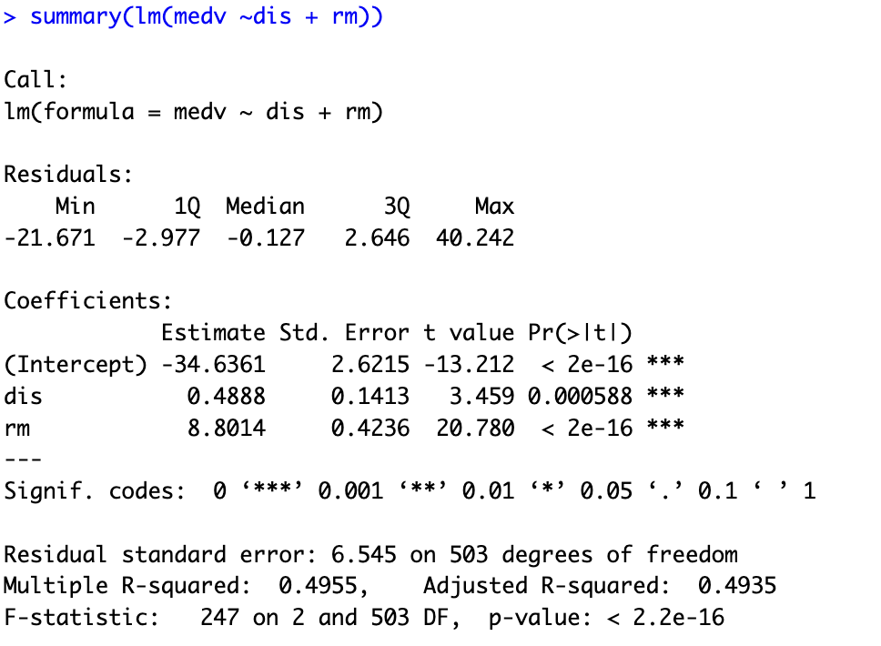

Slide 7
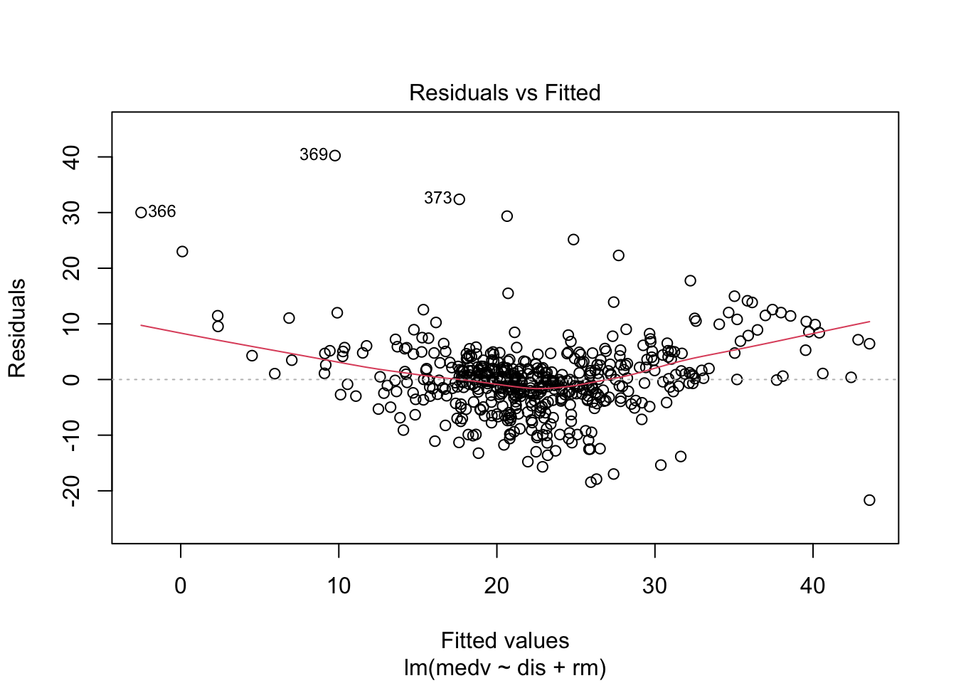
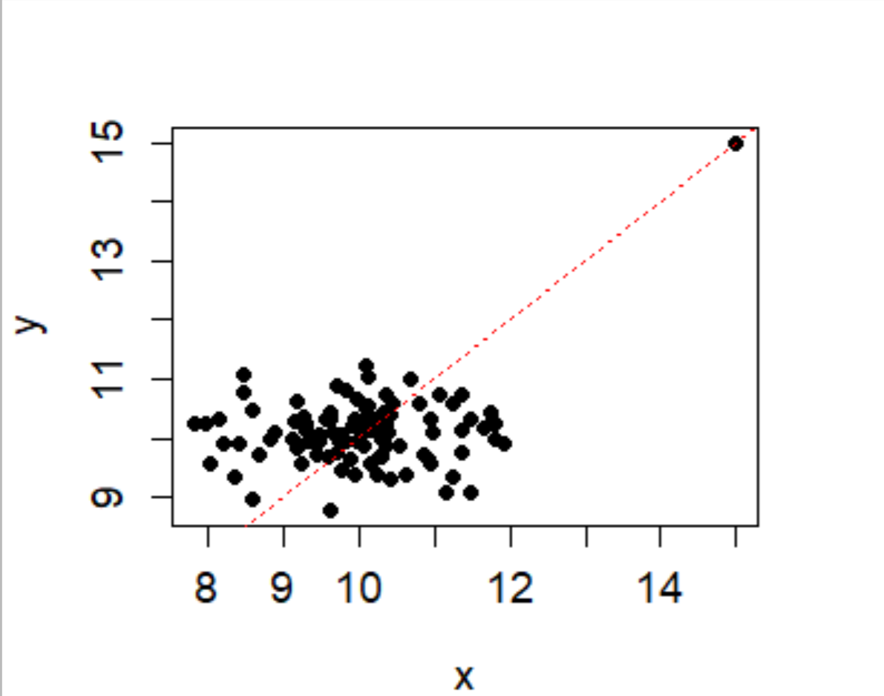
Common error*
Residual vs Fitted plot is what is used to plot linearity and flags the most extreme values
Example of how an outlier
Can alter the slope of the line of best fit!

Slide 8
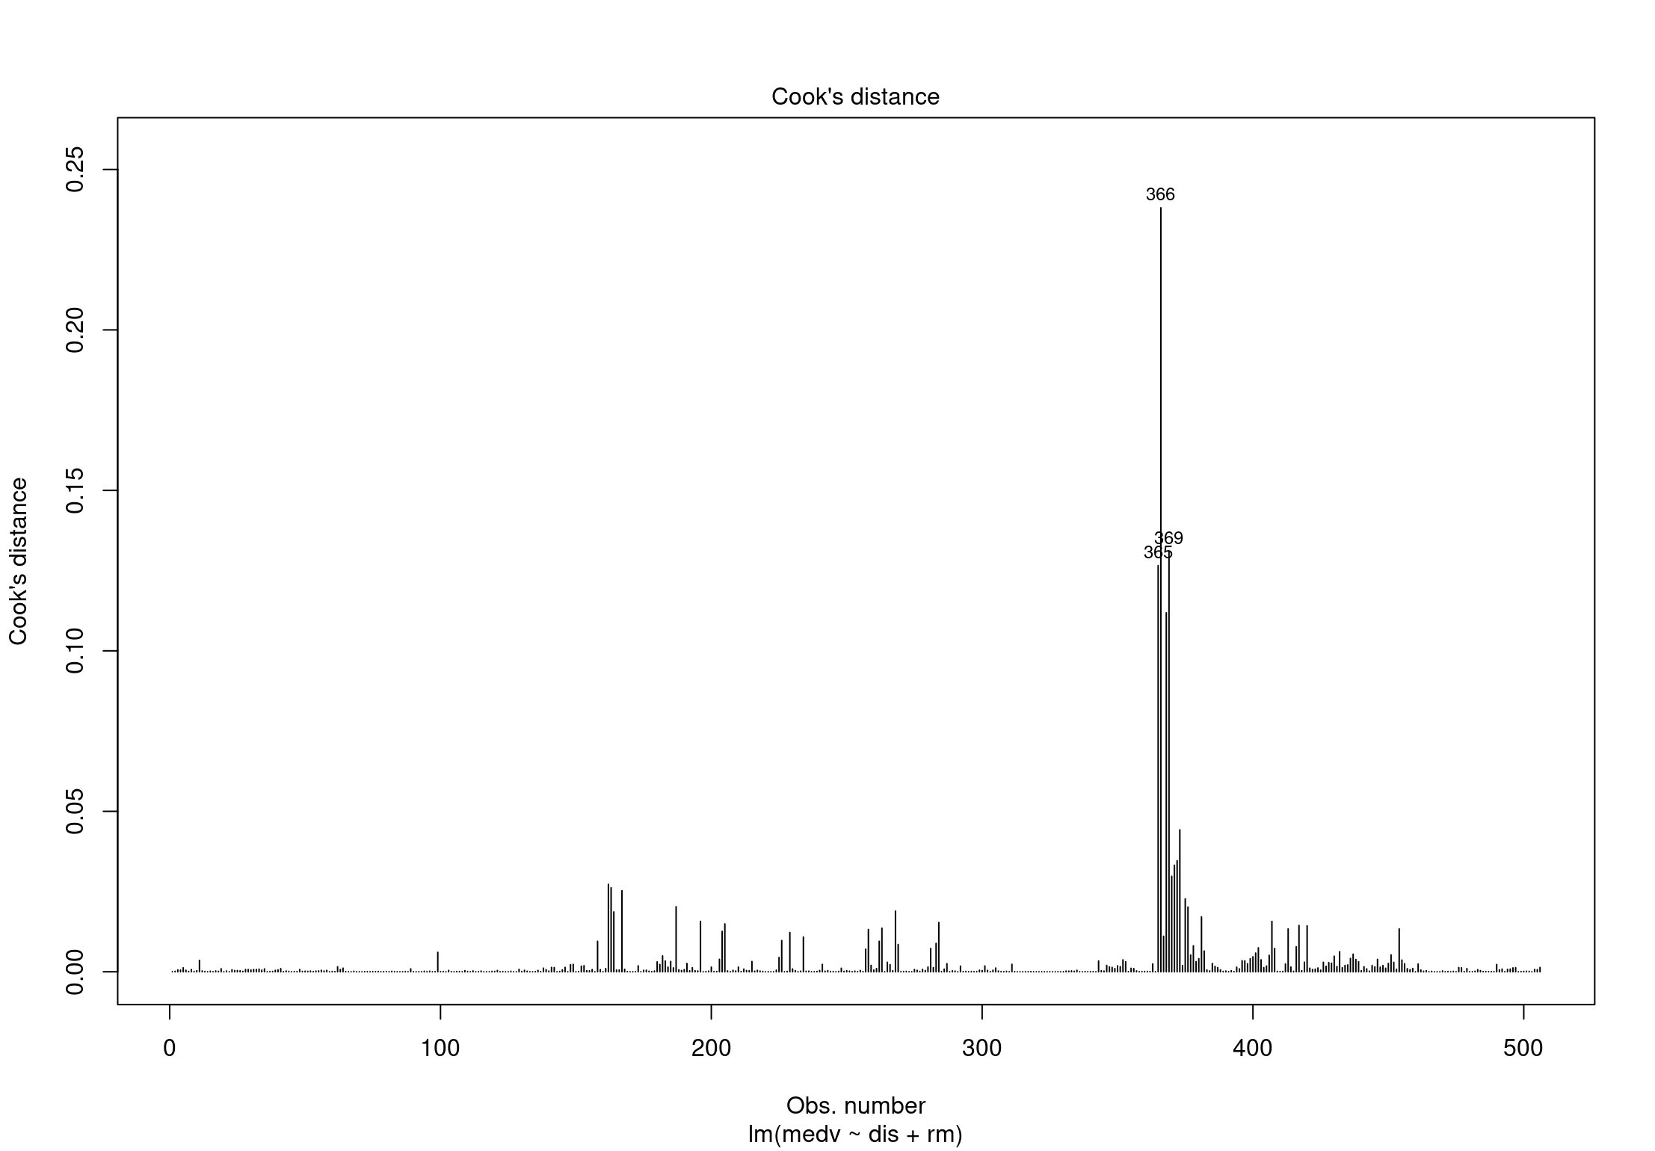
Cook’s distance plot is what is used to identify influential data points/ outliers
As you can see, observations 366, 365, 369 are outliers (NOT 373, although extreme!)

Slide 9
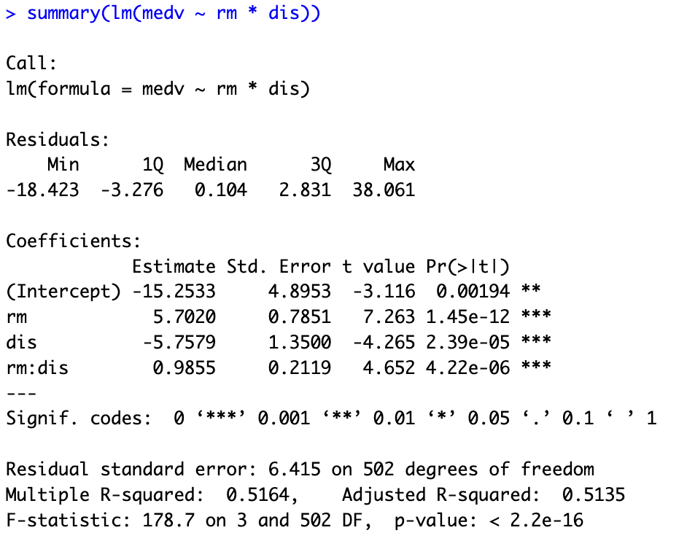

Slide 10
Question 3
Out of 22

Slide 11
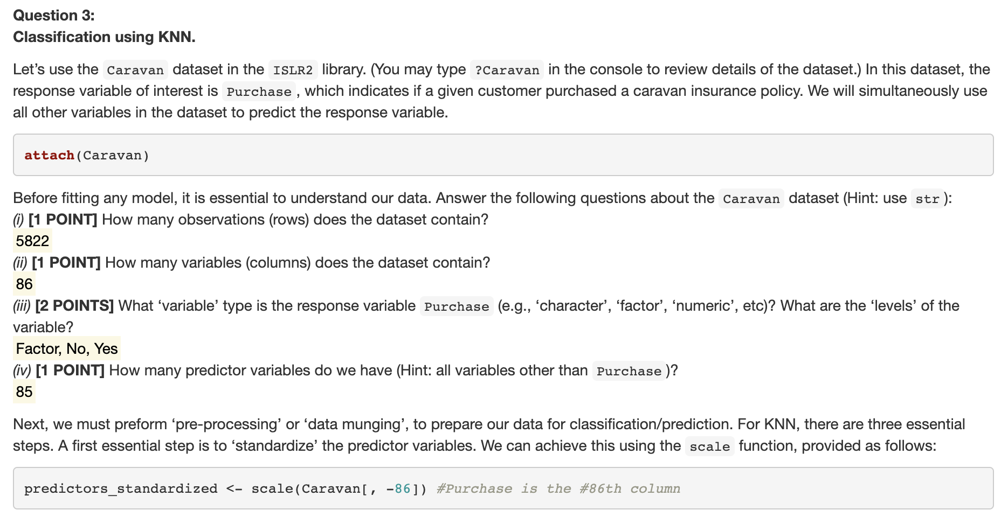
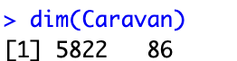

Slide 12
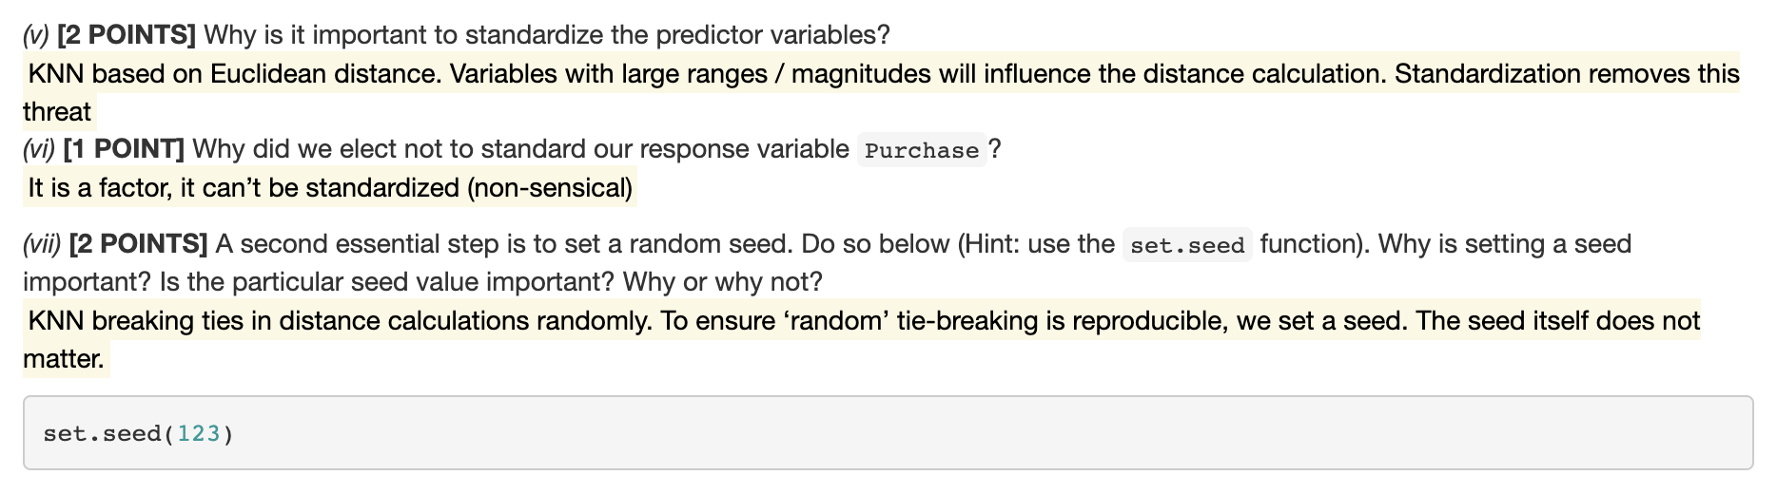
Common error*
If one variable contains much larger numbers because of the units or range of the variable, it will dominate other variables in the distance measurements. But this doesn't necessarily mean that it should be such an important variable.
Feature 2
x
Feature 1
EX. Effect of scaling feature axes on k (k = 1) nearest neighbor classification.
Original data. Large range of the horizontal axis increases the distance between patterns which differ in feature 1, allowing the knn to discriminate more finely along this dimension.
Scaled data removes this influence of feature 1 on the distance calculation!
x
Feature 2
Feature 1

Slide 13
Common error*
set.seed(199)
set.seed(123)
x
x
Feature 2
Feature 2
Feature 1
Feature 1

Slide 14
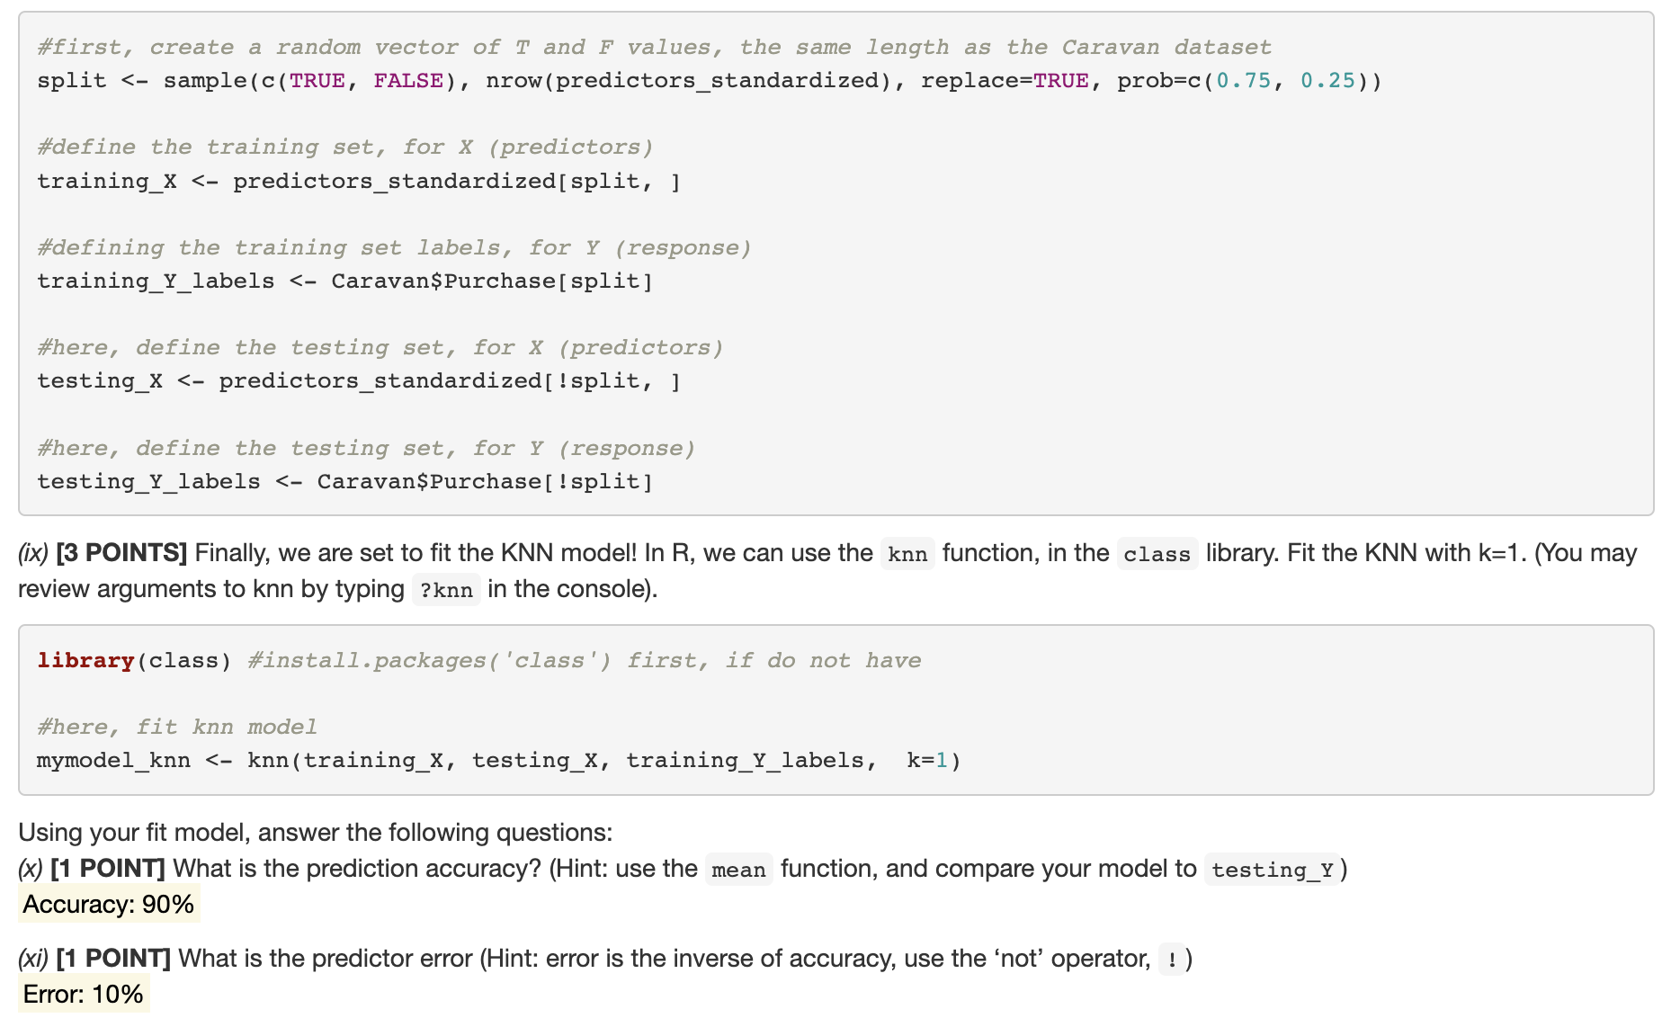
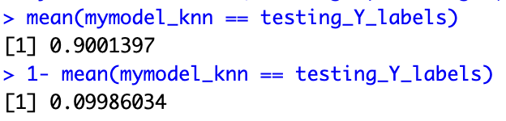

Slide 15
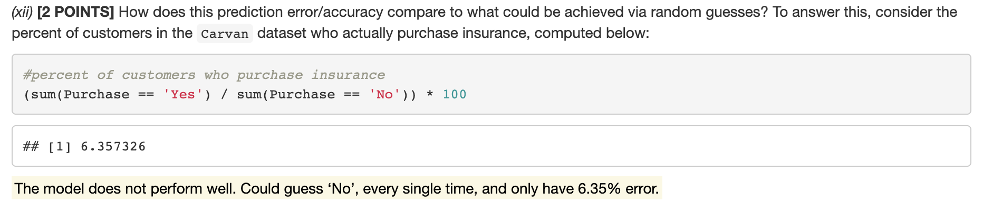
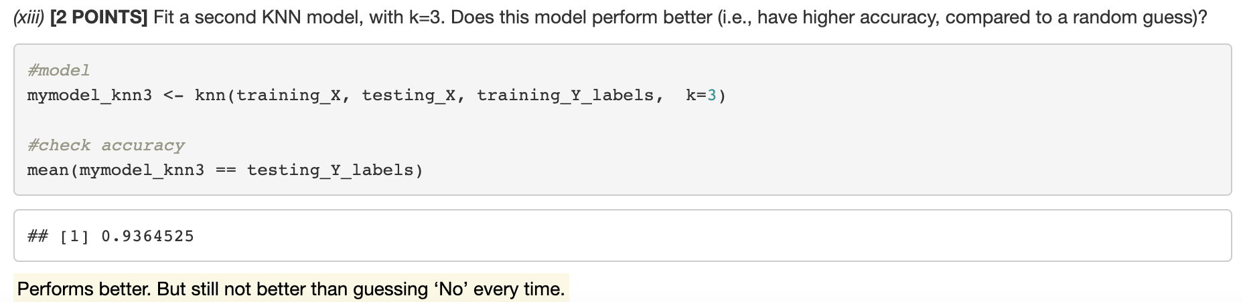
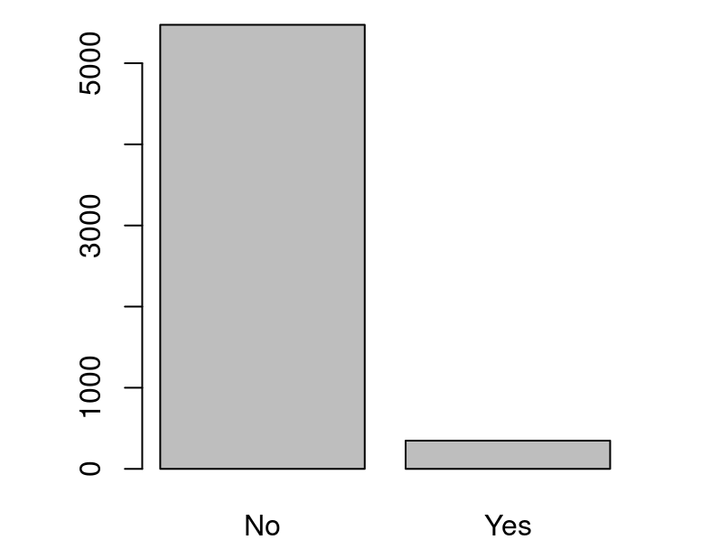
Common error*
This means, a model that guesses ‘No’ every single time has an error rate of 6.35% →This error rate is smaller than our models! (10%)

