Slide 1
Data Distribution Shifts and Monitoring
Production Jesús Calderón

Slide 2
Agenda
7.1. Monitoring
ML System Failures
Data Distribution Shifts
Monitoring and Observability
7.2 Continual Learning and Test in Production
Testing data distribution shifts.

Slide 3
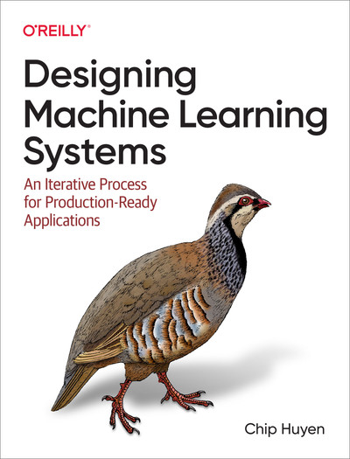
About These Notes
These notes are based on Chapter 8 of Designing Machine Learning Systems, by Chip Huyen.

Slide 4
ML System Failures

Slide 5
What is an ML System Failure?
A failure happens when one or more expectations of the system is not met:
Traditional software expectations: system executes its logic within the expected metrics, such as latency and throughput.
ML performance: performance metrics are met, explanations are given, trust on the system (can be achieved by communicating uncertainty), etc.
Operational expectations can be more easy to detect than ML performance expectations.
Understanding why ML system fail can help monitor ML performance.

Slide 6
Software System Failures
Dependency failure
A package or codebase that the system depends on breaks, which leads to system failure.
Common when the dependency is maintained by a third-party.
Can also happen when our model is a dependency of a downstream consumer.
Deployment failure
The root cause is deployment errors: deploy old binaries, permissions are not correctly granted, etc.
Coding errors and integration errors (interface changes).
Hardware failures
Hardware use to deploy the model fails.
Downtime or crashing
Connectivity, security, and other issues may give rise to unreachable servers (AWS, Azure, GCP, etc.)
Distributed systems are complex systems and the risk of failure increases with complexity.

Slide 7
ML-Specific Failures
Production data is different from training data
A key assumption is that training and unseen data come from the same distribution.
When we say that a model learns from data, we are saying that the model learns the distribution of the training data with the goal of using this information on unseen data.
When predictions on unseen data are satisfactory, we say that the model “generalizes to unseen data”.
The test data that we use in the model development phase and the cross-validation are estimates of the error in unseen (production) data.
Reasons for difference:
Data collection, encoding, and instrumentation.
The world changes, data distributions are not stationary.
Edge cases
An ML model performs well in most cases, but fails in a small minority of cases, generally, with catastrophic consequences.
If number of edge cases increases, data distribution may have shifted.
Key concern for safety-critical applications: autonomous vehicles, health systems, risk monitoring, etc.
Degenerate feebdack loops
The model’s predictions influence the feedback, which in turn influences the next iteration of the model:
System outputs are used to generate the next set of inputs.
In user-facing applications, this can drive the options or interactions that a user is offered.
User interactions with the system are the training data.

Slide 8
Data Distribution Shifts

Slide 9
Types of Data Distribution Shifts
Three types of shifts:
Concept drift
Covariate shift
Label shift
Before we begin:
Assume that we are looking to make a prediction of Y given data X.
To do so, we estimate $P\left(Y|X\right)$.
Our data, shows a distribution P(X, Y) and we know that:
$$P\left(X,Y\right)=P\left(Y|X\right)P\left(X\right)P\left(X,Y\right)=P\left(X|Y\right)P\left(Y\right)$$

Slide 10
Types of Distribution Shifts
Covariate shift:
$P\left(X\right)$ changes.
$P\left(Y|X\right)$ does not change.
Label shift:
$P\left(Y\right)$ changes.
$P\left(X|Y\right)$ does not change.
Concept drift:
$P\left(Y|X\right)$ changes.
$P\left(X\right)$ does not change.
$$P\left(X,Y\right)=P\left(Y|X\right)P\left(X\right)P\left(X,Y\right)=P\left(X|Y\right)P\left(Y\right)$$
$P\left(X,Y\right)$ joint distribution.
$P\left(Y|X\right)$ conditional probability of output Y given input X.
$P\left(X\right)$ probability density of input.
$P\left(Y\right)$ probability density of output.

Slide 11
Covariate Shift
Covariate shift:
$P\left(X\right)$ changes.
$P\left(X|Y\right)$ does not change.
Widely studied distribution shifts.
Covariate is an independent variable that can influence the outcome of a statistical trial but it is not of direct interest.
Example: while predicting house prices as a function of location a covariate is square footage.
Causes:
Sampling methods: example, oversampling of cancer patients over 40.
Training data is artificially altered: applied SMOTE and distribution changed.
Active learning: instead of randomly sampling, use samples most helpful to that model according to some heuristic.
Major changes in the production environment or application: changes in marketing, for example, induce more clients from a certain demographic not previously represented in training data.

Slide 12
Label Shift
Label shift:
$P\left(Y\right)$ changes.
$P\left(Y|X\right)$ does not change.
Also known as prior shift, prior probability shift, or target shift.
The output distribution changes, but for a given output, the input distribution stays the same.
When covariate shift happens, it could be followed by label shift.
Methods for detecting covariate and label shifts are similar.

Slide 13
Concept Drift
Concept drift:
$P\left(Y|X\right)$ changes.
$P\left(X\right)$ does not change.
Also known as posterior drift.
Input distribution remains the same, but the conditional distribution of the output given an input changes.
“Same input, different output.”
Can be cyclcic or seasonal.

Slide 14
Monitoring and Observability

