Slide 1
Model Deployment
Production Jesús Calderón

Slide 2
Introduction

Slide 3
Agenda
6.1 Model Deployment and Prediction Service
ML Deployment Myths and Anti-Patterns
Batch Prediction vs Online Prediction
Model Compression
ML in the Cloud
6.2 Deployment
Deployment to a DB.
Deployment to Pickle file.
Power BI and Jupyter.

Slide 4

About These Notes
These notes are based on Chapters 7 of Designing Machine Learning Systems, by Chip Huyen.

Slide 5
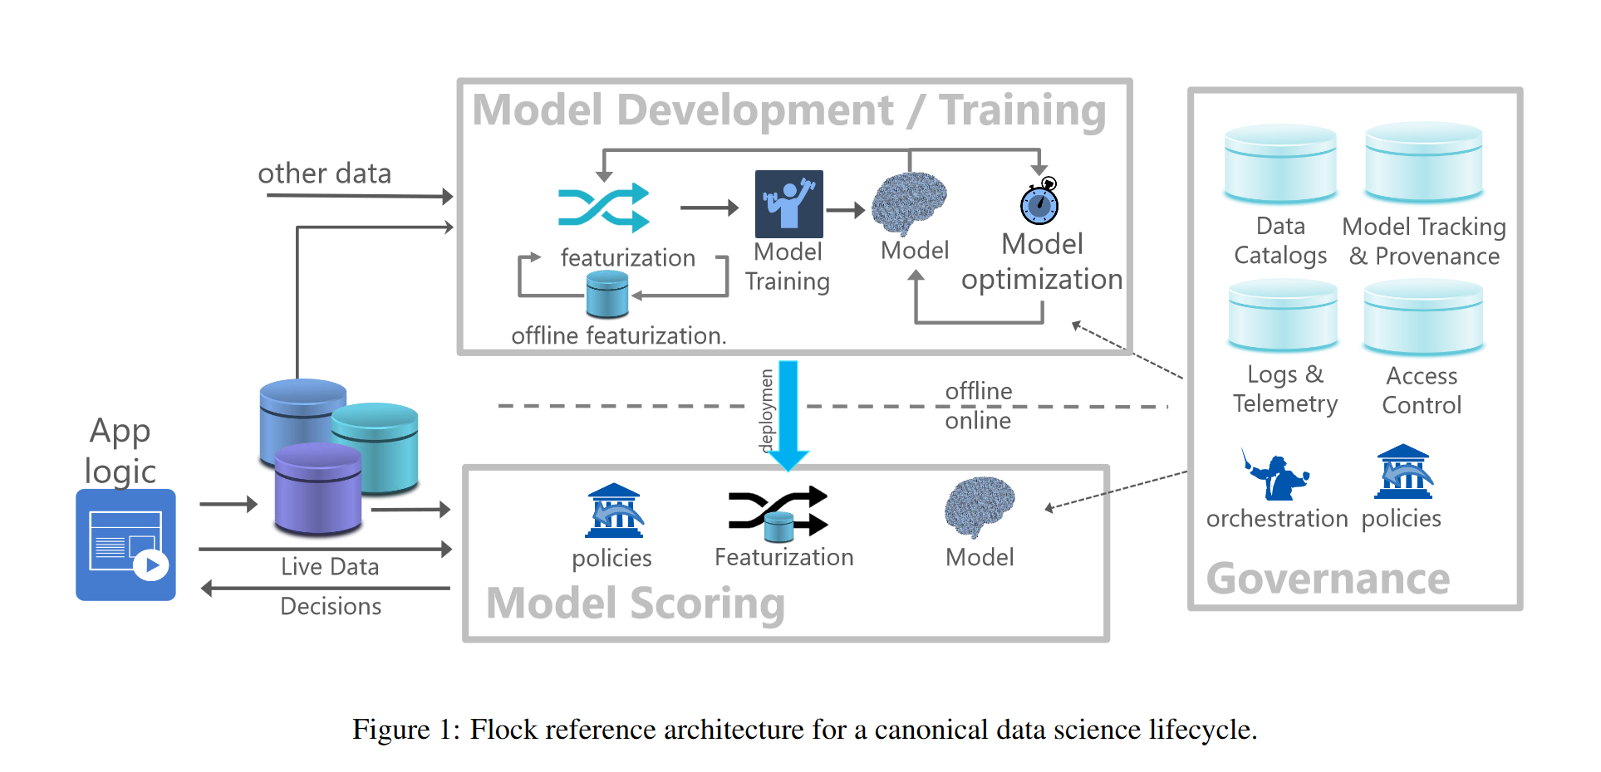
Reference Architecture
Aggrawal et al. (2020)

Slide 6
Deployment
Deploying a model is to make it useable by allowing users to interact with it through an app or by using its results for a purpose in a data product (BI visuals, reports, data views).
Deployment is a transition of development to production environment.
There is a wide range of production environments: from BI to live applications serving millions of users.
Engaging with users in formal or informal feedback conversations is useful, although not always possible.

Slide 7
Deployment Myths and Anti-Patterns
1. You only deploy one or two ML models at a time
Infrastructure should support many models, not only a few.
Many models can interact and we also need a way of mapping these interactions.
Ride sharing app:
10 models: ride demand, driver availability, estimated time of arrival dynamic pricing, fraud, churn, etc.
20 countries.
2. If we don’t do anything, mode performance stays the same
Software does not age like fine wine.
Data distribution shifts: when the data distribution that the trained model is different from the one during training.

Slide 8
Deployment Myths and Anti-Patterns (cont.)
3. You won’t need to update your models as much
Model performance decays over time.
Deploy should be easy:
Development environment should resemble as close as possible the production environment.
Infrastructure should be easier to rebuild than to repair.
Small incremental and frequent changes.
4. Most ML engineers don’t need to worry about scale
Scale means different things to different applications.
Number of users, availability, speed or volume of data.

Slide 9
Batch Prediction Vs Online Prediction
Online Prediction
Predictions are generated and returned as soon as requests for these predictions arrive.
Also known as on-demand prediction.
Traditionally, requests are made to a prediction service via a RESTful API.
When requests are made via HTTP, online prediction is known as synchronous prediction.
Batch Prediction
Predictions are generated preiodically or whenever triggered.
Predictions are stored in SQL tables or in memory. They are later retrieved as needed.
Batch prediction is also known as asynchronous prediction.

Slide 10
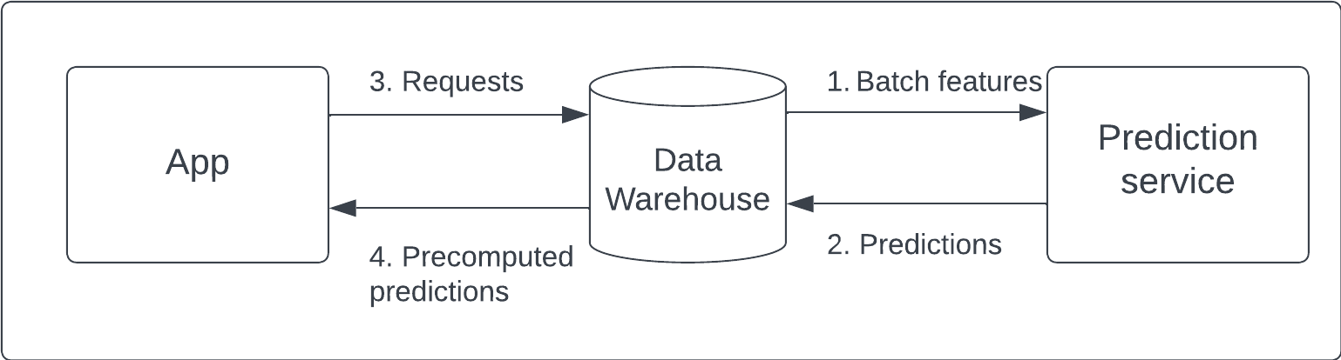
Model Prediction (Inference) Service
Batch prediction: uses only batch features.
Online prediction that uses only batch features (e.g., precomputed embeddings).
Online streaming prediction: uses batch features and streaming features.
Batch Prediction (based on Huyen 2021)

Slide 11
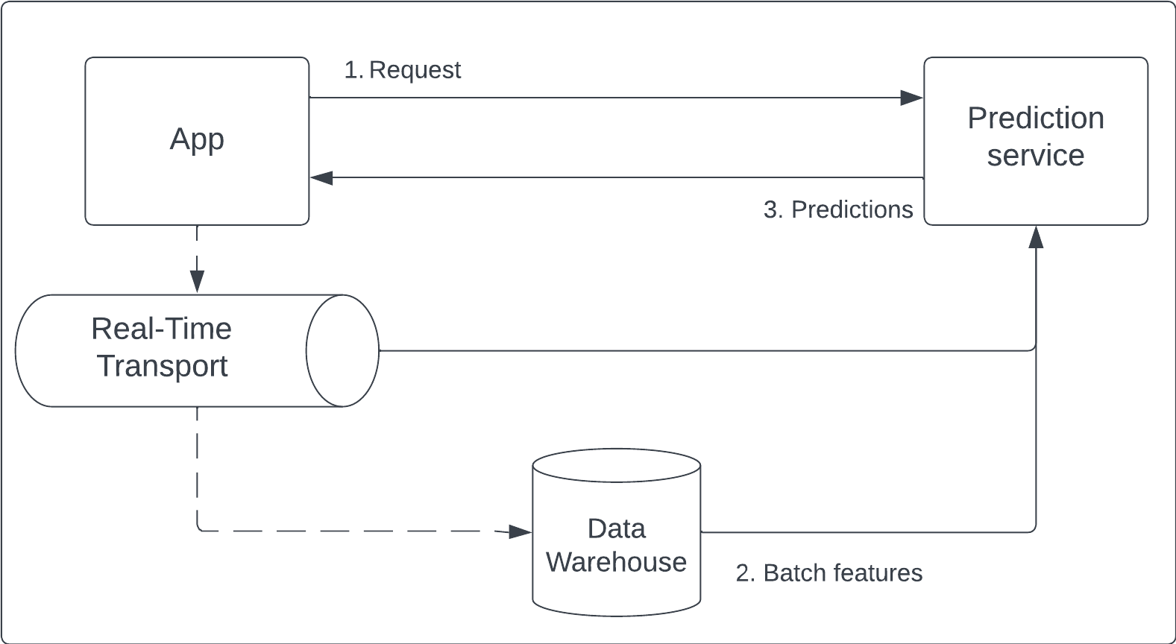
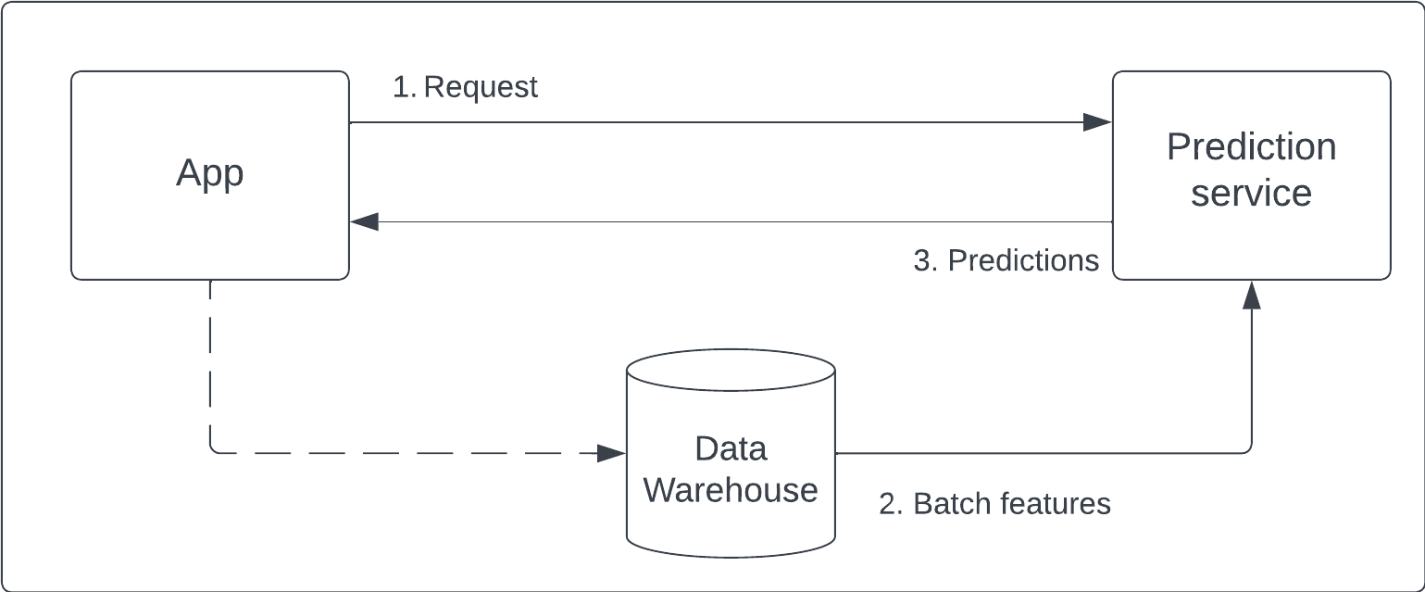
Model Prediction (Inference) Service (cont.)
Online Prediction (based on Huyen 2021)
Streaming Prediction (based on Huyen 2021)

