Slide 1
Introduction to ML Systems
Production Jesús Calderón

Slide 2
Introduction

Slide 3
Agenda
Course Introduction
1.1 Overview of ML Systems
When to Use ML
ML in Production
ML vs Traditional Software
1.2 Introduction to ML System Design
Business and ML Objectives
Requirements of Data-Driven Products
Iterative Process
Framing ML Problems
1.3 Project Setup
Introduction.
Repo File Structure.
Git, authorization, and production pipelines.
VS Code and Git.
Python virtual environments.
Branching Strategies.
Commit Messages.

Slide 4
Slides, Notebooks, and Code
Slides
These notes are based on Chapters 1 and 2 of Designing Machine Learning Systems, by Chip Huyen.
Notebooks
./notebooks/production_1_setup.ipynb
Code
./src/logger.py
./src/.env
./src/docker/docker-compose.yml
./src/docker/.env

Slide 5
Machine Learning

Slide 6
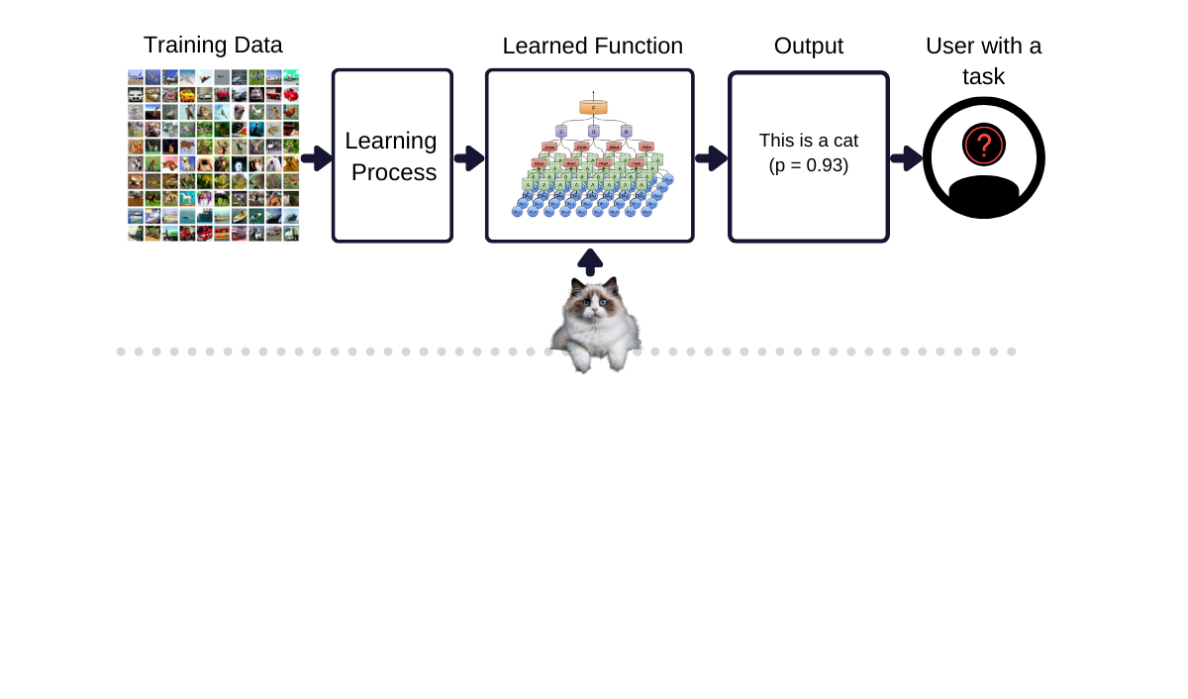
ML: An Illustration

Slide 7
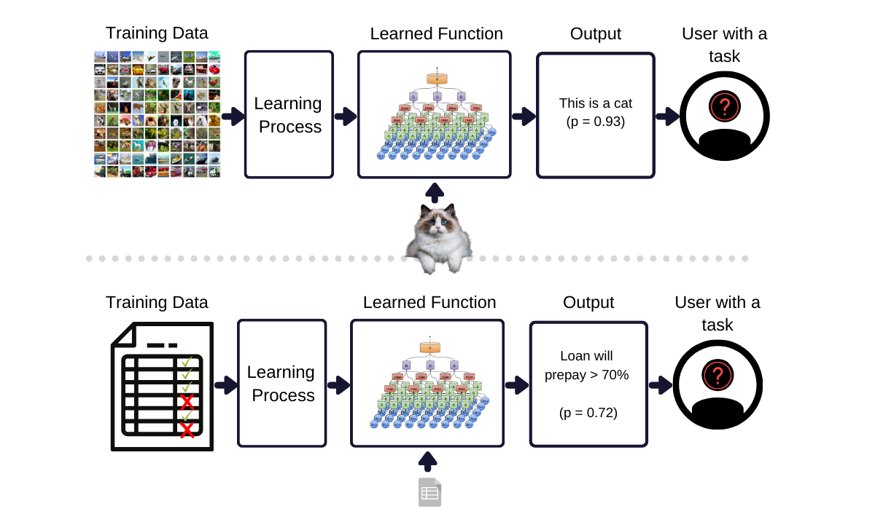
ML: An Illustration

Slide 8
What is Machine Learning (ML)?
“A computer program is said to learn from experience E with respect to some class of tasks T and performance measure P, if its performance at tasks in T, as measured by P, improves with experience E.”
(Mitchel, 1997)
ML is a collection of methods that allow a computer to:
Learn autonomously to perform a task based on a set of examples and without being explicitly programmed to perform the task.
Gain from experience such that the method performs better in the measure that it observes additional examples.
Generalize results beyond the data used for training the method.

Slide 9
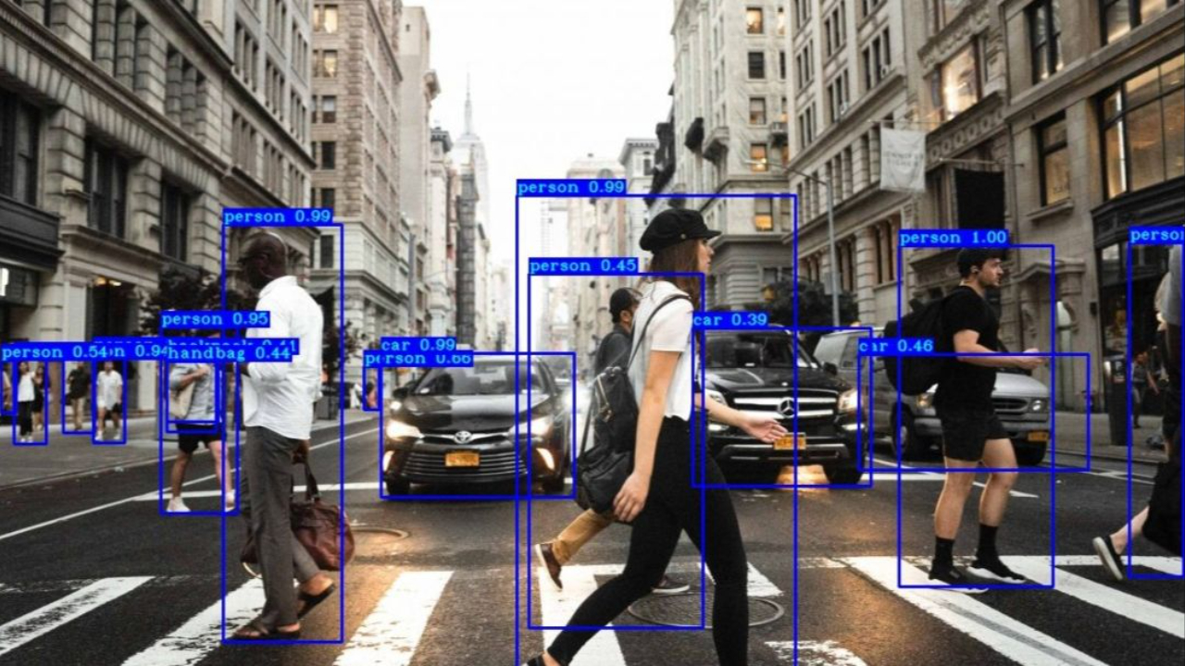
Why Use Machine Learning?
ML is used when a task is too complex or impractical to program explicitly.
When applied successfully, ML will enable:
Greater scale: automation.
Better performance.
Doing things that were not possible before.
(Source)

Slide 10
When to Use ML?
A business problem is not the same as an ML problem.
Generally, a business will be concerned with profit maximization (directly or indirectly): increasing sales, cutting costs, enhancing customer satisfaction, reducing churn, increasing time on the website, etc.
The objective of an ML method is to enhance the performance of the predictive task, given more data.
Optimising ML performance metrics does not automatically translate to optimizing business performance.
Some of the most popular business applications of ML are in areas where business and ML performance overlap: fraud detection, recommender systems, etc.
“Machine learning is an approach to (1) learn (2) complex patterns from (3) existing data and use these patterns to make (4) predictions on (5) unseen data.”
(Huyen, 2022)

Slide 11
ML System Design

Slide 12
Characteristics of ML Use Cases
Learn:
The system can learn autonomously.
Given a series of inputs, the system learns how to produce outputs.
Not every ML model can learn any hypothesis; more complex models will tend to be more flexible.
Complex patterns
There are patterns to learn, and they are complex.
ML solutions are only helpful if there are patterns.
Simple patterns could be learned, but the cost of applying ML may be unreasonable.
Existing data
Data is available, or it is possible to collect data.
Out-of-domain predictions may fail because of a lack of training data.
Online (real-time) learning systems could be deployed and trained using production data.
Predictions
ML algorithms will generate predictions. Therefore, the problem to solve should be predictive.
A prediction could be about a future event (forecast) or an event that is difficult to observe (e.g., fraud detection or clustering).

Slide 13
Characteristics of ML Use Cases (cont.)
Unseen data
Unseen data shares patterns with the training data.
The learning method generalizes reasonably well on testing data.
It is repetitive
ML algorithms perform better with experience: repetitive tasks afford such experience.
The cost of wrong predictions is cheap.
Achieving perfect performance may not be possible.
Human-level performance or better could be achieved.
It’s at scale
Upfront costs are involved: infrastructure, staff, DevOps.
Setting up an ML system that caters to many ML models concurrently.
Patterns are constantly changing
Hard-coded solutions can become stale and outdated.
The ML system’s environment changes: economics, social behaviour, trends, etc.
Feedback: the ML system informs a company’s actions, affecting, in turn, the company’s interactions with the external environment.

Slide 14
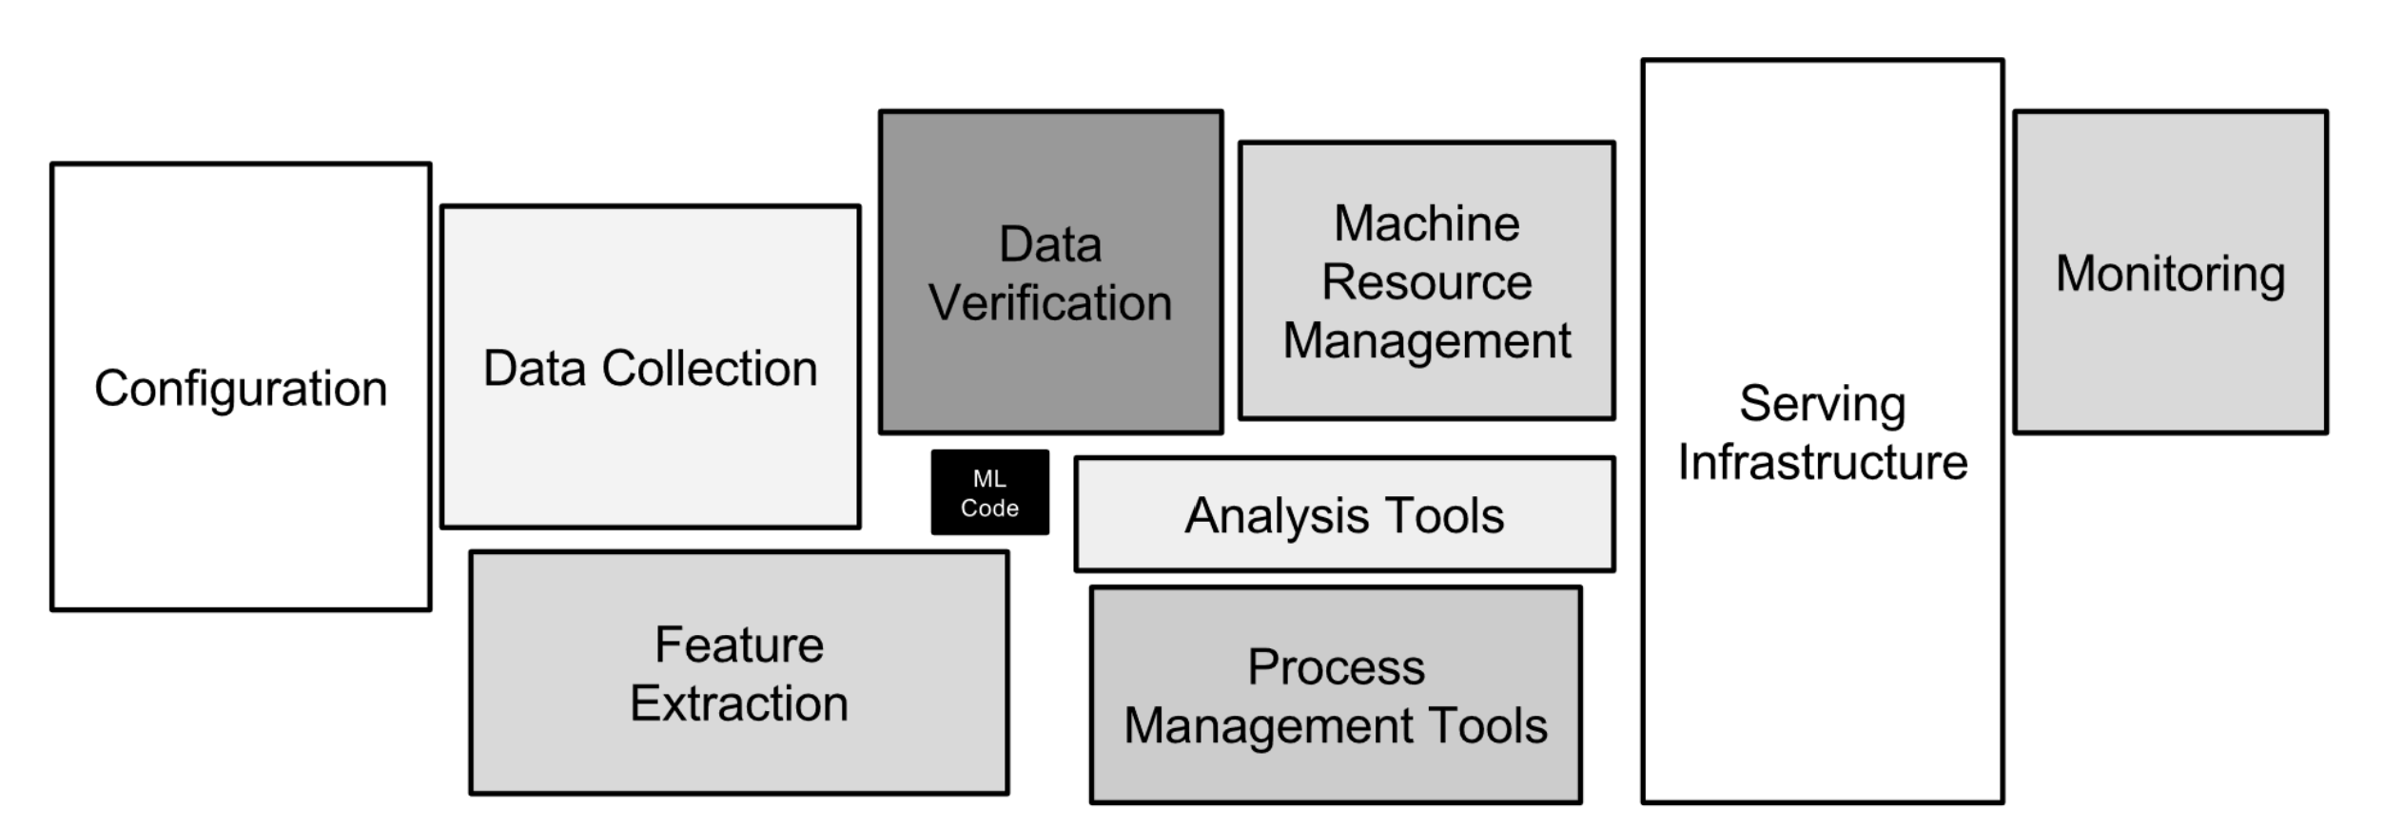
ML Systems Design
ML methods are not ML systems: the learning method needs to be applied to data, assessed, tuned, deployed, governed, and so on.
ML system design is a system approach to MLOps, i.e., we will consider the system holistically, including:
Business requirements.
Data stack.
Infrastructure.
Deployment.
Monitoring.
MLOps: a set of tools and best practices for bringing ML into production.
(Sculley, 2015)

Slide 15
How is ML in Production Different?

Slide 16
ML in Research vs Production
Dimension | Research | Production
Requirements | State-of-the-art model performance on benchmark datasets | Different stakeholders have different requirements
Computational priority | Fast training, high throughput | Fast inference, low latency
Data | Static | Constantly shifting
Fairness | Often not a focus | Must be considered
Interpretability | Often not a focus | Must be considered
(Huyen, 2022)

Slide 17
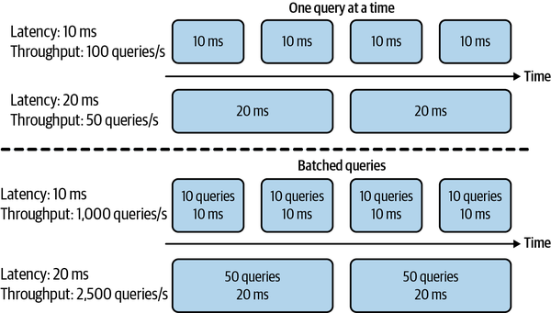
Business and ML Objectives
Different stakeholders require different things:
ML engineers: increase performance or efficiency of recommender system.
Sales: recommend more profitable options.
Product: reduce latency.
Platform: stability.
Manager: control costs.
Computational priorities
During model development:
Training is the bottleneck.
Throughput, the number of cases processed, should be maximized.
In production:
Fast inference is desirable.
Latency, the time between when a query is received and when it is addressed, should be minimized.
Latency is usually measured using percentiles of time elapsed (e.g., 99th percentile should be below X ms.)
(Huyen, 2022)

Slide 18
Business and ML Objectives (cont.)
Data
Data quality.
Historical vs constantly generated data.
Fairness
Fair and ethical decision-making is a key requirement.
ML algorithms make predictions based on encodings of past observations: they can perpetuate the biases in the data and more.
Explainability
Trust.
Legal requirements.
Informativeness: besides predictions, we require feature importance and other information about or results.
Transferrability: can learning from a scenario be applied to other scenarios?

Slide 19
Requirements of ML Systems

Slide 20
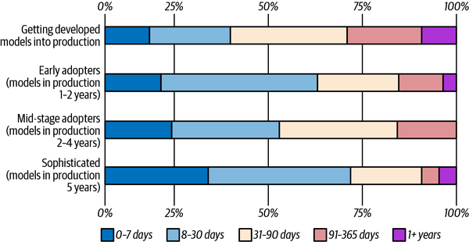
Lead Time to Production
(Huyen, 2022)

Slide 21
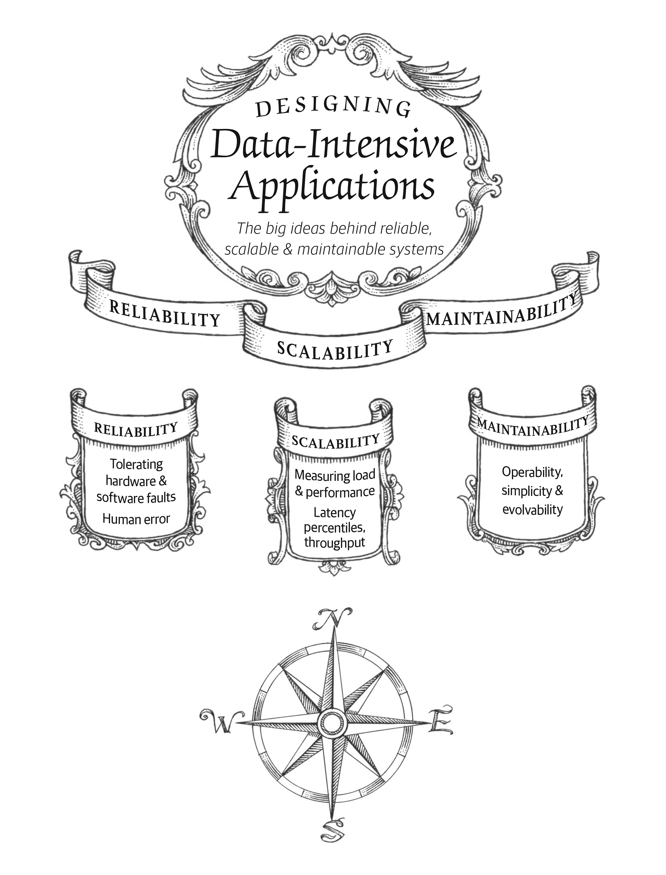
Designing Data-Intensive Applications
Many applications today are data-intensive instead of compute-intensive.
The limit factor is data and not computation.
Concerns: the amount of data, complexity of data, and speed at which it changes.
ML Systems tend to be embedded in data-intensive applications.
(Kleppmann, 2017)
(Kleppmann, 2017)

Slide 22
Fundamental Requirements of ML Systems
Reliability: The system should continue to perform the correct function at the desired level of performance, even in the face of adversity.
May require reporting uncertainty of results.
Remove “silent failures”: the system should alert the users of unexpected conditions.
If all else fails, shut down gracefully (e.g., close connections, log errors, alert downstream processes, etc.)
Scalability to ensure the possibility of growth:
Increase complexity.
Traffic volume or throughput.
Model count.
Maintainability to allow different contributors to work productively on the same system:
Maintain existing capacities.
Expand to new use cases.
Adaptability to shifting data distributions and business requirements.
The system should allow discovering aspects for performance improvements.
Allow updates without service interruptions.

Slide 23
ML System Design: An Iterative Process

Slide 24
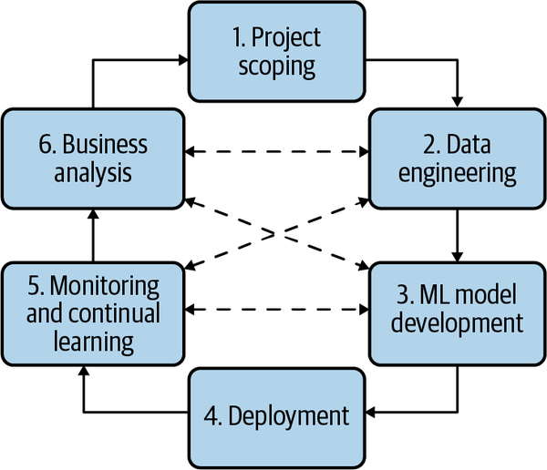
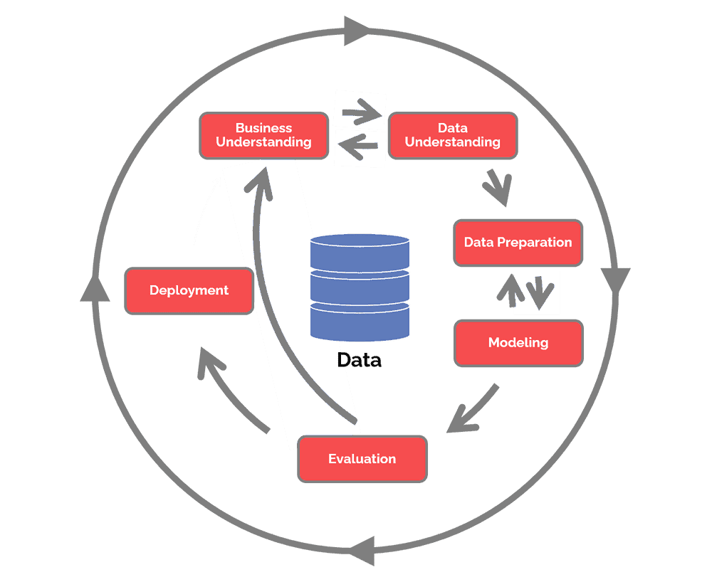
Developing ML Systems
(Huyen, 2022)
CRISP-DM (c. 1999): have things changed that much? (source)

Slide 25
Framing ML Problems
Classification tasks are:
Binary:
Two classes.
Simplest classification problems
Multiclass:
More than two (mutually exclusive) classes.
High cardinality (number of classes) problems will be more complex than low cardinality problems.
High cardinality can be addressed with a hierarchical classification approach: first, classify into large groups, then classify into specific labels.
Multilabel:
An observation can have more than one label.
One approach is to treat the problem as multiclass by creating unique labels out of combinations of individual labels.
Another approach is one-vs-rest, where each label is treated with a different binary classification model.
The output of an ML model dictates the type of ML problem.
In general, there are two types of ML tasks:
Classification.
Regression.
A regression model can be framed as a classification model and vice versa.
Regression to classification: apply quantization.
Classification to regression: predict the likelihood of class.

Slide 26
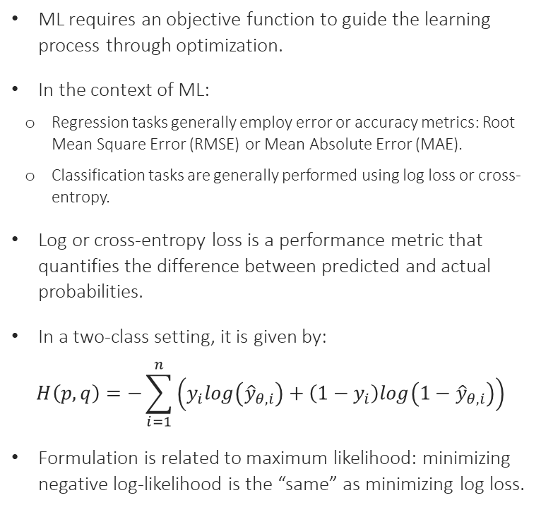
Objective Functions
ML requires an objective function to guide the learning process through optimization.
In the context of ML:
Regression tasks generally employ error or accuracy metrics: Root Mean Square Error (RMSE) or Mean Absolute Error (MAE).
Classification tasks are generally performed using log loss or cross-entropy.
Log or cross-entropy loss is a performance metric that quantifies the difference between predicted and actual probabilities.
In a two-class setting, it is given by:
$$H\left(p,q\right)=−\sum_{i=1}^{n}{\left(y_{i}log\left({\hat{y}}_{θ,i}\right)+\left(1−y_{i}\right)log\left(1−{\hat{y}}_{θ,i}\right)\right)}$$
Formulation is related to maximum likelihood: minimizing negative log-likelihood is the “same” as minimizing log loss.
Assume the actual value is 1.
If the model is confident and correctly predicted 0.9, then Loss = -(1*log(0.9)) = 0.10536
If the model is unsure and predicted 0.5, then Loss = -(1*log(0.5)) = 0.6931.
If the model is confident but incorrectly predicted 0.1, then Loss = -(1*log(0.1)) = 2.0258

Slide 27
Our Reference Architecture

Slide 28
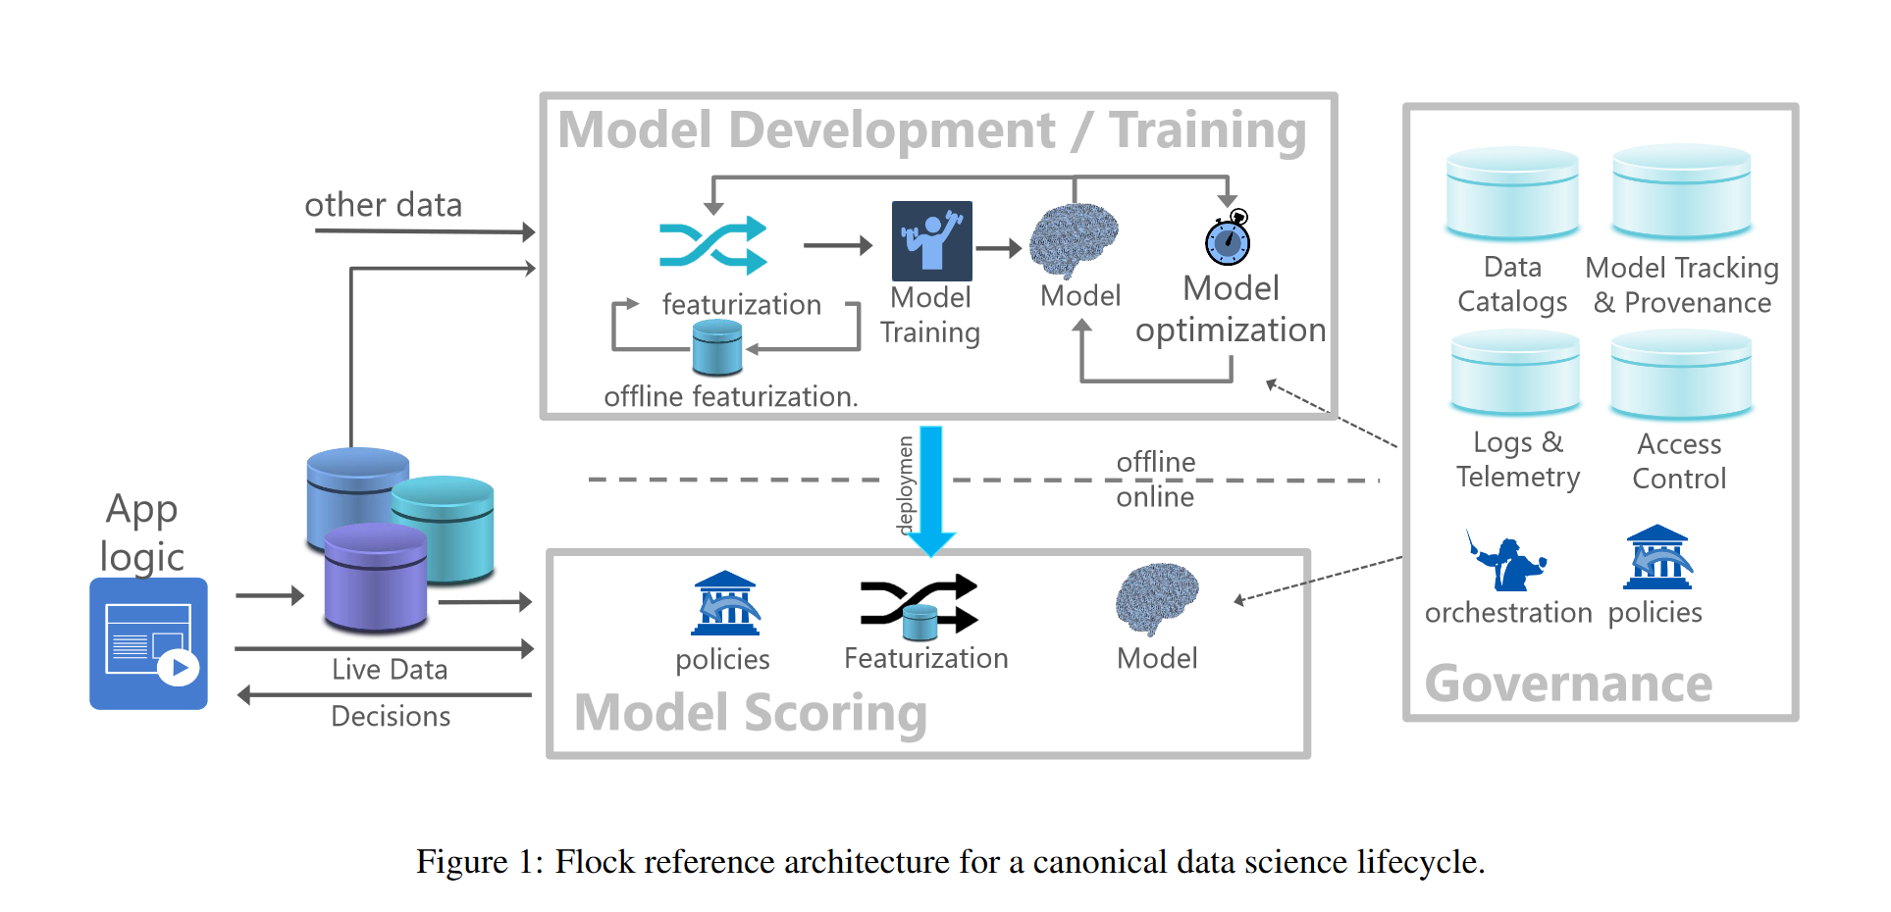
The Flock Reference Architecture
Agrawal et al (2019)

Slide 29
References

Slide 30
References
Agrawal, A. et al. “Cloudy with high chance of DBMS: A 10-year prediction for Enterprise-Grade ML.” arXiv preprint arXiv:1909.00084 (2019).
Huyen, Chip. “Designing machine learning systems.” O’Reilly Media, Inc.(2022).
Kleppmann, M. “Designing data-intensive applications: The big ideas behind reliable, scalable, and maintainable systems.” O’Reilly Media, Inc. (2017).
Mitchell, Tom M. “Machine learning.” (1997).
Olah, C. “Conv Nets: A Modular Perspective.” (2014) URL
Sculley, D. et al. “Hidden technical debt in machine learning systems.” Advances in neural information processing systems 28 (2015).
Wirth, R. and J. Hipp. “CRISP-DM: Towards a standard process model for data mining.” Proceedings of the 4th international conference on the practical applications of knowledge discovery and data mining. Vol. 1. (2000).

