Slide 1
Working with Training Data
Production Jesús Calderón

Slide 2
Introduction

Slide 3
Agenda
3.1 Working with Training Data
Sampling
Labeling
Class Imbalance
Data Augmentation
3.2 A Training Pipeline
Sampling in Python.
An initial training pipeline.
Modularizing the training pipeline.
Decoupling settings, parameters, data, code, and results.

Slide 4
Slides, Notebooks, and Code
These notes are based on Chapter 4 of Designing Machine Learning Systems, by Chip Huyen.
Notebooks
./notebooks/production_3_1_sampling.ipynb
./notebooks/production_3_2_pipeline.ipynb
Code
./src/credit_experiment_nb.py
./src/credit_preproc_ingredient.py
`./src/
./src/.env

Slide 5
Our Reference Architecture

Slide 6
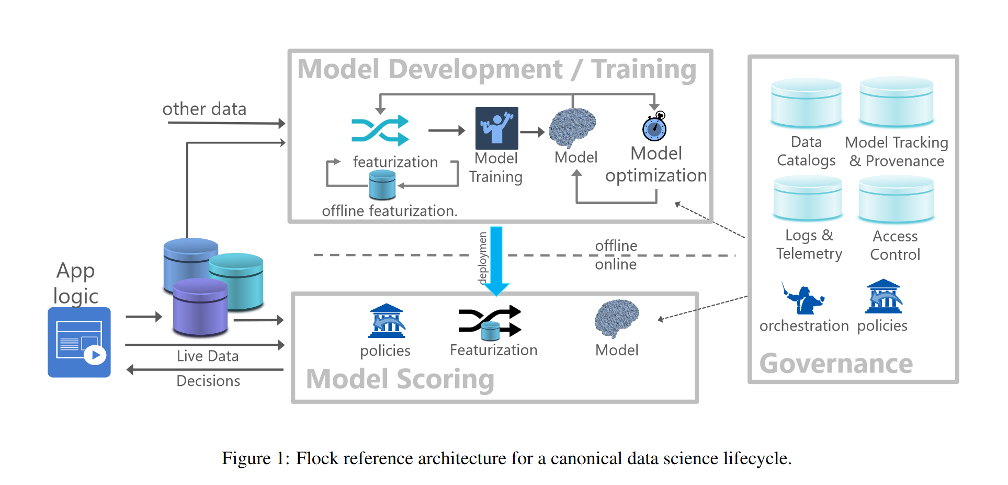
The Flock Reference Architecture
Agrawal et al (2019)

Slide 7
Sampling

Slide 8
Why Sample?
Sampling is embedded across the ML lifecycle: data exploration, train/validation/test split, etc.
Sometimes, sampling is necessary:
We cannot access all possible data in the real world.
Using all data is unfeasible, costly, or otherwise impractical.
Accomplish a task faster and cheaper: experiment with a new model, explore data, etc.
There are two families of sampling:
Nonprobability sampling.
Random sampling.

Slide 9
Nonprobability Sampling
Generally, selecting data to train ML methods using this family of sampling methods is a bad idea, but some of them are popular.
Convenience sampling
Select data based on their availability.
Popular and convenient: fast, inexpensive, practical.
Not scientific and does not offer guarantees.
Snowball sampling
Future samples are selected based on existing samples.
Sampling in social media (or other) networks: select a base sample of accounts, then expand the sample by adding the accounts they follow, and so on.
Judgement sampling
Experts decide what samples to include.
AKA: risk-based, SME, subjective, etc.
Quota sampling
Select samples based on predefined and heuristic quotas.
Example: select 100 responses from all age groups without considering the proportional representation of age groups.

Slide 10
Random Sampling
Simple Random Sampling
All potential samples in the population have equal probabilities of being selected.
Advantage: Easy to implement.
Disadvantage: Rare categories of data may not appear in the selection: if a class appears in 0.01% of the data and we randomly select 1% of the population, we may not get a representation of this minority class.
Stratified Sampling
First, divide the population into groups we care about, then sample from each group separately.
Each group is called a stratum and this method is called stratified sampling.
Advantage: the distribution of groups in the population is reflected in the sample.
Particularly important for selecting training, validation, and test sets.
This method is only sometimes possible (multilabel cases, for example, may not be treated).
Weighted Sampling
Each sample is given a weight, determining the probability of being selected.
This method allows us to leverage domain expertise.
Can be used to adjust samples that are coming from a different distribution than the original data:
Assume the data contains 25% red samples and 75% blue samples.
We know the actual distribution is closer to 50% red and 50% blue.
We can apply red weights that are three times higher than blue weights.

Slide 11
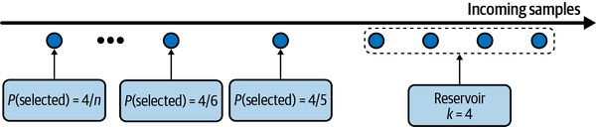
Reservoir Sampling
Useful for streaming data where the concept of “universe” is difficult to implement.
Motivation: we want samples from a Tweeter feed with equal probability.
Objectives:
Every tweet has an equal probability of being selected.
You can stop the algorithm at any time, and the tweets are sampled with the correct probability.
Reservoir sampling:
Put the first k elements into the reservoir.
For each incoming nth element, generate a random number i such that 1 ≤ i ≤ n.
If 1 ≤ i ≤ k: replace the ith element in the reservoir with the nth element. Else, do nothing.
Each incoming nth element has a k/n probability of being in the reservoir.
Reservoir Sampling (Huyen, 2021)

Slide 12
Labeling

Slide 13
Hand Labels
Getting hand-labelled data takes much work.
It is expensive, particularly if subject matter expertise is required. For instance, compare:
Hand label a sentiment data set.
Hand label a medical diagnosis data set.
It may be invasive: hand labelling data requires someone to see it.
Hand labelling is slow.
Label ambiguity or label multiplicity occurs when multiple conflicting labels exist for a data instance.
Label multiplicity may occur when labels are input by multiple annotators or data comes from different sources.
Disagreements among annotators are common, particularly as the need for subject matter expertise increases.
A potential solution is to have a clear problem definition and task guidance.

Slide 14
Examples of Label Multiplicity
Annotator | # entities | Annotation
1 | 3 | [Darth Sidious], known simply as the Emperor, was a [Dark Lord of the Sith] who reigned over the galaxy as [Galactic Emperor of the First Galactic Empire].
2 | 6 | [Darth Sidious], known simply as the [Emperor], was a [Dark Lord] of the [Sith] who reigned over the galaxy as [Galactic Emperor] of the [First Galactic Empire].
3 | 4 | [Darth Sidious], known simply as the [Emperor], was a [Dark Lord of the Sith] who reigned over the galaxy as [Galactic Emperor of the First Galactic Empire].
(Huyen, 2021)

Slide 15
Natural Labels
Natural ground truth labels or natural labels occur when the system can automatically evaluate or partially predict.
Examples: time travelled on a particular route on Google Maps, stock return, etc.
Natural labels are inexpensive to obtain and motivate many ML projects.
Recommender systems are the prime example of natural labels: we will know if the recommendation was good, if it was acted on.
Many tasks can be framed as recommendation tasks; for example, predicting an ad’s clickthrough rate can be reframed as recommending the best ads.
Natural labels that are inferred from user behaviours like clicks and ratings are known as behavioural labels.
Behavioural labels can be:
Explicit labels are observed from user behaviour (click, upvote, rating, etc.)
Implicit labels are inferred by non-behaviour, for example, ads that are not clicked.
Inferring an implicit label depends on the feedback loop length, which is the time between serving a prediction and the feedback on it provided.

Slide 16
Handling the Lack of Labels
Method | How | Ground truths required?
Weak supervision | Leverages (often noisy) heuristics to generate labels | No, but a small number of labels are recommended to guide the development of heuristics
Semi- supervision | Leverages structural assumptions to generate labels | Yes, a small number of initial labels as seeds to generate more labels
Transfer learning | Leverages models pretrained on another task for your new task | No for zero-shot learning. Yes for fine-tuning, though the number of ground truths required is often much smaller than what would be needed if you train the model from scratch
Active learning | Labels data samples that are most useful to your model | Yes

Slide 17
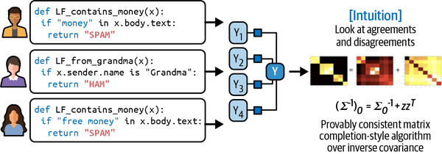
Weak Supervision
If hand labelling is costly, can we automate it?
Weak supervision is built on heuristics that are codified using Labeling Functions (LF):
Keyword heuristic.
Regular expressions.
Database lookup.
Outputs of other models.
LFs are combined, reweighted, and denoised to produce the labels.
In principle, no hand labels are required. In practice, a few may be required to get a sense of the accuracy of LF.
Combining LF (Huyen, 2022)

Slide 18
Semi-Supervision
Leverages structural assumptions to generate new labels based on a small set of initial labels.
Useful when the number of labels is limited.
Approach 1: self-training.
Train a model on an existing set of labelled data.
Make predictions for unlabeled samples; keep only the ones with high raw probability scores.
Train a new model on an expanded set of labels.
Approach 2: similarity.
Assume that data samples that share similar characteristics share the same labels.
Similarity is established by more complex methods (clustering, k-nn, etc.)
Approach 3: perturbation.
Assume that small perturbations to a sample do not change its label.
Apply small perturbations to your training instances to obtain new training instances.

Slide 19
Class Imbalance

Slide 20
What is Class Imbalance?
Class imbalance occurs when one or more classes have significantly lower proportions in the data than other classes.
The majority class dominates, but interest is generally in the minority class (e.g., default, fraud, or market crash).
Models trained on imbalanced data will tend to be under-fitted; they will not be able to classify the minority class successfully.
ML (particularly deep learning) works well when the class distribution is balanced. At the same time, performance decreases with class imbalance because:
There is insufficient signal for the model to learn to detect the minority class.
It is easier for a model to find a suboptimal solution by exploiting a simple heuristic instead of learning anything useful about the underlying pattern.
Asymmetric costs of error.
Class imbalance is the norm in many subject domains.
To handle class imbalance:
Choose the right performance metric.
Data-level methods: change the data distribution to reduce the imbalance.
Algorithm level methods: change the learning method to make it more robust to class imbalance.

Slide 21
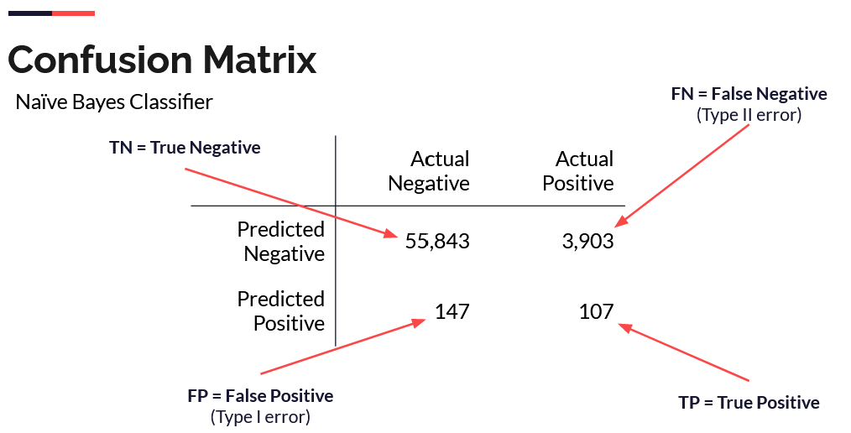
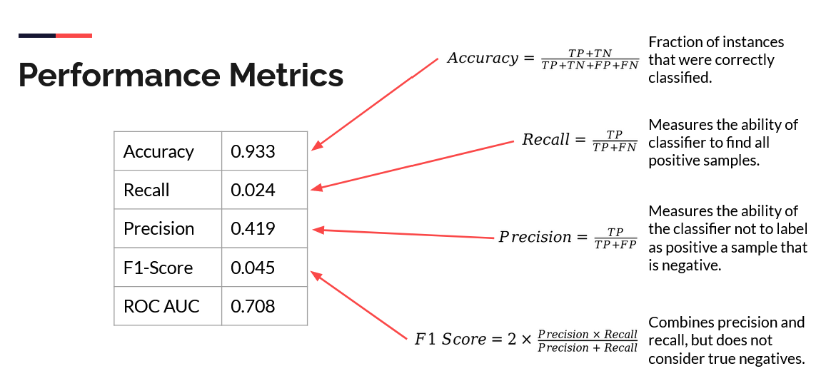
Performance Metrics

Slide 22
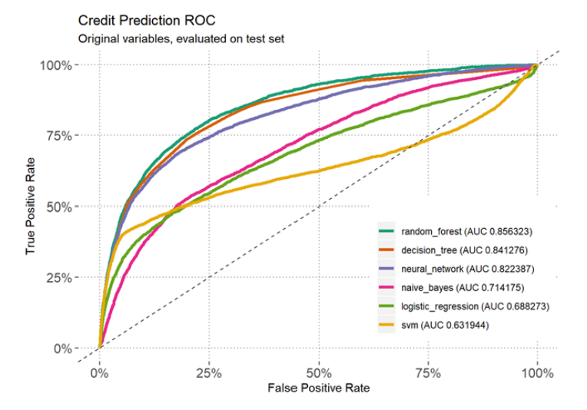
Class Probabilities Carry Information
Class probabilities offer more information about model predictions than the simple class value.
Given class probabilities, one could decide to predict a class by comparing them to a threshold.
A Receiver Operating Characteristic (ROC) curve shows the relationship between the True Positive Rate (TPR) and the False Positive Rate (FPR) for a variety of thresholds.
A greater Area Under the ROC Curve (AUC ROC) indicates a better model: AUC ROC can be interpreted as the probability that the classifier ranks a randomly chosen positive instance above a randomly chosen negative one.
AUC ROC measures the ranking order of a model’s prediction: it is useful when costs are unavailable and class distributions are unknown.

Slide 23
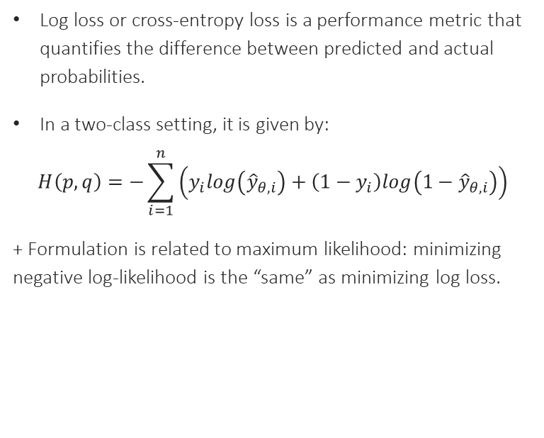
Cross-entropy, Negative Log-Loss, and Log-Likelihood
Log loss or cross-entropy loss is a performance metric that quantifies the difference between predicted and actual probabilities.
In a two-class setting, it is given by:
$$H\left(p,q\right)=−\sum_{i=1}^{n}{\left(y_{i}log\left({\hat{y}}_{θ,i}\right)+\left(1−y_{i}\right)log\left(1−{\hat{y}}_{θ,i}\right)\right)}$$
+ Formulation is related to maximum likelihood: minimizing negative log-likelihood is the “same” as minimizing log loss.
Assume the actual value is 1.
If the model is confident and correctly predicted 0.9, then Loss = -(1*log(0.9)) = 0.10536
If the model is unsure and predicted 0.5, then Loss = -(1*log(0.5)) = 0.6931.
If the model is confident but incorrectly predicted 0.1, then Loss = -(1*log(0.1)) = 2.0258

Slide 24
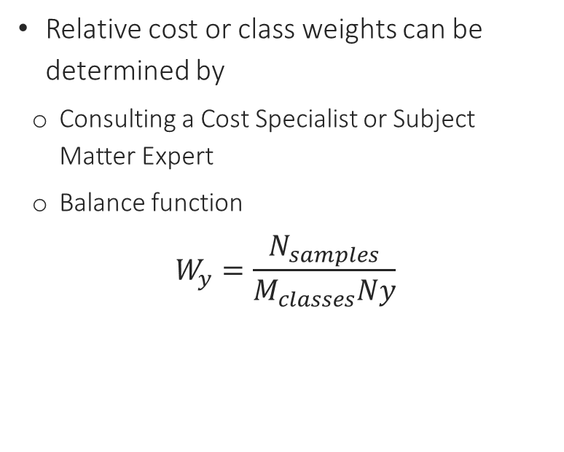
Class Weights
Some models can optimize a cost or loss function that differentiates for specific types of errors.
In some instances, one can assume that misclassifying minority events (false negatives) is more costly than incorrectly predicting non-events (false positives).
Relative cost or class weights can be determined by
Consulting a Cost Specialist or Subject Matter Expert
Balance function
$$W_{y}=\frac{N_{samples}}{M_{classes}Ny}$$

Slide 25
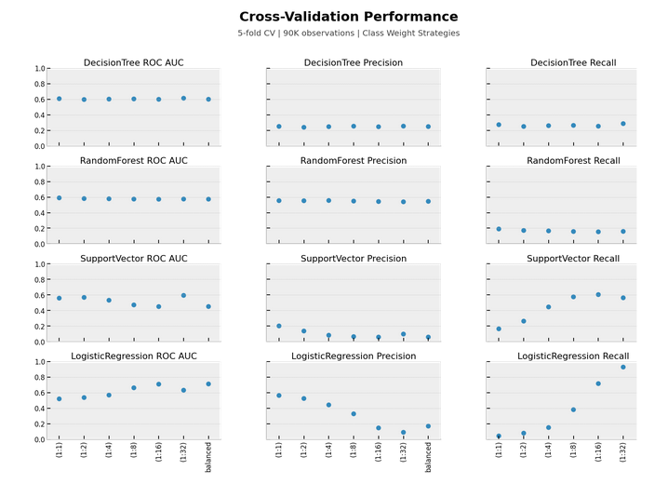
Class Weights and Performance
Class weights (unequal costs) can affect model parameters and performance.
Not every model will be equally affected by class weight strategies.

Slide 26
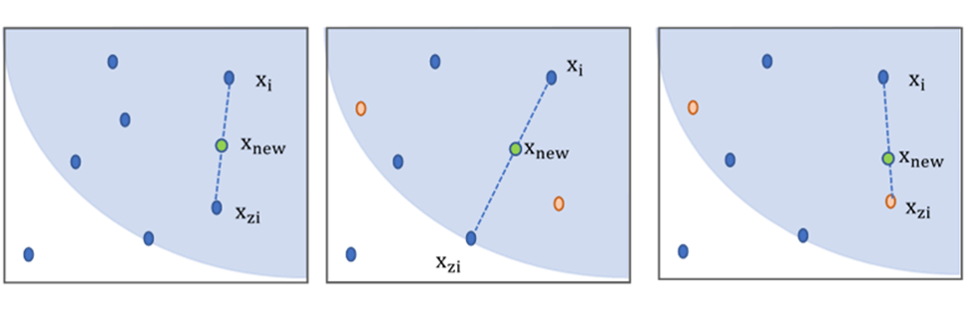
SMOTE
SMOTE: Synthetic Minority Oversampling TEchnique
Creates new instances based on random linear combinations of existing cases.
ADASYN: Adaptive Synthetic Sampling Method
Similar to SMOTE, but new instances are generated based on density.
With the availability of conformal prediction and advanced ML methods, synthetic oversampling is challenging to justify.
(Source)

Slide 27
References

Slide 28
References
Agrawal, A. et al. “Cloudy with high chance of DBMS: A 10-year prediction for Enterprise-Grade ML.” arXiv preprint arXiv:1909.00084 (2019).
Huyen, Chip. “Designing machine learning systems.” O’Reilly Media, Inc.(2022).

