Slide 1
Model Development
Production Jesús Calderón

Slide 2
Agenda
5.1 Model Development and Offline Evaluation
Model Development and Training
Ensembles
Experiment Tracking and Versioning
Distributed Training
AutoML
Model Offline Evaluation
5.2 Experiment Tracking
Observability and telemetry
Docker and Portability
Experiment Tracking in Python
Experiment Components

Slide 3
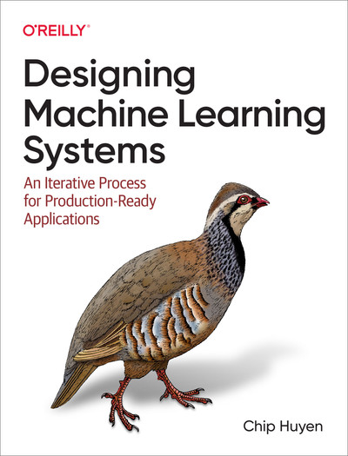
About These Notes
These notes are based on Chapters 5 of Designing Machine Learning Systems, by Chip Huyen.

Slide 4
Model Development and Training

Slide 5
Evaluating ML Models
Evaluating ML models in production is a multidimentional problem.
Model performance (of course) is improtance, but also how long it takes to train, latency at inference, (cost of) compute requirements, and explainability.
Different types of algorithms require different numbers of labels as well as different amounts of compute power.
Some take longer to train than others, whereas some take longer to make predictions.

Slide 6
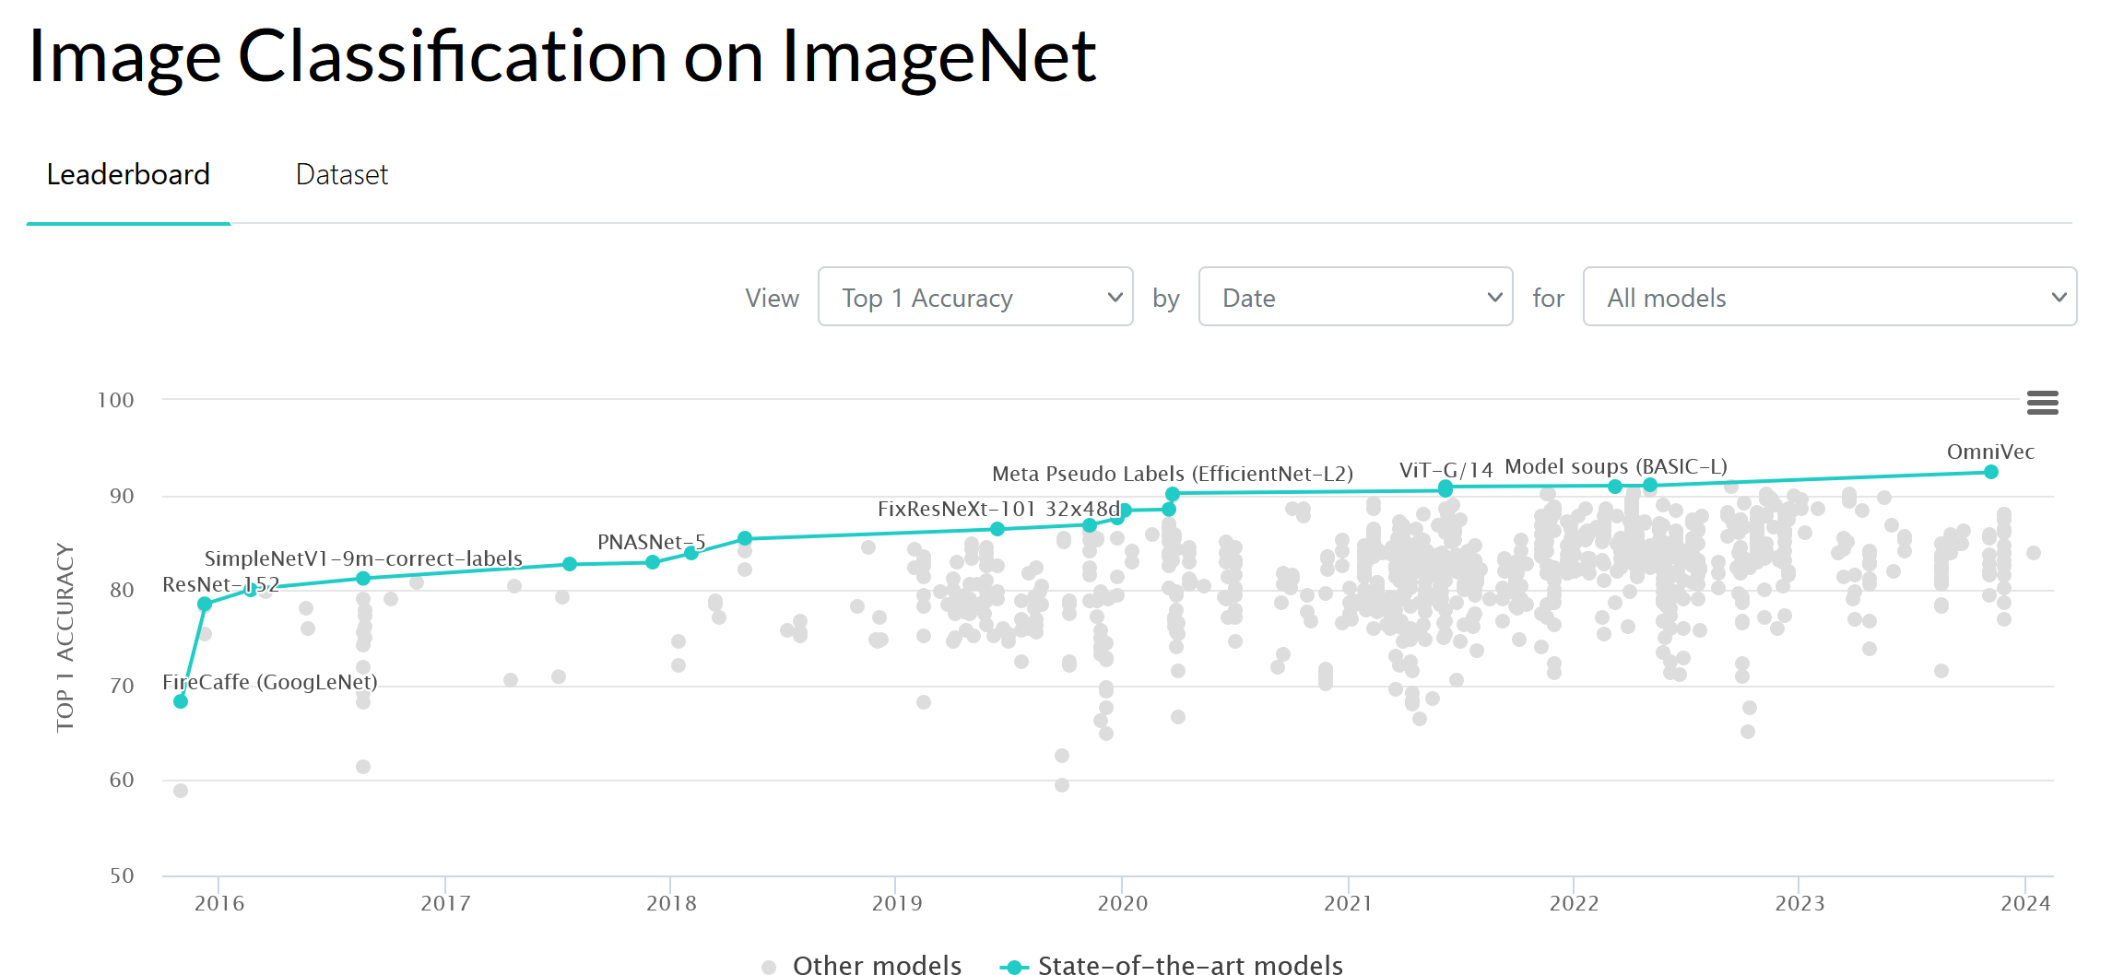
Guidance for Model Selection (1/3)
Avoid the state-of-the-art trap
Researchers evaluate models in academic settings: if a model is state-of-the-art, it performs better than existing models on some static dataset.
It is important to remain up to date, but solve the problem first.
Start with the simplest models
Simple is better than complex: easier to deploy, easier to understand, and serve as a baseline.
Easier to deploy: speeds up to experimentation cycle.
Easier to understand: adds complexity as needed.
Baseline: simple models serve as a starting comparison point model development.
State of the Art Model Performance on ImageNet (paperswithcode.com)

Slide 7
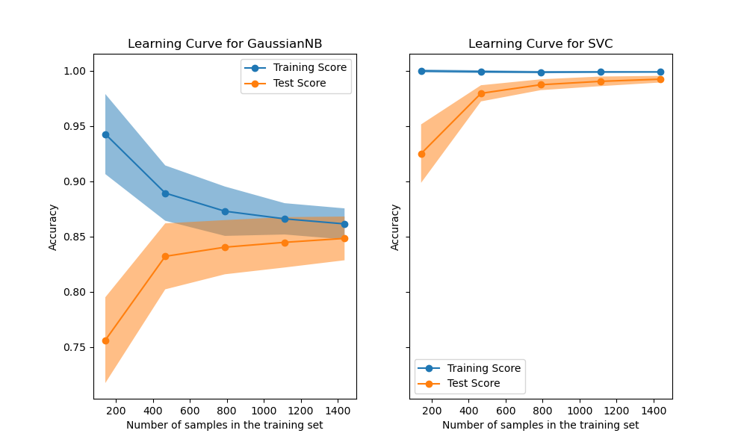
Guidance for Model Selection (2/3)
Avoid human biases in selecting models
Human biases can be introduced throughout the model development process.
Experiment methodically and store results.
Model has three components: algorithmic logic, code, and data.
Evaluate good performance now versus good performance later
A simple way to estimate how your model’s performance might change with more data is to use learning curves.
While evaluating models, consider their potential for improvement and how easy/difficult it is to achieve.
Learning Curves ( scikit-learn.org )

Slide 8
Guidance for Model Selection (3/3)
Evaluate trade-offs
False positives vs false negatives: reducing false positives may increase false negatives and vice versa.
Compute requirement and model performance: a more complex model may deliver better performance, but at what cost?
Understand your model’s assumptions
Every model comes with its own assumptions.
Prediction assumption: every model that aims to predict an output Y from an input X, assumes that it is possible to predict Y based on X.
Independent and Identically Distributed: neural nets assume that examples are independent and identically distributed.
Smoothness: supervised learning models assume that there is a set of functions that can transform inputs into outputs such that similar inputs are transformed into similar outputs. If an input X produces Y, then an input close to X would produce an output proportionally close to Y.
Linear boundaries, conditional independence, normally distributed, and so on.

Slide 9
Ensembles

Slide 10
The Wisdom of the Crowds
“Aggregating the judgment of many consistently beats the accuracy of the average member of the group, and is often as startlingly accurate […] In fact, in any group there are likely to be individuals who beat the group. But those bull’s-eye guesses typically say more about the power of luck […] than about the skill of the guesser. That becomes clear when the exercise is repeated many times.”
(Tetlock and Gardner, 2015)

Slide 11

Ensembles
Ensemble methods are less favored in production because ensembles are more complex to deploy and harder to maintain.
Common in tasks where small performance boosts can lead to huge financial gain, such as predicting the click-through rate for ads.
Ensembles perform better when underlying classifiers are uncorrelated.
Top Solutions on SQuAD 2.0 ( source )

Slide 12
Possible Outcomes
Outputs of three models | Probability | Ensemble’s output
All three are correct | 0.7 * 0.7 * 0.7 = 0.343 | Correct
Only two are correct | (0.7 * 0.7 * 0.3) * 3 = 0.441 | Correct
Only one is correct | (0.3 * 0.3 * 0.7) * 3 = 0.189 | Wrong
None are correct | 0.3 * 0.3 * 0.3 = 0.027 | Wrong

Slide 13
Bagging
(Huyen, 2021)
(Huyen, 2021)

Slide 14
Bagging (bootstrap aggregating) is designed to improve the training stability and accuracy of ML algorithms.
Reduces variance and helps avoid overfitting; it improves unstable methods (e.g., tree-based methods)
Outline:
Given a data set, create n data sets by sampling with replacement (bootstrap).
Train classification or regression model on each bootstrap.
If classification, decide by majority vote; if regression, use the mean result.
Sampling with replacement ensures that each bootstrap is created independently from its peers.
::: ::::::

Slide 15
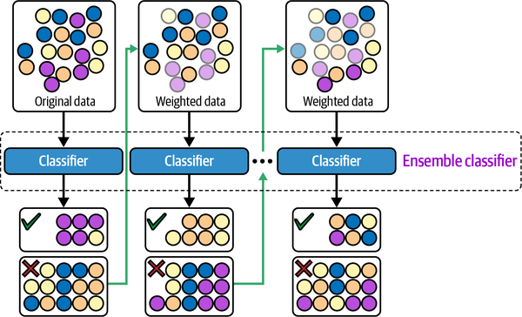
Boosting
Family of iterative ensamble algorithms that convert weak learners to strong ones.
Outline:
Each learner is trained on the same set of samples, but the samples are weighted differently in each iteration.
Future weak learners focus more on the examples that previous weak lerners misclassified.
Examples: Gradient Boosting Machine (GBM), XGBoost, and LightGBM.
(Huyen, 2021)

Slide 16
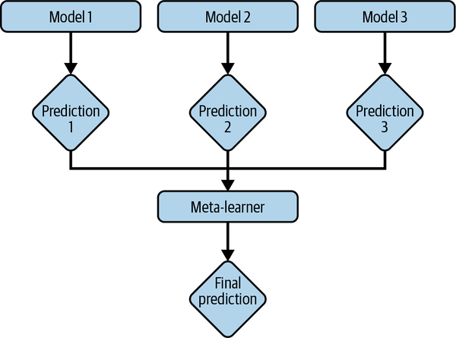
Stacking
Outline:
Create base learners from the training data.
Create a metalearner that combines the outputs of the base learners to output predictions.
(Huyen, 2021)

Slide 17
Experiment Tracking and Versioning

Slide 18
Experiment Tracking
The process of tracking the progress and results of an experiment is called experiment tracking.
ML Flow and Weights & Balances are experiment tracking tools.
At a minimum, track performance (loss) and time (speed).
Values over time of any parameter and hyperparameter whose changes can affect model performance.
Model performance metrics : on all nontest splits like accuracy, F1, perplexity.
Loss curve: train split and each of the eval splits.
Log of corresponding sample, prediction, and ground truth labels.
Speed of the model: number of steps per second or number of tokens processed per second.
System performance metrics: memory, CPU, GPU.

Slide 19
Versioning
The process of logging all the details of an experiment for the purpose of possibly recreating it later or comparing it with other experiements is called versioning.
DVC versioning tool that also provides some experiement tracking.
ML models in production are part code and part data.
Code versioning has more or less become a standard in the industry.
Data versioning is not standard.
Code versioning tools allow to switch between version of the codebase by keeping copies of all the old files. Data may be too large for duplication to be feasible.
Code versioning tools allow several people to work on the same code at the same time by replicating locally. Data may be too large, as well.
What is a diff when versioning data? DVC, for example, only checks in changes in checksum.
Compliance with GDPR may also be problematic if full history of data is kept.

Slide 20
Distributed Training

Slide 21
AutoML

Slide 22
Model Offline Evaluation

