Slide 1
Why Isn’t it Funny: A Recommender System For Jokes
Project by Adam Ten Hoeve

Slide 2
So we’re building some recommender Systems
So we want to use math to find the best jokes. Let’s use jokes we already have.
3 Primary Methods:
Collaborative
Build recommendations from users who had similar ratings to the jokes we’ve already ranked.
Content-Based
Build recommendations from the content of the jokes themselves.
Hybrid
Staple the above two methods together and hope you get something better out.

Slide 3
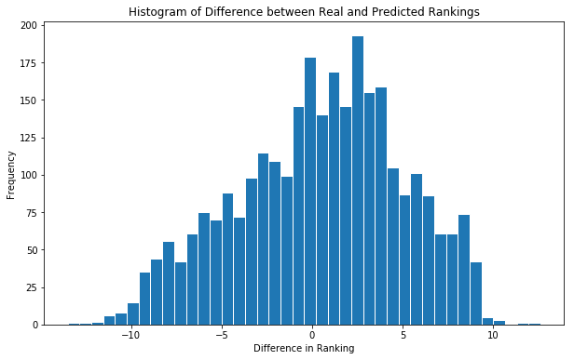
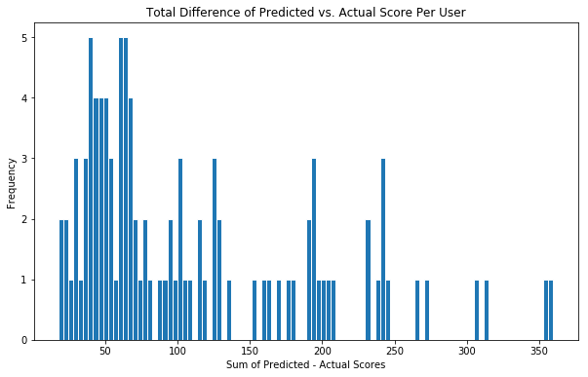
Collaborative Method
Predicting user’s rankings from rankings of similar users.

Slide 4
Content-Based
Categorical
TF_IDF
Hybrid
Hard coded Boolean “features” for each joke about its contents.
Examples include jokes about religion or politics, contain the phrase “In a bar” or “screw in a lightbulb.”
About which words appear in which jokes.
The more specific the word, the more it “represents” that joke.
If the same word is only in a few jokes, then those jokes are similar.
Combine both methods.
Lots of features.

Slide 5
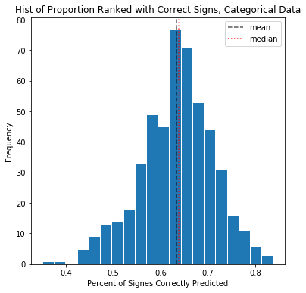
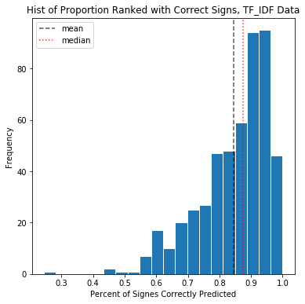
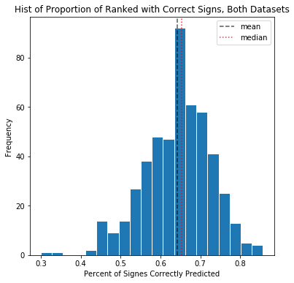
Evaluating Content-Based Methods: Correct Signs
Categorical
TF_IDF
Hybrid

Slide 6
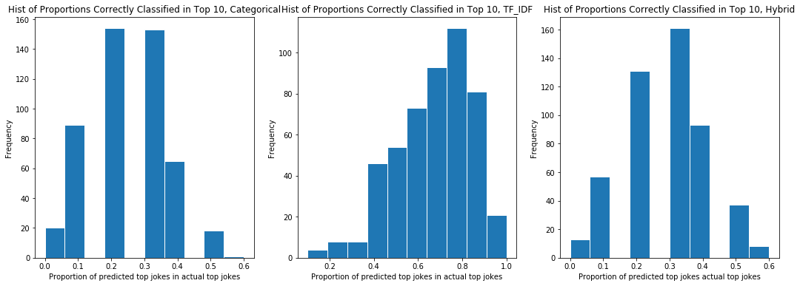
Evaluating Content Models: Predict Top Jokes
Categorical
TF_IDF
Hybrid

Slide 7
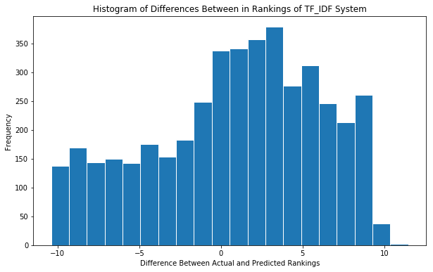
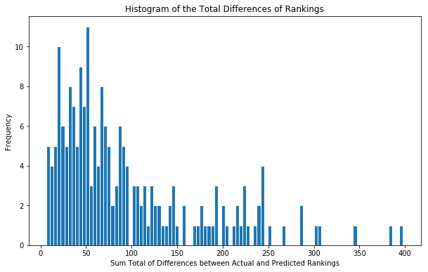
TF_IDF System
Conclusion: Use the TF_IDF data for the content-based system.
Not Perfect. Gives a “preference” between [-1, 1], so can stretch to ranking scale to use as predictions.

Slide 8
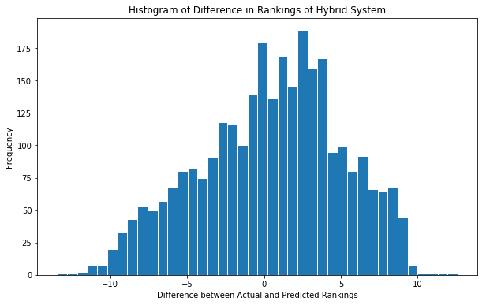
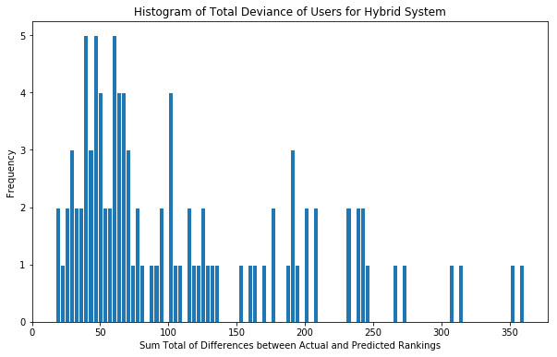
Hybrid System
Compute the predicted scores of the Collaborative and TF-IDF systems, then take the average of the scores.

Slide 9
Wait, isn’t that a problem?

Slide 10
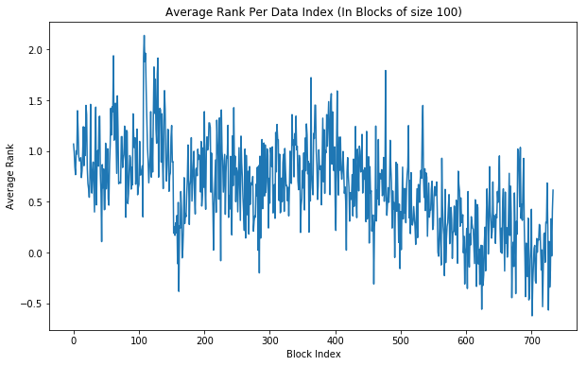
Systematic Error
The initial users are, on average, rated higher than lower index users.
If we evaluate with a set holdout set, the data will be subjected to a systematic error.
To fix, we can randomize the rows used for our holdout set.

Slide 11
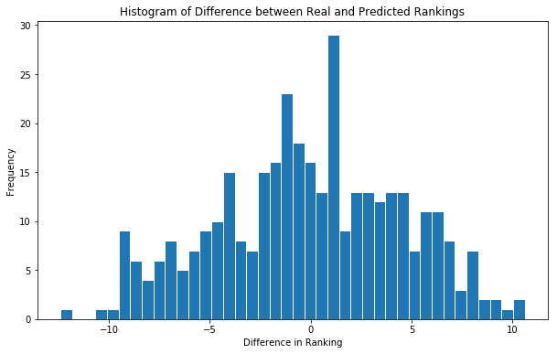
Accounting for this error

Slide 12
Other Problems
Running evaluations on large holdout sets was not possible on my laptop.
Working with NaNs.
Debugging was not fun.
I had to read all the bad jokes.

Slide 13
So Does it Work?
Let’s do an extreme case and rate the following jokes as 10. What joke gets recommended?
How many programmers does it take to change a lightbulb? NONE! That's a hardware problem....
How many Irishmen does it take to change a lightbulb? Two, one to hold the lightbulb and the other to drink until the room spins.
How many men does it take to screw in a light bulb? One... men will screw anything.
How many feminists does it take to screw in a light bulb? That's not funny.
How many Presidents does it take to screw in a light bulb? It depends upon your definition of screwing a light bulb.
An old Scotsmen is sitting with a younger Scottish gentleman and says to the boy. "Ah, lad look out that window. You see that stone wall there, I built it with me own bare hands, placed every stone meself. But do they call me MacGregor the wall builder? No! He Takes a few sips of his beer then says, "Aye, and look out on that lake and eye that beautiful pier. I built it meself, laid every board and hammered each nail but do they call me MacGregor the pier builder? No! He continues..."And lad, you see that road? That too I build with me own bare hands. Laid every inch of pavement meself, but do they call MacGregor the road builder? No!" Again he returns to his beer for a few sips, then says, "Agh, but you screw one sheep..."
You Decide

