Slide 1
AI-Powered Ticket Triage System
Automating Helpdesk with LLM Technology
Project Presentation

Slide 2
Team Members & Core Responsibilities
Our team divided the research and implementation as follows:
- Govind: Backend, FastAPI, LLM & Database
- Vishali: Data preprocessing, NLP & Prompt Engineering
- Geetha: Dataset, SQL/Data handling, Dashboard & Testing
- Srinivas: ML model, Feature Engineering & Evaluation
- Saikumar: AI/LLM testing, Prompting & AI research

Slide 3
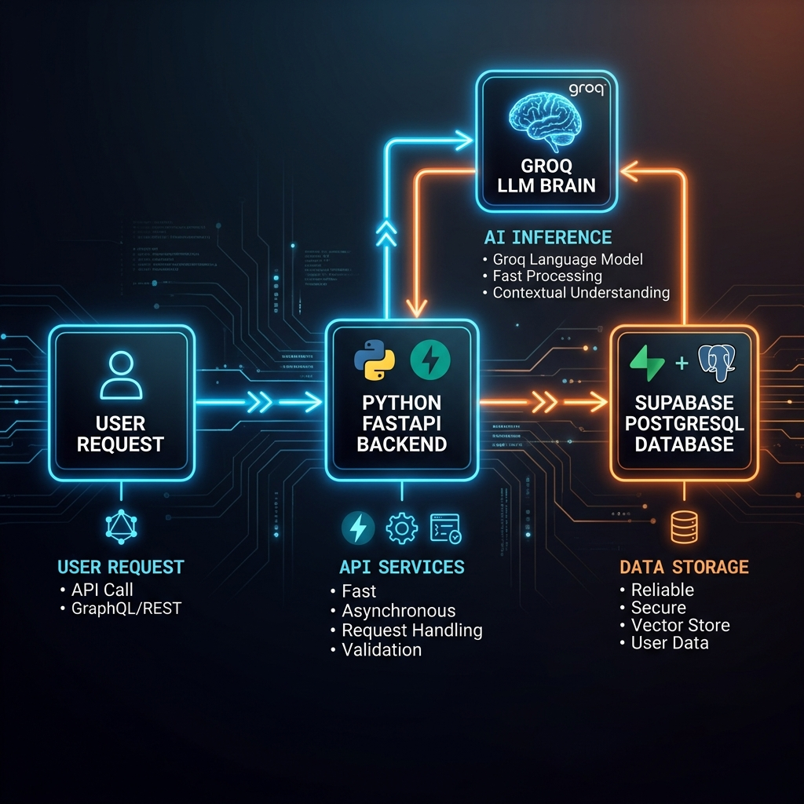
System Architecture: AI Workflow

Slide 4
System Workflow Details
1. Frontend (React/Vite): User submits ticket via our modern portal.
2. Backend (FastAPI): Receives request and coordinates AI.
3. LLM (Groq API): Extracts Category, Priority, and Summary in one pass.
4. Database (Supabase): Stores validated SQL data.

Slide 5
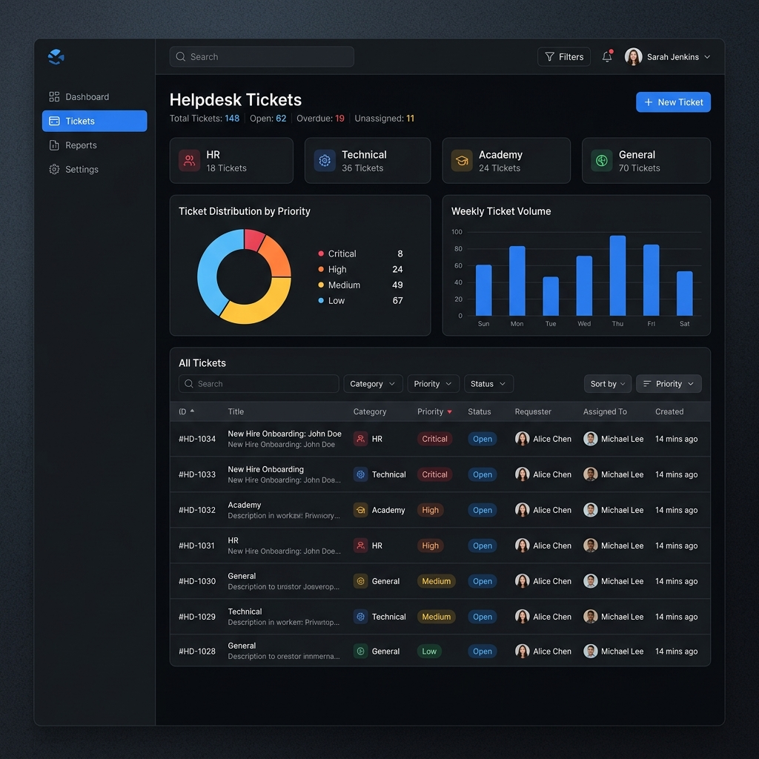
React Helpdesk Dashboard

Slide 6
Optimization & Design Decisions
Defending our architectural choices during evaluation:
  Q: Why are we not using traditional NLP?
    A: The Groq LLM natively understands natural language context without needing manual text tokenization. Also, since we use a React application for the UI, complex text parsing isn't needed on the backend.
  Q: What about traditional ML Models & Feature Engineering?
    A: We evaluated ML, but LLMs proved superior for dynamic classification. They don't require constant retraining, making backend lightweight.
  Q: How is Data/SQL managed?
    A: The React dashboard connects to FastAPI, which securely handles SQL insertion via Supabase.

