Slide 1
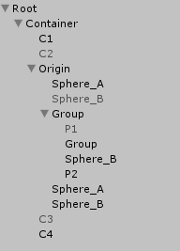
ObjectsBeforeSelf
Child/Children
Parent/Ancestors
ObjectsAfterSelf
Descendants

Slide 2
ObjectsBeforeSelf
Parent/Ancestors
Child/Children
LINQ to GameObject
ObjectsAfterSelf
LINQ to GameObject
Descendants
origin.Descendants()
.Where(x => x.tag == "foobar")
.OfComponent<BoxCollider2D>();

