Slide 1
Matrix-Spencer
Nischal

Slide 2
Spencer’s Six Deviation Suffice

Slide 3
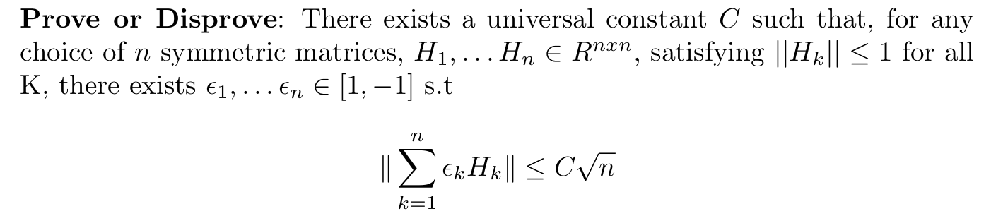
Matrix-Spencer

Slide 4
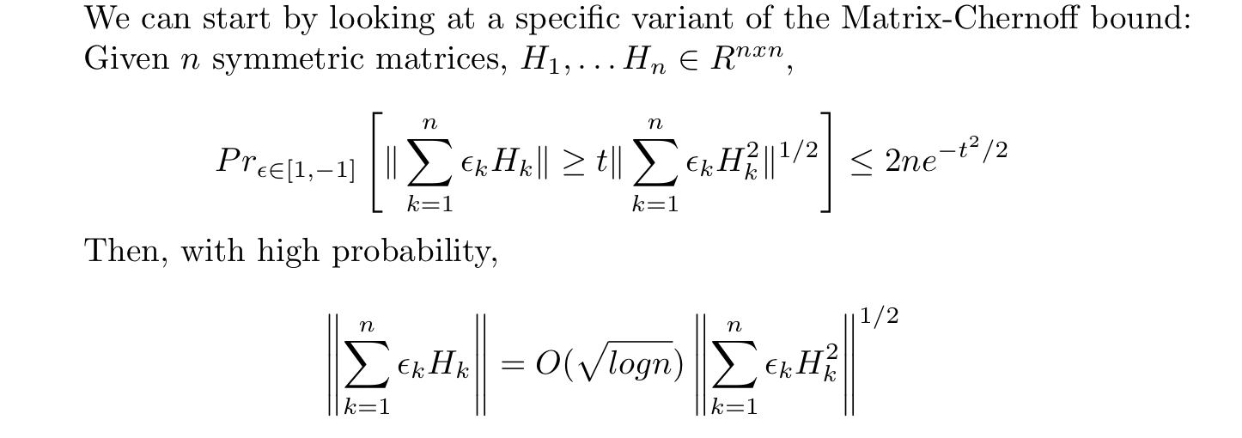
Current Bound

Slide 5
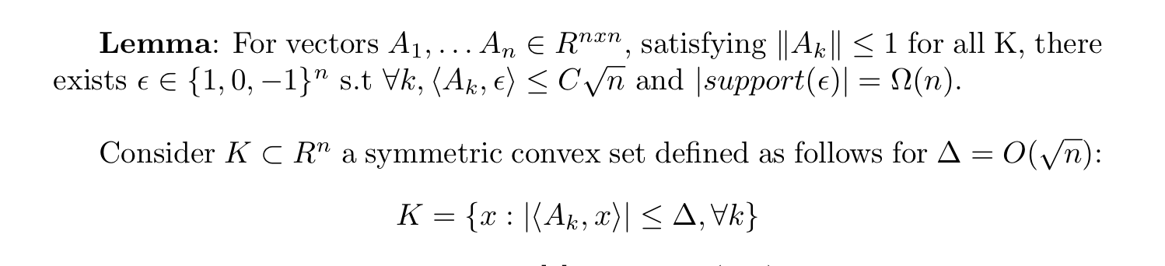
Brief Sketch of Gluskin’s Proof

Slide 6
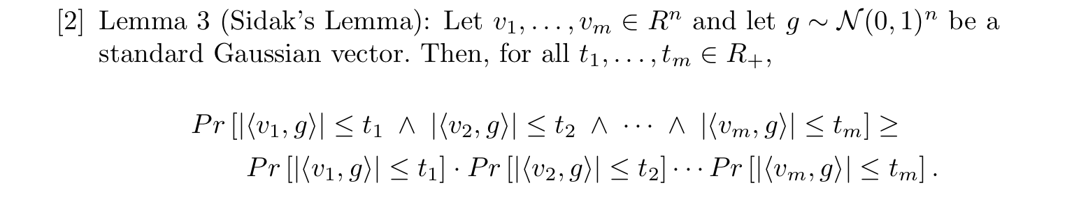
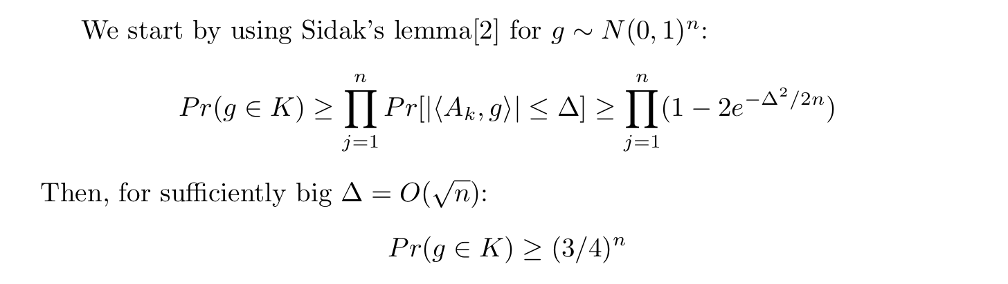

Slide 7
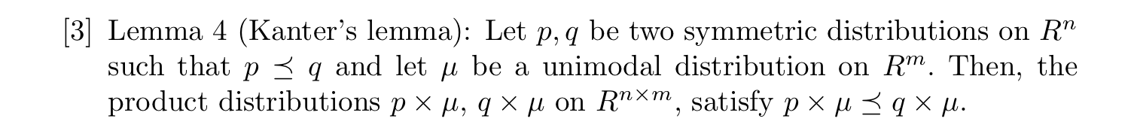
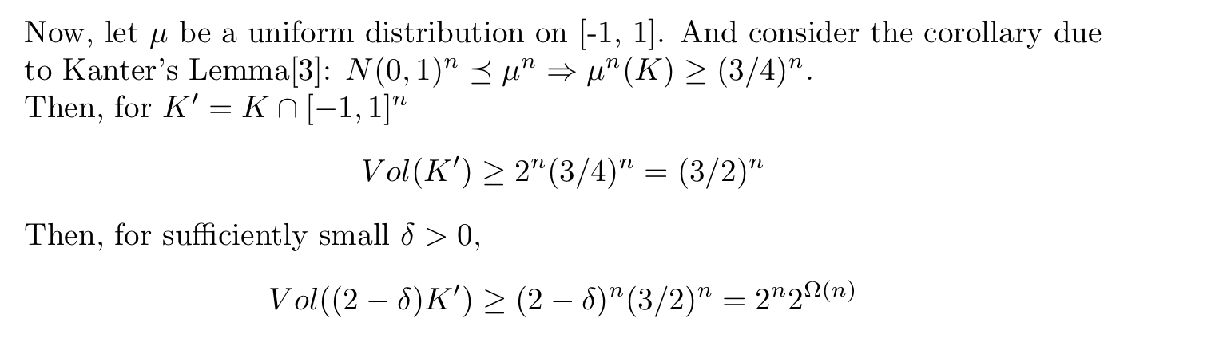

Slide 8
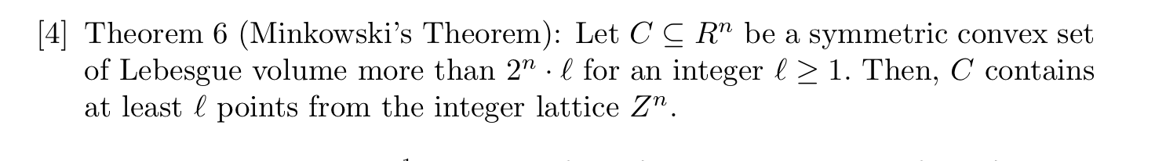
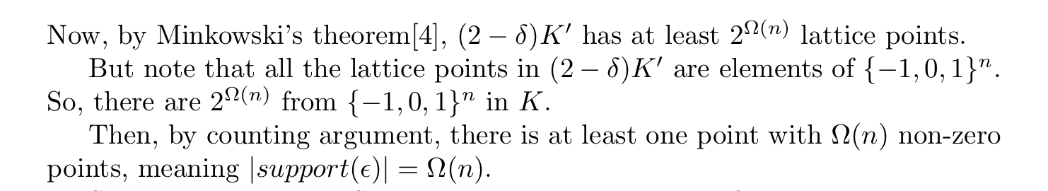

Slide 9
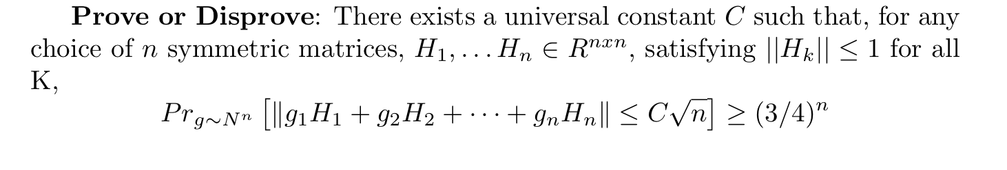
Restatement of Matrix-Spencer

Slide 10
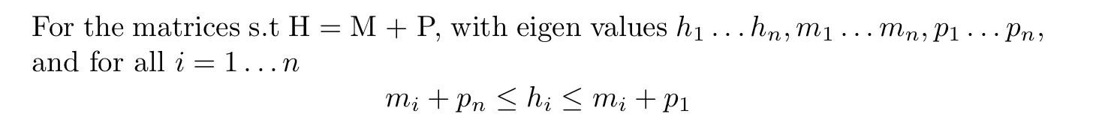
Weyl’s Inequality

Slide 11
SDP restriction? Generalized Gluskin’s

Slide 12
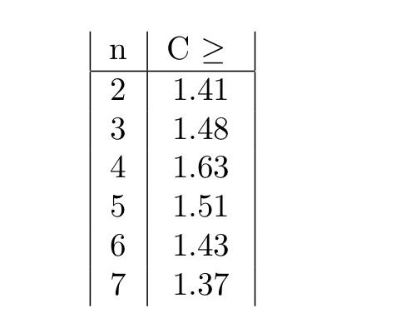
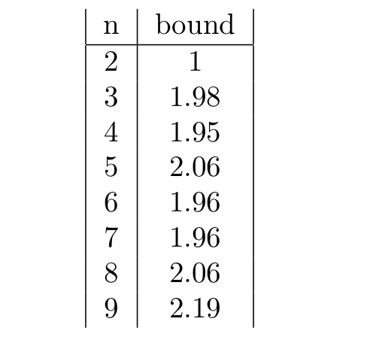
Numerics – General case VS SDP

