Slide 1

Enzorg
Organize your work the smart way

Slide 2

Team Name
Domain-Not-Specified
Team Members
M M Nazmul Hossain 200042118
Rhidwan Rashid 200042149
Sian Ashsad 200042151

Slide 3

Contents of the Presentation
01
Introduction
04
Overview of Features
02
Design Flow
05
Timeline Comparison
03
ER Diagram
06
Project Demonstration

Slide 4


Introduction
Web-based platform to organize and handle both personal and group projects

Slide 5
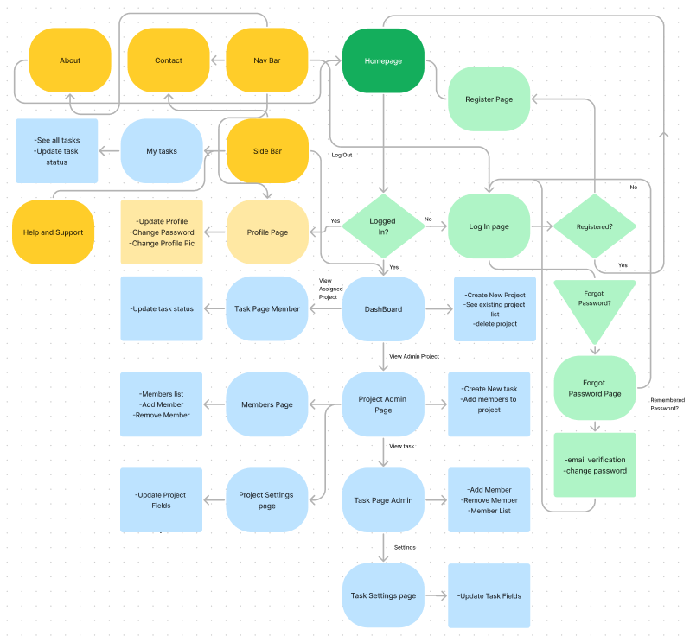
EnzOrg Flowchart

Slide 6
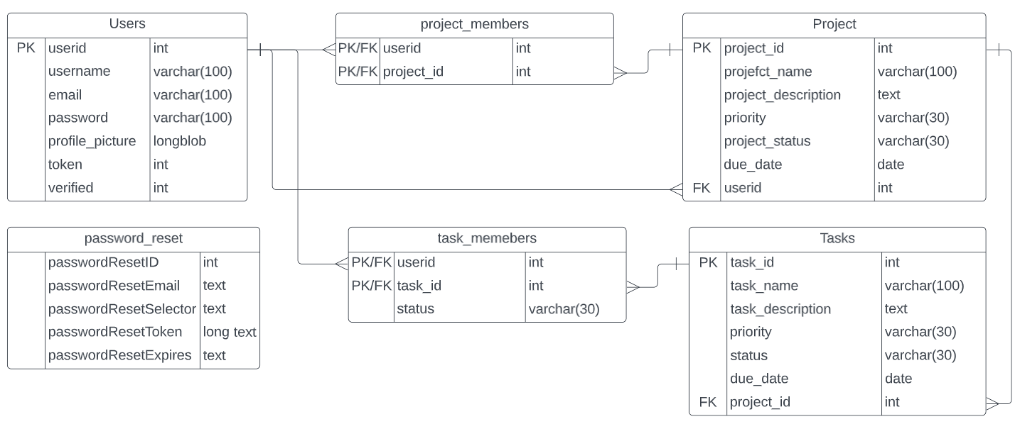
ER Diagram

Slide 7

Implemented Features
User Login and Registration with verification
3
Adding, Removing Projects and tasks
1
2
Project/Task distribution and division
4
Project and Task Progress

Slide 8
Implemented Features(Continued)
Deadline Warning
7
Project and Task Updating
5
6
Project and Task Prioritizing
8
Access Abstraction

Slide 9

Features to be Implemented
1
Roadmap
2
Recover Deleted Projects

Slide 10

Technologies
CSS
Style and Layout the Web Pages
HTML
Develop the Structure of the Web Pages
JavaScript
Making the Website More Interactive and
PHP
Handling the Backend
MySQL
Modifying the Database
Version Control
GitHub
7

Slide 11
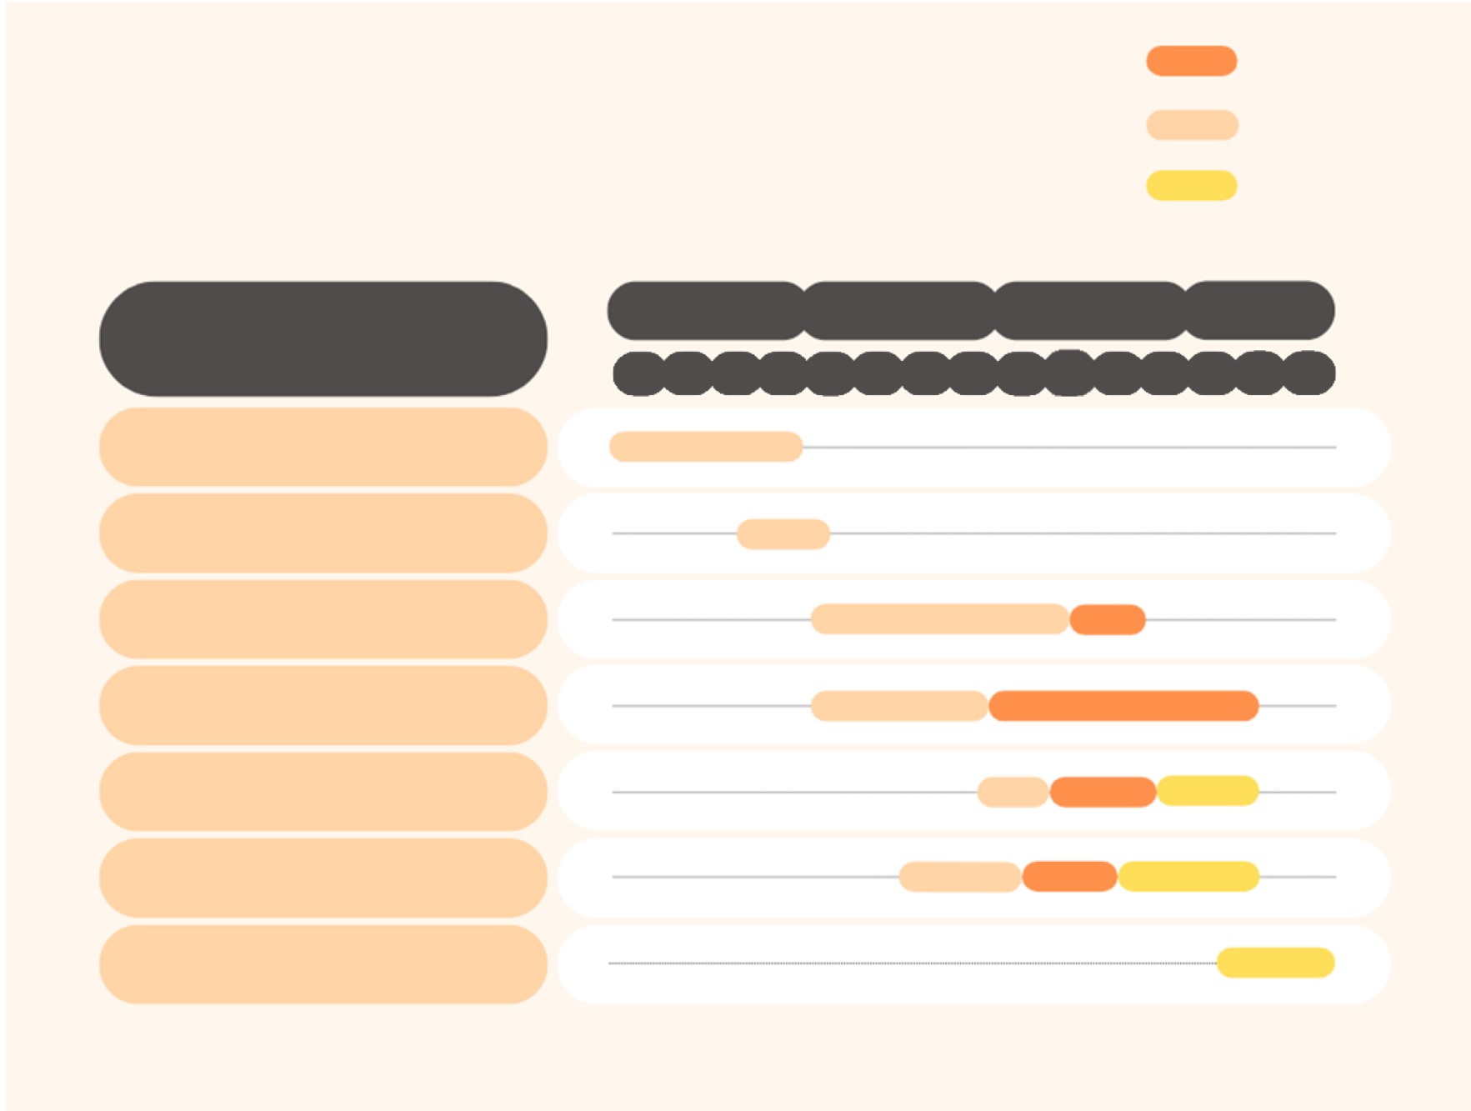

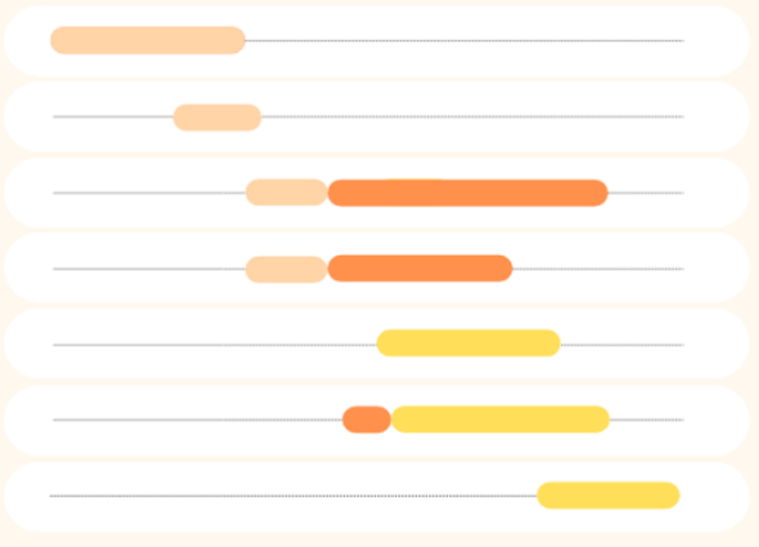
Ongoing
Timeline (Proposal)
Completed
Future
RoadMap
August
September
November
October
SPL-1 Project Progress Estimation
W2
W3
W8
W13
W11
W12
W1
W14
W4
W5
W7
W6
W9
W15
W10
Planning
Existing Platform Research
Technology Research
User Interface Development
Database Implementation
Backend Development
Testing and Bug Fixing

Slide 12
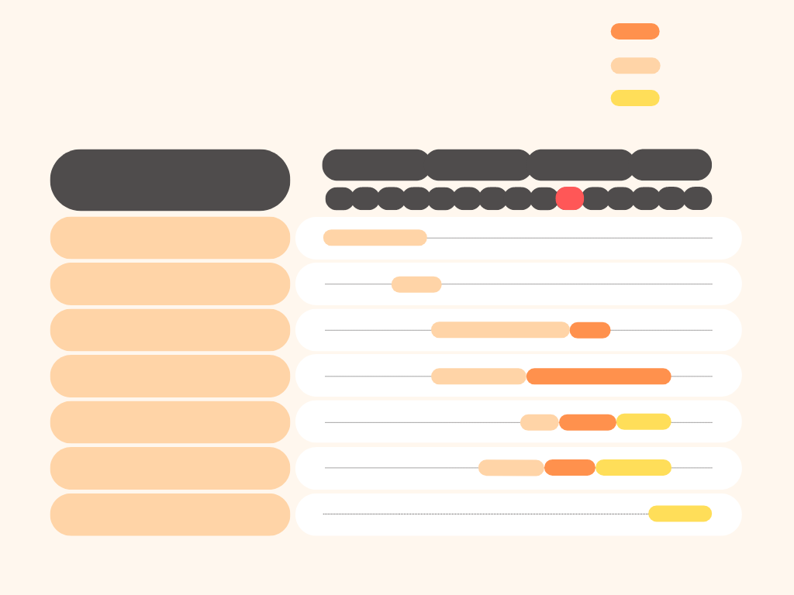
Ongoing
Timeline (Progress)
Completed
Future
RoadMap
August
November
September
October
SPL-1 Project Progress Estimation
W11
W2
W12
W3
W8
W10
W13
W1
W14
W4
W5
W7
W15
W6
W9
Planning
Existing Platform Research
Technology Research
User Interface Development
Database Implementation
Backend Development
Testing and Bug Fixing

Slide 13

Ongoing
Timeline (Final)
Completed
Future
RoadMap
August
November
September
October
December
SPL-1 Project Progress Estimation
4
18
5
9
10
11
17
1
14
2
6
7
8
12
13
15
3
20
19
16
Planning
Existing Platform Research
Technology Research
User Interface Development
Database Implementation
Backend Development
Testing and Bug Fixing

Slide 14
Progress Demonstration

Slide 15


Thank you
For your Kind Attention
WE ARE NOW OPEN FOR QUESTIONS

