Slide 1

Enzorg
Organize your work the smart way

Slide 2

Team Name
Domain-Not-Specified
Team Members
M M Nazmul Hossain 200042118
Rhidwan Rashid 200042149
Sian Ashsad 200042151

Slide 3

Contents of the Presentation
01
Brief Description
04
Technologies
02
Design Flow
05
Timeline Comparison
03
ER Diagram
06
Project Demonstration

Slide 4


Brief Interpretation
Web-based platform to organize and handle both personal and group projects

Slide 5

Key Features
User Login and Registration
3
Adding, Removing Projects
1
Task distribution and division
4
Task duration and state
2

Slide 6
Key Features(Continued)
Deadline Warning
7
Task Updating and Prioritizing
5
8
Access Hierarchy
6
Roadmap

Slide 7
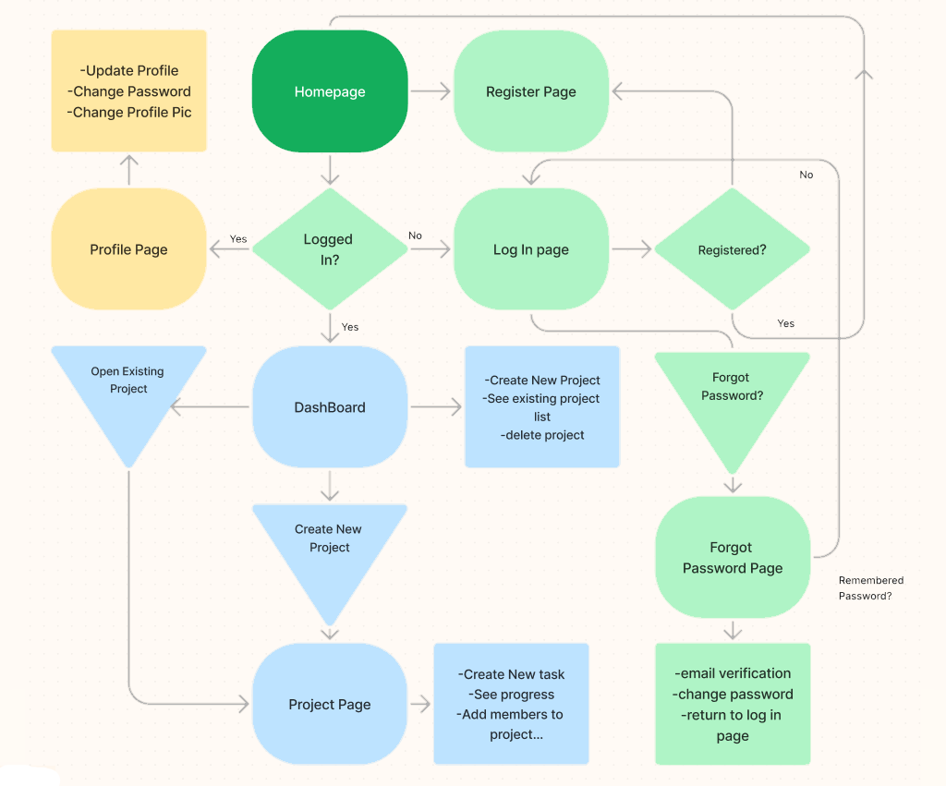
EnzOrg Flowchart

Slide 8
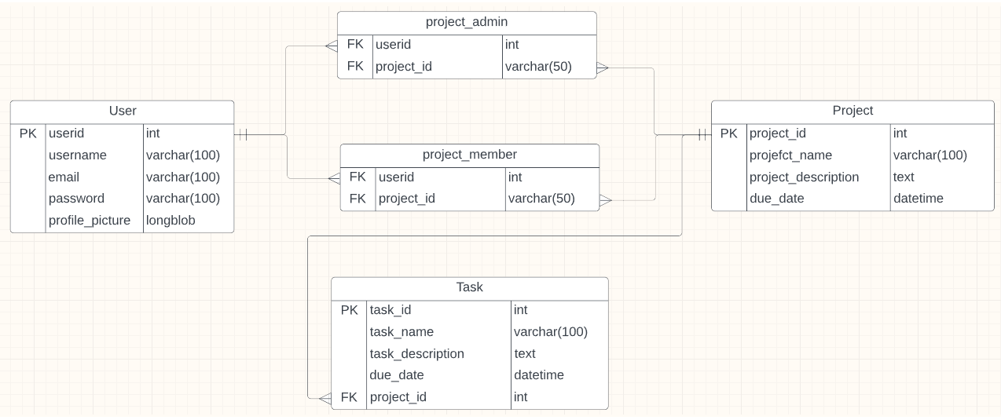
ER Diagram

Slide 9

Technologies
CSS
Style and Layout the Web Pages
HTML
Develop the Structure of the Web Pages
JavaScript
Making the Website More Interactive and
PHP
Handling the Backend
MySQL
Modifying the Database
Version Control
GitHub
6

Slide 10
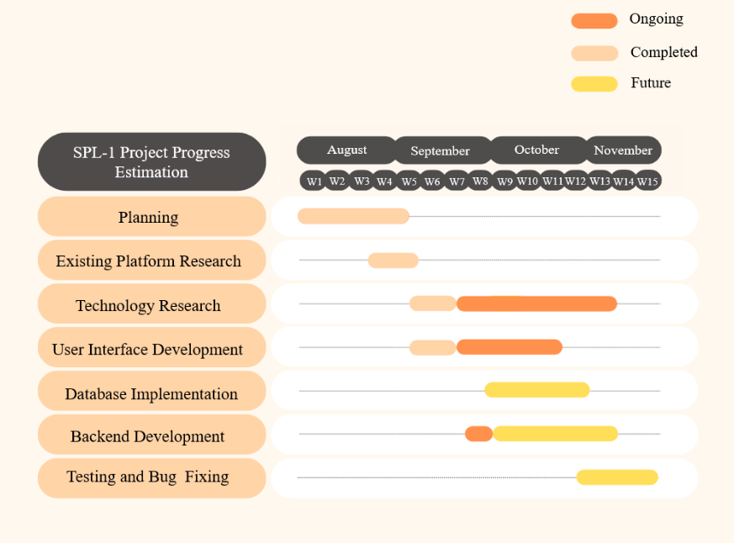

Timeline (Previous)
RoadMap

Slide 11
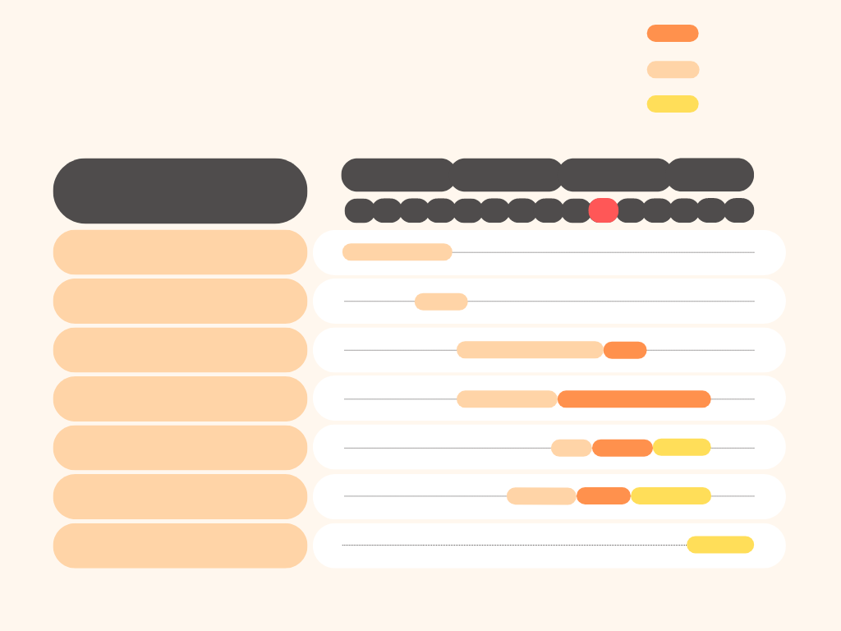
Ongoing
Timeline (Updated)
Completed
Future
RoadMap
August
October
September
November
SPL-1 Project Progress Estimation
W11
W2
W12
W3
W8
W10
W13
W1
W14
W4
W5
W7
W15
W6
W9
Planning
Existing Platform Research
Technology Research
User Interface Development
Database Implementation
Backend Development
Testing and Bug Fixing

Slide 12
Progress Demonstration

Slide 13


Thank you
For your Kind Attention
WE ARE NOW OPEN FOR QUESTIONS

