Slide 1

Multipurpose Project Manager
Organize your work the smart way

Slide 2

Team Name
Domain-Not-Specified
Team Members
M M Nazmul Hossain 200042118
Rhidwan Rashid 200042149
Sian Ashsad 200042151

Slide 3

Contents of the Presentation
01
Introduction
04
Key Features
02
Motivation
05
Technologies
03
Brief Interpretation
06
Timeline

Slide 4

Introduction
Problem Statement
Unorganized Work
Monitoring issue
Schedule Breakdown
Procrastination
Confusion in group projects
Lack of Initiative

Slide 5

Motivation
Organize work & projects
Maintaining pace with any scheduling
Fluid workflow in groups
A single platform to do it all !
Existing Similar Platforms
Infinity, Jira, Asana, SmartTask etc.

Slide 6


Brief Interpretation
Web-based platform to organize and handle both personal and group projects

Slide 7

Key Features
User Login and Verification
3
Task distribution and division
1
Task duration and state
2
Adding and Removing tasks
4

Slide 8
Key Features(Continued)
Deadline Warning
7
Task Updating and Prioritizing
5
8
Access Hierarchy
6
Roadmap

Slide 9

Technologies
CSS
Style and Layout the Web Pages
HTML
Develop the Structure of the Web Pages
JavaScript
Making the Website More Interactive and
PHP
Handling the Backend
MySQL
Modifying the Database
Version Control
GitHub
6

Slide 10
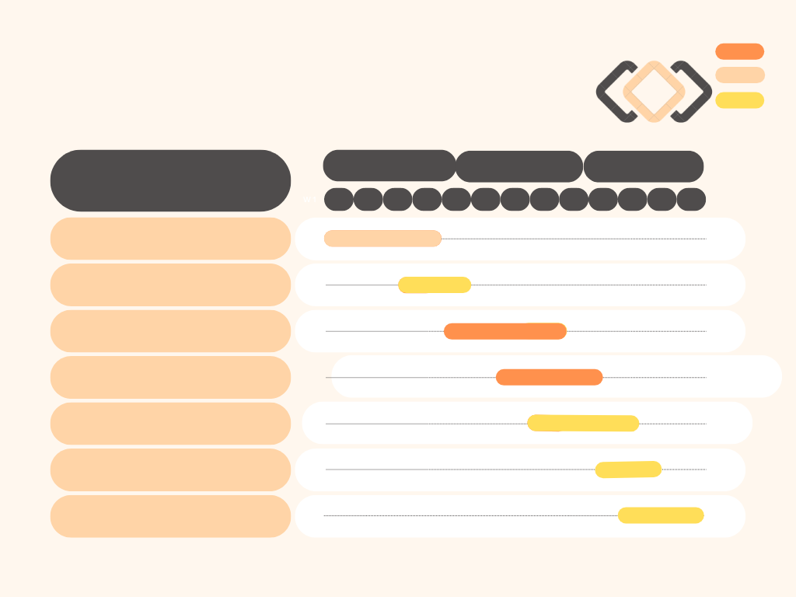

Ongoing
Timeline
Completed
RoadMap
Future
August
September
November
SPL-1 Project Progress Estimation
W 1
W 2
W 3
W 4
W 5
W 6
W 7
W 8
W 9
W 10
W 11
W 12
W 13
Planning
Market and Technology Research
Prototype Development
User Interface Development
Backend Development
Begin Testing
Bug Fixing

Slide 11


Thank you
For your Kind Attention
WE ARE NOW OPEN FOR QUESTIONS

