Slide 1
Visualization research recommender
Simone Bartolini 1752197

Slide 2
Goal
The goal of the project is to design a tool to help researchers explore the literature in the visualization field to find the best topics to study by analyzing their trends.

Slide 3
Dataset
The vispubdata dataset contains information on visualization publications from 1990 to 2020. Out of all attributes present in the dataset, these are the ones we are interested in:
the conference where the paper was presented;
the year the paper appeared at the conference;
the title of the paper;
the digital object identifier (DOI);
the type of paper (conference paper, journal paper or miscellaneous);
the authors of the paper;
the references of the papers;
the keywords chosen by the authors.

Slide 4
Topic extraction
The first thing to do is defining the topics. This is done by finding clusters of keywords that often occur together using hierarchical clustering.
The user can adjust the distance threshold of the clustering and filter out specific keywords in order to find the right clusters.

Slide 5
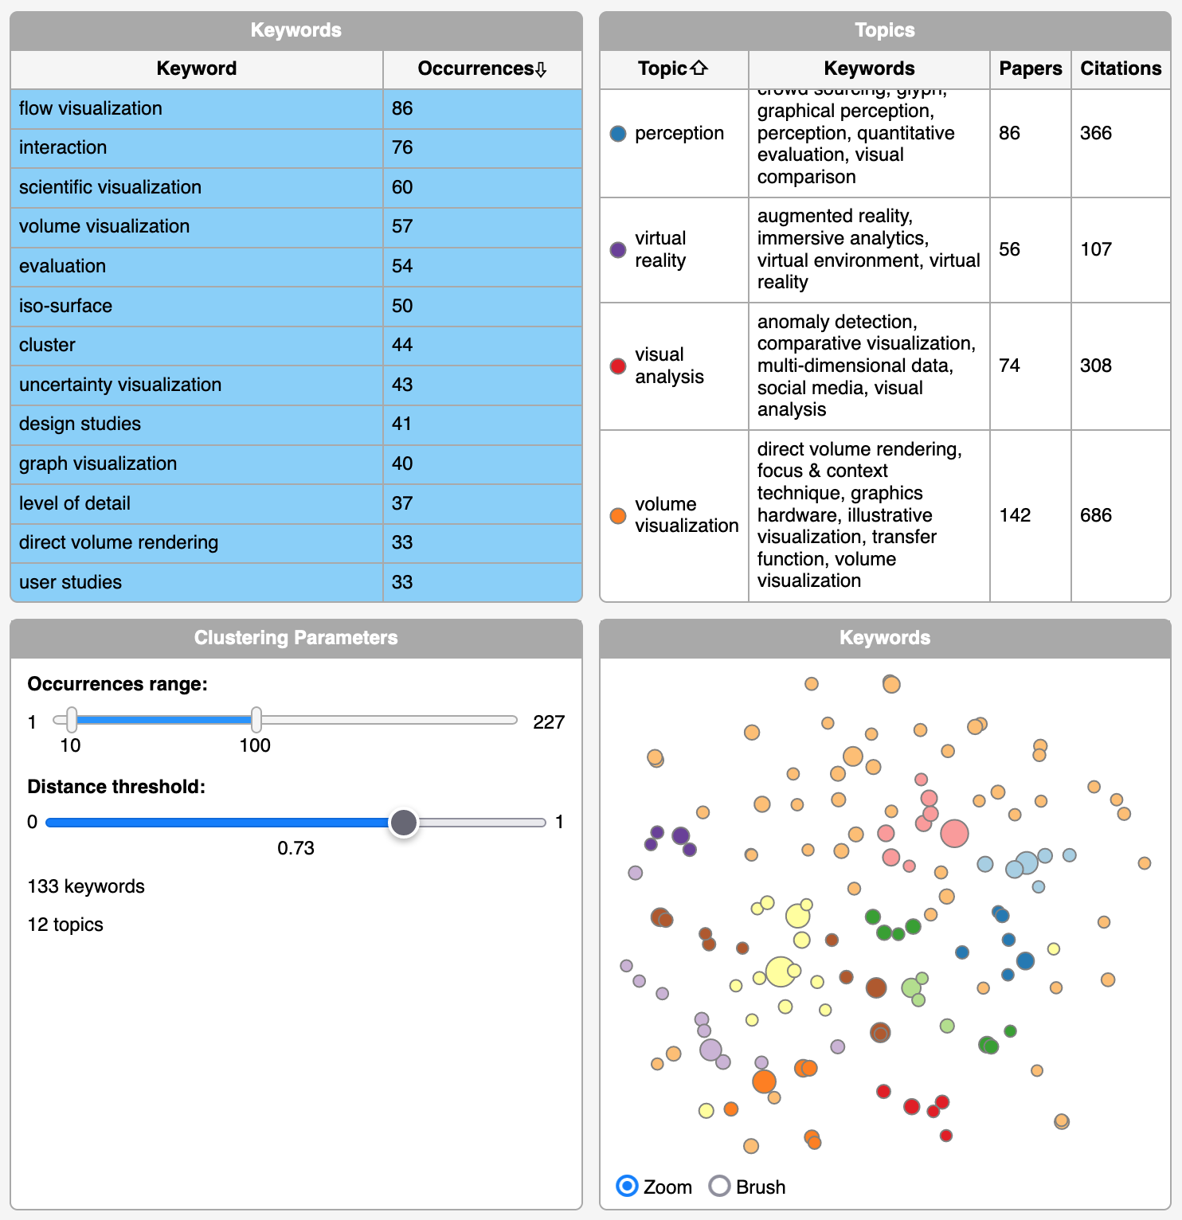
To aid the user in this task the tool shows:
A table of all keywords with their occurrences.

Slide 6
To aid the user in this task the tool shows:
The number of keywords selected as input of the clustering and the resulting number of topics.

Slide 7
To aid the user in this task the tool shows:
A table of the topics with the relative keywords, the number of papers covering the topic and their total citations count.

Slide 8
To aid the user in this task the tool shows:
A scatterplot of the keywords where:
The position is obtained using TSNE based on the co-occurrence matrix;
The size represent the frequency of the keyword;
The color represents the topic.

Slide 9
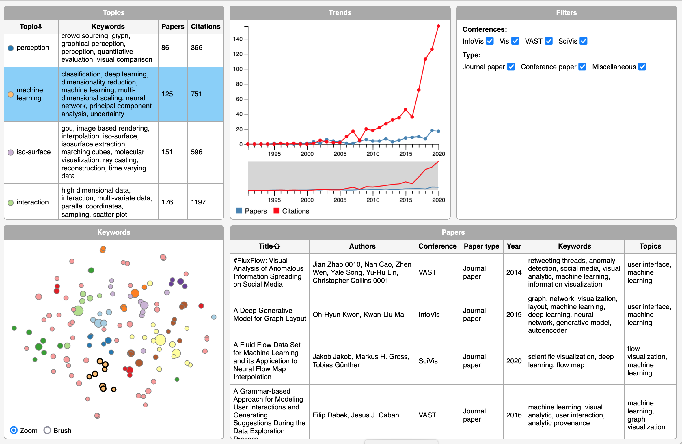
Trends analysis
Once the topics have been defined, the user can analyze their evolution over time by selecting them from the table. A line chart will be populated with the evolution over time of the number of published articles dealing with that topic and their citations.

Slide 10
Trends analysis
Additionally, a table will be populated with the list of all papers in the topic.

