Slide 1
Redis介绍
2013年5月7日

Slide 2
What?
Redis是什么？
Redis is an open source, BSD licensed, advanced key-value store. It is often referred to as a data structure server since keys can contain strings, hashes, lists, sets and sorted sets.
Redis author : antirez , from Italy
http://antirez.com/

Slide 3
What?
特点
性能非常高.
丰富的数据类型
支持持久化
原子-redis的所有操作都是原子的.
丰富的特性-支持 publish/subscribe，通知，key过期等特性

Slide 4
What！
数据类型
strings
Hashes
lists
Sets
sorted sets

Slide 5
Why?
Redis的应用场景
缓存
对复杂数据结构的良好支持
像SNS中的关系，以及一些计数类的需求
像消息队列，发布/订阅功能的需求

Slide 6
Why?
what we need?
快！！！
– 小数据量，高速读写访问
– 大数据量，有明显热点数据
– 大数据量，无热点数据

Slide 7
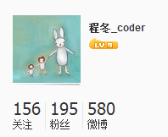
How！
结构化数据存取
redis> hset chenng guanzhu 156
(integer) 1
redis> hset chenng fans 195
(integer) 1
redis> hset chenng microblogs 580
(integer) 1
redis>
redis> hgetall chenng
1) "guanzhu"
2) "156"
3) "fans"
4) “195"
5) "microblogs"
6) “580"

Slide 8
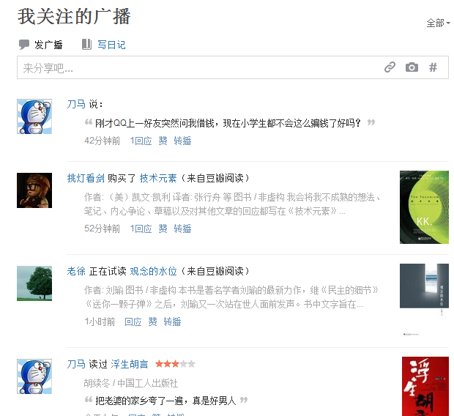
How！
分页
redis> lpush chengdong:broadcast:all "test broadcast"
(integer) 1
redis> lpush chengdong:broadcast:all "i want to sleep"
(integer) 2
redis> lpush chengdong:broadcast:all "welcome to redis world!"
(integer) 3
redis> lrange chengdong:broadcast:all 0 5
1) "welcome to redis world!"
2) "i want to sleep"
3) "test broadcast"
redis>

Slide 9
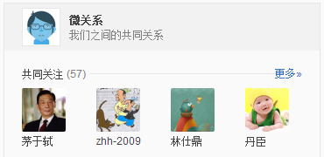
How！
关系
redis> sadd chengdong:guanzhu "laoxu"
(integer) 1
redis> sadd chengdong:guanzhu "luoyonghao"
(integer) 1
redis> sadd zuoxiao:guanzhu "pop"
(integer) 1
redis> sadd zuoxiao:guanzhu "luoyonghao"
(integer) 1
redis> sinter zuoxiao:guanzhu chengdong:guanzhu
1) "luoyonghao"
redis>

Slide 10
How！
Clients
PHP
Python
Ruby
C#
C++
Node.js
Java
Objective-C
Perl
C
Common Lisp
Erlang
Go
Smalltalk
…
http://redis.io/clients

Slide 11
Q/A

Slide 12

谢谢！
公司地址： 中国上海市浦东新区民生路1518号金鹰大厦B栋802B
电话: (86) 5034 7600 传真: (86) 5034 7650
Email: sales@conversant.com.cn

