Slide 1
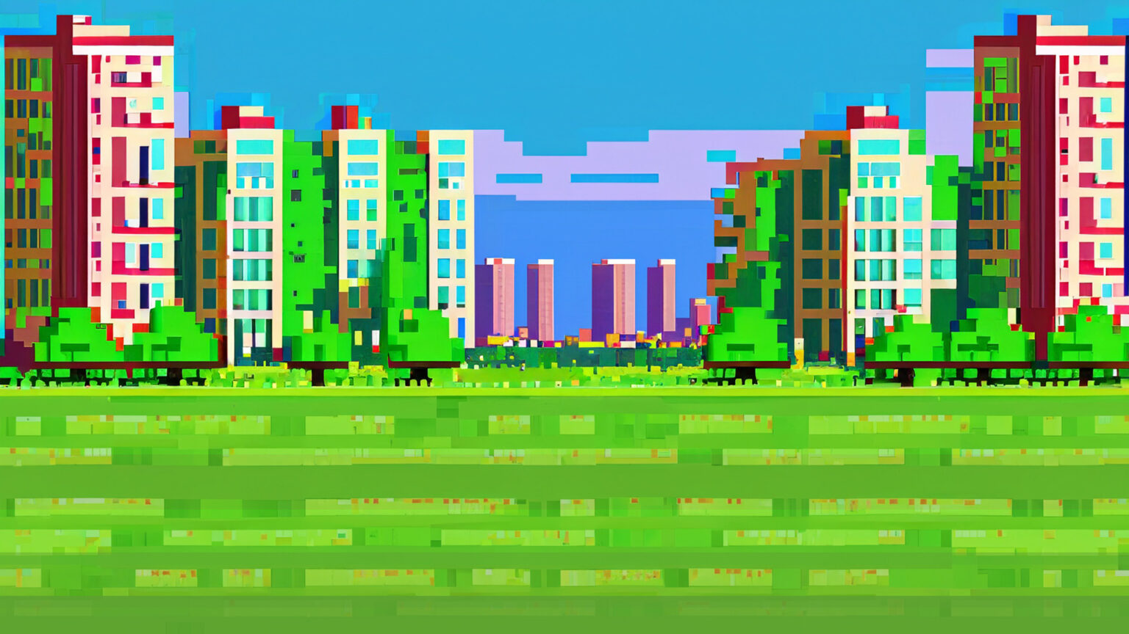
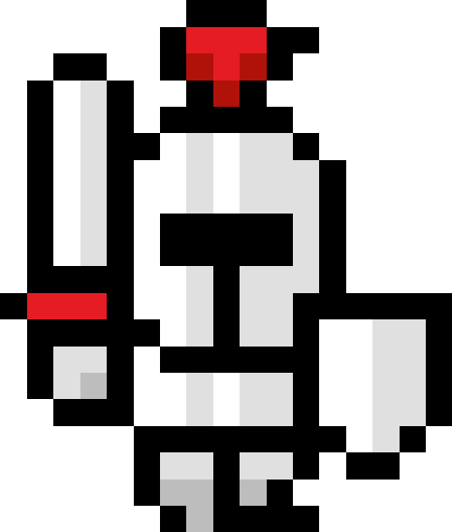
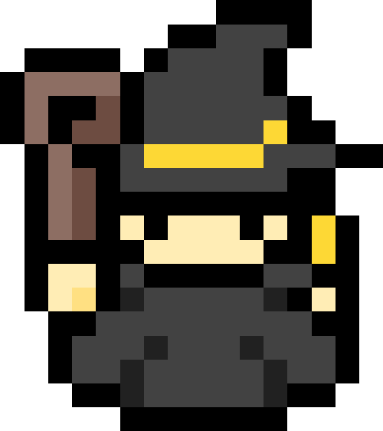
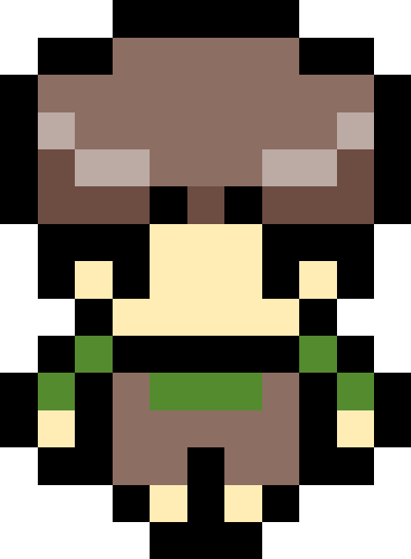
Press SPACE to advance turn
Player 1: 0 points
Player 2: 0 points
Player 3: 0 points
Turn: 1
Roulette: 5
Game Start
Player 1’s turn: spinning roulette…
Player 1 rolled a 5 and landed on White Masu

