Slide 1
Compiling Fundamentals
15-213/15-513/14-513: Introduction to Computer Systems

Slide 2
Questions that will be answered today
What does it mean to compile code?
What does compiling code look like?
How can code be compiled?
What are Makefiles?

Slide 3
Why is this important?
It is important to understand how programs are compiled to have a better understanding of how different parts of a computer interact with each other.
Fundamental aspect of how computers run code.
Notes:
The different parts are: pre-processor, compiler, assembler, linker & loader. So that we will be able to write efficient, better and optimized code for a certain hardware machine.
The computer understands 0s and 1s. So, we need to convert our textual code into machine language.

Slide 4
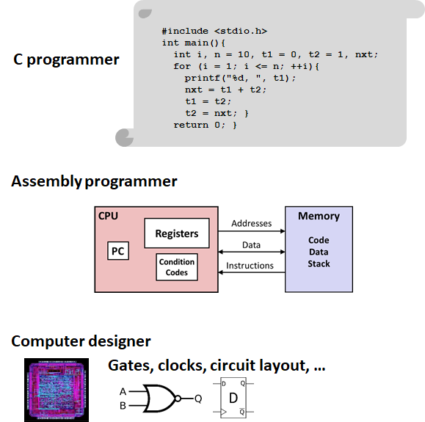
Levels of Abstraction
C [and other high level languages] are easy for programmers to understand, but computers require lots of software to process them
Machine code is just the opposite: easy for the computer to process, humans need lots of help to understand it
Assembly language is a compromise between the two: readable by humans (barely), close correspondence to machine code

Slide 5
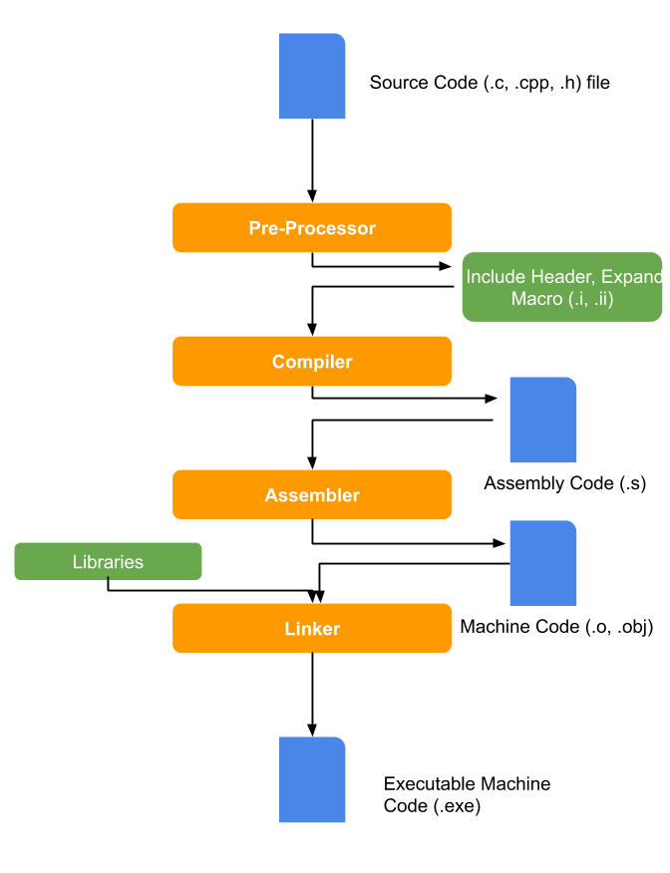
What does it mean to compile code?
The computer only understands machine code directly
All other languages must be either
interpreted: executed by software
compiled: translated to machine code by software
Notes:
Yes, the second stage is called “compiling” and the whole process is also called “compiling.” Sometimes people will call the second stage “compilation proper” to distinguish. The compilers course will spend more time on that stage than the other three put together.

Slide 6
What does it mean to compile code?
Computer follows steps to translate your code into something the computer can understand
This is the process of compiling code [a compiler completes these actions]
Four steps for C: preprocessing, compiling, assembling, linking
Most other compiled languages don’t have the preprocessing step, but do have the other three
Notes:
Yes, the second stage is called “compiling” and the whole process is also called “compiling.” Sometimes people will call the second stage “compilation proper” to distinguish. The compilers course will spend more time on that stage than the other three put together.

Slide 7
Stepping through the stages
Pre-Processor
$ gcc -E [flags] [filenames]
Compiler
$ gcc -S [flags] [filenames]
Assembler
$ gcc -c [flags] [filenames]
$ objdump -d [filenames]
Linker
$ gcc -o [exename] [flags] [filenames]
Notes:
Reference slide for input and output for each stage.

Slide 8
C Code to Machine Code

Slide 9
Pre-Processor
Unique to the C family; other languages don’t have this
Processes #include, #define, #if, macros
Combines main source file with headers (textually)
Defines and expands macros (token-based shorthand)
Conditionally removes parts of the code (e.g. specialize for Linux, Mac, …)
Removes all comments
Output looks like C still

Slide 10
Before and after preprocessing
#include <limits.h> #include <stdio.h> int main(void) { // Report the range of `char` on this system printf("CHAR_MIN = %d\n" "CHAR_MAX = %d\n", CHAR_MIN, CHAR_MAX); return 0; }
# 1 "test.c"
# 1 "/usr/lib/gcc/x86_64-linux-gnu/10/include/limits.h" 1 3 4
...
# 1 "/usr/include/stdio.h" 1 3 4
...
extern int fprintf (FILE *__restrict __stream,
const char *__restrict __format, ...);
extern int printf (const char *__restrict __format, ...);
...
# 874 "/usr/include/stdio.h" 3 4
# 3 "test.c" 2
int main(void) {
printf("CHAR_MIN = %d\n"
"CHAR_MAX = %d\n",
# 6 "test.c" 3 4
(-0x7f - 1)
# 6 "test.c"
, 0x7f);
return 0;
}
Contents of header files inserted inline
Comments removed
Macros expanded
“Directive” lines (beginning with #) communicate things like original line numbers
Notes:
Truncated
Metadata for the next stages

Slide 11
Compiler
The compiler translates the preprocessed code into assembly code
This changes the format and structure of the code but preserves the semantics (what it does)
Can change lots of details for optimization, as long as the overall effect is the same
Notes:
scans code file, "lexes" tokens, "parses" tokens according to the grammar of the language, builds up an "internal representation (IR)" that encodes the semantics of the language, produces an output that preserves the semantics but usually not the syntax (i.e., translates into a different language, like going from C to asm).
(Compiler optimization lecture coming up on Oct 7)

Slide 12
Before and after compilation
extern int printf (const char *__restrict
__format, ...);
int main(void) {
printf("CHAR_MIN = %d\n"
"CHAR_MAX = %d\n",
(-0x7f - 1), 0x7f);
return 0;
}
.file "test.c"
.section .rodata.str1.1,"aMS",@progbits,1
.LC0:
.string "CHAR_MIN = %d\nCHAR_MAX = %d\n"
.text
.globl main
main:
subq $8, %rsp
movl $127, %edx
movl $-128, %esi
leaq .LC0(%rip), %rdi
xorl %eax, %eax
call printf@PLT
xorl %eax, %eax
addq $8, %rsp
ret
.size main, .-main
C source code converted to assembly language
Textual, but 1:1 correspondence to machine language
printf just referred to, not declared
Notes:
In the real thing there are like twice as many “directives” which I deleted to make it all fit on the slide.
Simple compiler optimization turned -0x7f-1 into $-128

Slide 13
Assembler
Parses assembly code and mainly translates into bits
There is some flexibility to generate the most efficient version of machine code, but mostly responsible for just translating to bits.
Notes:
Yet another level of translator. Like a compiler in that it parses, not only scans. Low-level processing of assembly instructions that have been emitted by the compiler to generate the corresponding bit patterns that the machine knows what to do with. Assembler has some flexibility to generate the most efficient version of the machine code -- chooses instruction formats when multiple equivalent ones exist, but mostly responsible for just translating to bits.

Slide 14
Before and after assembling
.file "test.c"
.section .rodata.str1.1,"aMS",@progbits,1
.LC0:
.string "CHAR_MIN = %d\nCHAR_MAX = %d\n"
.text
.globl main
main:
subq $8, %rsp
movl $127, %edx
movl $-128, %esi
leaq .LC0(%rip), %rdi
xorl %eax, %eax
call printf@PLT
xorl %eax, %eax
addq $8, %rsp
ret
.size main, .-main
$ objdump -s -r test.o
test.o: file format elf64-x86-64
RELOCATION RECORDS FOR [.text]:
OFFSET TYPE VALUE
0000000000000011 R_X86_64_PC32 .LC0-0x0000000000000004
0000000000000018 R_X86_64_PLT32 printf-0x0000000000000004
Contents of section .rodata.str1.1:
0000 43484152 5f4d494e 203d2025 640a4348 CHAR_MIN = %d.CH
0010 41525f4d 4158203d 2025640a 00 AR_MAX = %d..
Contents of section .text:
0000 4883ec08 ba7f0000 00be80ff ffff488d H.............H.
0010 3d000000 0031c0e8 00000000 31c04883 =....1......1.H.
0020 c408c3 ...
Everything is now binary
Notes:
“Relocations” for addresses not yet known

Slide 15
Before and after assembling
.file "test.c"
.section .rodata.str1.1,"aMS",@progbits,1
.LC0:
.string "CHAR_MIN = %d\nCHAR_MAX = %d\n"
.text
.globl main
main:
subq $8, %rsp
movl $127, %edx
movl $-128, %esi
leaq .LC0(%rip), %rdi
xorl %eax, %eax
call printf@PLT
xorl %eax, %eax
addq $8, %rsp
ret
.size main, .-main
$ objdump -d -r test.o
test.o: file format elf64-x86-64
Disassembly of section .text.startup:
0000000000000000 <main>:
0: 48 83 ec 08 sub $0x8,%rsp
4: ba 7f 00 00 00 mov $0x7f,%edx
9: be 80 ff ff ff mov $0xffffff80,%esi
e: 48 8d 3d 00 00 00 00 lea 0x0(%rip),%rdi
11: R_X86_64_PC32 .LC0-0x4
15: 31 c0 xor %eax,%eax
17: e8 00 00 00 00 call 1c <main+0x1c>
18: R_X86_64_PLT32 printf-0x4
1c: 31 c0 xor %eax,%eax
1e: 48 83 c4 08 add $0x8,%rsp
22: c3 ret
Just to emphasize that 1:1 correspondence between assembly and machine instructions

Slide 16
Linker
Static Library Files (.lib, .a)
Aggregates multiple independently compiled files containing machine code
Fills in those unknown addresses
The goal is to create 1 file with all of the needed code to run the program
This is the file you run to check your code!
Notes:
aggregates multiple independently compiled files containing object/machine code. Simplest use: combining independently compiled objects into a single program. Intermediate use: combining a program's object code with the object code stored in a static library (.a). Advanced use: combining a program's object code with pointers that the "dynamic loader" will use to find libraries that might live in the file system on a target system where the program eventually runs.

Slide 17
How to Use The Compiler (gcc)
Notes:
Spoorthi starts here

Slide 18
GCC - What is it?
GNU Compiler Collection
GCC is a set of compilers for various languages. It provides all of the infrastructure for building software in those languages from source code to assembly.
The compiler can handle compiling everything on its own, but you can use various flags to breakdown the compilation steps
Example:
gcc [flags] [infile(s)]
Notes:
GCC contains compilers for multiple languages, and provides the infrastructure needed to go from source code written in that language to assembly, and eventually executable machine code
The compiler can compile directly from source code to executable, but you can also use it to breakdown compilation steps (ie use it to just go from source code to preprocessed text)

Slide 19
Common GCC Flags
-o [EXECUTABLE NAME] : names executable file
-Ox : Code optimization
-O0 : Compile as fast as possible, don’t optimize [this is the default] -O1, -O2, -O3: Optimize for reduced execution time [higher numbers are more optimized]
-Os : Optimize for code size instead of execution time. -Og : Optimize for execution time, but try to avoid making interactive debugging harder.
-g : produce “debug info”: annotate assembly so gdb can find variables and source code
-Wall : enable many “warning” messages that should be on by default, but aren’t
- Does not turn on all of the warning messages GCC can produce.
- See https://gcc.gnu.org/onlinedocs/gcc-4.8.0/gcc/Warning-Options.html for many more
-Werror : turns all warnings into errors
-std=c99 : use the 1999 version of the C standard and disable some (not all!) extensions
Notes:
-O3 makes the code so big that, if you use it for the entire program, the executable may be slower than if you had used -O2, because it doesn’t fit in the instruction cache.
One instructor’s recommended set of warnings options for new programs: -Og -std=gnu11 -Wall -Wextra -Wpedantic -Wstrict-prototypes -Wwrite-strings -Werror
Note -std=gnu11, not -std=c11; the extensions disabled by -std=cXX include, unfortunately, a bunch of important library functions that you’re likely to want for anything complicated.
You have to turn on some level of optimization (anything but -O0) to get all the warnings. Yes, really.

Slide 20
Makefiles

Slide 21

What is a makefile?
Automates the process of creating files (using a compiler)
For example, create bomb from bomb.c, phases.c, and util.c
Running make bomb will update bomb
Only if any of the source files have changed; avoids unnecessary work
Remembers complicated compiler commands for you
Can also store recipes for automating development tasks
make format to reformat source files
Notes:
For example, if you have some unchanged source files that already have associated object files, recompiling will only generate new object files for the changed source files and then link them with the existing object files for source files that were unchanged.

Slide 22
Makefiles are lists of rules
There are two kinds of rules: normal and phony
Normal rules create files
Phony rules don’t directly create files
Each rule has a target.
For normal rules, the target is the name of the file that the rule will create
For phony rules, the target is an arbitrary name for what the rule does
Rules may have prerequisites (also known as dependencies)
Prerequisites are the files that are needed to create the target
If any of the prerequisites doesn’t exist, it must be created first
If any of the prerequisites is newer than the target, the target is “out of date” and must be re-created
Rules may have commands.
One or more shell commands that create the target from its prerequisites
For phony rules, just some commands to be run

Slide 23
Normal rule example
bomb: bomb.o phases.o util.o $(CC) -o bomb bomb.o phases.o util.o

Slide 24
Normal rule example
If this file doesn’t exist…
… or if it is older than any of these files…
bomb: bomb.o phases.o util.o $(CC) -o bomb bomb.o phases.o util.o
… then run this command.

Slide 25
Normal rule example
If this file doesn’t exist…
… or if it is older than any of these files…
bomb: bomb.o phases.o util.o $(CC) -o bomb bomb.o phases.o util.o
This refers to the value of a variable, named CC, that holds the name of a C compiler.
… then run this command.

Slide 26
Normal rule without prerequisites
output_dir: mkdir output_dir
Run mkdir output_dir if output_dir does not exist
If it does exist, no action

Slide 27
Normal rule without commands
bomb.o: bomb.c support.h phases.h
Re-create bomb.o if any of bomb.c, support.h, phases.h is newer
The commands to do this are given somewhere else
A pattern rule elsewhere in the Makefile
An implicit rule built into Make

Slide 28
Pattern and implicit rules
%.o: %.c $(CC) $(CFLAGS) -c -o $@ $<
To create an .o file from a .c file with the same base name, use this command
Special variables $@ and $< give the name of the .o and .c files respectively
Variables CC and CFLAGS can be set to customize behavior
This rule is implicit — built into Make — you don’t have to write it yourself
Notes:
Make has lots of these implicit rules. It knows how to create object files from C, C++, Fortran, etc.
However, it doesn’t have an implicit rule for creating executables from object files. You have to write those yourself. (this is for silly historical reasons)

Slide 29
Phony rule example
all: bomb bomb-solve .PHONY: all
When asked to create “all”, create bomb and bomb-solve
Does not create a file named “all”
The .PHONY annotation can be anywhere in the makefile
Notes:
Usually a phony rule has either dependencies or commands, but not both

Slide 30
Phony rule example 2
clean: rm -f bomb bomb-solve *.o .PHONY: clean
When asked to create “clean”, run this command
Which deletes bomb, bomb-solve, and all object files
Does not create a file named “clean”

Slide 31
The make command
Running make in the shell will cause the shell to look for a Makefile in the current directory. If it finds one, it will attempt to create the first target listed in the Makefile.
You can also run make <target_name> to indicate exactly which target you want to create.
By convention, the first target is a phony target named all
so make and make all do the same thing
as the name implies, this is to create everything that the makefile knows how to create
Phony rules serve as entry points into the Makefile
make all creates everything, make clean deletes all generated files, make check runs tests, …
But you can also make bomb.o if that’s the only thing you want

Slide 32
A complete Makefile
CC = gcc
CFLAGS = -std=c99 -g -O2 -Wall -Werror
all: bomb bomb-solve
bomb: bomb.o phases.o util.o
$(CC) $(LDFLAGS) -o $@ $^ $(LIBS)
bomb-solve: bomb.o phases-solve.o util.o
$(CC) $(LDFLAGS) -o $@ $^ $(LIBS)
bomb.o: bomb.c phases.h support.h
phases.o: phases.c phases.h support.h
phases-solve.o: phases-solve.c phases.h support.h
util.o: util.c support.h
clean:
rm -f bomb bomb-solve *.o
.PHONY: all clean
OK to use undefined variables
LDFLAGS, LIBS
Found in environment or treated as empty
Don’t need to give commands to create object files from C source
But do need to list header file dependencies for each object file
Do need to give commands to create executables (missing feature)
all rule at the top, clean rule at the bottom
One .PHONY annotation for all phony rules

Slide 33
Rules form a graph
all
clean
bomb
bomb-solve
bomb.o
phases.o
phases-solve.o
util.o
CC = gcc
CFLAGS = -std=c99 -g -O2 -Wall -Werror
all: bomb bomb-solve
bomb: bomb.o phases.o util.o
$(CC) $(LDFLAGS) -o $@ $^ $(LIBS)
bomb-solve: bomb.o phases-solve.o util.o
$(CC) $(LDFLAGS) -o $@ $^ $(LIBS)
bomb.o: bomb.c phases.h support.h
phases.o: phases.c phases.h support.h
phases-solve.o: phases-solve.c phases.h support.h
util.o: util.c support.h
clean:
rm -f bomb bomb-solve *.o
.PHONY: all clean
bomb.c
phases.c
phases-solve.c
util.c
Make avoids unnecessary work
If bomb.c changes, make all will re-create bomb.o, bomb, bomb-solve
If phases.c changes, make all will only re-create phases.o and bomb
Make can see through missing targets
If bomb.o does not exist, make bomb creates it from bomb.c

Slide 34
Practice!
https://www.cs.cmu.edu/~213/bootcamps/lab3_handout.pdf

Slide 35
Feedback:
https://tinyurl.com/213bootcamp2

Slide 36
Appendix

Slide 37
Linking Files

Slide 38
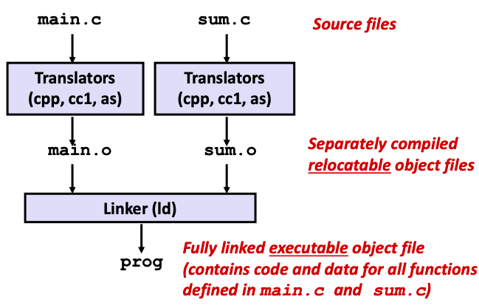
Why are we learning about linking files?
Linker is a computer system program that takes object files (generated by a compiler or an assembler) and combines them into a single executable file, library file, or another object file.
Programs are translated and linked using a compiler driver:
linux> gcc -Og -o prog main.c sum.c
linux> ./prog
More in future lecture!

Slide 39
What does a linker do?
Symbol resolution
Programs define and reference symbols (global variables and functions)
Linker associates each symbol reference with exactly 1 symbol definition
Relocation
Merges separate code and data sections into single sections
Relocates symbols from relative locations in .o files to final memory locations
Updates all references to symbols to reflect new positions

Slide 40
Linker symbols
Global symbols
Symbols defined by module m that can be referenced by other modules.
e.g., non-static C functions and non-static global variables.
External symbols
Global symbols that are referenced by module m but defined by some other module.
Local symbols
Symbols that are defined and referenced exclusively by module m.
e.g., C functions and global variables defined with the static attribute.
Local linker symbols are not local program variables

Slide 41
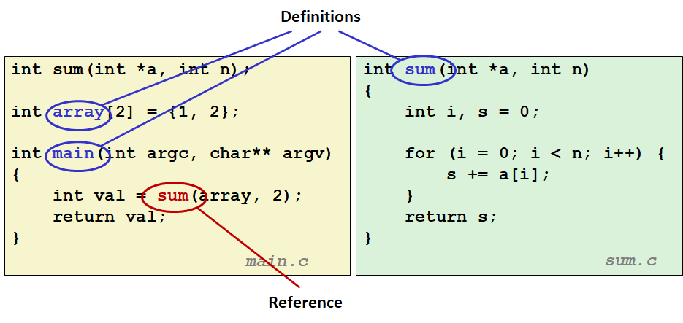
Symbols

Slide 42
Why do you need linkers?
Modularity
Program can be written as a collection of smaller source files, rather than one monolithic mass.
Efficiency
Time: Separate compilation
Change one source file, compile, and then relink. No need to recompile other source files.
Space: Libraries
Common functions can be aggregated into a single file…

Slide 43
Static vs Dynamic Linking
Static Linking
Executable files and running memory images contain only the library code they actually use
Dynamic linking
Executable files contain no library code
During execution, single copy of library code can be shared across all executing processes

Slide 44
Types of object files
Relocatable object file (.o file)
Code and data that can be combined with other relocatable object files to form executable object file
Each .o file is produced from exactly one source (.c) file
Executable object file (a.out file)
Code and data that can be copied directly into memory and then executed
Shared object file (.so file)
Special type of relocatable object file that can be loaded into memory and linked dynamically, at either load time or run-time

Slide 45
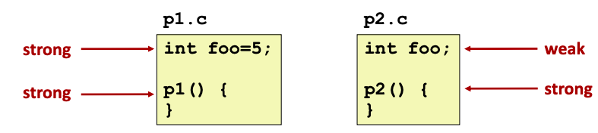
How Linker resolves duplicate symbol definitions
Program symbols are either strong or weak
Strong: procedures and initialized globals
Weak: uninitialized globals
Or one's declared with specifier extern

Slide 46
Symbol rules
Multiple strong symbols are not allowed
Each item can be defined only once
Otherwise, linker error
Given a strong symbol and multiple weak symbols, choose the strong symbol
References to the weak symbol resolve to the strong symbol
If there are multiple weak symbols, pick an arbitrary one

Slide 47
LD_LIBRARY_PATH
If you are using dynamic libraries, you need to tell the compiler where to look for the library!
It is easiest to use dynamic libraries with makefiles, just include this line:
LD_LIBRARY_PATH = “~/my/path”
If you are interested in creating a dynamic library, follow the steps here:
Shared Libraries: https://tldp.org/HOWTO/Program-Library-HOWTO/shared-libraries.html
Dynamic Libraries: https://tldp.org/HOWTO/Program-Library-HOWTO/dl-libraries.html
Notes:
Static library -> a copy of library code is contained in the executable so only needed at compile time, not runtime
Dynamic library -> loaded when the executable is run

Slide 48
Resources
https://missing.csail.mit.edu/2020/metaprogramming/
https://www.cs.cmu.edu/~15131/f17/topics/makefiles/
https://www.gnu.org/software/make/manual/html_node/Phony-Targets.html
https://makefiletutorial.com/
https://www.oreilly.com/library/view/programming-embedded-systems/0596009836/ch04.html
https://gcc.gnu.org/onlinedocs/gcc/
https://daveparillo.github.io/cisc187-reader/build-tools/make.html

