Slide 1

SUBMITTED BY Vikas Sharma – 1904086 Kamlesh Kumar – 1904084 Md Kashif Raza - 1904103
A Presentation on
Sign Language Recognition
Under the supervision of
Dr. Bharat Gupta

Slide 2
Contents
Objective
Introduction
Literature Review
Challenges and Issues
Approach to the problem
Data Collection
Results
Conclusion
References
2

Slide 3
Objective
It becomes very difficult to converse with deaf and mute people, so we need a language structure to understand what they are trying to say.
Language is a barrier in between normal people and mute people.
Our aim is to create an interface that convert sign language to the text by which everyone can understand the sign language of the peoples who are unable to speak.
3

Slide 4
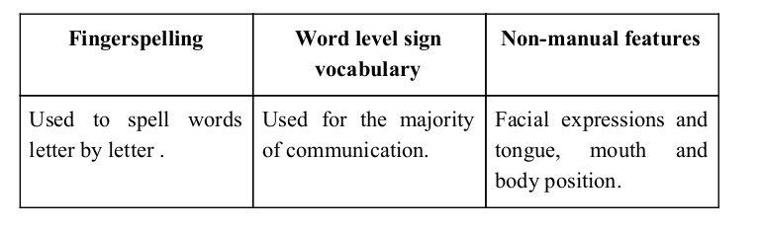
Introduction
American sign language is a predominant sign language ​Since the only disability Dumb and Deaf people have is communication related and they cannot use spoken languages hence the only way for them to communicate is through sign language.
Communication is the process of exchange of thoughts and messages in various ways such as speech, signals, behavior and visuals.
Deaf and dumb(D&M) people make use of their hands to express different gestures to express their ideas with other people.
Sign language is a visual language and consists of 3 major components:
4

Slide 5
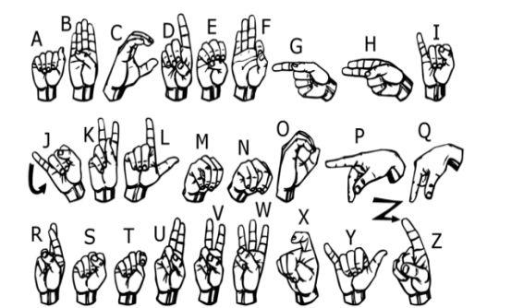
In our project we basically focus on producing a model which can recognize alphabets hand signs. The hand sign we aim to train are as given in the image below.

Slide 6
Literature Review
In recent years there have been great strides in building classifiers for image detection and recognition on various datasets using various machine learning algorithms. Deep learning, in particular, has shown improvement in accuracy on various datasets.
There has been various researches done in the area of recognition of hand gestures and after studying some of them it has been found that following are the basic steps to be followed in this process:-
A. Gathering Data : There are various ways to collect data. In this particular sign language detection topic, mainly these two approaches to collect data can be used.
1.Using devices with sensors: In this approach electromagnetic devices with sensors can be used to collect data for example wearable gloves with sensors. These sensors take out the necessary information but this technique is quite costly.
2.Vision based: In this approach camera is used to collect images for the model. So, it gives us a plus point that no external device is used & no extra expense made. in

Slide 7
B. Pre-processing Gathered Data & Feature Extraction
Pre-processing of data means converting raw data into usable form so that it can be fed to the model for training. Features are nothing but patterns present in your data that helps in extraction necessary information for further model training process.
It removes unnecessary data hence simplify your data. For data collected from gloves, we don't need to do much thing as it already gives precise results. But for vision based approach pre-processing becomes crucial.
C. Classifying Gestures
Various techniques like Hidden Markov Model , Naïve bayes Classifier , Convolution Neural network etc can be used in classification of gestures.

Slide 8
CHALLENGES AND ISSUES:
There were many challenges faced by us during the project. The very first issue we faced was of selecting the right image classifier algorithm as there are many like KNN, Naive Bayes classifier, etc. . As we are working with images we need more accuracy to predict the images
The second issue was with the accuracy which is not up to the mark as we were expected.
At last after saving the high accuracy model we tested on the real world data (hand signs) using OpenCV and found that the accuracy was very low.
After analyzing the whole project and the model we found that the dataset used for this project from Kaggle does not provide enough information so that the model recognize real hand sign.

Slide 9
Approach to the problem
To solve the first issue we end up choosing CNN as it designed to automatically and adaptively learn spatial hierarchies of features through backpropagation by using multiple building blocks, such as convolution layers, pooling layers, and fully connected layers as well as fits our requirements.
we used the data augmentation to solve our second issue, which is a process of artificially increasing the amount of data by generating new data points from existing data.
This includes adding minor alterations to data or using machine learning models to generate new data points in the latent space of original data to amplify the dataset.
The resolution to the last issue we faced is disused in the future scope.

Slide 10
Data Collections
We have used the American Sign Language (ASL) data set that is provided by MNIST and it is publicly available at Kaggle. This dataset contains 27455 training images and 7172 test images all with a shape of 28 x 28 pixels.
These images belong to the 25 classes of English alphabet starting from A to Y (No class labels for Z because of gesture motions). The dataset on Kaggle is available in the CSV format where training data has 27455 rows and 785 columns.
The first column of the dataset represents the class label of the image and the remaining 784 columns represent the 28 x 28 pixels. The same paradigm is followed by the test data set.
The data collected in the MNSIT data is varied by having the same signs made by different subjects in different backgrounds. Moreover, the images were also cropped in various ways; however, the desired hand region was left unchanged.
After exploring the dataset, as shown in figure “Distribution of labels in the training set”, the data is observed to be evenly balanced across the values.
The wide variety of training sample values are evenly distributed, as can be seen from the visualization.

Slide 11
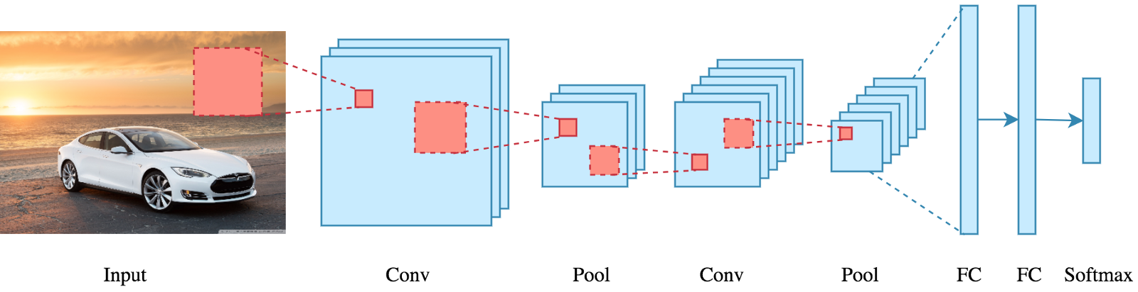
What exactly is a CNN?
In deep learning, a convolutional neural network (CNN/ConvNet) is a class of deep neural networks, most commonly applied to analyze visual imagery. Now when we think of a neural network we think about matrix multiplications but that is not the case with ConvNet.
It uses a special technique called Convolution. Now in mathematics convolution is a mathematical operation on two functions that produces a third function that expresses how the shape of one is modified by the other.

Slide 12
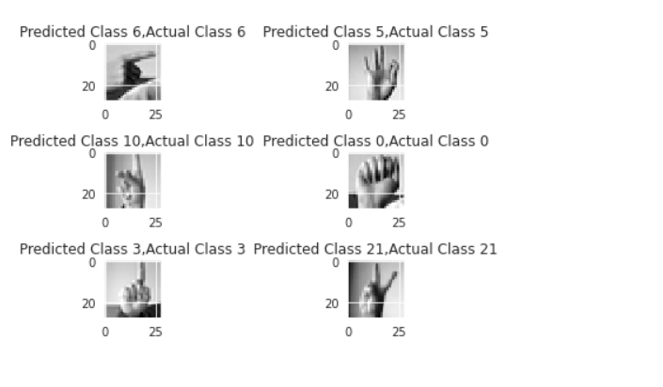
Results and Future Work :

Slide 13
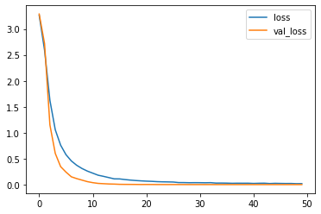
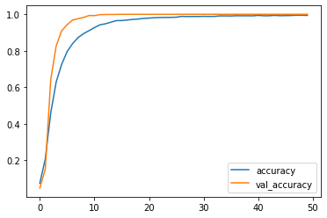
LOSS PLOT
ACCURACY PLOT

Slide 14
The proposed CNN model has the ability to achieve an accuracy of 99.63% on the proposed test dataset. Initially, when only one convolutional layer is utilized and there was overfitting in the dataset.
To overcome this issue of overfitting, two more layers are added so that some parameters are dropped and still preserve the essential features of images. Moreover, the dropout layer, Batch Normalization, and data augmentation are also used to overcome the same and achieve a better performance of our network.
The letters like ‘J’ and ‘Z’ were not included in the classification due to the hand movement. So, the video frames are required to classify them.
The study may be carried out in the proposed work to accept the video frames and classify the letters like ‘J’ and ‘Z’ as well. Moreover, a large dataset of Sign Language is required as the available dataset is quite constrained and most of the researchers are carried out on the same by making it more difficult to compare the work of different researchers.

