Slide 1
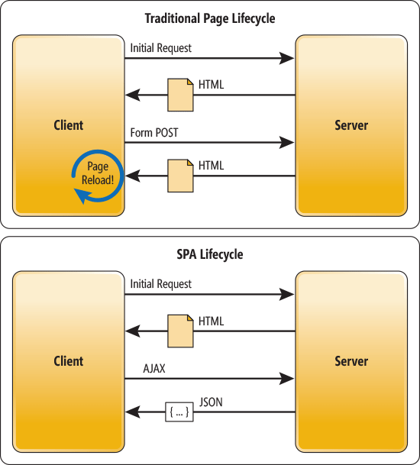
Traditional vs SPA approach

