Slide 1
Sokoban – State-Space Search
& Competitive Agents
Group 1

Slide 2
01
Team Members & Task Assignment

Slide 3
Team Members
Student ID | Full name | Email
523H0081 | Phạm Nguyễn Vĩnh Phúc | phuc270605@gmail.com
524H0005 | Triệu Ngọc Vân Anh | vananh298206@gmail.com
524H0007 | Trần Hữu Danh | steam020906@gmail.com
524H0008 | Lâm Tấn Đạt | datlam.31012019@gmail.com
524H0010 | Ngô Huỳnh Đức | huynhduc9881@gmail.com

Slide 4
Task Assignment
Full name | Tasks | Completion Percentage
Phạm Nguyễn Vĩnh Phúc | GUI Development, Presentation Design | 80%
Triệu Ngọc Vân Anh | GUI Development, Presentation Design | 90%
Trần Hữu Danh | State-Space Formulation, UCS & A* Implementation, Performance Evaluation, Heuristic Analysis | 100%
Lâm Tấn Đạt | State-Space Formulation, UCS Implementation, Competitive Two-Agent Formulation | 100%
Ngô Huỳnh Đức | Overall Game Flow Design, GUI Development, Competitive Two-Agent Formulation, Agent Decision-Making, Competitive Game Implementation | 100%

Slide 5
02
Problem Overview

Slide 6

Problem Overview
Problem Statement:
Find the optimal path for the agent to push all boxes onto their designated goal positions in Sokoban.

Slide 7
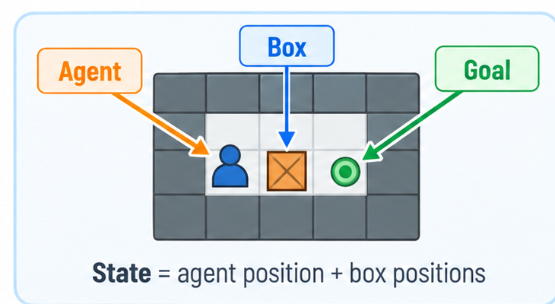
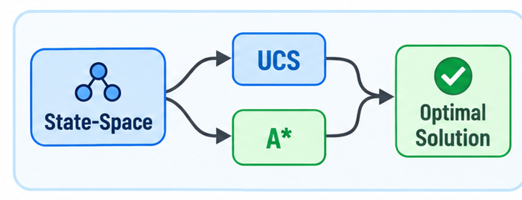
Problem Overview
How did we approach the problem?
Represent Sokoban using agent and box positions as states.
What solutions and algorithms did we use?
Model Sokoban as a state-space and use UCS & A* to find the optimal solution.

Slide 8
03
RQ1: State-Space Formulation

Slide 9
RQ1: Approach & Solution
How did we approach it?
Treat Sokoban as a search problem: a state = agent position + set of box positions
Walls and goals never change, so they stay outside the state
What solution did we implement?
SokobanProblem defines ACTIONS (N/S/E/W: legal move or push), RESULT, GOAL_TEST and step cost = 1
State key = (agent, sorted boxes) → O(1) visited check, shared by UCS and A*

Slide 10
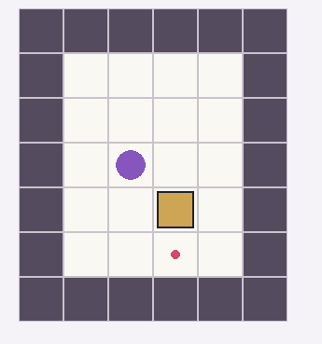
State-Space Formulation
State agent position + box positions
Transition diagram
Step 0
agent (2,3)
East
Step 1
agent (2,4)
South
Step 2
Goal ✓
Actions North · South · East · West
Transition move; push a box if the cell behind is free
each arrow: cost = 1
Goal test all boxes sit on goals
Step cost 1 per action
Notes:
ẢNH: chụp 1 map Sokoban nhỏ (hoặc 2 ảnh trước/sau khi đẩy box) đặt vào khung nét đứt.

Slide 11
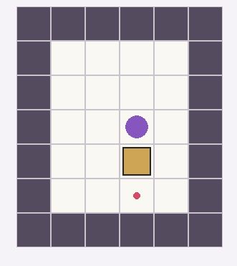
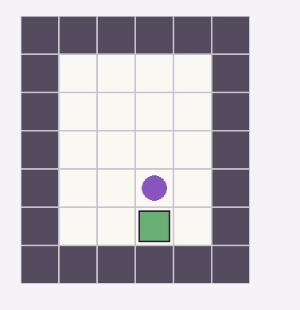
State-Space Formulation
Transition diagram
Step 0
agent (2,3)
Stesp 1
agent (2,4)
Step 2
Goal ✓
East
South
Notes:
ẢNH: chụp 1 map Sokoban nhỏ (hoặc 2 ảnh trước/sau khi đẩy box) đặt vào khung nét đứt.

Slide 12
Transition Logic
ACTIONS(s):
for d in {N, S, E, W}:
next ← agent + d
if next is wall / outside: skip
if next has a box:
target ← next + d
if target is wall or box: skip
add d
RESULT(s, d):
move agent to next
if a box was there: push it to target
GOAL_TEST(s): boxes == goals
STATE_KEY(s): (agent, sorted boxes)
Pros
+ Textbook, clear formulation
+ O(1) set lookups; key avoids revisits
+ Shared by UCS and A*
Cons
– No general deadlock detection
– State space explodes with more boxes

Slide 13
04
RQ2: Search Algorithms
UCS & A*

Slide 14
RQ2: Approach & Solution
How did we approach it?
UCS and A* follow the same graph-search structure.
The main difference is the priority function.
What solution did we implement?
UCS: pop the smallest g(n), guaranteed optimal baseline
A*: pop the smallest f(n) = g(n) + h(n); states with h = ∞ are pruned
Optional time limit: on timeout the search returns STAY

Slide 15
UCS vs A*
UCS
A*
Expand state n
Expand state n
g(n) = cost so far
vs
f(n) = g(n) + h(n)
Priority queue (min-heap)
Priority queue (min-heap)
Pop the smallest g
Pop the smallest f
Same engine, one difference: the priority key. Cost = 1 per move, so g = number of moves.

Slide 16
Search Pseudocode
SEARCH(problem, key):
// key = g for UCS, g + h for A*
frontier ← PQ{start}; explored ← ∅
while frontier not empty:
if time limit exceeded: RETURN TIMEOUT
n ← pop smallest priority
if n.state ∈ explored: continue
explored ← explored ∪ {n.state}
if GOAL_TEST(n.state): return path
for a in ACTIONS(n.state):
s' ← RESULT(n.state, a)
if h(s') = ∞: skip // A* only
push s' with key(s')
return failure
UCS
+ Optimal, no heuristic needed
+ Perfect baseline
– Expands huge state sets, big frontier
A*
+ Far fewer nodes + early pruning
– Only as good as h (ours is coarse)
– No best-g map / re-open logic

Slide 17
05
Heuristic Function for A*

Slide 18
Heuristic: Approach & Solution
How did we approach it?
Design a problem-specific heuristic (not Manhattan / Euclidean)
Count the work left, and detect states that can never be solved
What solution did we implement?
h(s) = number of boxes not on a goal
Box in a wall corner and not on a goal → h(s) = ∞ → prune the state
Cheap to compute: O(#boxes) per evaluation

Slide 19
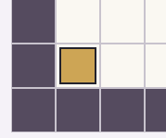
Our Heuristic
h(s) = # boxes not on a goal
Corner deadlock
Box stuck in a wall corner
& not on goal → h(s) = ∞ (prune)
Not Manhattan / Euclidean
problem-specific, as required
The box can never leave the corner → this state is a dead end

Slide 20
Heuristic Pseudocode
HEURISTIC(state):
count ← 0
for each box not on a goal:
if (wall above or below)
AND (wall left or right):
return ∞ // dead corner
count ← count + 1
return count
Pros
+ Cheap to compute
+ Prunes dead states early
+ Admissible & consistent (RQ4)
Cons
– Coarse: ignores distances & agent
– Misses tunnel / freeze deadlocks
Cost: O(#boxes) per evaluation

Slide 21
06
RQ3: Time & Space Complexity Analysis

Slide 22
RQ3: Approach & Solution
How did we approach it?
Run UCS and A* on the same map and compare them on four metrics
Metrics: time, memory, nodes expanded, max frontier size
What solution did we implement?
Runtime = mean of 5 runs; peak memory measured with tracemalloc
Nodes and frontier are counted inside the search; results saved to CSV and bar charts
Result: A* is 38× faster, 28× fewer nodes, 28× less memory, same cost 34

Slide 23
Experiment Design & Results
map | algorithm | solved | cost | depth | nodes_expanded | max_frontier | time_sec | memory_kb
example_map.txt | UCS | TRUE | 34 | 34 | 485183 | 145563 | 29.0319 | 1534447
example_map.txt | A* | TRUE | 34 | 34 | 17640 | 5230 | 0.7615 | 56728.45
Input map
Sokoban problem
Run UCS / A*
Measure
time · memory · nodes · frontier
CSV + charts
38×
faster
29.0 s → 0.76 s
28×
fewer nodes
485k → 17.6k
27×
less memory
1.5 GB → 57 MB
Both found cost = 34 → A* stays optimal. Runtime = mean of 5 runs, memory via tracemalloc.

Slide 24
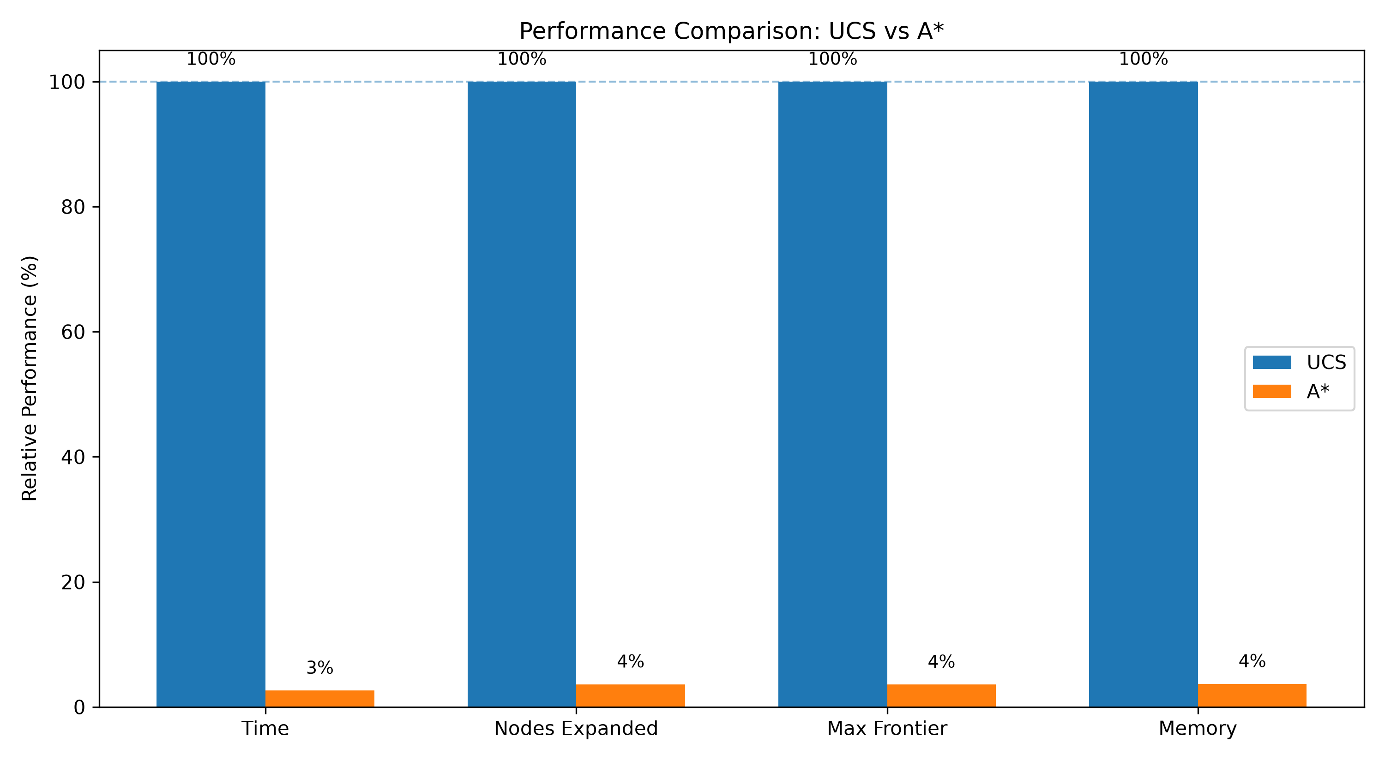
Experiment: Pros & Cons
Pros
+ 4 metrics: time, memory, nodes, frontier
+ Runtime averaged over 5 runs
+ Results saved to CSV
Cons
– Only 1 map tested so far
– Ratios may differ on other maps
– Worst case still exponential
Notes:
ẢNH: chèn các bar chart do plot_results sinh ra (hoặc 1 ảnh gộp 4 chỉ số).

Slide 25
07
RQ4: Heuristic Properties
Admissibility & Consistency

Slide 26
RQ4: Approach & Solution
How did we approach it?
Prove the heuristic is admissible and consistent
Then verify by experiment on sampled reachable states
What solution did we implement?
Proof: each off-goal box needs ≥ 1 push, so h ≤ h*; one move changes h by ≤ 1, so h(s) ≤ 1 + h(s′)
Experiment: BFS samples ≤ 150 states, UCS gives h*(s)
Result: admissible 26/26 ✓, consistent 62/62 ✓

Slide 27
Why the Heuristic Is Valid
Admissible: h ≤ h*
k boxes off-goal → each needs ≥ 1 push
1 move pushes ≤ 1 box, cost 1
so h* ≥ k = h
Corner dead end: h* = ∞, no under-estimate
Consistent: h(s) ≤ 1 + h(s′)
One move changes #on-goal by ≤ 1
so h drops by at most 1 per step
h(s) − h(s′) ≤ 1 = step cost
Admissible + consistent → A* never loses optimality

Slide 28
Verification Experiment
UCS gives h*(s)
h ≤ h* ?
26/26 ✓
Initial state
BFS sample
(≤ 150 states)
Generate
successors s′
h(s) ≤ 1+h(s′) ?
62/62 ✓
+ Theory and experiment agree
– Sample-based, not a proof; only 26 sampled states solved by UCS in time
map | states_checked | admissible_ok | admissible_fail | consistent_ok | consistent_fail
example_map.txt | 26 | 26 | 0 | 62 | 0
Verification Result

Slide 29
08
RQ5: Game GUI & System Design

Slide 30
RQ5: Approach & Solution
How did we approach it?
Build the GUI with OOP and separation of concerns: one class, one job
Solve first, then replay the solution step by step
What solution did we implement?
pygame app: GameApp, ScreenController, EventHandler
Screens: MainMenuScreen, MapSelectScreen, GameScreen; MapRenderer draws the board, ui_config holds styles
Playback: Space pause/resume, ← → previous/next step, auto-play every 700 ms

Slide 31
GUI Architecture (OOP)
GameApp
ScreenController
EventHandler
MainMenuScreen
MapSelectScreen
GameScreen
Separation of concerns: one class, one job
MapRenderer
ui_config

Slide 32
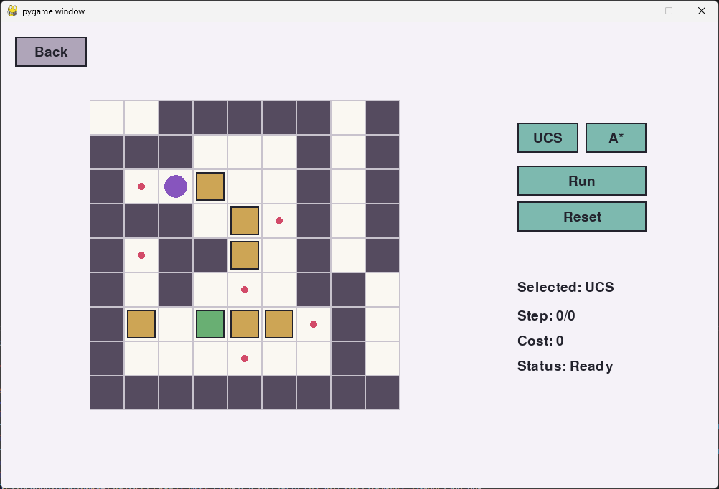
Playback Controls
Space pause / resume
← → previous / next step
Auto-play 1 step every 700 ms
Pros
+ OOP, clear responsibilities
+ Step counter = total cost
Cons
– Not yet run on macOS 13.7.8 Intel
Notes:
ẢNH: chụp màn hình GameScreen (single mode) đang chạy, thấy nút UCS/A* và bộ đếm Step.

Slide 33
09
RQ6: Competitive Two-Agent Formulation

Slide 34
RQ6: Approach & Solution
How did we approach it?
Extend the single-agent state with a second agent and box ownership
Both agents choose an action at the same time each turn
What solution did we implement?
CompetitiveState: agent1, agent2, boxes, box_owners (who pushed last)
Score = boxes on goals owned by the agent; pushing a box changes its owner (stealing)
resolve_actions blocks conflicts: same target cell, swap, push into same cell

Slide 35
Competitive State & Scoring
CompetitiveState
Ownership “stealing”
agent 1 · agent 2
A1 pushes box onto goal → A1 +1
boxes
A2 pushes it off → owner = A2
goals · walls
A2 pushes it back on → A2 +1
box_owners (who pushed last)
Pros
+ Simple ownership rule
+ Rules separate from state
Cons
– No adversarial search (minimax)
– Rules only; strategy is in RQ7

Slide 36
Simultaneous Turn
State S(t)
Conflicts handled
same target cell
swap positions
push into same cell
enter opponent’s cell
Agent 1 · A*
→ action a1
Agent 2 · UCS
→ action a2
Conflict resolver
Trade-offs
– Blocks a cell the opponent is leaving
– Resolved jointly, then applied
Apply valid actions
S(t+1) · ownership · score

Slide 37
10
RQ7: Agent Decision-Making Strategy

Slide 38
RQ7: Approach & Solution
How did we approach it?
Each agent reuses its search algorithm to plan a path to +1 point
Receding horizon: plan → act once → re-plan every turn
What solution did we implement?
Agent 1 uses A*, Agent 2 uses UCS; goal: own score > current score
Time limit 1000 ms per agent; take only the first action of the plan
No plan / timeout → Fallback legal move → STAY only if no move is available

Slide 39
Two AI Decision Lanes
Current state
Agent 1 · A*
Agent 2 · UCS
find a path to +1 point
find a path to +1 point
time limit 1000 ms
time limit 1000 ms
take the 1st action only
take the 1st action only
re-plan every turn
Conflict resolver
timeout → STAY

Slide 40
Decision Pseudocode
CHOOSE_ACTION(state, agent):
plan ← Search(state, 1000 ms)
if plan found:
return first action
return FALLBACK_MOVE(state)
Pros
+ Reuses UCS / A* from RQ2
+ Re-plans as the board changes
+ Re-plans as the board changes
Cons
– Blind to opponent’s plans
– A* h not admissible for “+1 point”
– Corner pruning can drop useful states
– 1000 ms is per agent, not per turn
Receding horizon: plan → act once → re-plan

Slide 41
11
RQ8: Competitive Game Implementation

Slide 42
RQ8: Approach & Solution
How did we approach it?
Simulate the whole match first, then replay it in the GUI
Keep each agent in its own file so agents are easy to swap
What solution did we implement?
CompetitiveMain.run(state, n): for n steps both agents choose an action, applied jointly
The action list is replayed step by step; box colour = owner
Final score decides the winner, or a draw

Slide 43
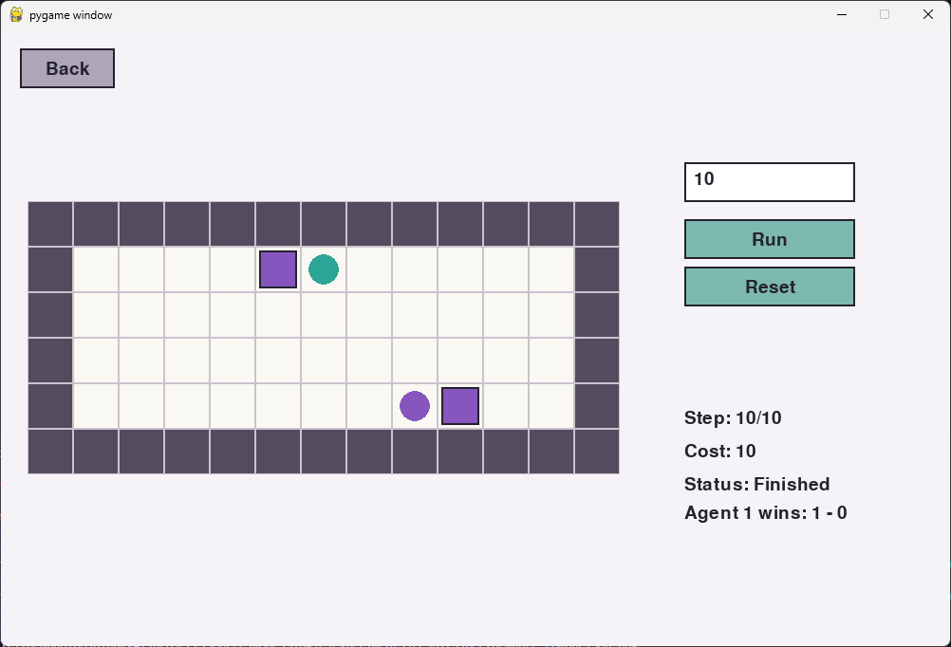
Competitive GUI & Flow
Input n steps
Colours box colour = owner
Result winner / draw
Choose map
Enter n
Run both agents
Replay steps
Show winner
+ Agents in separate files → easy to swap – Match simulated first, then replayed
Notes:
ẢNH: chụp màn hình competitive mode, thấy box màu khác nhau của 2 agent, ô nhập n và kết quả winner.

Slide 44
12
Task Completion Summary

Slide 45
Requirement Coverage
RQ | Solution | Note
1 | State-space model | Complete
2 | UCS + A* with custom heuristic | Complete
3 | Time / memory / nodes / frontier | Complete
4 | Proofs + BFS/UCS sampling | Complete
5 | pygame GUI, OOP | Complete
6 | 2-agent state + conflict resolver | Complete
7 | A* vs UCS, re-plan, 1000 ms | Complete
8 | Competitive GUI + separate agents | Complete

Slide 46
Thanks!
Please keep this slide for attribution

