Slide 1
Review

Slide 2
Score composed of:
Experiments 30%
Programming Exam 20%+20%
Finnal Exam 30%

Slide 3
Final Exam
Choice 20%
Short answer 30%
Completion 50%

Slide 4
Chapter 1 Introduction to Java
Features of Java
A typical Java development environment
Java programs normally undergo five phases: Edit, Compile, Load, Verify, Execute
To test-drive a Java application using the command line
Three edition for Java SDK

Slide 5
Chapter 2. Introduction to Java Applications
To Know some convention and syntax.
To write simple Java applications.
main method
To use input and output statements.
Class Scanner ( nextInt … )
OutputStream (System.out.println(…))
Java’s primitive types.
boolean, byte, char, short, int, long, float, double
Identifier
a series of characters consisting of letters, digits, underscores (_) and dollar signs ($) that does not begin with a digit and does not contain spaces.
Basic memory concepts.
Garbage collection

Slide 6
Chapter 3 Introduction to Classes, Objects Methods and Strings
class and object
instance variables and local variables
primitive and reference types
Member access modifiers

Slide 7
Chapter 4. Control Statements: Part I
if and if else selection statements
? :
While repetition statement
= += -= …
++ --
Graphics, JPanel, paintComponet

Slide 8
Chapter 5. Control Statements: Part 2
for, switch, do…while
break and continue
logical operators
& && | || ! ^

Slide 9
Chapter 6 methods: a deeper look
static methods and fields
Argument Promotion and Casting
final
Class Math.
passing information between methods.
packages import
jdk packages
random-number generation
SecureRandom
method overloading

Slide 10
Chapter 7. Arrays and ArrayLists
To declare an array, initialize an array and refer to individual elements of an array.
enhanced for statement
To pass arrays to methods.
multidimensional arrays.
variable-length argument lists.

Slide 11
Chapter 8. Classes and Objects: A Deeper Look
Encapsulation and data hiding.
this
Composition
String.format
Garbage Collection
Static import
enum

Slide 12
Chapter 9. Object-Oriented Programming: Inheritance
The notions of superclasses and subclasses.
super
How constructors are used in inheritance hierarchies.
Class Object

Slide 13
Chapter 10. Object-Oriented Programming: Polymorphism
The concept of polymorphism and how to use it .
Overriding
abstract class, interface and concrete classes.
To determine an object's type at execution time.
instanceof

Slide 14
Chapter 11. Exception Handling a deeper look
try, throw , catch and finally
Checked exceptions and unchecked exceptions.

Slide 15
ch12 JavaFX GUI part 1
Vbox and GridPaneLayout container
How to write basic JavaFX program
.fxml controller main

Slide 16
ch13 JavaFX GUI part 2
additional layouts (TitledPane, BorderPane and Pane)
Set up event handlers that respond to property changes on controls(such as the value of a Slider).

Slide 17
Chapter 14. Strings, Characters and Regular Expressions
String
StringBuilder
Character
Regular Expression

Slide 18
Chapter 15. files, Input output Stream NIO and xmlserialization
To create, read, write and update files.
The differences between text files and binary files.
Path
Scanner , Formatter
FileInputStream , FileOutputStream
ObjectInputStream,ObjectOutputStream
ObjectInputStream ObjectOutputStream

Slide 19
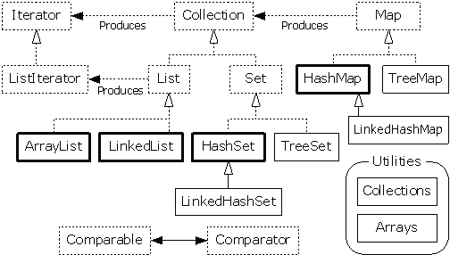
Chapter 16. Generic Collections
What collections are.
Arrays, Collections .
collections framework.
How to use them.

Slide 20
Chapter 17 Java SE 8 Lambdas and Streams
what functional programming is
lambda expressions
Stream’s basic methods

Slide 21
Chapter 20. Generic Classes and Methods
Generic class, generic methods
To understand raw types（原始类型） and how they help achieve backwards compatibility.
To use wildcards(通配符) when precise type information about a parameter is not required in the method body.

Slide 22
Chapter 23 Concurrency
How to create and execute a new thread.
The life cycle of a thread.
Thread synchronization.

Slide 23
Chapter 24 JDBC
How to connect to a database

Slide 24
Chapter 25 Network
To implement Java networking application by using sockets and datagrams.

