Slide 1
2026
Project Report
E-commerce Product Review Sentiment Classification: A Machine Learning Approach
—— Zeng Cheng
A wonderful serenity has taken possession of my entire soul

Slide 2

Problem definition and datasets selection
01

Slide 3

Problem context
Against the backdrop of the rapid development of e-commerce and digital commerce, massive product reviews have become a core basis for consumer decision-making, enterprise product optimization and service upgrading

Slide 4
Target variable
Assumptions and Constraints
Justification of Dataset Rationality
Learning Task
Business value

Slide 5

Justification of Dataset Rationality
Why is this datasets suitable for advanced machine learning research?
1. Sufficiently complex: multiple features + non-trivial relationships
2. Real-world relevance: Suitable for real business scenarios
3.Manageable Scale: Balancing Modeling Depth & Execution Feasibility
4.Additional Support: Extended Features Adapting to Advanced ML Techniques

Slide 6
Learning Task
Supervised learning-based three-class sentiment classification task. Construct a model to automatically classify review sentiments (positive, neutral, negative) based on product review text and rating data, which belongs to a text classification problem in the field of Natural Language Processing (NLP).

Slide 7

The target variable is the sentiment category, which contains three mutually exclusive categories.
Target variable
1.Business Operations
2.Efficiency Improvement
3.User Experience
Business value

Slide 8
Assumptions and Constraints
Assumptions
Constraints
1.Data Limitation
2.Text Ambiguity Constraint
1.Consistency Assumption between Ratings and Sentiments
2.Text Validity Assumption
3.Text Ambiguity Constraint
4.Feature Singularity Constraint
5.Ethical and Compliance Constraints
3.Keyword Representativeness Assumption
4.Category Independence Assumption

Slide 9
EDA Key Findings & Data Preprocessing
02

Slide 10
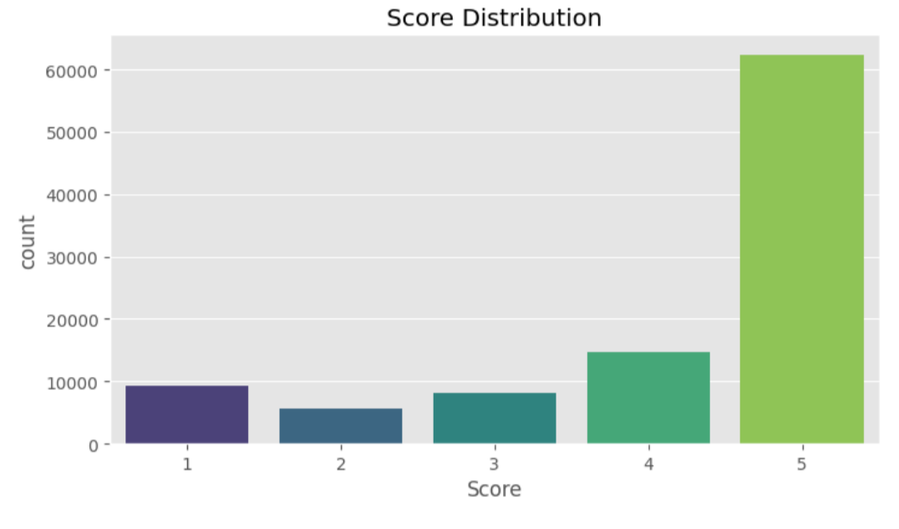
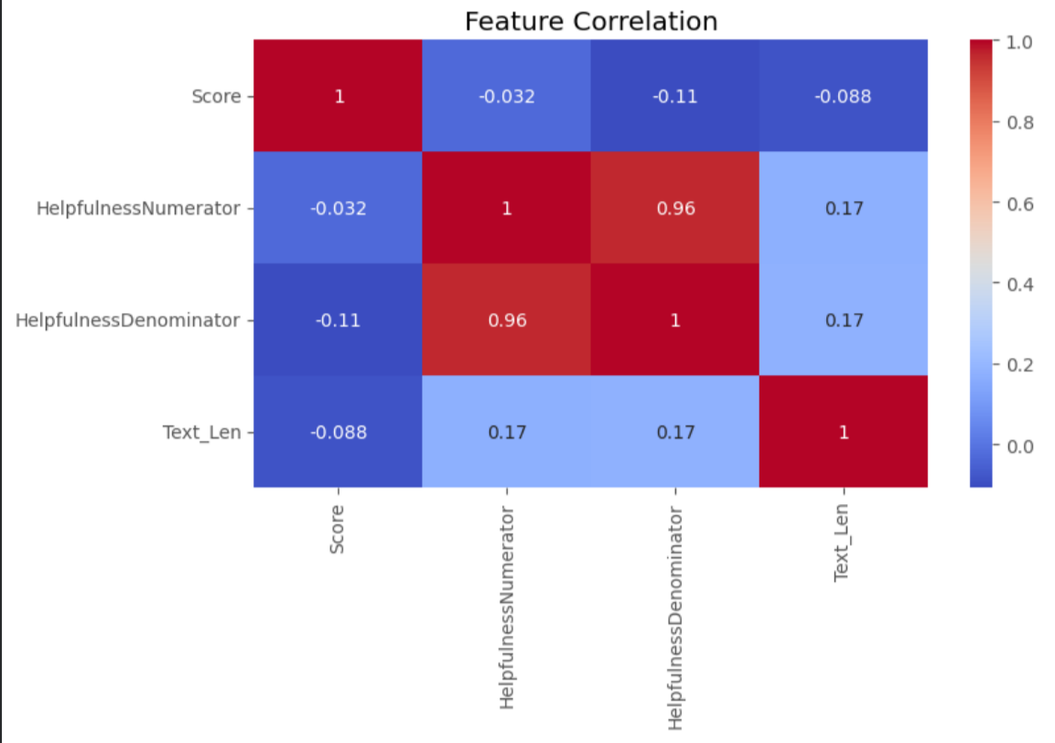
EDA Key Findings VisualizationDataset Overview
High correlation (0.96) between HelpfulnessNumerator & Denominator
Severe imbalance (majority 5-star reviews)

Slide 11
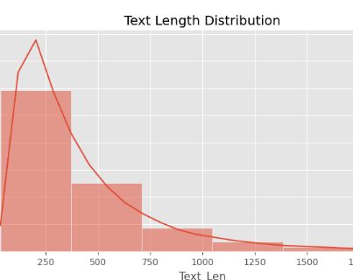
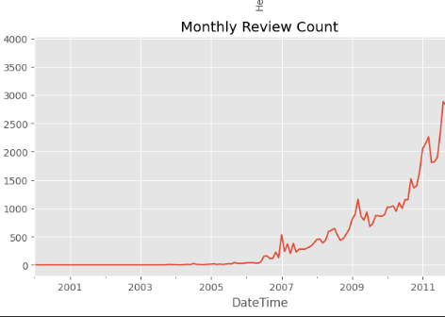
EDA Key Findings VisualizationDataset Overview
Exponential review growth post-2008
Most reviews have short text (≤ 500 characters)

Slide 12
Quality Assessment
Missing Value
Minimal missing values
no critical features like `Score` or `Text` are missing.
Class Imbalance
Severe imbalance in rating distribution,
with over 60% being 5-star reviews.
Logic Error
Some records have more helpful votes than total votes,
which is logically inconsistent.
Multicollinearity (VIF)
Extremely high VIF values for helpfulness features,
indicating severe multicollinearity.

Slide 13
Data Quality Processing Plan
Noise Removal:
Feature Scaling
Drop invalid helpfulness rows
Log-transform HelpfulnessDenominator
Label Encoding
Text Cleaning
Convert Score to Sentiment (0/1)
Remove HTML tags & lowercase text

Slide 14
Baseline model
establishing and evaluating
03

Slide 15
Split the dataset into training/test sets (using an 80:20 ratio).
Random seed for reproducibility
Preserve class distribution in splits
random_state=42
stratify=y
20% for testing, 80% for training
test_size=0.2

Slide 16
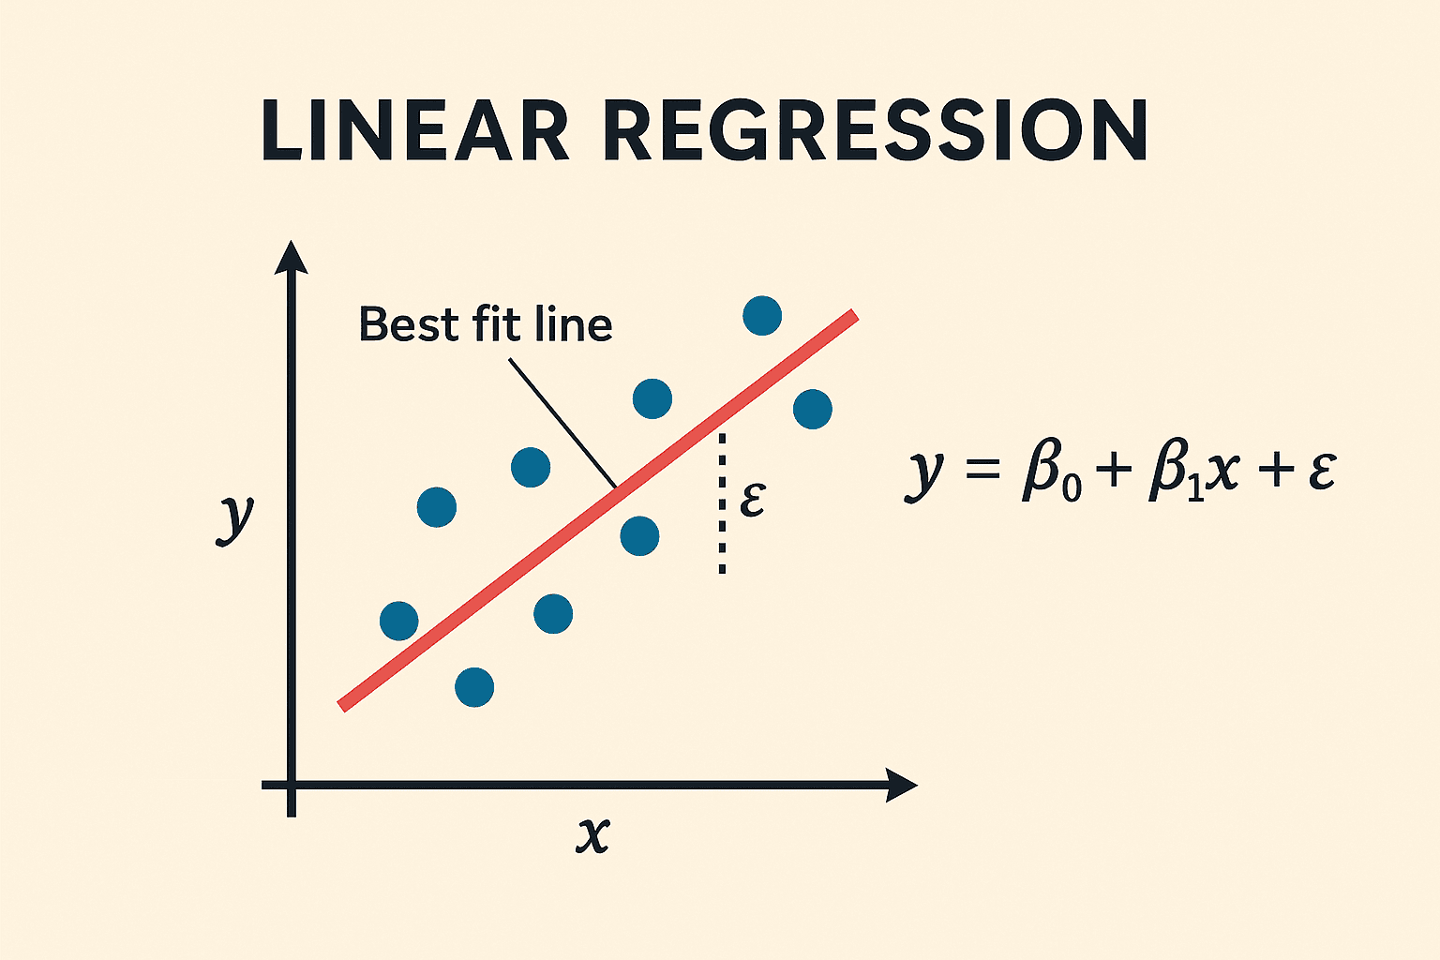


Estblish the linear Regression baseline Model
1. set max_iter=2000 to Increase iterations to ensure convergence
3.Evaluate model performance on test data
X_test_tfidf = tfidf.transform(X_test)
2. Train the model using training data
lr_model.fit(X_train_tfidf, y_train)此处添加您的文本内容在此处添加您的文本内容

Slide 17
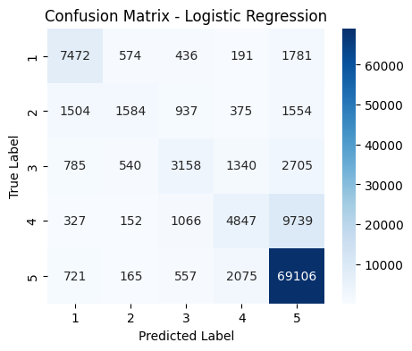
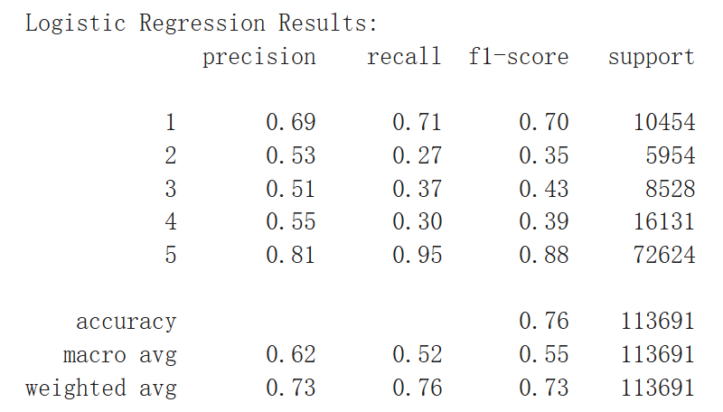
Logistic Regression Classification Metrics Across 5 Classes (Accuracy: 76%)
Key Insights:
• 76% correct (diagonal)
• Class 5: Strong performer (95%)
• Classes 2-4: Frequent confusion
• Primary error: Class 2→Class 4

Slide 18
04
LSTM: Advanced Model Training and Evaluation

Slide 19
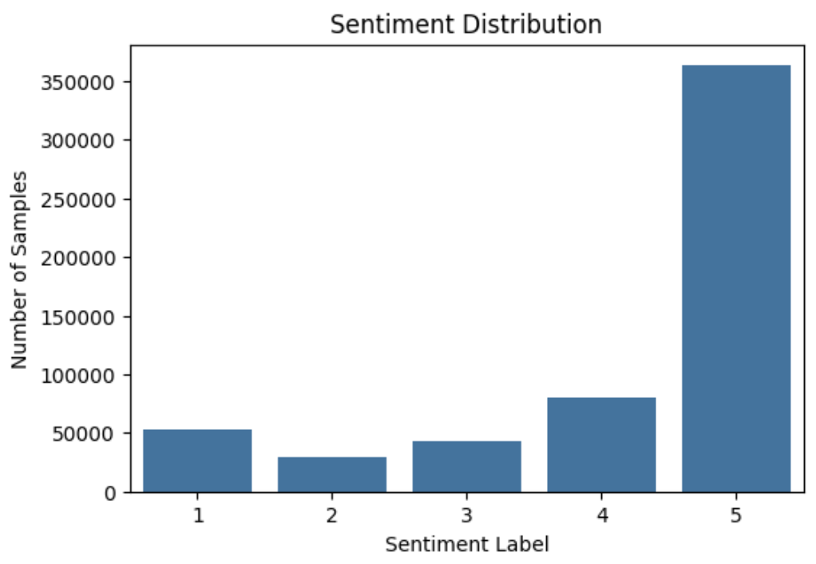
Module Background & Experiment Setup
Team Context
Building on prior work (Dataset, EDA, Logistic Regression baseline), this module focuses on the LSTM advanced model.
Data Setup
Uses Amazon Reviews dataset (Text as features, Score 1-5 as labels) with an 80-20 stratified train-test split.
Evaluation Scope
Convergence analysis, 5-class metrics, and baseline comparison.

Slide 20
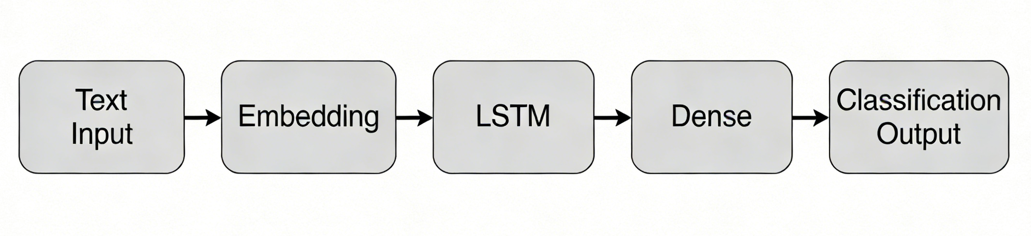
LSTM Model Architecture & Training Setup
Feature Processing
Tokenization (num_words=5000) → Sequence Padding (max_len=100)
Network Architecture
Embedding(input_dim=5000, output_dim=64) →
LSTM(units=64, dropout=0.2, recurrent_dropout=0.2) →
Dense(units=5, activation=softmax)
Training Hyperparameters
Adam optimizer, sparse_categorical_crossentropy loss, 5 epochs, batch size 1024, test set as validation set.

Slide 21
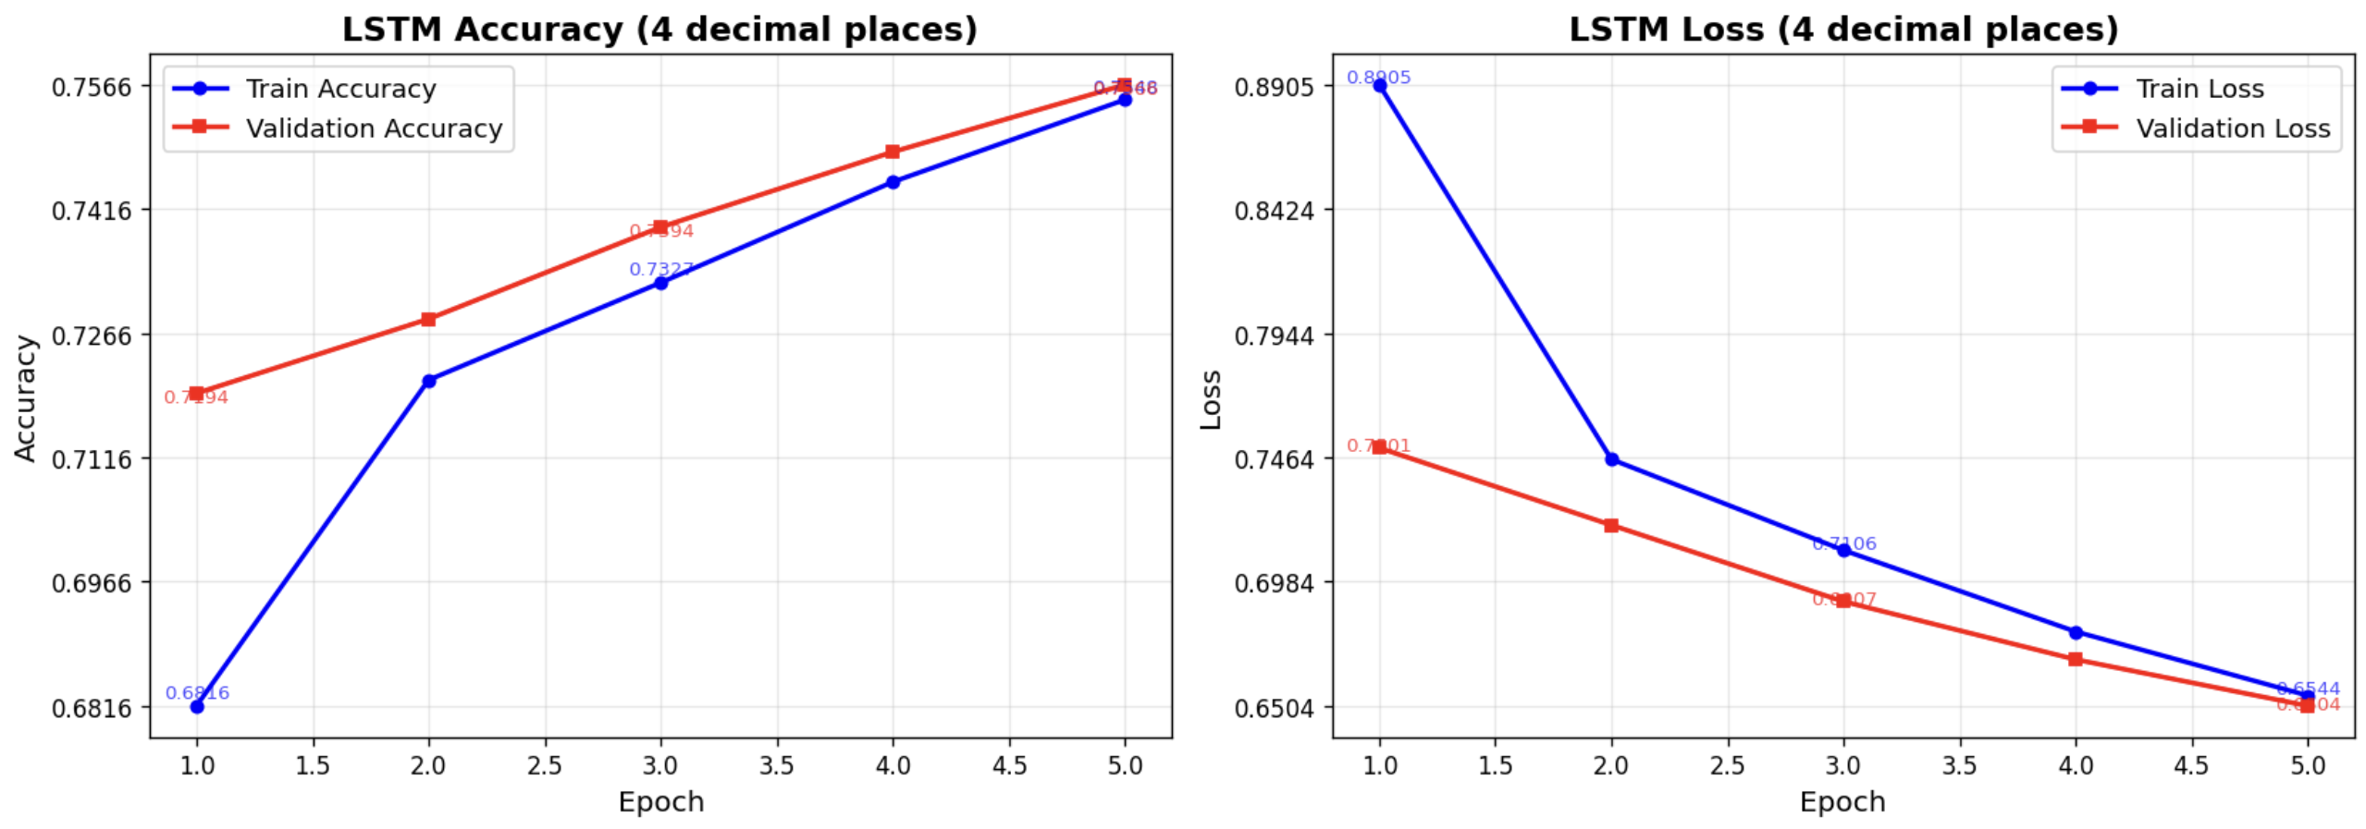
LSTM Training Trend Visualization
Training Trend
Over 5 epochs, both training and validation accuracy increased consistently, while loss decreased steadily.
Convergence Observation
The curves show no significant fluctuations, indicating the model achieved stable convergence within 5 epochs.

Slide 22
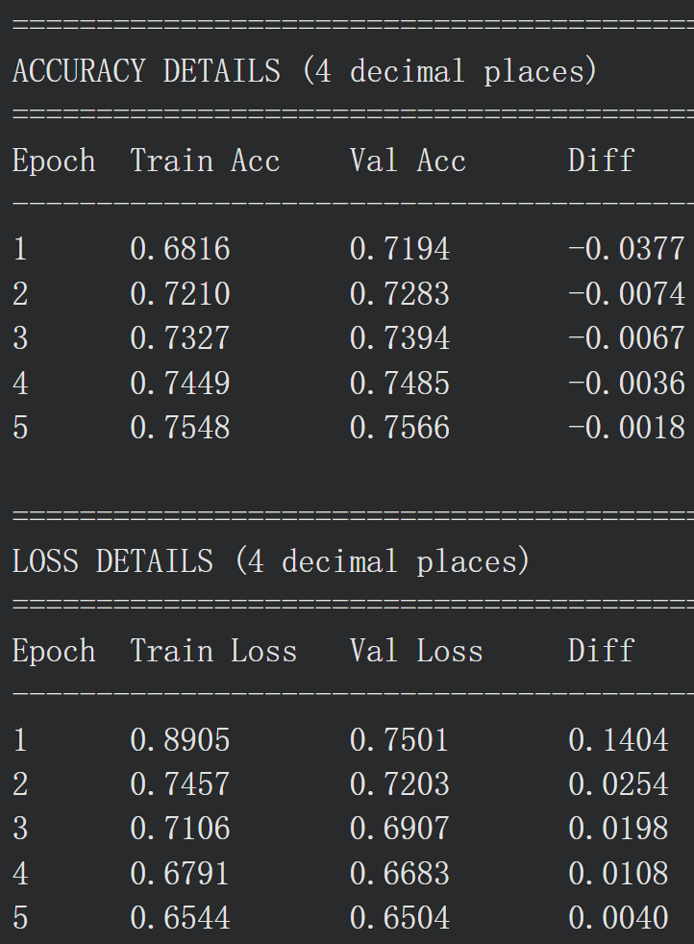
LSTM Key Metrics & Overfitting Check
Final Epoch Metrics
Train Acc: 0.7548
Val Acc: 0.7566
Train Loss: 0.6562
Val Loss: 0.6504
Overfitting Analysis
The gap between training and validation metrics is extremely small (Diff < 0.002) in the final epoch, confirming our dropout regularization effectively prevented overfitting.

Slide 23
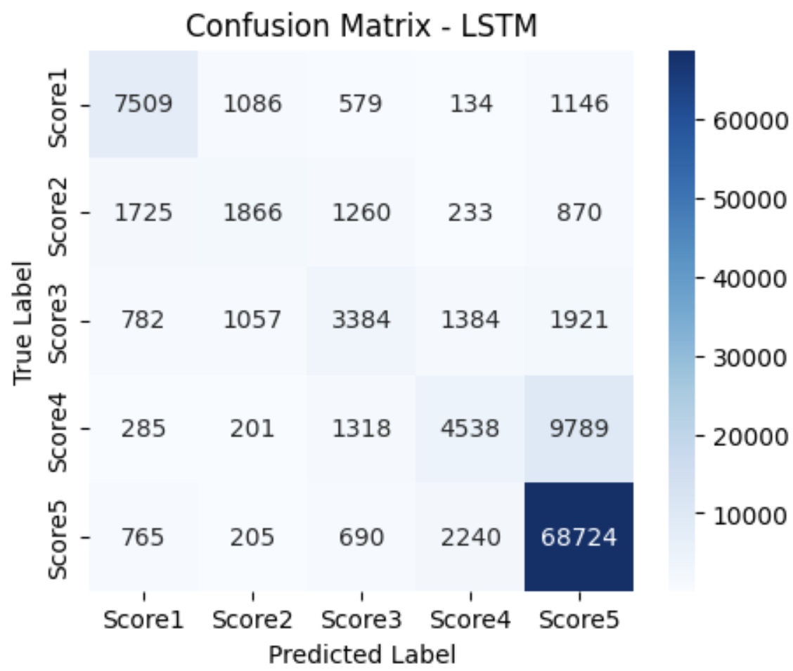
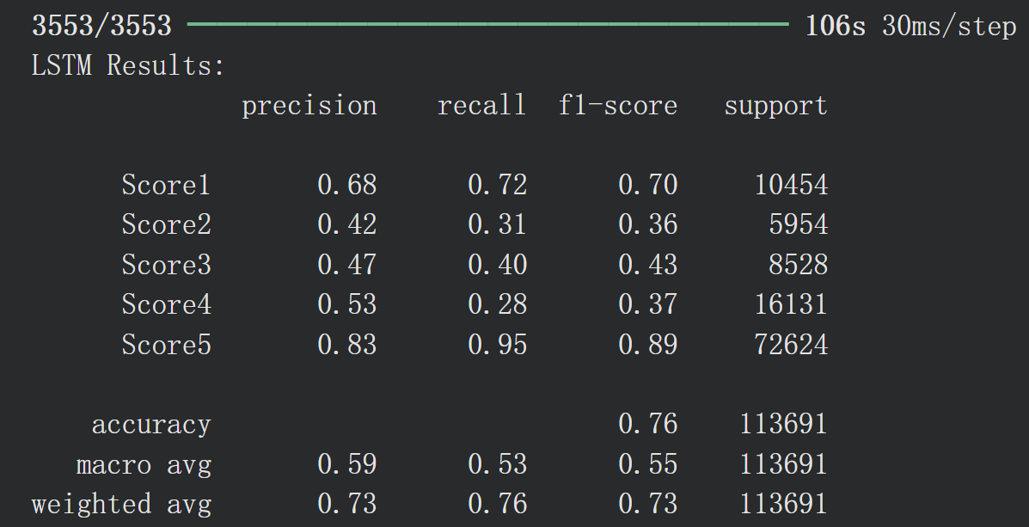
LSTM 5-Class Quantitative Evaluation
Overall Performance
Error Analysis
Accuracy = 0.76
Weighted F1 = 0.73
Key misclassifications: Score 4 → Score5
Score 2 → Score 1/3
Class-wise Metrics
Score 5(Positive): F1 = 0.89, Recall = 0.95
Score 2/3/4(Neutral/Moderate): F1 = 0.36-0.43
Score 1 (Negative): F1 = 0.70

Slide 24
LSTM vs Logistic Regression
LSTM: Accuracy = 0.76, Weighted F1 = 0.73
Logistic Regression: Accuracy = 0.76, Weighted F1 = 0.73
Observation: Identical overall performance
Core Metrics Comparison
Both models achieve similar accuracy, but LSTM captures contextual semantics, while Logistic Regression relies on TF-IDF word frequencies.
Performance Insight

Slide 25
05
Feature Analysis and Achievement Integration

Slide 26
Ranking of Core Feature Importance
And other features(not very important)
3.Release Year
4.User Occupation
5.Rating Time
In sum,User ratings mainly depend on content type and user info (age, job). The release year matters less. Time has almost no effect.
1. Type
(highest weight)
2.User Age
(second highest weight)

Slide 27
Insight 1: User ratings tend to cluster in the middle-to-high range (mostly 3-4 stars).
Moderately satisfied
Age
Key Business Insights
Insight 2: Different age groups show very different rating preferences.
Type
Insight 3: Consumption type is a key factor affecting ratings.

Slide 28
E-commerce Platform Recommendations
1. Personalized Recommendations
Match products to users based on age, job, and genre preferences.
2. Category Management
Focus on growing core categories.
3. Review Management
For subjective raters like students, strengthen review guidance (e.g., pin high-quality reviews) to reduce the impact of extreme negative
ratings.
4. New Product Promotion
Increase exposure for new releases/movies to
promote new product.

Slide 29

Future Plans
1.Better Models: Use deep learning (like neural networks) to make rating predictions more accurate.
2.More Data Sources: Add external data like product reviews and user behavior history to improve the model's performance on different scenarios.
3.Real-World Use: Test with real e-commerce data, add time-based factors for dynamic predictions, and apply it to actual business needs like personalized recommendations and user management.

Slide 30
202X
THAHKS FOR YOUR
LISTENING
Presented by Zeng Cheng
A wonderful serenity has taken possession of my entire soul

