Slide 1
SentiGAN: Generating Sentimental Texts via Mixture Adversarial Networks
IJCAI2018 Distinguished Paper
Ke Wang, Xiaojun Wan
Institute of Computer Science and Technology, Peking University The MOE Key Laboratory of Computational Linguistics, Peking University
Reporter:ziyang

Slide 2
Motivation
the texts generated by GAN usually suffer from the problems of poor quality, lack of diversity and mode collapse.

Slide 3
Contribution／Bright spot
propose a novel framework SentiGAN：multiple generators and one multi-class discriminator.
propose a new penalty based objective to make each generator produce diversified texts of a specific sentiment label.
outperforms the existing models in both the sentiment accuracy and quality of generated texts. (Use several metrics i.e. fluency, novelty, diversity, intelligibility to measure the quality of generated texts )
The main intuition is that since text sentiment classification is very strong, we can use the classifier to guide the generation of sentimental texts.

Slide 4
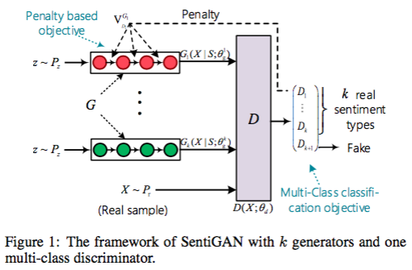

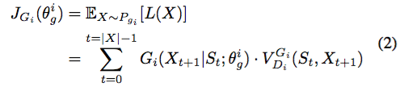

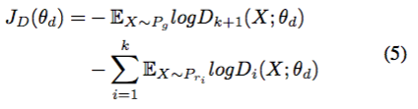
Model
the objective of the i-th generator:
penalty function for the i-th generator :
objective function of the discriminator:

Slide 5
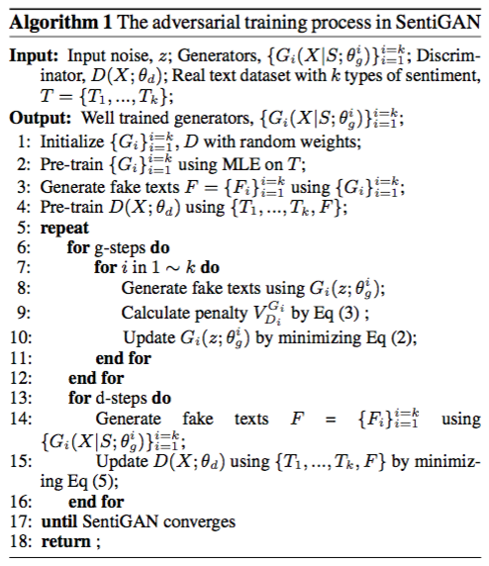
Training

Slide 6
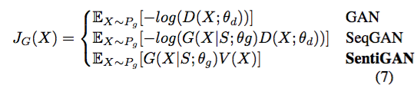


theoretical analysis of Penalty-Based Objective
1.can be considered as a measure of wasserstein distance： provides meaningful gradients, even when the distributions of P and P do not overlap.
wasserstein distance :
2.forces the generator to prefer a smaller G(X |S ; θg ). Thus it results in the generation of diversified samples, rather than repetitive but “good” samples.

Slide 7
Experiments
Evaluate:
1.sentiment accuracy of the generated texts
2. the quality of generated texts (i.e., fluency, novelty, diversity, intelligibility)

Slide 8
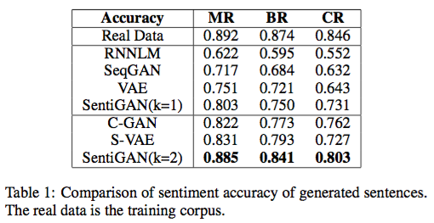
sentiment accuracy of the generated texts
Evaluator: state-of-the-art sentiment classifier [Hu et al., 2016] achieves an accuracy of 90% on the SST.

Slide 9
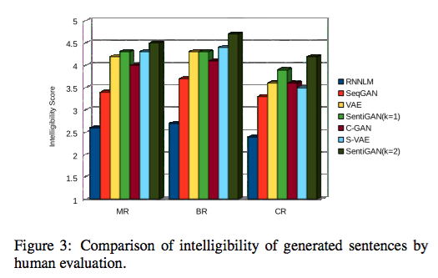
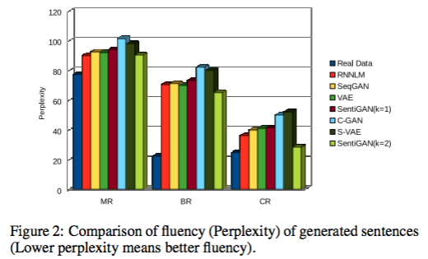
Fluency
Intelligibility

Slide 10


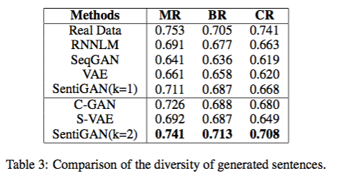
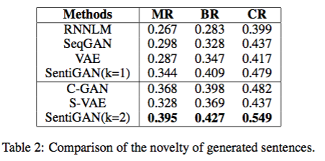
Novelty
Diversity

Slide 11
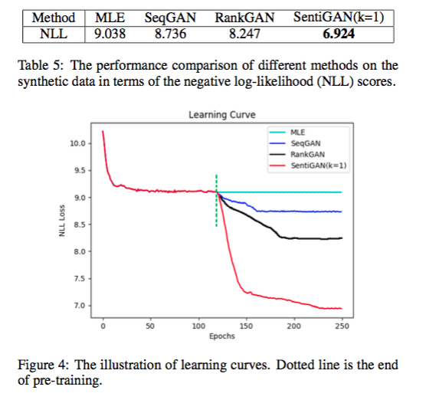
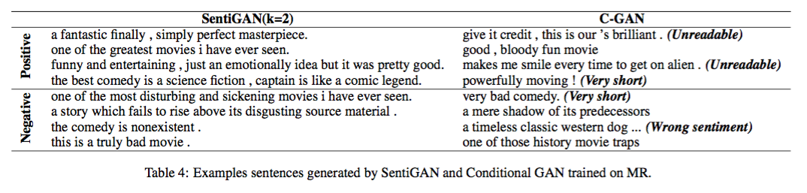
Validation of Penalty-Based Objective

Slide 12
some thoughts
Diversity
Only focus on generating short sentences (length ≤ 15 words)
Classifier: Benefit? Limit?

