Slide 1
Does the language model understand numbers?
Junxin Li
2022.01.20

Slide 2
Papers
1. Do Language Embeddings Capture Scales? (EMNLP Findings 2020)
2. Numeracy enhances the Literacy of Language Models (EMNLP 2021)
3. Investigating Numeracy Learning Ability of a Text-to-Text Transfer Model (EMNLP Findings 2021)
4. Predicting Numerals in Natural Language Text Using a Language Model Considering the Quantitative Aspects of Numerals (NAACL-HLT 2021)

Slide 3
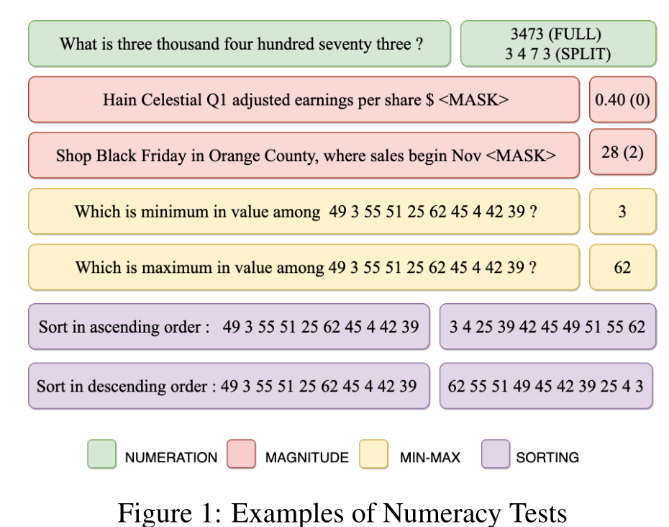
Background
Numbers are everywhere.
Numbers are neglected.
BPE： 1234 → 12-34 or 123-4 or 1-234
Numbers are important.

Slide 4
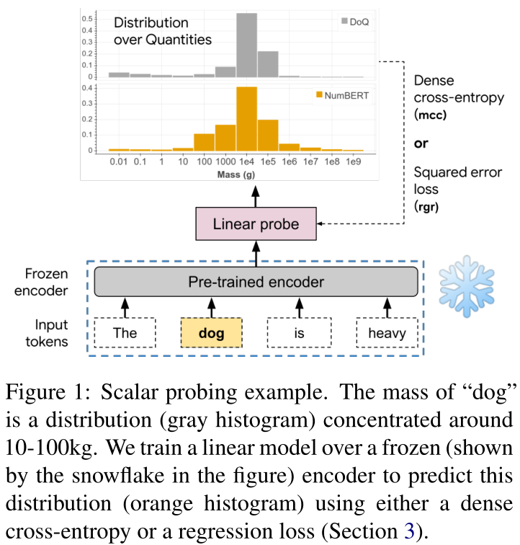
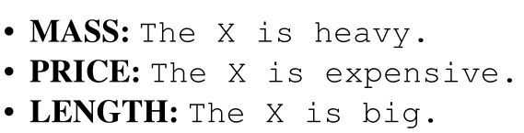
Embedding method
Do Language Embeddings Capture Scales? (EMNLP Findings 2020)
Overview: They pretrain BERT-base with a modified training corpus where all numbers are converted to scientific notation.
Definition : They define the scalar probing task (see Figure1) as the problem of predicting a distribution over values of a scalar attribute of an object.

Slide 5
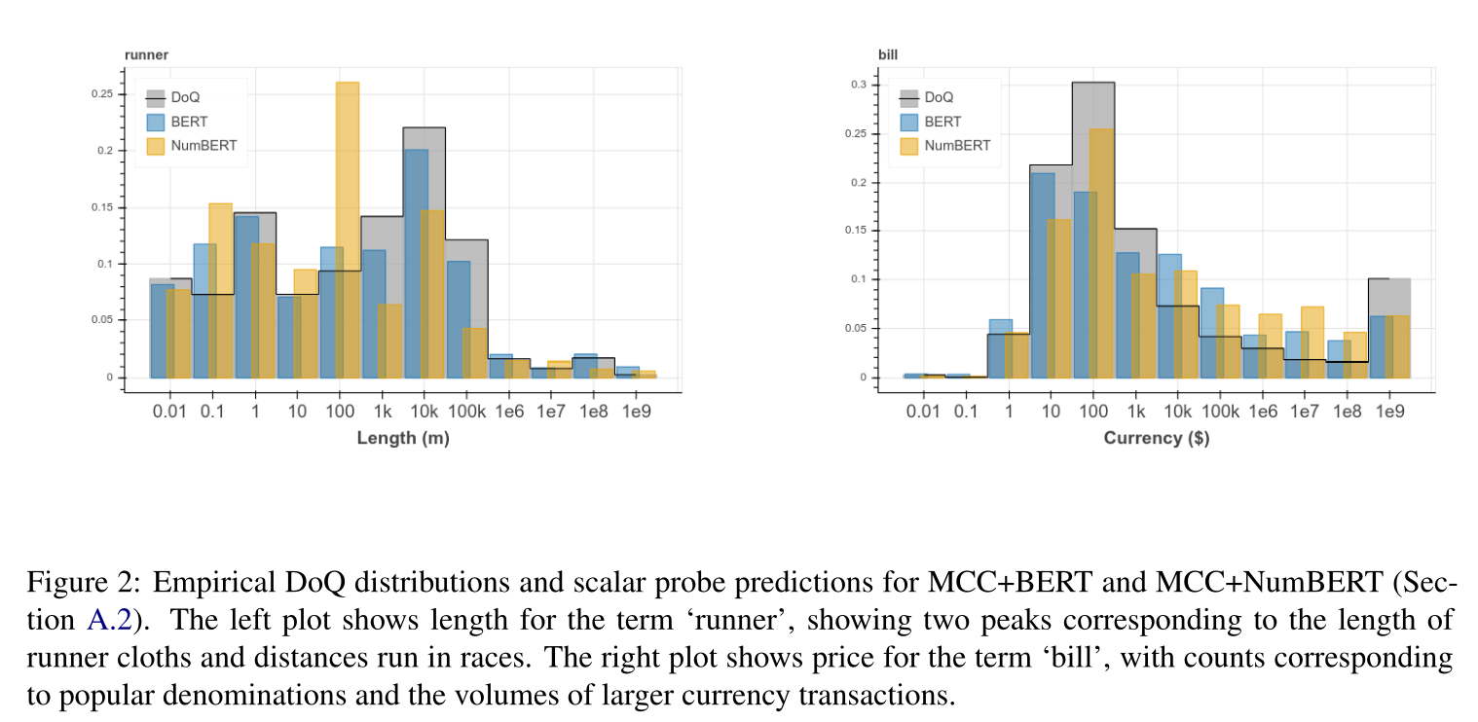
Embedding method
Do Language Embeddings Capture Scales? (EMNLP Findings 2020)
Regression : predict log of the median of all values for each object for the scale attribute under consideration.
Multi-class Classification (mcc) : Predict number distribution.

Slide 6
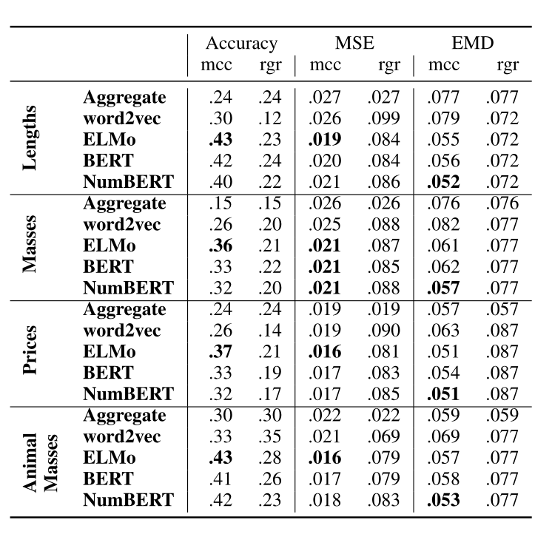
Embedding method
Do Language Embeddings Capture Scales? (EMNLP Findings 2020)
scientific notation : a combination of an exponent and mantissa
314.1
3141[EXP]2
This enables the BERT model to more easily associate objects in the sentence directly with the magnitude expressed in the exponent, ignoring the relatively insignificant mantissa.

Slide 7
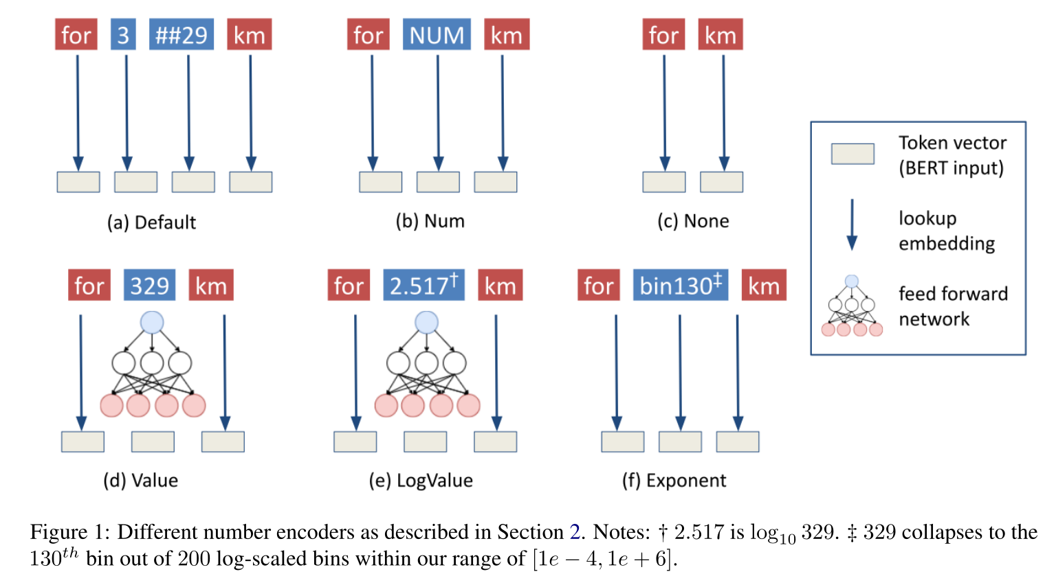
Embedding method
Numeracy enhances the Literacy of Language Models (EMNLP 2021)

Slide 8
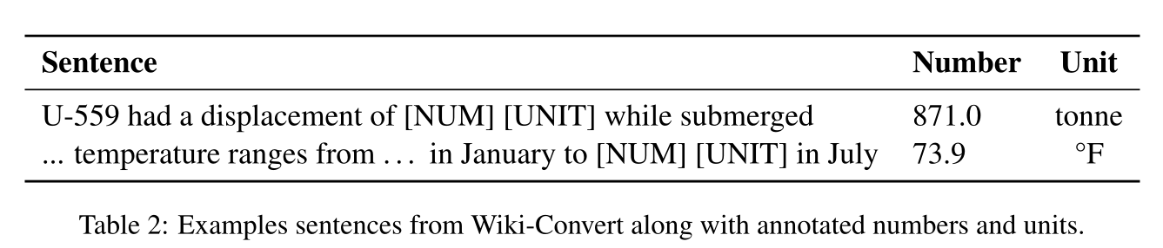
Embedding method
Numeracy enhances the Literacy of Language Models (EMNLP 2021)
New dataset: Wiki-Convert

Slide 9
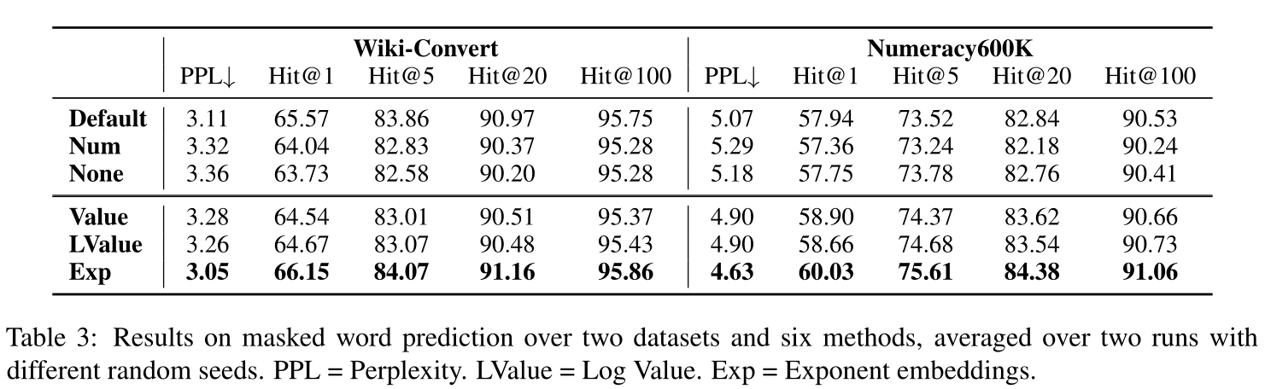
Embedding method
Numeracy enhances the Literacy of Language Models (EMNLP 2021)

Slide 10
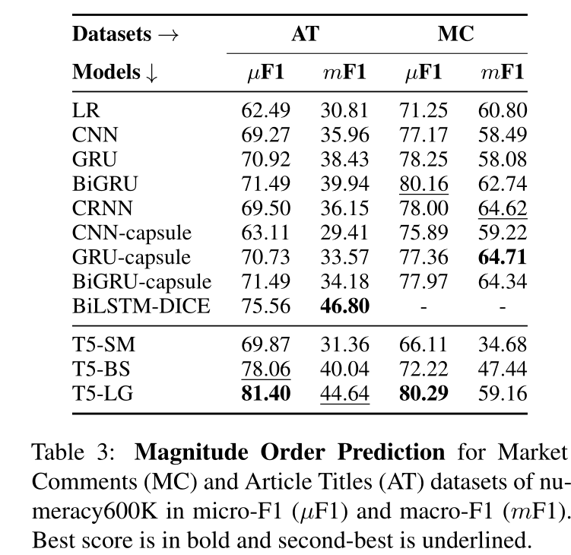
T5 for Numberacy Task
Investigating Numeracy Learning Ability of a Text-to-Text Transfer Model (EMNLP Findings 2021)

Slide 11
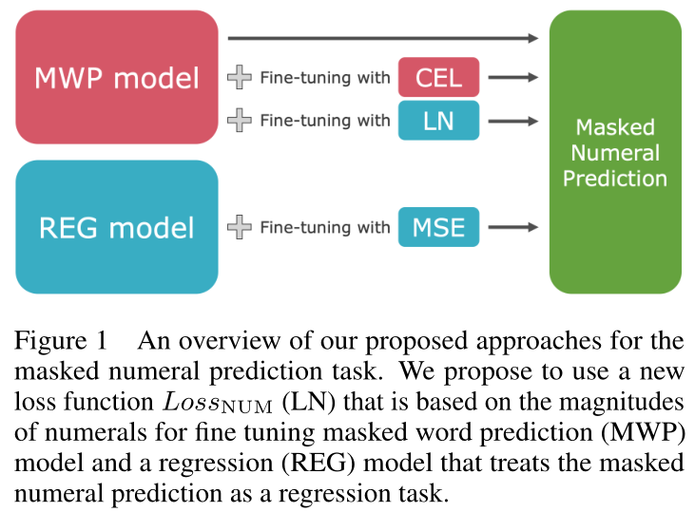
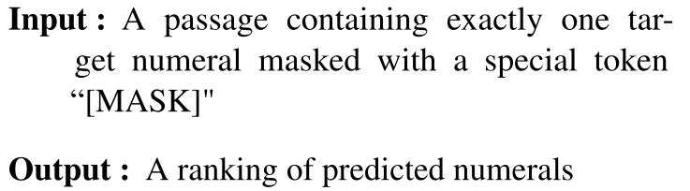
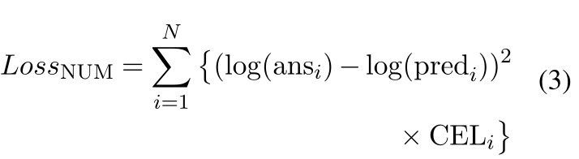
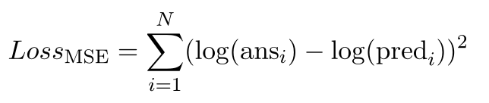
Masked Number Prediction
Predicting Numerals in Natural Language Text Using a Language Model Considering the Quantitative Aspects of Numerals (NAACL-HLT 2021)
Definition of this task
Approach
1) LossNUM
2) REG Model

Slide 12
The End
Thanks

