Slide 1
Retrieval Augumented Generation

Slide 2
Background
Retrieval Models
recall task: search the candidates given the query
sparse model (TF-IDF, BM25)
dense models (DPR, dense phrase, ...)
rerank task: rank the candidates based on the given context
Generation Models
given the prefix, generate the candidates step by step
Retrieval Augmented Generation Models (RAG)
decouple the language model and the background knowledge, easy to scale up
recall related sentences or documents from the corpus
given the prefix and these related resources, generate the candidates step by step

Slide 3
Outline of Retrieval augmented Generation Models
Differential Methods
Concatenation: REALM, RAG
Hidden vector: using extra memory encoder
LM Probability rerank: kNN-LM, Pointer Network
Non-differential Methods: WebGPT, Retro

Slide 4
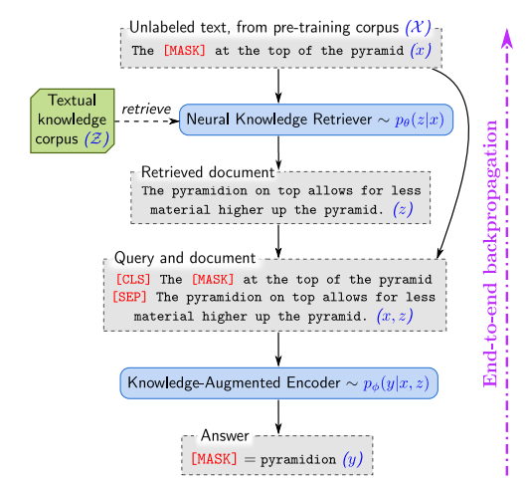

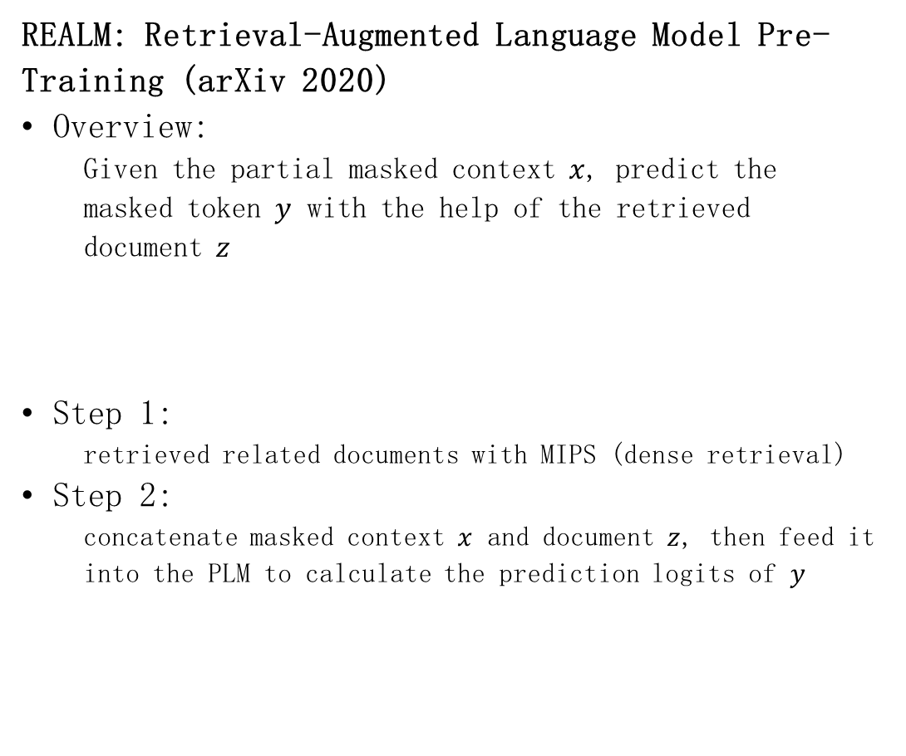
Differential Methods: Concatenation
REALM: Retrieval-Augmented Language Model Pre-Training (arXiv 2020)
Overview:
Given the partial masked context $x$, predict the masked token $y$ with the help of the retrieved document $z$
Step 1:
retrieved related documents with MIPS (dense retrieval)
Step 2:
concatenate masked context $x$ and document $z$, then feed it into the PLM to calculate the prediction logits of $y$

Slide 5


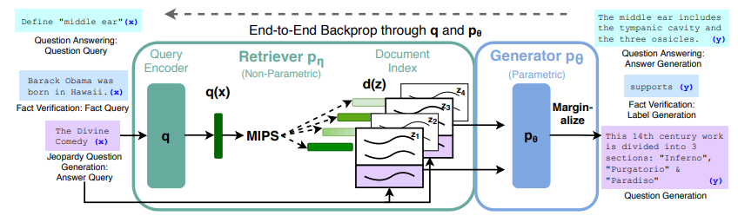
Differential Methods: Concatenation
Retrieval-Augmented Generation for Knowledge-Intensive NLP Tasks (NIPS 2020)
Overview:
Same with REALM, RAG also conduct the retrieval-augmented generation by using MIPS and concatenation operations
RAG-Sequence Model:
generate the whole sequence probability based on each document
RAG-Token Model:
generated the next token probability based on all of the documents

Slide 6
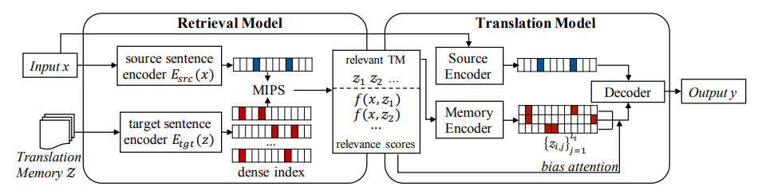
Differential Methods: Hidden Vector
Neural Machine Translation with Monolingual Translation Memory (ACL 2021)
Overview:
follow the basic process of the concatenation-based models (RAG, REALM)
Difference:
additional memory encoder models encode memory (retrieved documents/sentences) into dense representation
advantage: faster
disadvantage: squeezed document representation (dense vector) may lose essential information

Slide 7
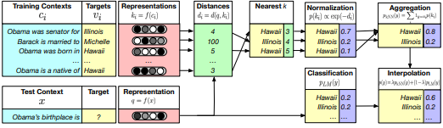
Differential Methods: LM probability rerank
Generalization Through Memorization: Nearest Neighbor Language Models (ICLR 2020)
Overview:
Build the offline index by saving the context-target value (context=prefix, target=next token), then use the k-NN target token probability to rerank the next token probability.
kNN context-target retrieval:
search the related context-target pairs by calculating the similarity of the context and query
Rerank the next token probability:
final next token probability is composed from the language models and the normalized kNN targets.

Slide 8
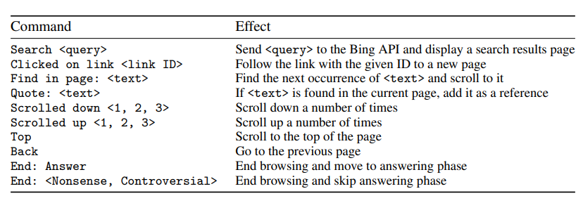
Non-differential Methods
WebGPT: Browser-assisted question-answering with human feedback (arXiv 2021.12)
Overview:
Fine-tuning GPT-3 to answer the long-form question based on the knowledge searched from the online search engine (Bing), which means the optimizing process is non-differential.
Define demonstrations for fine-tuning the GPT-3 model
At each step, the model must issue one of the command
When the model issues the command End: Answer or the maximum reference number is achieved, the GPT-3 model begins to write the answer based on the question and all of the references that are recorded during browsing.
Discussion of non-differential
Disadvantage: non-differential models are hard to optimize. For WebGPT, lots of complex optimizing methods are used to fine-tune the model (supervised learning, reinforcement learning, reward modeling, and rejection sampling)
Advantage:
get rid of the dependence, more flexible, easy to scale

Slide 9
Any Questions?

