Slide 1
Adversarial Training for Pre-trained Models
Dong Wang
Notes:
Adversarial [ˌædvəˈseəriəl]

Slide 2
Overview
FreeLB: Enhanced Adversarial Training for Natural Language Understanding （ICLR 2020）
SMART: Robust and Efficient Fine-Tuning for Pre-trained Natural Language Models through Principled Regularized Optimization (ACL 2020)
TextAT: Adversarial Training with Token-Aware Perturbation for Natural Language Understanding (arxiv 2004.14543)
ELECTRA: Pre-training Text Encoders as Discriminators Rather Than Generators (ICLR 2020)
Revisiting Pre-Trained Models for Chinese Natural Language Processing (arxiv 2004.13922)

Slide 3
Introduction
Adversarial training is a method for creating robust neural networks. During adversarial training, mini-batches of training samples are contaminated with adversarial perturbations (alterations that are small and yet cause misclassification), and then used to update network parameters until the resulting model learns to resist such attacks.
In CV(Computer Vision), adversarial training can improve the robustness, but it usually leads to the reduction of generalization. In NLP, adversarial training improves both robustness and generalization.
Notes:
Contaminated [kənˈtæmɪneɪtɪd]
Parameters [pəˈræmɪtəz]

Slide 4
Introduction
Adversarial Training
Adds adversarial perturbations to word embeddings and minimizes the resultant adversarial loss around input samples.
e.g. PGD, FreeLB, SMART, TextAT
Adversarial Example in Natural Languages
Produce actual adversarial examples.
e.g. ELECTRA, MacBERT

Slide 5
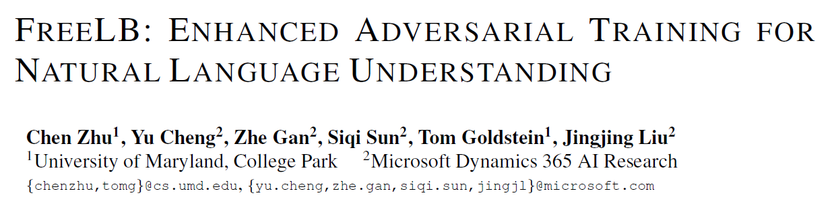

Slide 6
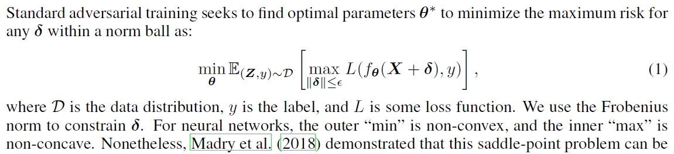
Method
Increase loss in input and decrease loss in parameter
Notes:
Optimal [ˈɒptɪməl]

Slide 7

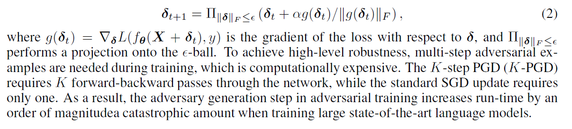
Method
PGD
Notes:
It use the gradient of the loss with respect to delta to update delta and use delta to calculate the gradient.

Slide 8
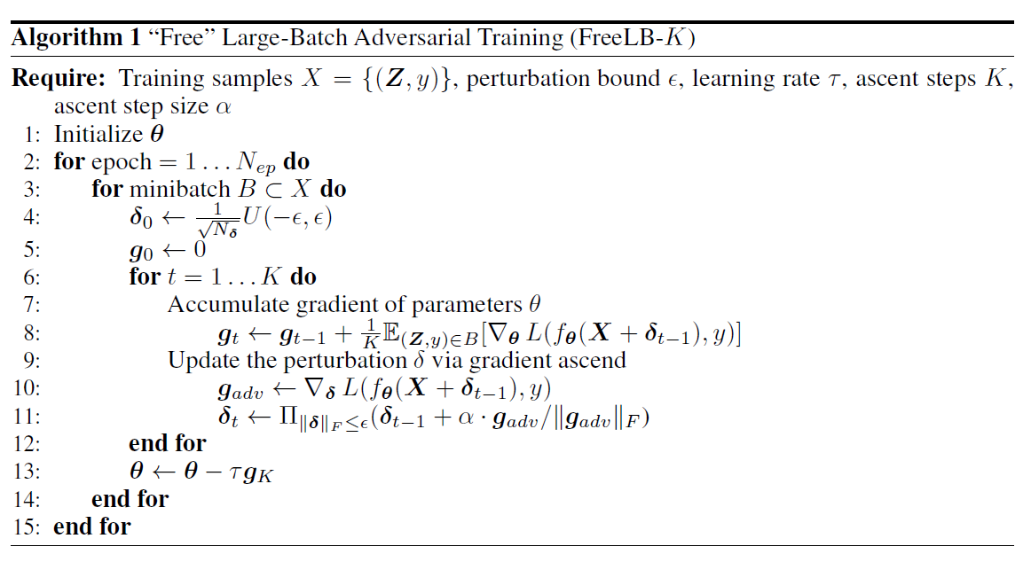
Method
Notes:
PGD use the gradient of the last step to update the parameter, while FreeLB accumulate gradient of parametes theta. This the main difference between FreeLB and PGD.

Slide 9
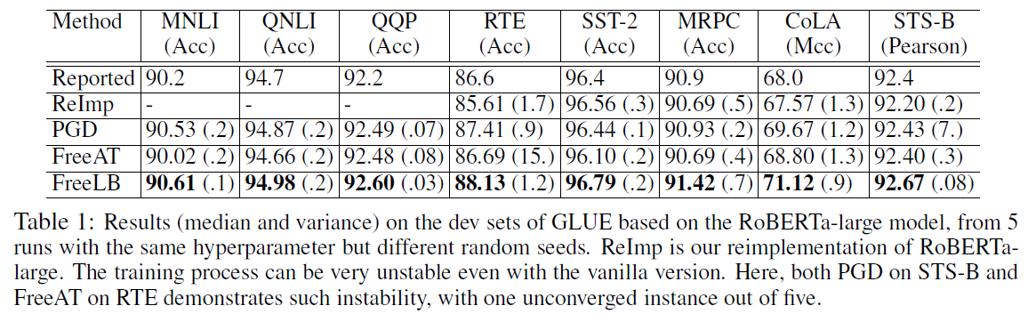
Experiment

Slide 10
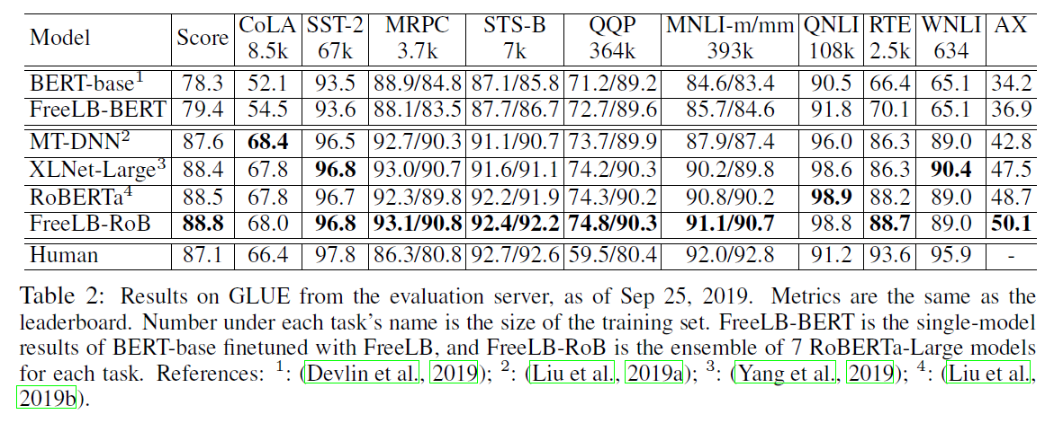
Experiment

Slide 11
Summary
The method leverages recently proposed “free” training strategies (accumulate gradient of parametes ) to enrich the training data with diversified adversarial samples at no extra cost than PGD-based adversarial training.
Perform diversified adversarial training on large-scale state-of-the-art models.
Only adversarial examples are used for training.

Slide 12
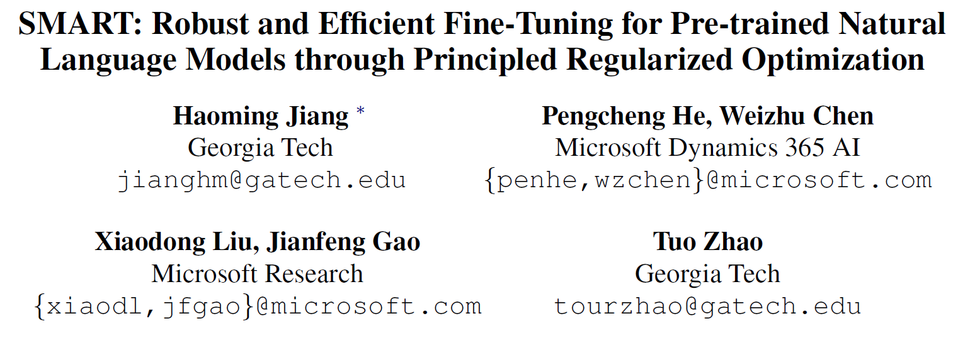

Slide 13
Introduction
Due to the limited data from the target task/domain and the extremely high complexity of the pre-trained model, aggressive fine-tuning often makes the adapted model overfit the training data of the target task/domain and therefore does not generalize well to unseen data.
To effectively control the extremely high complexity of the model, this method propose a Smoothness-inducing Adversarial Regularization technique.

Slide 14
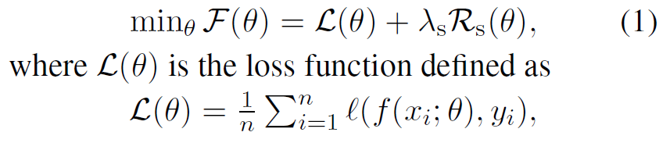


Smoothness-inducing Adversarial Regularization
This method solves the following optimization for fine-tuning:

Slide 15
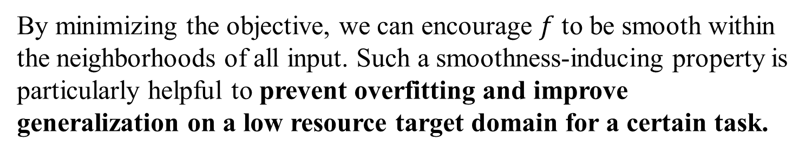
Smoothness-inducing Adversarial Regularization
By minimizing the objective, we can encourage $f$ to be smooth within the neighborhoods of all input. Such a smoothness-inducing property is particularly helpful to prevent overfitting and improve generalization on a low resource target domain for a certain task.
Notes:
~ tilde [ˈtɪldə]

Slide 16

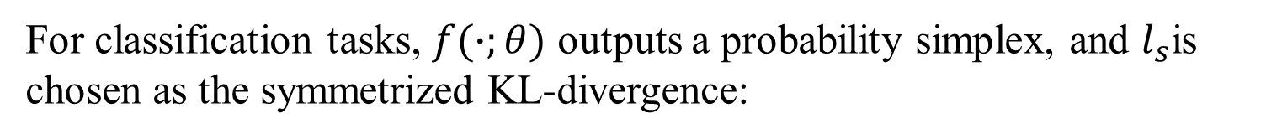

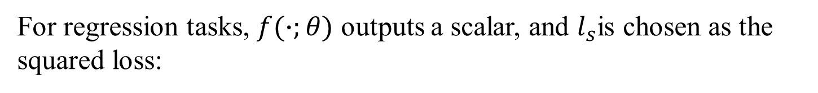
Smoothness-inducing Adversarial Regularization
For classification tasks, $f(∙;θ)$ outputs a probability simplex, and $l_{s}$is chosen as the symmetrized KL-divergence:
For regression tasks, $f(∙;θ)$ outputs a scalar, and $l_{s}$is chosen as the squared loss:
$$l_{s}\left(p,q\right)={(p−q)}^{2}$$

Slide 17
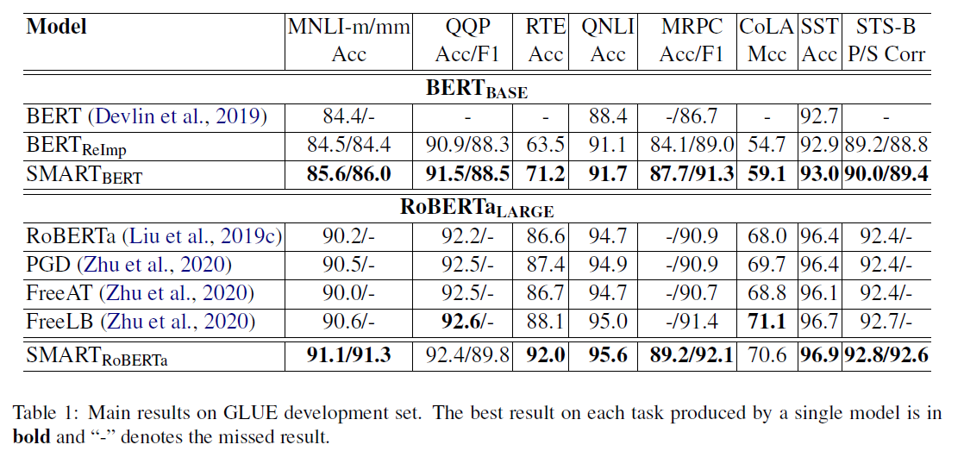
Experiment

Slide 18
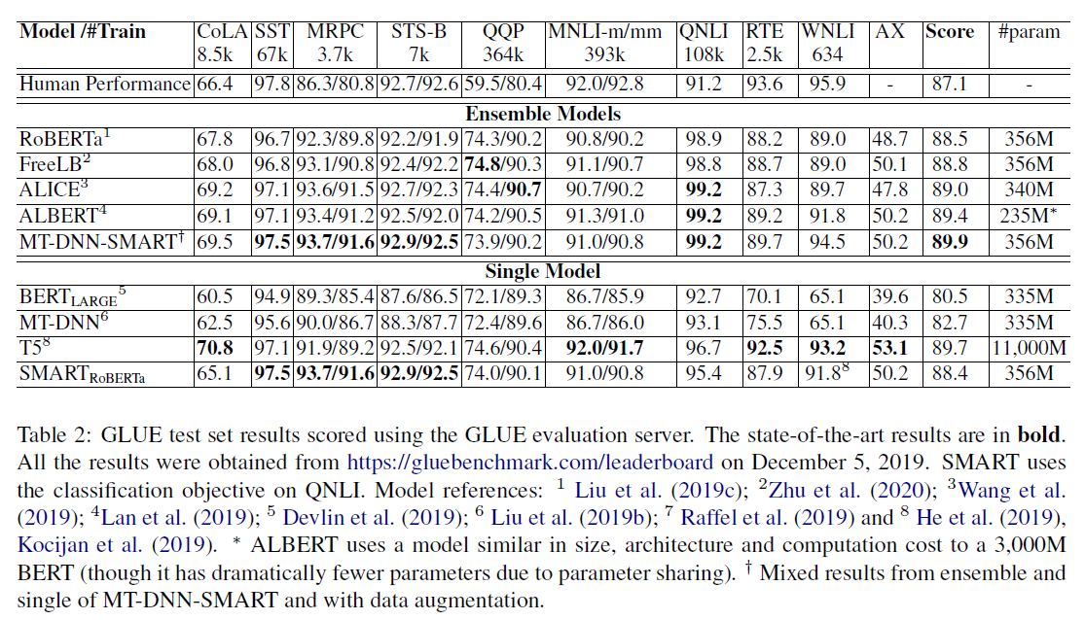
Experiment

Slide 19
Summary
This method propose an explicit regularization to effectively control the model complexity at the fine-tuning stage.
This method compare the adversarial example with the normal example.

Slide 20
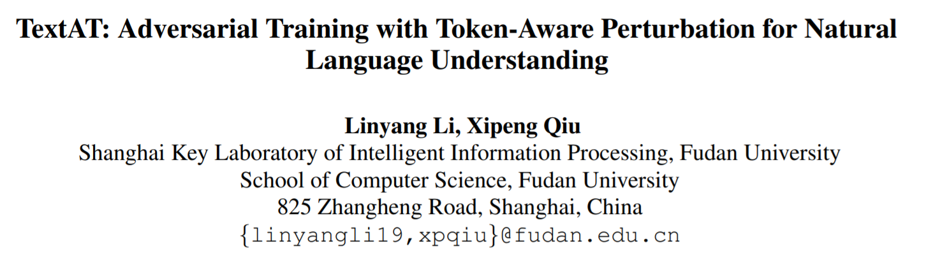

Slide 21
Introduction
Different from pixels in images or signals in audios, embeddings used in texts possess abundant semantic information. Therefore, perturbations are less focused on certain tokens when randomly initialized within the batch processing. To tackle this problem, this paper accumulate the perturbations of discrete tokens throughout the training process.
In this paper, we introduce two steps to create better adversarial samples:
(1) global accumulated token perturbation;
(2) discrete token normalization ball.

Slide 22


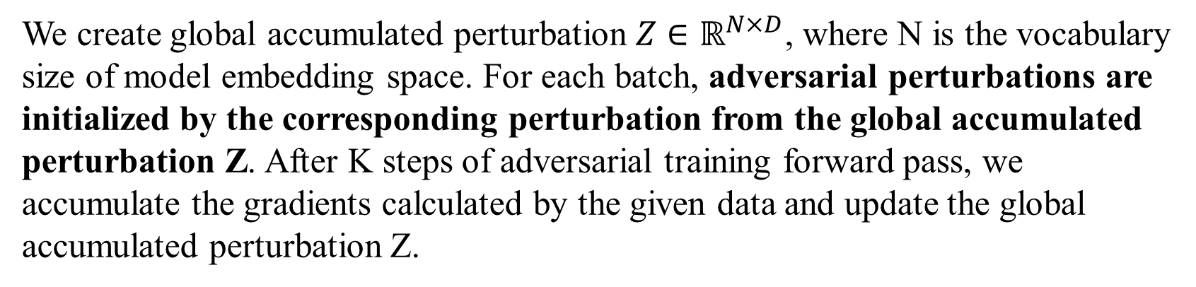
Method
(1) global accumulated token perturbation
We create global accumulated perturbation $Z∈ℝ^{N×D}$, where N is the vocabulary
size of model embedding space. For each batch, adversarial perturbations are initialized by the corresponding perturbation from the global accumulated perturbation Z. After K steps of adversarial training forward pass, we accumulate the gradients calculated by the given data and update the global accumulated perturbation Z.
Notes:
Beside the delta, it has a eta represent the global perturbation.

Slide 23
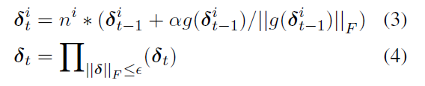
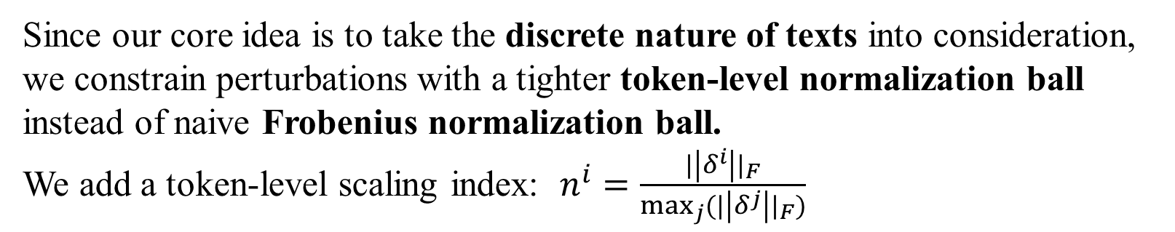
Method
(2) Normalization Ball of Discrete Tokens
Since our core idea is to take the discrete nature of texts into consideration, we constrain perturbations with a tighter token-level normalization ball instead of naive Frobenius normalization ball.
We add a token-level scaling index: $n^{i}=\frac{{|\left|δ^{i}\right||}_{F}}{\max_{j}{({|\left|δ^{j}\right||}_{F})}}$
We can rewrite the normalization ball constraint as:
Notes:
Through such a constrain ball, less important words are less likely to be altered by adversarial perturbations. The overall perturbation is therefore
less destructive to the original clean data while maintaining an adversarial effect

Slide 24
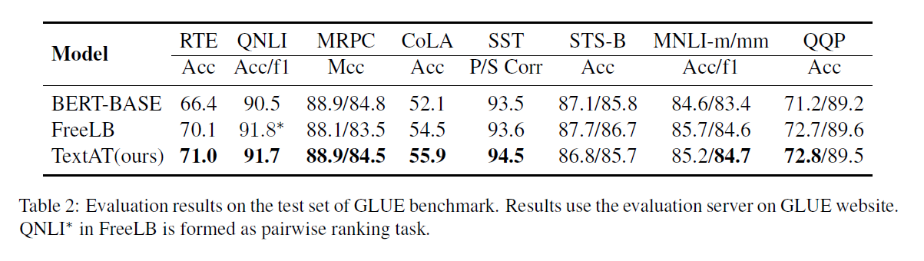
Experiment

Slide 25
Summary
PGD generate multi-step adversarial examples to achieve high-level robustness, but only use the last gradient.
FreeLB take the average gradient in K iterations.
TextAT propose a global accumulated token perturbation and a token-aware Normalization Ball.
Notes:
Above methods adds adversarial perturbations to word embeddings and minimizes the resultant adversarial loss around input samples. And then I will introduce some methods that produce actual adversarial examples.

Slide 26
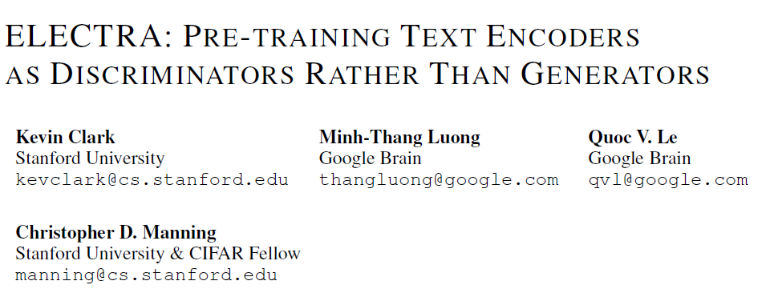

Slide 27
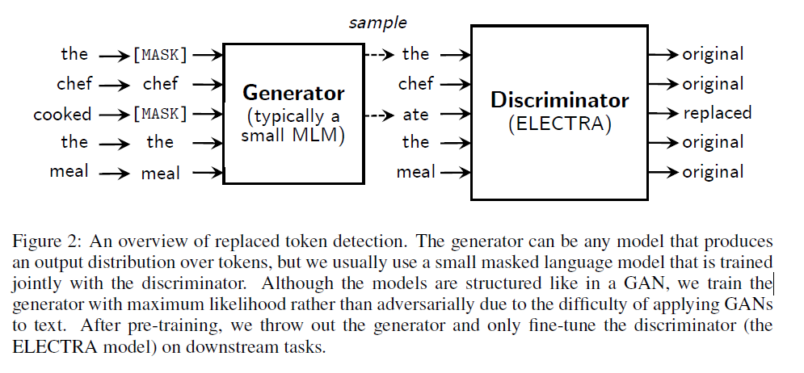
Method
Notes:
Different from BERT that only use an encoder, electra use a masked language model to replace the word in the sentence and use a discriminator to identity the replacement words

Slide 28
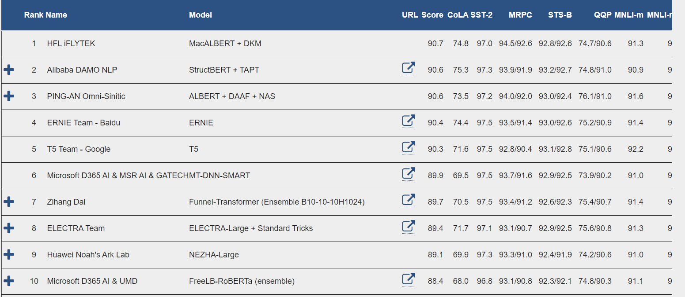

Slide 29
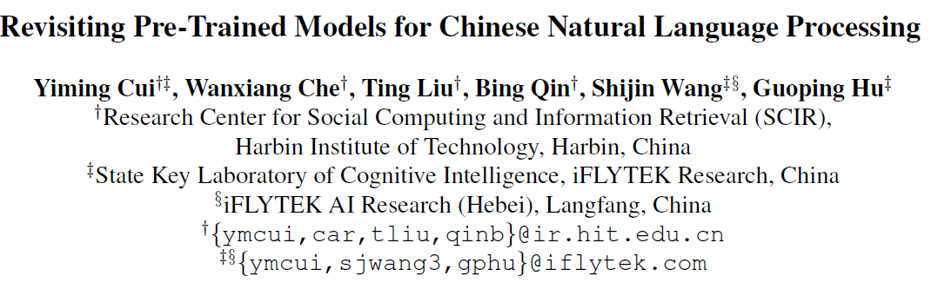

Slide 30
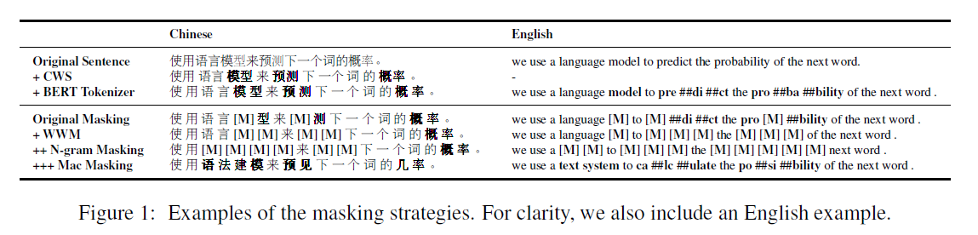
Introduction
Instead of masking with [MASK] token, which never appears in the fine-tuning stage, we propose to use similar words for the masking purpose. A similar word is obtained by using Synonyms toolkit (Wang and Hu, 2017), which is based on word2vec similarity calculations. If an N-gram is selected to mask, we will find similar words individually. In rare cases, when there is no similar word, we will degrade to use random word replacement.
Notes:
It will use the similar words to reconstruct the original words.

Slide 31
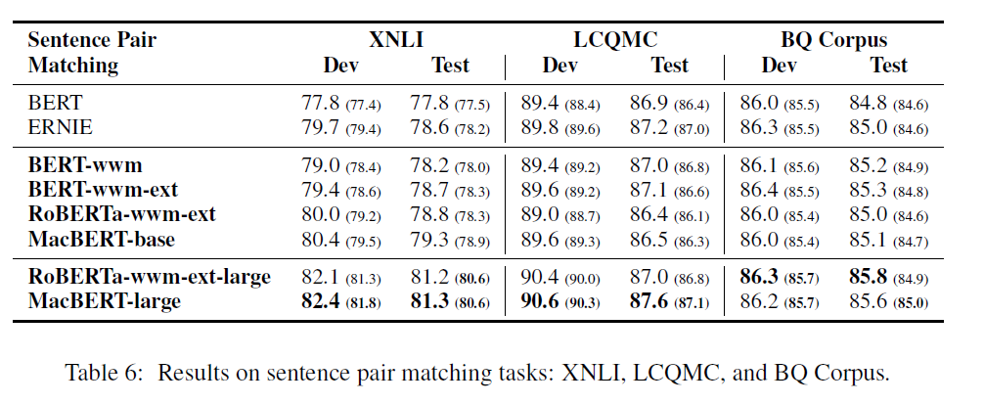
Experiment

Slide 32
Summary
Adversarial training improves both robustness and generalization.
Many recent studies try to add adversarial training in the pre-trained models, and achieve better results.
Token-level adversarial training (including token-level perturbations and token-level word replacement) can benefit the NLU task.

Slide 33
Thanks and QA

